Slide 1

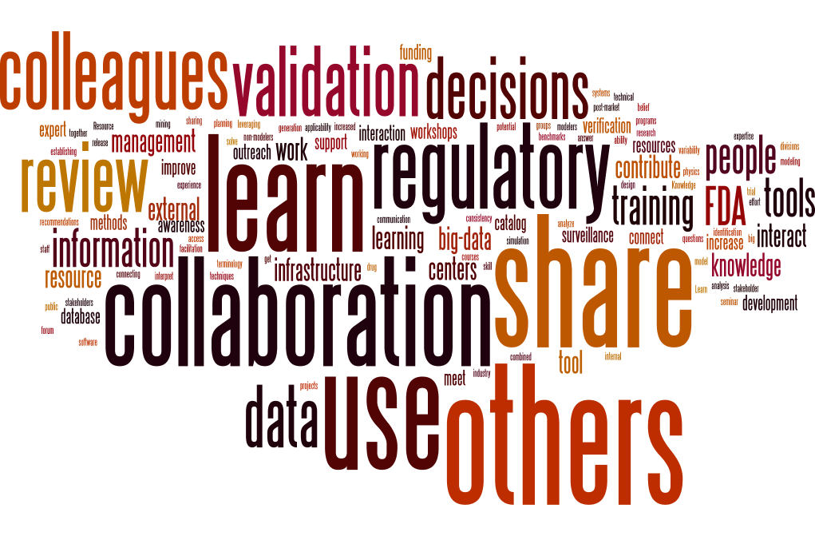
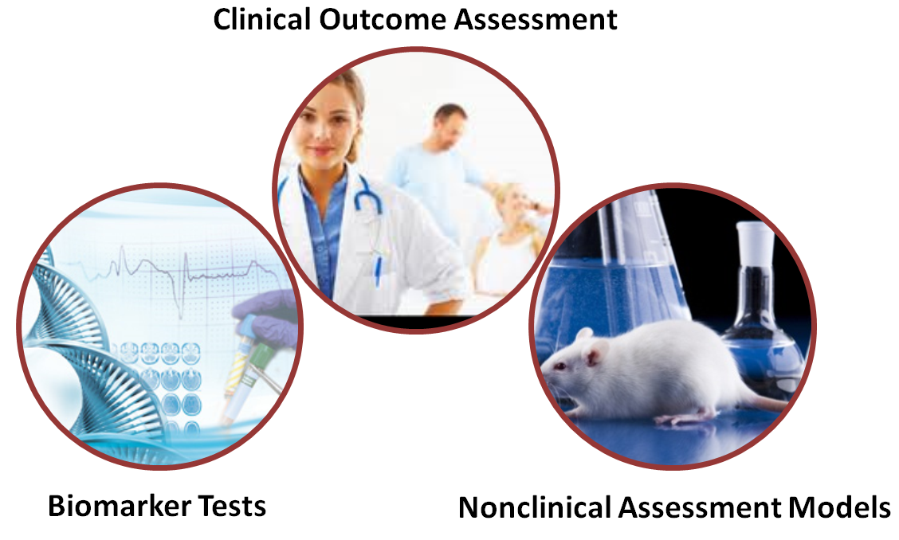
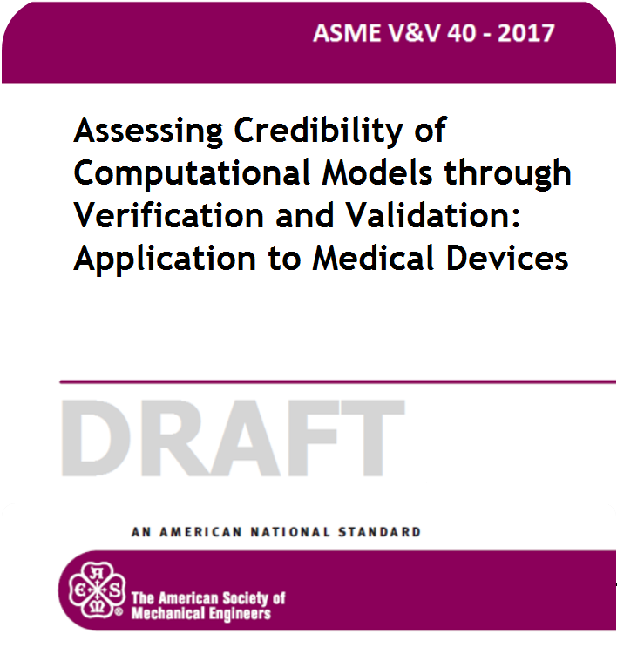
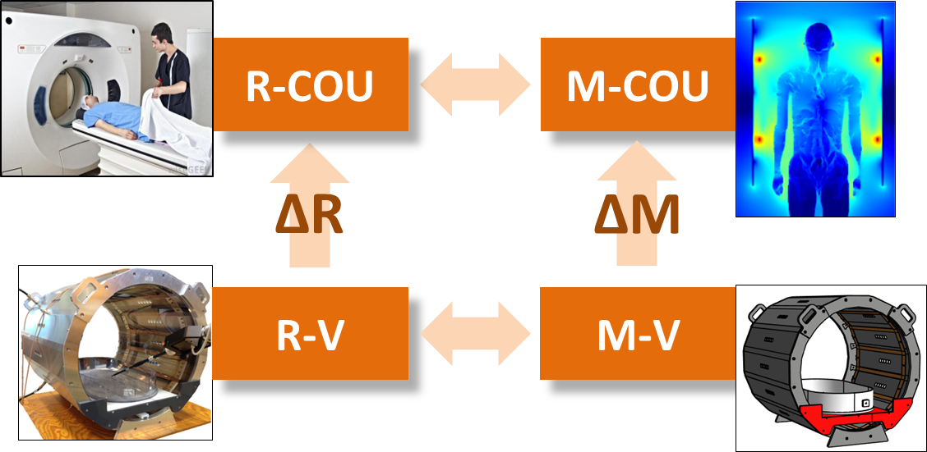
Tina Morrison
U.S. FDA
March 23, 2017

Slide 2
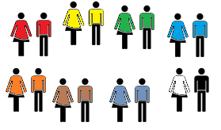


FDA Modeling and Simulation Working Group
Sponsored by the Office of the Chief Scientist Fall 2016
Main Objectives:
  Raise awareness of the successes, challenges and opportunities for modeling and simulation to advance regulatory science at the FDA;
  Create an environment for enhanced communication and coordination on cross-cutting modeling and simulation efforts at FDA;
  Establish credibility principles for modeling and simulation used for research and regulatory decision-making;
Leadership
Interest Groups
Implementation Teams
Knowledge/
Big Data
Communication Plan
FDA White Paper
Credibility Principles
Chemical
Mechanistic
Physics
Statistical

Slide 3



FDA Development Tool Programs: scientifically validated tools that aid development and regulatory evaluation
Drug Development Tools (DDT)
The context of use defines the boundaries within which evidence & justification supports tool use. It should include four key components:
Product area (e.g., total hip replacement)
Stage of development (e.g., design verification)
Specific Role of tool (e.g., predict load limit)
Regulatory Evaluation (e.g., performance data for 510(k))
Clinical
Outcome Assessment
Biomarker Tests
Nonclinical
Assessment Models
Medical Device Development Tools (MDDT)
MDDT: https://www.fda.gov/MedicalDevices/ucm374427.htm
DDT: https://www.fda.gov/downloads/drugs/guidances/ucm230597.pdf

Slide 4
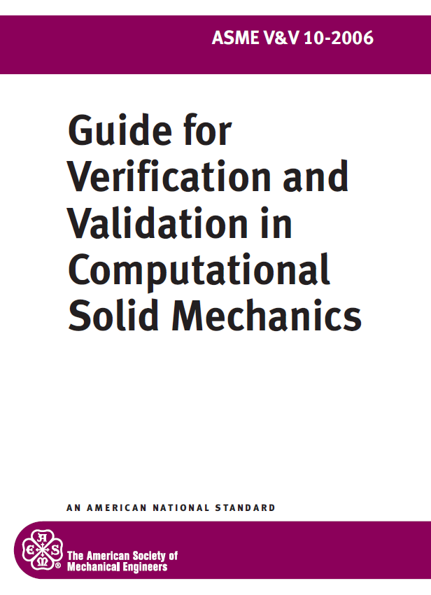
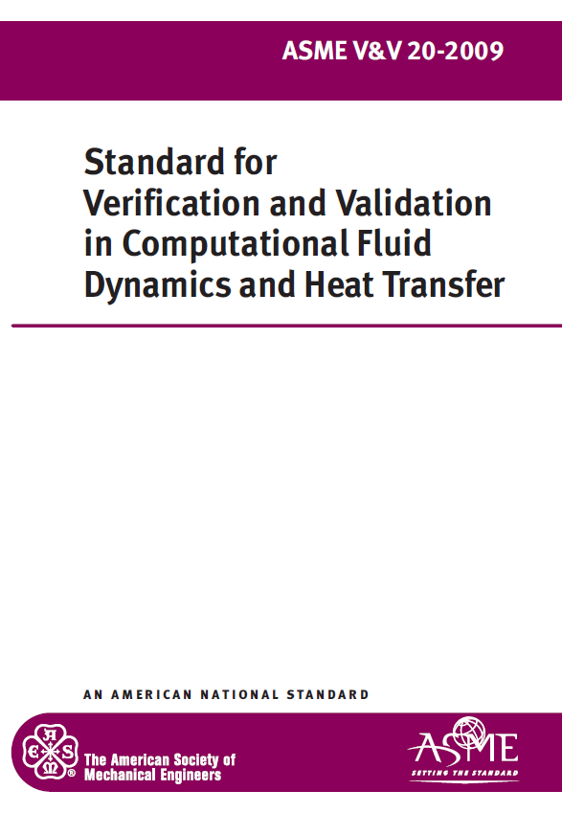
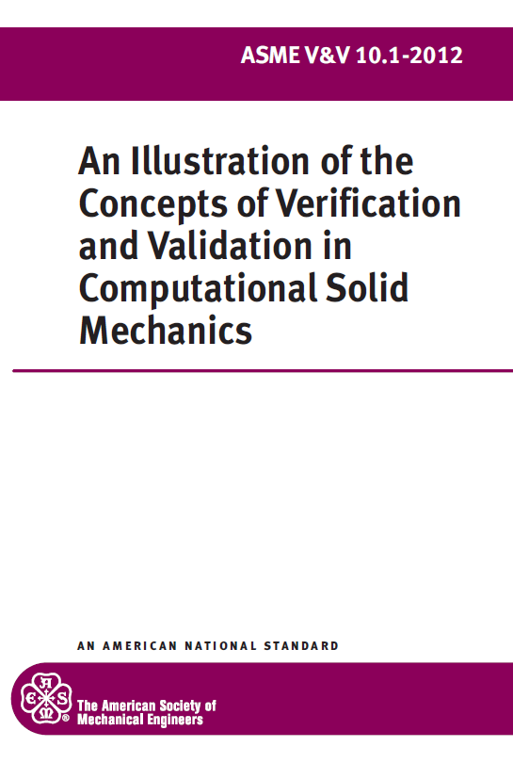

ASME V&V40: Verification and Validation of Computational Modeling for Medical Devices
ASME V&V CHARTER | Coordinate, promote, and foster the development of standards that provide procedures for assessing and quantifying the accuracy and credibility of computational models and simulations.
V&V 10 | Computational Solid Mechanics
V&V 20 | Computational Fluid Dynamics and Heat Transfer
V&V 30 | Computational Simulation of Nuclear System Thermal Fluids Behavior
V&V 40 | Computational Modeling of Medical Devices
V&V 50 | Computational Modeling for Advanced Manufacturing
Not how to do V&V but how to determine the level of evidence needed to support using a computational model for a specific context of use
  KEY ASPECTS
  new concepts regarding context of use, model risk and credibility goals
  risk-informed credibility assessment framework
    rigor of V&V is commensurate with model risk
  emphasize documentation and reporting
Verification and Validation of Computational Modeling and Simulation - A community effort.
https://dx.doi.org/10.6084/m9.figshare.3468962.v1
POSTER: Risk-informed Credibility Assessment Method.
https://dx.doi.org/10.6084/m9.figshare.3409291.v1

Slide 5
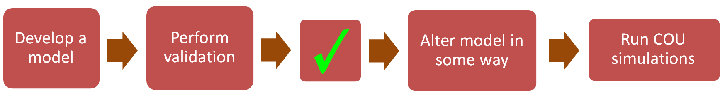
Applicability Analysis (Poster #98)
Step-by-step process for considering the applicability of the model and its validation results to the context of use (COU)
Enables the practitioner to break down the broad question of applicability into a series of specific tractable questions
Questions can be addressed using supporting evidence and/or subject matter expertise
Applicability Analysis for Biomedical Computational Models, P. Pathmanathan, R. Gray, V. Romero, T. Morrison, in submission

