Slide 1
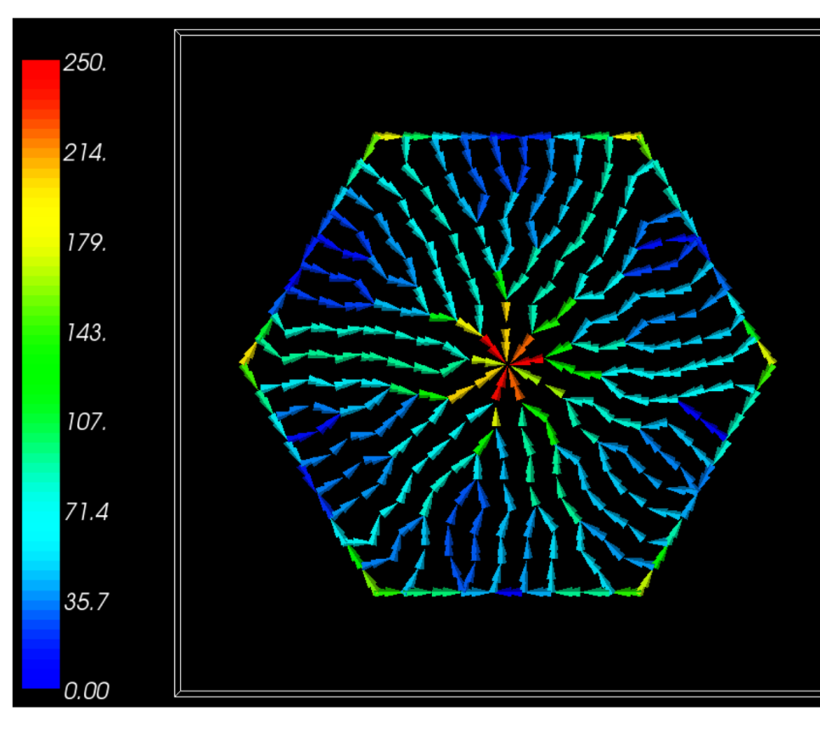
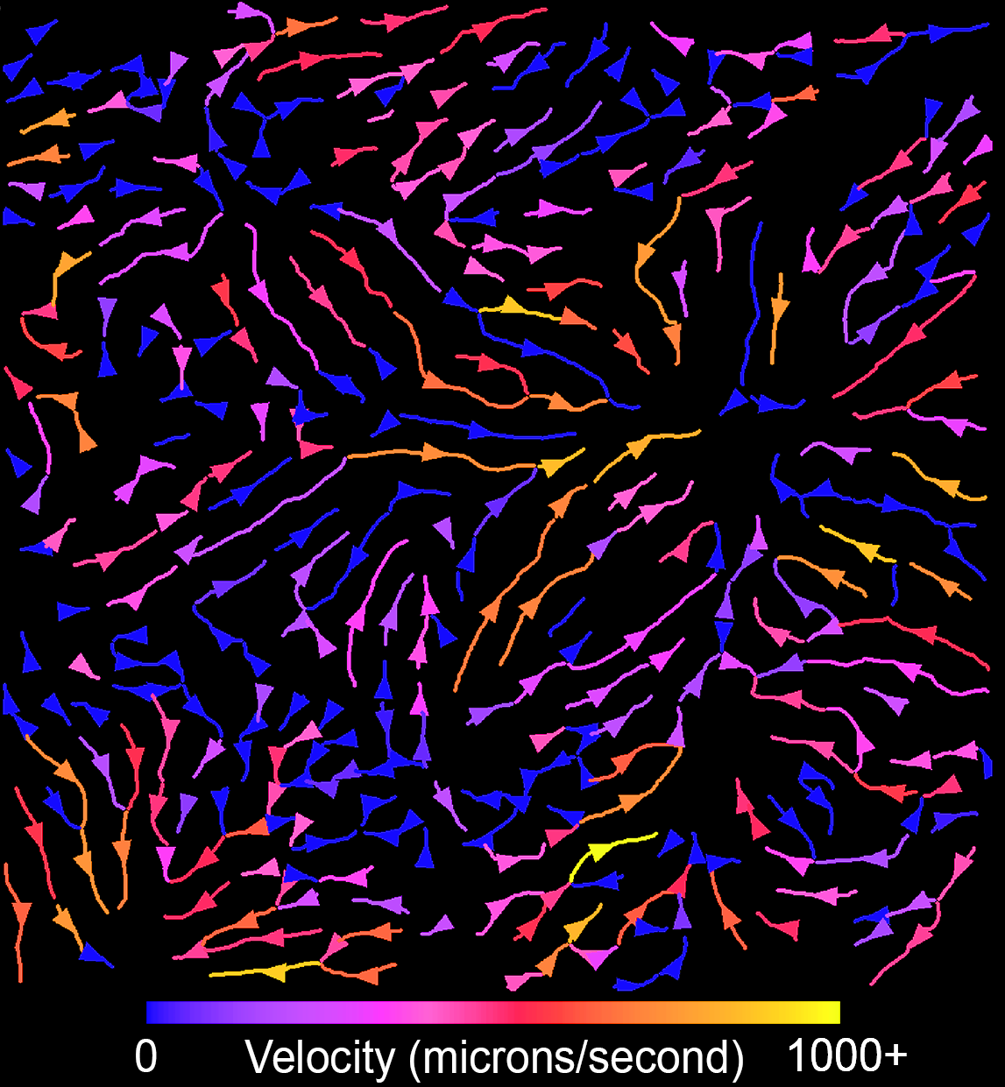
Development of a Multiscale Mechanistic Simulation of Acetaminophen Induced Liver Damage
The model: The liver is a frequent site of toxicity caused by drugs and environmental pollutants. We have previously developed a multiscale model of xenobiotic metabolism that allows us to couple coarse clinical measurements, such as blood levels of a toxicant or markers of liver damage, to a detailed liver model including the microvasculature and metabolic pathways. To calibrate this model we have collected detailed serum profiles, tissue histology and intravital microscopy data of the blood flow within the liver of a live animal.
What is new inside? Our intravital studies provided the first direct measurement of blood flow though the liver of a living animal after treatment with a typical liver toxin (Acetaminophen, APAP). In addition, we have longitudinal data across the key time window of APAP induced liver toxicity.
How will this change current practice? Our data and models provide insights into the relationship between clinical markers of liver damage (e.g., serum markers) and the changes in blood flow and cell damage. Changes in liver blood flow have long been recognized as key responses but the details at the microvasculature scale have been unknown.
End Users can couple these new flow models to previous models (such as our multiscale standards based liver model) to explain and predict the patterns of liver damage caused by liver toxicants.
B
Intravital microscopy of liver injury. Multiphoton fluorescence images of the liver in a living mouse after IP injection of 250 mg/kg APAP. Individual red blood cells are visible and the blue areas are focal lesions. This is a still from a video.
Automated measures of microvascular flow in the liver of a living mouse. Nearly instantaneous measurements of micro-vascular flow can be obtained from cross-correlation analysis of video micrographs collected at 100 frames per second.
Calculated flow velocities (right) within a virtual sinusoid network (left). Color bar is velocities in um/s.
James Glazier, James Klaunig, Ken Dunn; Indiana University, Grant: GM111243
Notes:
This project completed 6/2018. A small no cost extension runs through 6/2019, which is being used to complete animal studies.
For future work we are investigating the use of AI to generate maps of diffusible fields to either accelerate, or completely replace, PDE based diffusion solvers.
PI name, email: James A Glazier: jaglazier@gmail.com or James Sluka: jsluka@Indiana.edu

