Slide 1
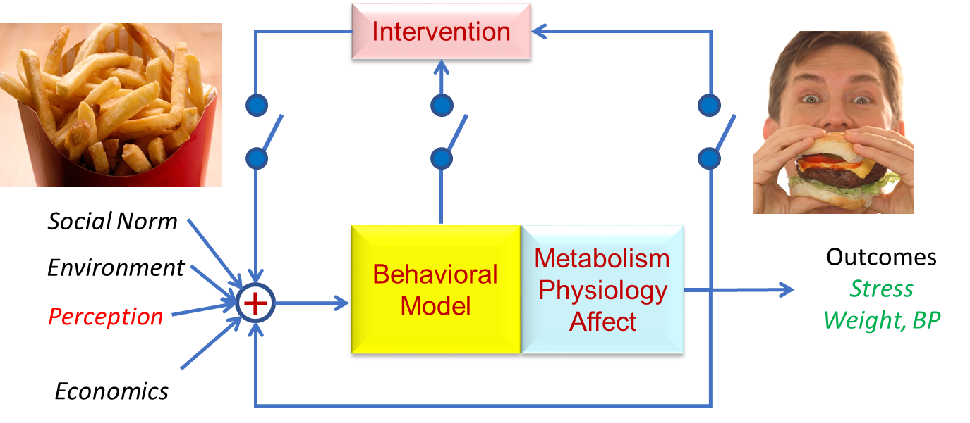
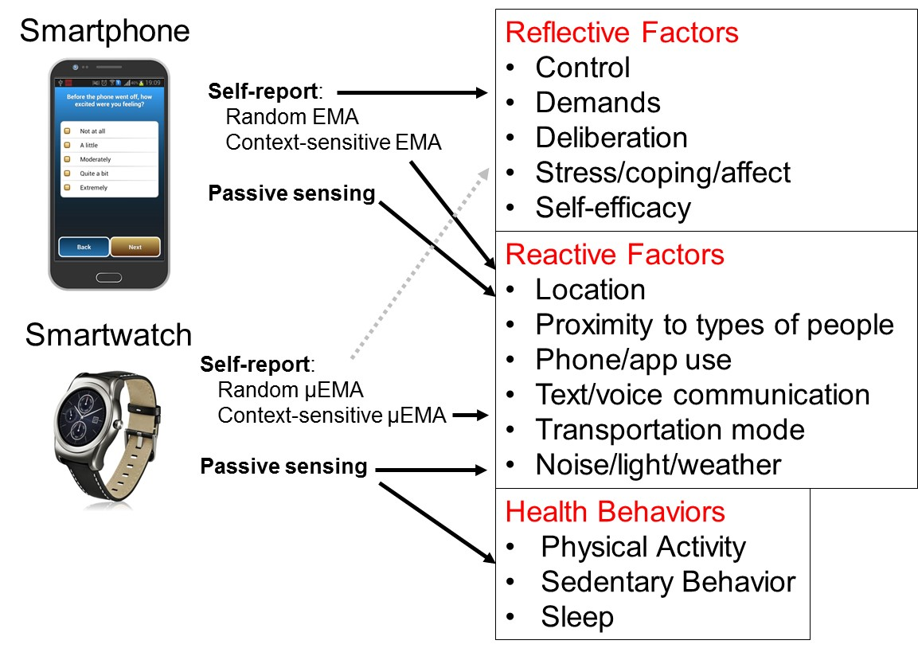
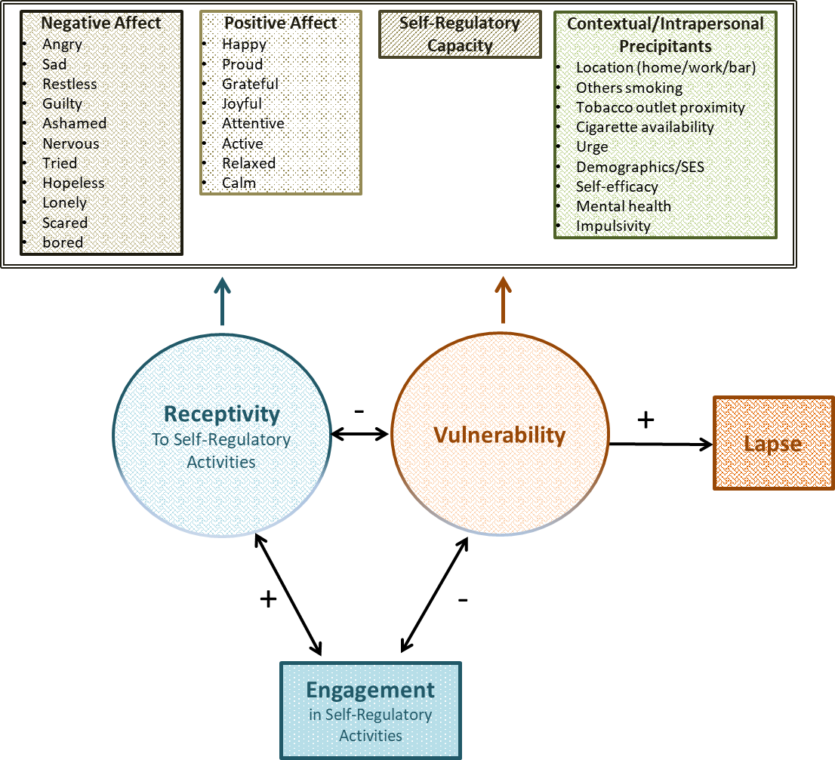
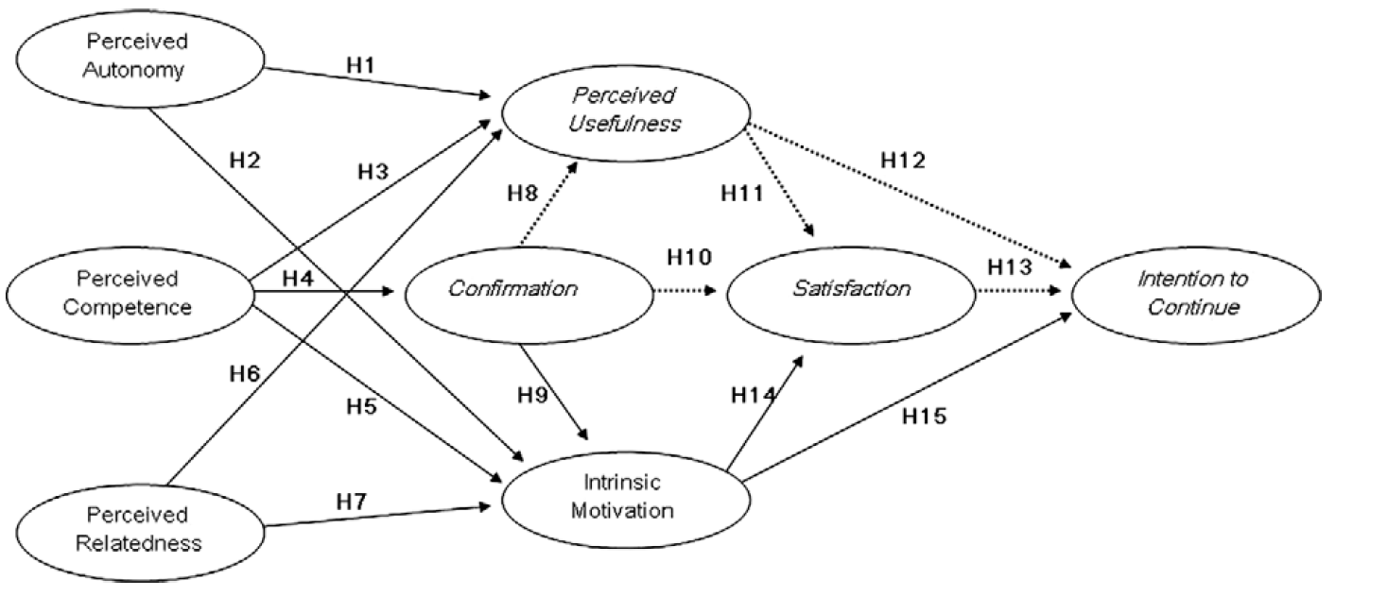
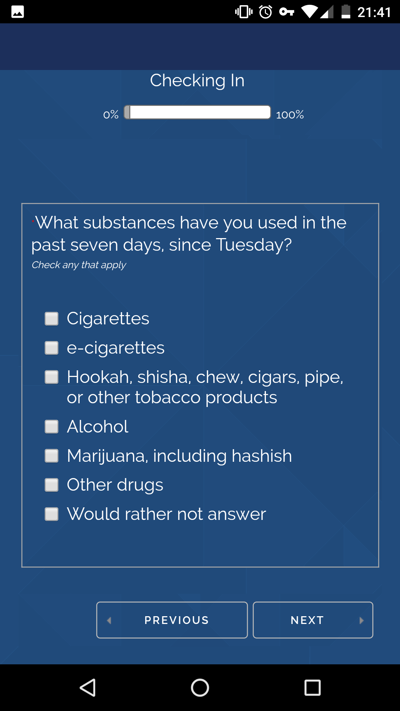
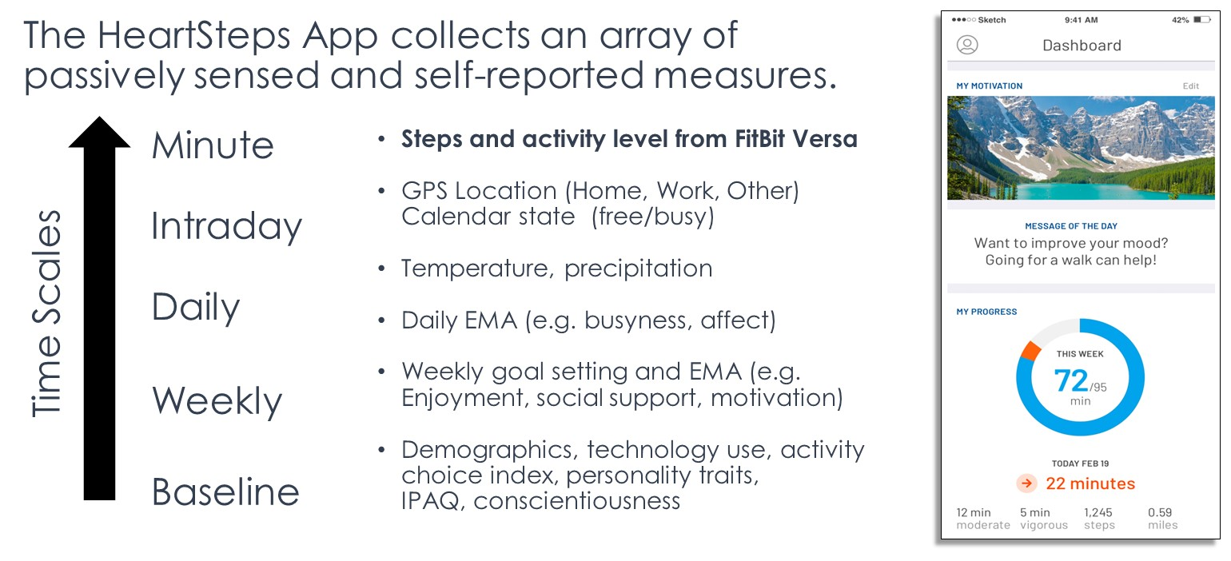
Measuring and Modeling Intensive Longitudinal Health Behaviors:
Overview of Projects in the Intensive Longitudinal Health Behavior Network (ILHBN)
Misha Pavel & Sy-Miin Chow
Northeastern
University
Behavior Modeling
Micro-Temporal Processes Underlying Health Behavior Adoption & Maintenance
Novel use of mHealth data to identify states of vulnerability and receptivity to JITAIs
Novel Use of mHealth Data to IndentifyStates of Vulnerability & Receptivity to JITAIs
Health Behaviors and States
Improving Behaviors Requires Closed Loop Just-in-Time Adaptive Intervention (JITAI)
Closed Loop Involves:
Unobtrusive measurements
Measurement models
Predictive models of behaviors
Ultimate goal: Develop mechanistic models
Current Approach: A combination of data-driven and principled-based approaches
Starting with psychological framework
Developing a dynamical realization of the model
Derive dynamical system
Test various aspects of the predictions against observable data
Health Behaviors
Activity Exercise
Substance Abuse
Weight
Stress
Depression Suicide Ideation
Sleep
Scientists: Dunton, Intille, Rothman, Hedeker, Leventhal, Redline
Goal: Assess differences in the micro-temporal processes underlying the adoption versus maintenance of behaviors
Theoretical Framework: Dual-Process Model of Decision-making and Behavior
Measurement: Prospective within-subject case-crossover observational design collecting Intensive Longitudinal Data (ILD) across 12-months in ethnically-diverse emerging adults (ages 18-24)
Modeling: Two-pronged approach: Use machine learning (ML) to identify person-specific combinations of factors predicting behavior episodes and lapses. Use multilevel regression to identify time-varying and time-invariant moderators
Scientists: Nahum-Shani, Wetter, Rehg, Moreno, Wu, Yap, Lam
Goal: Develop a Just-In-Time Adaptive Intervention (JITAI) to enhance real-time, real-world engagement in evidence-based self-regulatory activities
Theoretical Framework:
Vulnerability, Receptivity, Latent states
Measurement: 5 studies of ~1,500 smokers attempting to quit. Macro time scales (demographics, SES, mental health,self-efficacy, etc.) and micro time scales(heart rate variability, EMA, GPS)
Modeling: Machine learning (for pattern mining) and probabilistic latent variable models. Joint modeling of EMA, location, sensor, and time-to-event as a function of two underlying latent states
Data
Increasing Constraints
Model
Increasing Knowledge
Principles Mechanisms
Operationalizing Behavioral Theory for mHealth: Dynamics, Context and Personalization
A Twin Study of Adolescent Alcohol and Drug Use Development: Leveraging Intensive Longitudinal Assessments
Scientists: Spruijt-Metz, Klasnja, Marlin, Heckler, Rivera, Pavel
Goal: Behavior Assessment and Intervention: Increasing physical activity and decreasing sedentary behavior
Theoretical Framework: Self-Determination Theory
Measurement: A micro-randomized trial (MRT) of a multi-component, multi-timescale, adaptive mHealth intervention
Modeling: Dynamic state-space models of Self-Determination Theory starting with ARX models within time scales, and proceeding through Linear Parameter Varying, hybrid, and Dynamic Bayesian Network models
Scientists: Vrieze, Friedman
Goal: Develop a fine-grained model of developmental change in key risk domains and their relations to substance use, including moderation by environmental context.
Theoretical Framework: Dual systems model of adoles- cent risk behavior. Bottom-up, high sensation seeking and top-down executive function put adolescents at risk to use and misuse alcohol/ drugs.
Measurement: 1,000 adolescent twins, in-person assessments of Substance use, executive functions, personality, psychopathology, peer and family context. 2-year remote follow-up with CoTwins app
Modeling: Substance use data: growth curve models, classical twin genetic and environmental decomposition, and co-twin control models GPS and smartphone data: derivation of instrument variables (e.g., moving out of parental home; starting new job); twin similarity in environment
Acknowledgements
Research reported in this publication was supported by the ILHBN Cooperative Agreement funded jointly by the OBSSR, NCI, NIAAA, NIDA, and NIMH, under Award Numbers: U24EB026436 (PI: Sy-Miin Chow); U01CA229445 (Spruijt-Metz, Klasnja, Marlin); U01HL146327 (Dunton, Intille), U01CA229437 (Nahum-Shani, Wetter) and U01DA046413 (Vrieze & Friedman).The content is solely the responsibility of the authors and does not necessarily represent the official views of the NIH.

