Slide 1
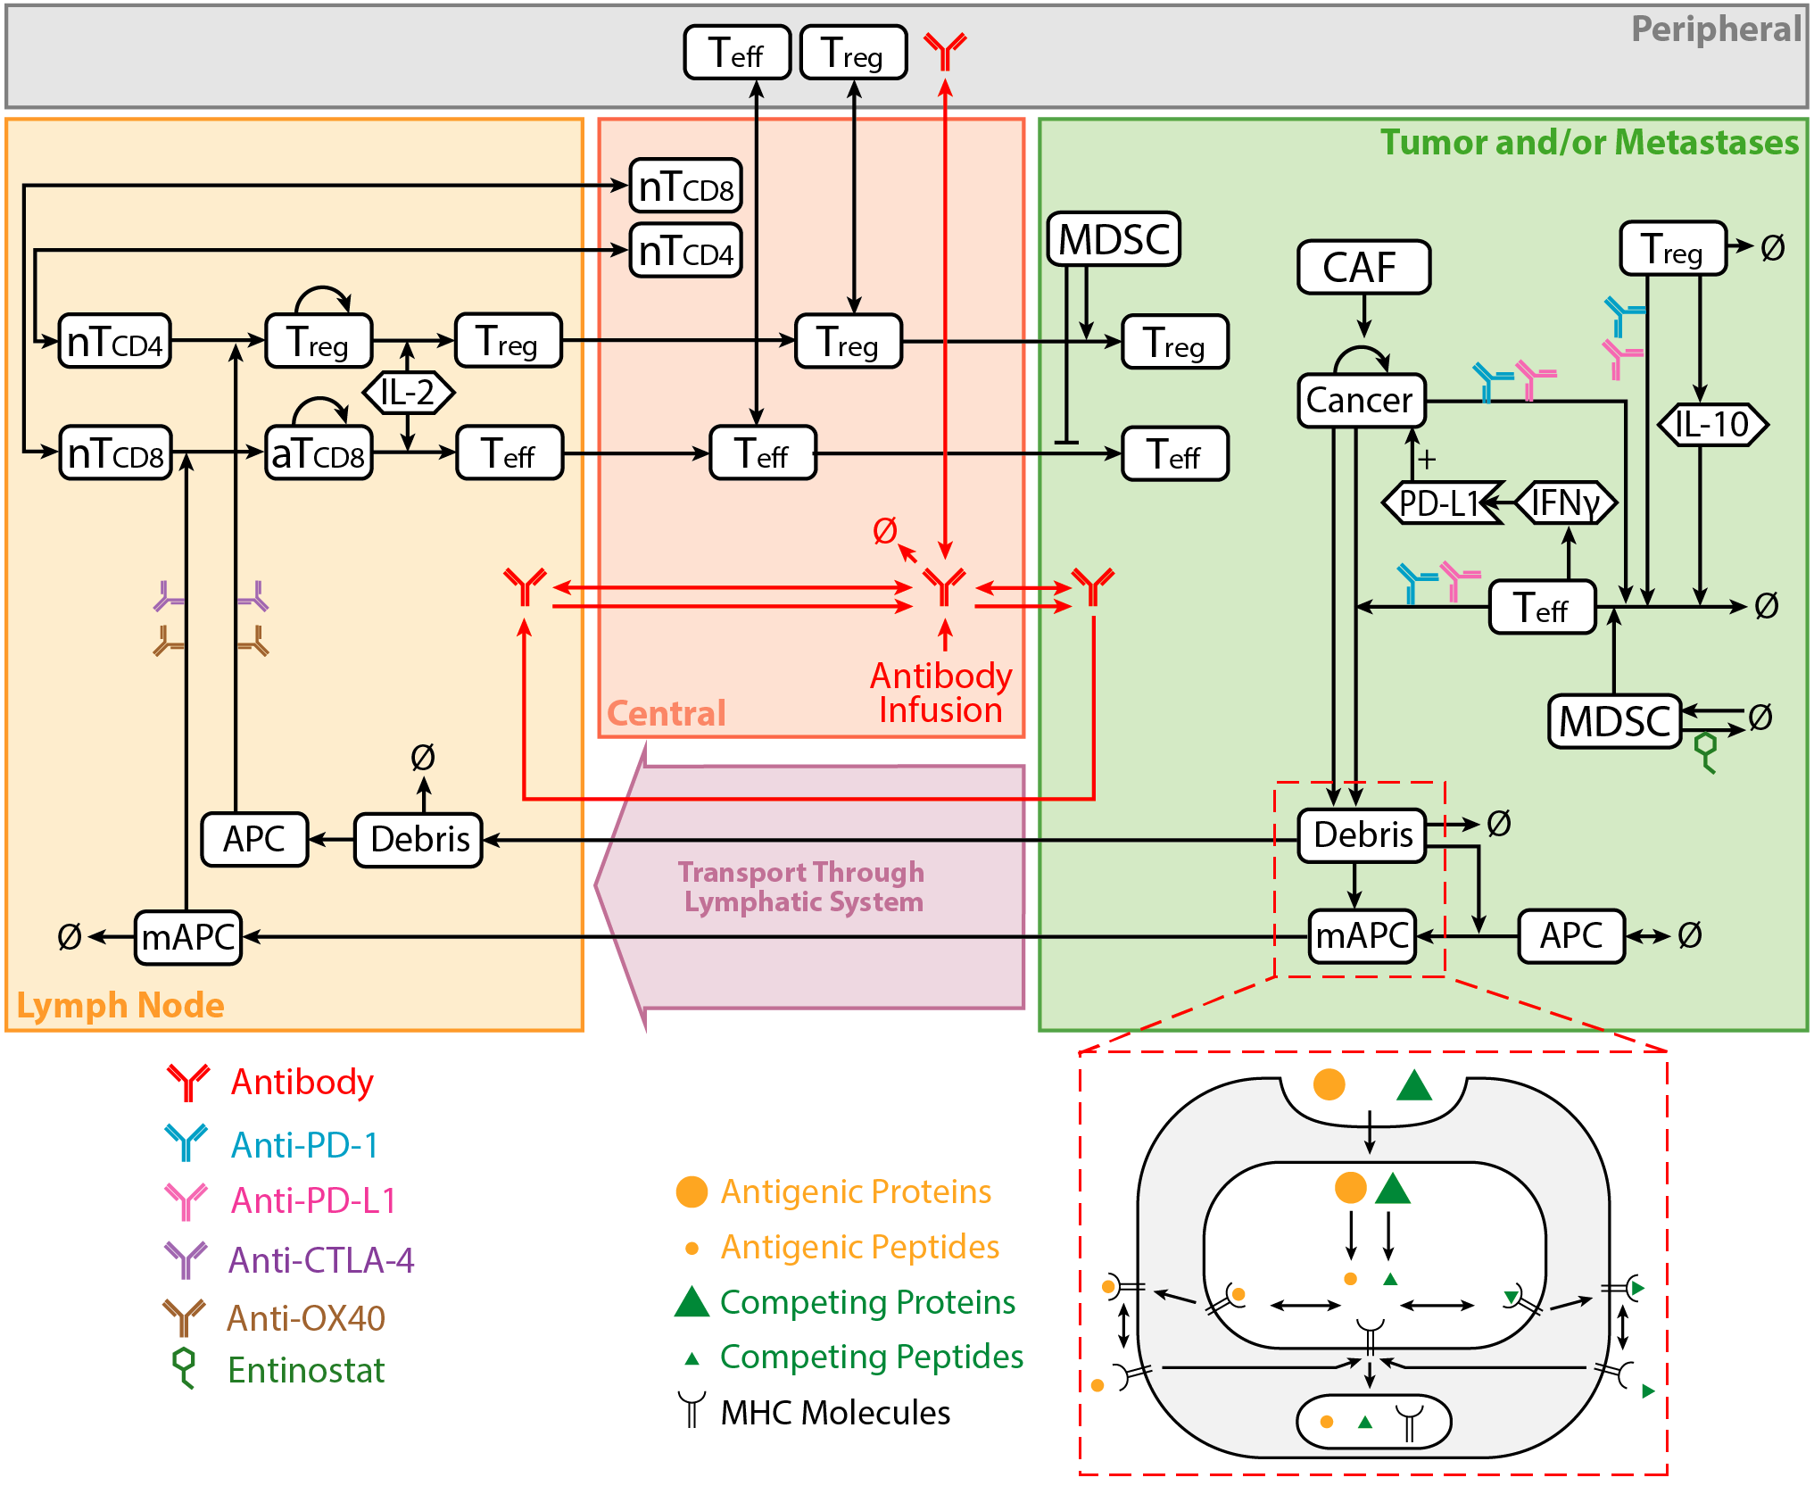
Integrating Bioinformatics in Multiscale Models of Hepatocellular Carcinoma U01CA212007
How will this change current practice?
The multiscale model will be the first to predict response for combination therapies for liver cancer, addressing the dire and unmet need to improve treatment.
End Users Researchers investigating new immuno-, targeted and combination therapies can use our platform to run virtual clinical trials and test new hypotheses through computer simulations.
The model A hybrid Quantitative Systems Pharmacology (QSP) model informed by the bioinformatically processed high-throughput molecular data, in-vitro organoids, animal models, and clinical data to predict the outcome of immuno- and targeted therapies in hepatocellular carcinoma
What is new inside? This project uses new computational techniques to incorporate intra- and intercellular signaling learned from bioinformatics analysis in innovative mathematical models spanning molecular, cellular, tumor, and organ scales.
MPI: Elana J Fertig, PhD
Aleksander S. Popel, PhD
Andrew J Ewald, PhD
Phuoc T Tran, MD
The Johns Hopkins School of Medicine
U01CA212007
Notes:
Instructions:
Submit 1 slide by COB Monday 2/25/19
Title - headline your theory-driven, mechanistic model
name the specific mathematical or statistical method and variations thereof
The model {describe purpose of model or method, describe construct, insert graphical depiction, video of simulation if applicable}
What is new inside? {describe new math, new algorithm}
How will this change current practice?
{Why is this important?}
End Users {Who are the stakeholders? What expertise should they have? How will they use it (e.g.: data & platform needed)?}
To include in NOTES section
define/explain it enough for a non-scientific person to explain to the general public (2-3 sentences)
Our mathematical model simulates the body’s immune cell interactions with cancer cells to predict how cancer will respond to various therapies, including immuno-therapy and small-molecule targeted therapies. We can then generate a large number of simulated patients (virtual patients) by varying the parameters in the model and simulate a clinical trial to test new therapies. This approach is less expensive are does not require the long approval process of a real clinical trial.
mention how can machine learning and AI help your project (2 sentences)
List future challenges or next steps after your project is done (1 sentence)
Our model contains a large set of parameters, many of them can be measured experimentally, or inferred through bioinformatics analysis, however, some of the parameter must be estimated based on the global behavior of the model.
Further details for Notes section - For the following communities (2 sentences):
Multiscale modeling: explain how the math will address methodological challenges (e.g.: crossing scales, sparse data, uncertainty, modularity, spatiotemporal simulation challenges, etc.)
To address parameter uncertainty, we generate a large number of virtual patients by varying the parameters in a physiological range (discarding virtual patients that result in unrealistic model outputs). From this type of analysis, we can determine the parameters to which the model is most sensitive.
PI name, email: Elana Fertig, ejfertig@jhmi.edu

