Slide 1
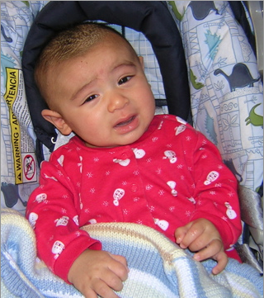
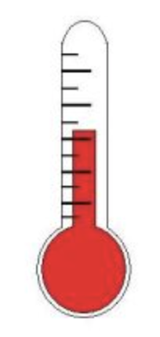
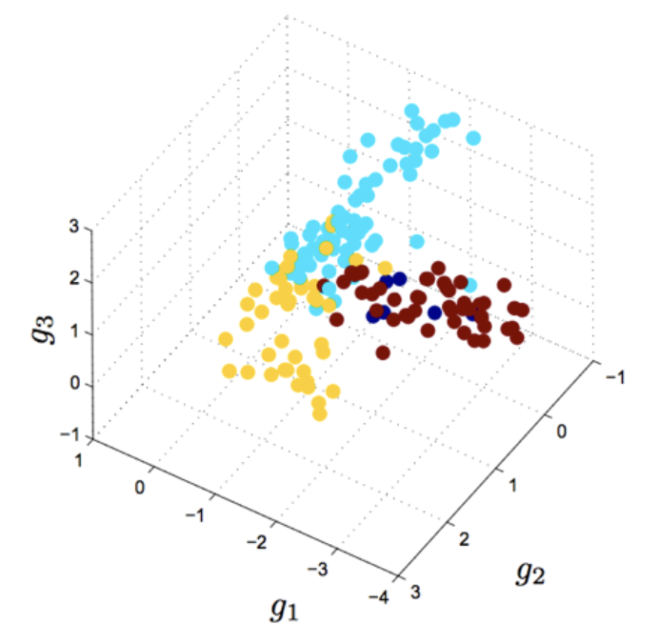
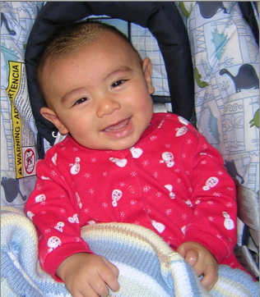
Machine learning algorithms that get better with experience
Input: real world or simulation
Feature extraction: measurement & preprocessing
Feature selection:
Dimensionality reduction (PCA)
Experience:
Mapping to desired outcomes
Output:
Decision or prediction
Testing and validation:
Bootstrapping
Training:
Clean inputs and outputs; new data

Slide 2
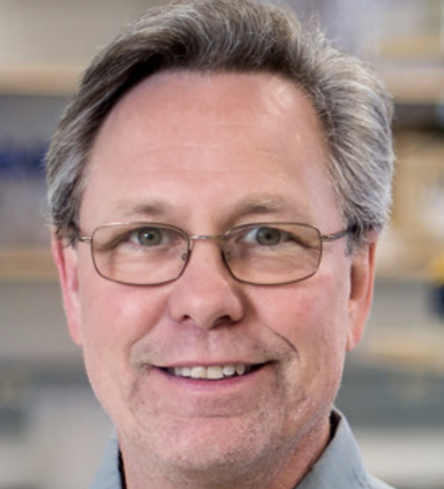
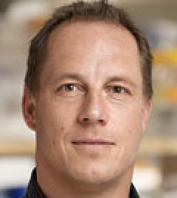
Machine learning in imaging: mitochondria Uri Manor, Gerry Shadel, Jan Karlseder, Salk Institute
Airyscan imaging at Nyquist limit
• sharp
• slow, phototoxicity
1/4th Nyquist undersampled
• 16x faster, 1/16th phototoxicity
• blurry
Machine learning
• undersampled image becomes sharp

Slide 3
Key questions How can these be further harnessed for MSM prediction and validation?
Can underlying models be used to quantify biological processes?
Omics data?
Pathway modeling?
Cell-cell interactions?
Meso-scale phenomena?
Can machine learning methods be harnessed for parameter estimation/model optimization?
Can machine learning reduce parameter space in experimental design?
Can machine learning reduce medical imaging requirements for validating to multiscale models?

Slide 4
Are you using or developing machine learning or causal inference methods across multi-scale data?
Addressing data from multi-scales:
Using machine learning to predict the contact area conferred between aggregating platelets under shear flows using inputs extracted from our extensive experimental database. (Danny Bluestein, Stony Brook University).
High dimensional calcium phenotyping of cellular response used to train neural network model of platelet signaling. (Scott Diamond, University of Pennsylvania)
Using manifold learning to obtain compact and parsimonious descriptors of SCN (suprachiasmatic nucleus) networks. (Michael Henson, University of Massachusetts)
We use machine learning to study protein folding. We develop amino acid text embedding and generating systems to design, build, and test proteins. (David Kaplan, Tufts University; Markus Buehler, MIT).
Our modeling extends from molecular biophysics (channels, enzymes, transporters) to whole body responses to exercise and pharmaceuticals. Our foci are on heart and skeletal muscle.
Simulating across scales:
Inference methods to calculate p-values for statistical significance of experimental data. (Mark Alber, UC Riverside)
Enhancement of image resolution for validation and clinical application of multiscale models. (Markus Buehler, MIT; Guy Genin, Washington University; Stavros Thomopoulos, Columbia)
Using machine learning approach to predict biomarkers for tuberculosis. (Dartois, Univ. Michigan)
We use a data-driven input-output (IO) modeling approach as a solution to the scale linking problem. (Gianluca Lazzi, University of Utah)

Slide 5
Are you using machine learning strategies for improving the optimization of MSM modeling?
Large-scale parameter estimation:
Exploring how to use machine learning to optimize alternative pathway fluxes. (James Bassingthwaighte, U Washington)
Using genetic algorithms to adjust parameters according to the fitness functions at cell and tissue levels. (William W. Lytton, Northwestern University).
Using machine learning algorithms for classifying drugs into dangerous and safe classes based on simulation results and for automatically constraining parameters in models. (Eric Sobie, Icahn school of Medicine at Mount Sinai).
Utilizing nonlinear optimization methods to identify parameter values based on fit to available data as well as model parsimony considerations. (Rajanikanth Vadigepalli, Thomas Jefferson University).
Using Bayesian schemes for obtaining robust parameter estimation. (C. alberto Figueroa, University of Michigan)
Using linear programming to efficiently optimize MSM model (Xiaobo zhou, UTHealth)
Uncertainty/Sensitivity quantifications of model outcome:
Perform local and global sensitivity analysis of parameters in ABM model, and ODE/PDE models (Xiaobo Zhou, UTHealth).
Perform systematic Sensitivity analysis of ABM to determine cause and effect.(Bruce Y. Lee, Johns Hopkins University)
Predictive MSM strongly incorporate uncertainty quantification.

Slide 6
How can machine learning methods/tools used for evaluating the prediction of MSM models?
In examining uncertainty, we have to assess 4 types of model uncertainty for prediction. These are (1) parameter (2) input (3) environment and (4) model structure itself. The first two could be handled by Monte Carlo techniques, except that for parameters, and sometime also inputs, there are inevitable correlations that render using iid process of any distribution invalid. Taking the correlation structure into account is much more computationally intensive, though it narrows the prediction space. Model environment includes the many fixed assumptions that go into modeling, constancies of the milieu, absence of perturbations, etc., and are omitted in order to represent a poorly defined but unchanging state.
Model structural uncertainty is critically important, ranging from consideration of the varied levels of precision and accuracy in different algorithms for a module to to inclusion of different modules and arrangements of them in a configured system. When a system can be structured in many different ways, machine learning may serve as vehicle for finding the most satisfying arrangements.
Image resolution enhancement

Slide 7
How do new theories/technologies in machine learning areas impacted MSM modeling?
Machine learning strategy that take into account physical principles. The use of physical principles will enable inferences in spite of noisy data.
Bayesian correlation analysis may serve as guides to refining uncertainty quantification
Machine learning based strategies speed up the parameter estimation.
Machine learning methods (Boosting, Deep Learning, Active learning, Transfer Leanrning, Dictionary learning, Generative Adversarial Networks, Reinforcement learning, etc) may improve the prediction of MSM.
Bayesian networks can support clinical experts in finding the best patient-specific therapeutic decisions.

Slide 8
Have new machine learning approaches improve your understanding of the complicated biological questions?
Exploring new machine learning methods for automatic image segmentation. (Alberto Figueroa, University of Michigan)
Develop a multiscale-imaging based cluster analysis (MICA) for analysis of asthmatic populations.
Applying an unsupervised machine learning technique for grouping sub-population of patients. (Ching-Long Lin, University of Iowa)
Combing feedforward neural network with Bayesian regularization to predict the contact area conferred between aggregating platelets.
Using regression methods to learn regulation points. (William R. Cannon, Pacific Northwest National Laboratory)

Slide 9
Key questions How can these be further harnessed for MSM prediction and validation?
Can underlying models be used to quantify biological processes?
Omics data?
Pathway modeling?
Cell-cell interactions?
Meso-scale phenomena?
Can machine learning methods be harnessed for parameter estimation/model optimization?
Can machine learning reduce parameter space in experimental design?
Can machine learning reduce medical imaging requirements for validating to multiscale models?

