Slide 1
Challenge #8: Problem-driven multiscale models that require high performance computing
PI Leads:
Julius Guccione (University of California, San Francisco)
and
Denise Kirschner, PhD (University of Michigan)
IMAG

Slide 2
Challenges 1-18 charge from IMAG
What has been accomplished in these Challenges?
    What exactly are the methodologies that were developed?
    Describe the newly developed methodologies for:
      bridging scales
      addressing sparse data
      simulating across scales
      addressing uncertainty quantification
How have these methodologies impacted each field?
    Have they changed the questions or approaches in the field?
    Have new theories resulted from this work to improve the understanding of the problems in the field?
What still needs to be done for these challenges?
  Are there methods from other fields that should be applied to your field?
  What further connections need to be made to address unmet needs?
What questions do you want to pose to the MSM Consortium related to these challenges?
IMAG

Slide 3
Pre-Meeting Summary for Group 8
1) We had 18 people in attendance at a video conference on March 1st
2)Topics summary:
a) were mostly focused on resources and how to access, manage and retain resources
b) how to streamline simulations to reduce computational needs
3) Resources:
--Individual PI resources
--Robust local resources (i.e. University)
--Supercomputers
      National cluster resources like XSEDE, NERSC, national labs, etc.

Slide 4
Pre-Meeting Summary Group 8
3) Investigator demands
Is it possible to get the resource as part of the review process?
  NSF and NIH both provides special instrumentation resources otherwise, this is expected of university (Vipin Chaudhary)
  Resources are over subscribed as it is (Ramana Madupu).
4) We need to identify
  Which resources that MSM investigators have access to:
  What they require
  (how) Can they acquire access

Slide 5
Pre-Meeting Summary for Group 8
5) We need an NIH computational resource separate from NSF
Science in general is becoming more computational
  Not being reflected in the funding process
  Funding agencies and national labs say go to your institution to get computer time
  Institutions say you have to pay, go to funding agencies for the funding
NIH Commons
  You can include money for cloud resources in a grant application May still be a max of up to 64 cores with special permission
  We have about that on our desktops
  Not orientated to the scale new scientific, MSM studies, which can require thousands of cores.

Slide 6
Pre-Meeting Summary for Group 8
6) Reproducibility—
  Scalability and streamlining
  When to perform code efficiency?
  C Augustin & G Plank (Graz, Austria) developed algebraic multigrid preconditioner for an iterative Krylov solver for HPC

Slide 7
Pre-Meeting Summary for Group 8
7) Code modifications:
  Efficiency and Coarse graining
    Input/output machine learning model, then extract
  smart algorithm development;
    look up table (or function) for one scale GPUs are another approach
  Only a few cores are needed for model development;
  model simulation studies need larger access
8) Benchmark HPC
  Are the thousands of simulations worth performing?

Slide 8
Pre-Meeting Summary for Group 8
9) What if there was a Common fund award
  Computational expensive MSM
  Concerted effort to try to assess the needs and meet them
10) Is cloud computing (Amazon AWS, Microsoft Azure, Google) the new answer?
  They all cost money and that only buys time on a virtual machine, sharing the physical machine with other users
  Exclusive access to the hardware costs more money

Slide 9
Pre-Meeting Summary for Group 8
11) NERSC (Ramana Madupu)
DOE and NERSC have the largest allocations
  DOE mission space focus
  Some others as well (she oversees biology)
  Very Limited and over subscribed
XSEDE (Vipin Chaudhary)
NSF and NIH both provides special instrumentation resources otherwise, this is expected of university

Slide 10
Pre-Meeting Summary for Group 8
12) Shared instrumentation grant
  We could Apply to NIH as collective MSM investigators
  Not sure NIH will get that?
  Need a fundamental rethinking of things
13) Clusters on University Campuses
  Since the NIH pays our (high) in-direct cost rate to our universities, maybe NIH can demand that they should provide free access?
  Who can enforce that?
  Make it a requirement for computational grants?
14) National Lab Super computers
  How to gain access?

Slide 11
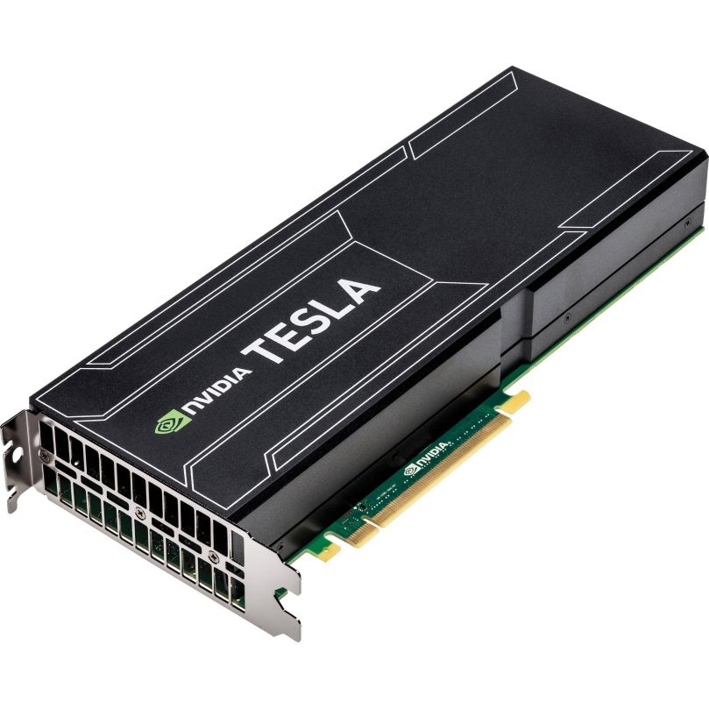
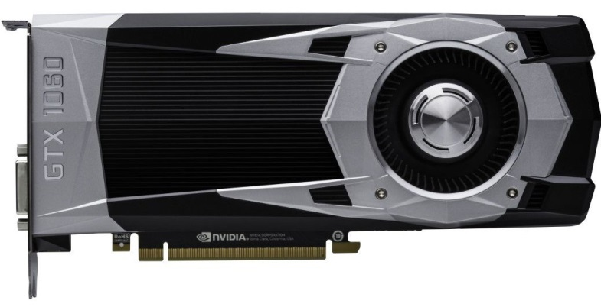
Notes on GPU-based computing: pros and cons- by Tim Secomb, University of Arizona
Advantages of GPUs
  High theoretical floating point operations per second
  Relatively inexpensive
  Can dedicate a system to your own project – no need to share!
  Libraries are available for all standard linear algebra operations, callable from standard C++
Disadvantages of GPUs
  Nonstandard operations require writing “kernels” in special programming language (CUDA or OpenCL)
  Debugging is more difficult for GPU code than for CPU code
  Requires a different approach to optimization for speed: floating point operations are very fast, but CPU-GPU memory transfers can kill performance
  As in any parallel computing, some algorithms do not benefit, and some need major modifications
  Cost and time to reprogram in GPU
Summary
  If your project has computations that are highly granular and would benefit from parallel processing, then it can be worth the (significant) effort to reprogram them for GPUs

Slide 12
SUMMARY SLIDES FROM MSM PIs

Slide 13
A Multi-scale Systems Pharmacology Approach to TB Treatment computational: Kirschner, Linderman (Michigan) and experimental: Dartois (Rutgers), Flynn (Pittsburgh)
Challenge #8: Problem-driven multiscale models that require high performance computing
We have demand for HPC as our system is a hybrid ABM that requires embarrassing parallel runs on thousands of cores.
We have obtained access to national resources via grants (XSEDE, NERSC), but local resources are expensive
We have honed an uncertainty and sensitivity quantification approach (Marino et al. 2008 )
Tunable resolution is our approach to fine vs coarse graining to fit the problem [1]
MSM community would benefit from resources dedicated to our efforts at the NIH—the demand is there and indirect costs should cover time on local resources
simulation needs by model type
Kirschner et al Tuneable resolution as a systems biology approach for
multi-scale, multi-compartment computational models. WIREs Syst Biol
Med 2014, 6:289-309, DOI: 10.1002/wsbm.1270, PMID: 24810243

Slide 14
Transport Phenomena in the Lymphatic System computational: Moore (Imperial College London), Bertram (Sydney) experimental: Zawieja (Texas A&M), Davis (Missouri)
Challenge #8: Problem-driven multiscale models that require high performance computing
Relevant goals: Model transport through lymph nodes coupled with ABM of immune cell communication. (Our lymphatic pumping models do not require HPC.)
We have access to HPC resources at Imperial College for ABM, but unclear if that will suffice for coupling to transport models.
Results so far indicate that lymph node swelling is required for limiting T cell exit during immune reaction.
Jafarnejad, M., M.C. Woodruff, D.C. Zawieja, M.C. Carroll, and J.E. Moore, Jr., Modeling Lymph Flow and Fluid Exchange with Blood Vessels in Lymph Nodes. Lymphat Res Biol, 2015. 13(4): p. 234-47.

Slide 15
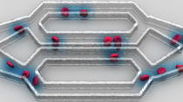
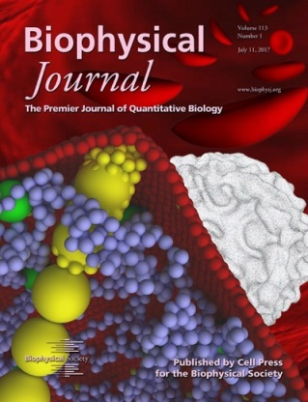
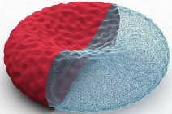
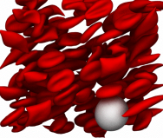
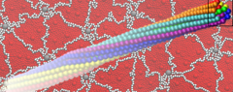
Multiscale modeling of sickle cell anemia: Methods and validation
George Em Karniadakis (Brown U), Ming Dao (MIT), John M. Higgins (MGH), Peter G. Vekilov (U Houston)
Challenge #8: Problem-driven multiscale models that require high performance computing
The number of DOFs in the proposed simulations is O(100M) and hence the time-continuous two-way coupling methodology we proposed should be parallelizable and scalable to tens of thousands of processors.
We have obtained access to DOE supercomputing centers (ALCF / OLCF) through INCITE / ALCC programs for computing. We have also used local resources (Brown CCV) for benchmark and pilot studies.
We have developed a GPU-accelerated simulator (_{USER}MESO; SC15 Gordon Bell Award finalist) for blood flow simulations (Tang et al., 2014, 2017; Blumer et al., 2017).
We have developed a parallel framework (Multiscale Universal Interface, MUI) for interfacing atomistic-mesoscopic-continuum formulations (Tang et al., 2015).
We have improved domain decomposition method so that we do not overlap the domains and uncertainty can be propagated seamlessly using black-box codes from one scale to another (Cho et al., 2015).
We have released our codes as open source software on GitHub, so MSM community would benefit from resources dedicated to our efforts.
Oxygen
transport
RBC
Blood flow
HbS fiber
Multiscale modeling of SCA
Tang & Karniadakis (2014). Accelerating dissipative particle dynamics simulations on GPUs, Comput Phys Commun, 185: 2809-2822.
Tang et al (2015). MUI: A concurrent framework for coupling heterogeneous solvers, J Comput Phys, 297: 13-31.
Blumers et al (2017). GPU-accelerated red blood cells simulations with transport DPD. Comput Phys Commun, 217: 171-179.
Cho et al (2015). Algorithms for propagating uncertainty across heterogeneous domains. SIAM J Sci Comput, 37: A3030-A3054.

Slide 16
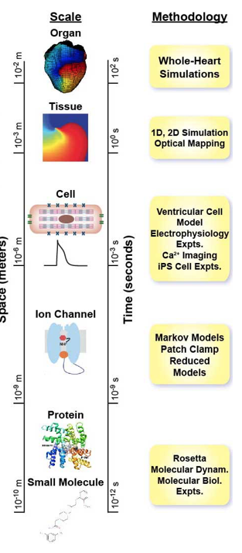
Challenge 8 - Problem-driven multiscale models that require high performance computing (Clancy Group)
What has been accomplished in these Challenges?
    We have developed automated job preparation and submission protocols for high-performance multi-node computer clusters for atomistic simulations of drug interactions with lipid membranes and ion channel proteins, necessary to generate parameters for multiscale functional models of cardiac safety or toxicity.
    We have garnered substantial computing resources:
      ~2,500 CPUs HPC at UC Davis to perform atomic scale simulations.
      Anton 2 supercomputer (2 allocations) at the Pittsburgh Supercomputing Center to perform atomic scale molecular dynamics simulations.
      We have just received an XSEDE allocation.
    We have partnered with the National Biomedical Computation Resource to develop Kepler Workflows for our multiscale models to ensure reproducibility, reliability and scalability.
IMAG

Slide 17
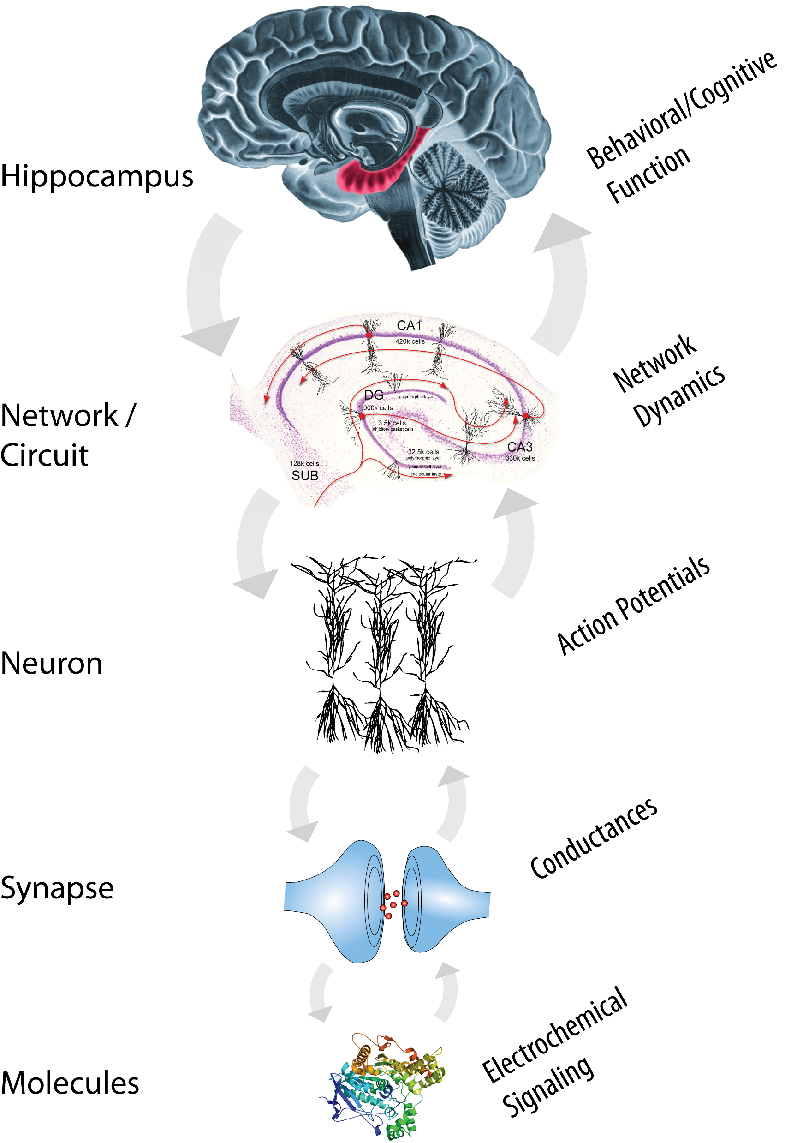
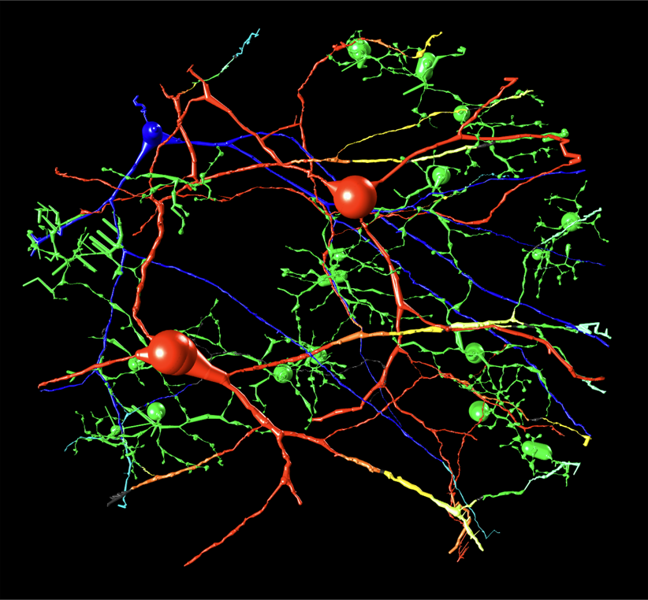
Predictive Modeling of Bioelectric Activity on Mammalian Multilayered Neuronal Structures in the Presence of Supraphysiological Electric Fields - HPC Requirements (Lazzi/Berger Group)
What has been accomplished?
  HPC-dependent large scale neuronal model of the hippocampus (4000 CPUs)
  Bridging scales and simulating across scales using input-output models of lower-scale mechanistic models
    An input-output modeling approach was developed to create compact surrogate models of computationally expensive mechanistic models that preserve the functional properties of the mechanistic models.
    The surrogate models replace the mechanistic models of lower-scale phenomena when simulating at higher scales to reduce complexity of the simulation while maintaining accurate representations of lower-scale phenomena.
How have these methodologies impacted each field?
  Machine learning: Development of a data-driven modeling approach for representing non-linear, dynamical systems using input-output models
  Computational Neuroscience: Preservation of synaptic AMPAR/NMDAR-related nonlinear dynamics during the simulation of large neural network models
  Artificial retina: Development of model-driven stimulation waveforms for virtual electrodes/multi-focal stimulation and control of spontaneous firing of ganglion cells
What still needs to be done for these challenges?
  Generalization/systematic incorporation of scale-bridging methodology to nonlinear dynamics
  Addressing uncertainty quantification

Slide 18
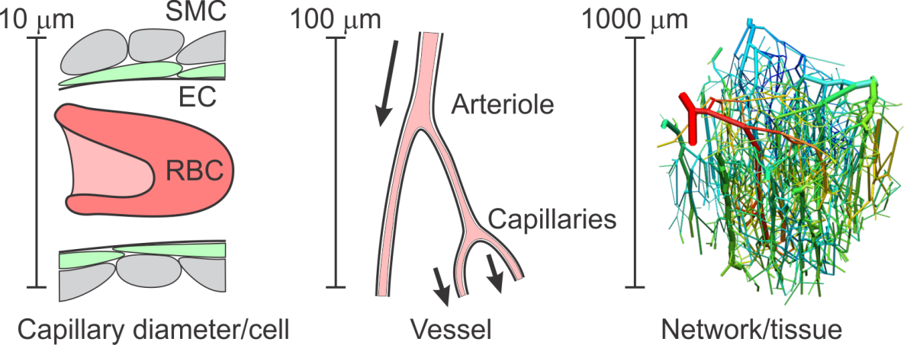
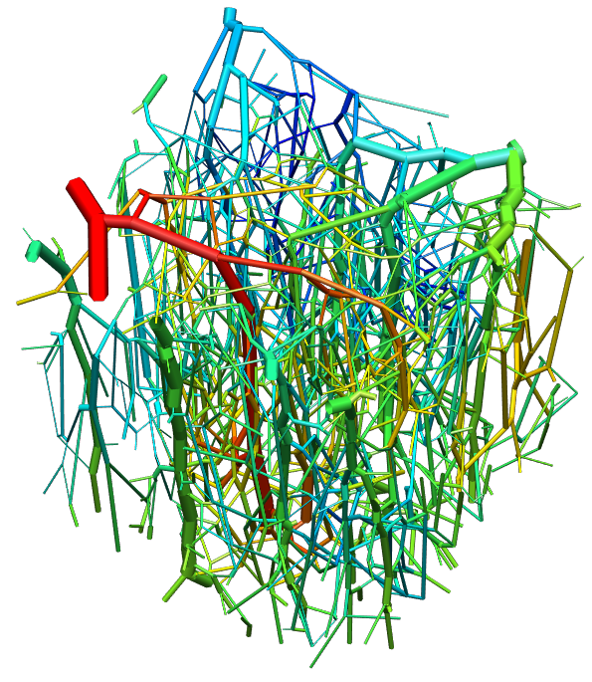
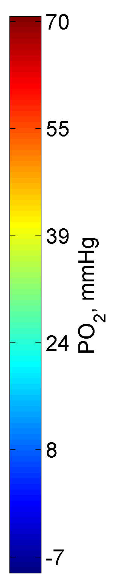
Multiscale modeling of cerebral blood flow and oxygen transport
Theoretical: Secomb (Arizona)
Experimental: Sakadzic (MGH), Boas (Boston U)
Challenge #8: Problem-driven multiscale models that require high performance computing
Progress
  Greens function method for simulating solute transport to tissue by complex microvascular networks implemented using GPUs
  Unknown flow boundary conditions on network (sparse data). Previously developed flow estimation algorithm requires solution of large linear systems. New fast iterative solver exploits special structure and sparseness of system
Impact
  Greens function method for solute transport adopted by several groups around the world
  Methods for modeling flow and mass transport in networks important tools for ongoing studies of tumors, cardiac muscle, retina and brain
  Insights into blood flow and oxygen transport to brain applicable to conditions in which transport is impaired, including stroke, brain injury and neurodegenerative diseases
Challenges
  Difficulty in automatic reconstruction of fully connected network structures from 3D optical imaging.
  Sparse data, especially boundary conditions on flow and solutes
Vascular network from mouse cerebral cortex, color coded for vessel PO₂. Oxygen demand = 6 cm³O₂/100cm³/min.

Slide 19
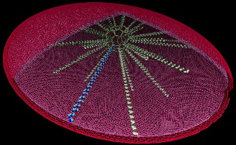
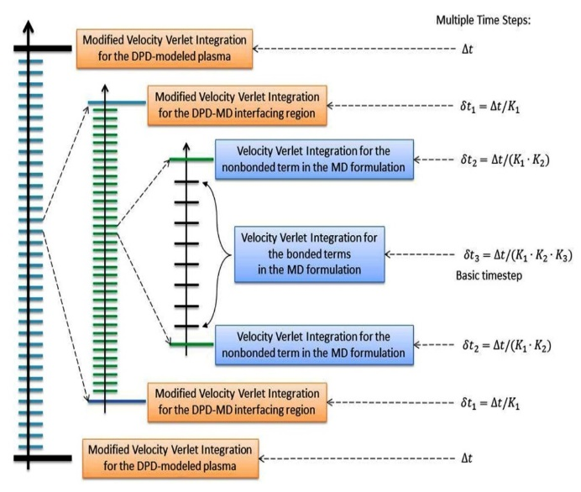
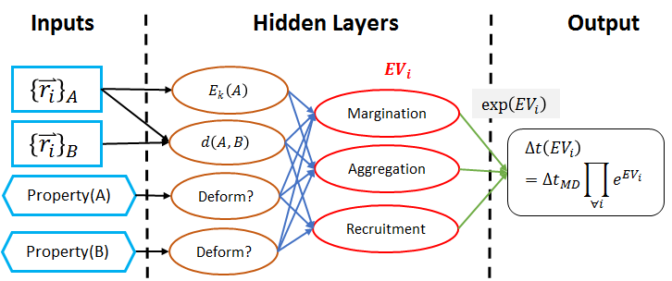
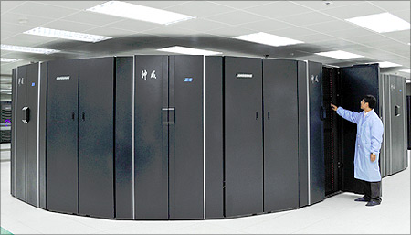
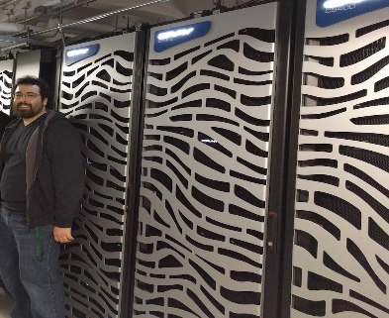
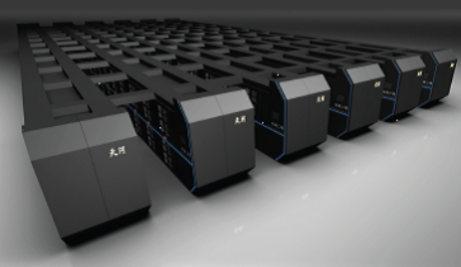
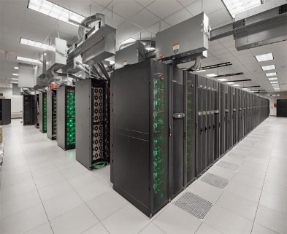
Challenge #8 HPC for Problem-Driven MSM
Simulation Size
  Platelet model: 140,015 particles, 8.38 μm³, ρ = 16,708/μm³
  Flow model: 10,787,776 particles, 20K μm³, ρ = 532/μm³
  Total: Flow 10.8M (97%) + 2×Platelets 280K (3%) = 11M
Time Stepping Algorithms
  Multiple Time Stepping (MTS) Algorithm: Four-Level Method
  Adaptive Time Stepping (ATS) Algorithm: Event-Driven Method
  Machine Learning Optimized Algorithms
HPC Resources utilized
  Stony Brook Seawulf & LI-Red Cluster (1 M core-hours)
  XSEDE SDSC Comet Supercomputer (2.5M core-hours)
  XSEDE TACC Stampede Supercomputer (120K core-hours)
  China’s Tianhe-2 Supercomputer (110M core-hours)
  China’s Sunway Supercomputer (3M core-hours)
Platelet Components | # of Platelet Particles
Outer membrane | 33,502
Inner membrane | 33,502
Filamentous core | 70
Actin filaments | 40,088
Cytoplasm | 32,853
TOTAL: | 140,015
Time (s)
10⁻⁵
10⁻⁷
Mesoscopic/Macroscopic
coarse-grained
stochastic dynamics
Multiple Temporal Scales
10⁻⁹
Microscopic
coarse-grained molecular dynamics
Platelet Structures | Numbers
Bond | 274,590
Angle | 75,132
Dihedral | 107,456
Improper | 4,956
Cross-term | 2,412
10⁻¹¹
10⁻¹³
10⁻⁹
10⁻⁷
10⁻⁵
Length (m)
Classical Single-Constant TS
Multiple Spatial Scales
Single Timestep
Constant Timestep
Sunway
Seawulf
Platelet
Modeling
Platelet
Aggregation
Multiscale Simulations
Multiple Components
Multiple Phenomena
Novel Multiple-Adaptive TS
Multiple Timestep
Adaptive Timestep
Platelet Flipping
Platelet
Activation
Multiple Time Stepping (MTS) algorithm
4-level integrator Jump factors: K₁, K₂, K₃
Adaptive Time Stepping (ATS) algorithm
Event-driven timestep selection
Tianhe-2
Stampede

Slide 20
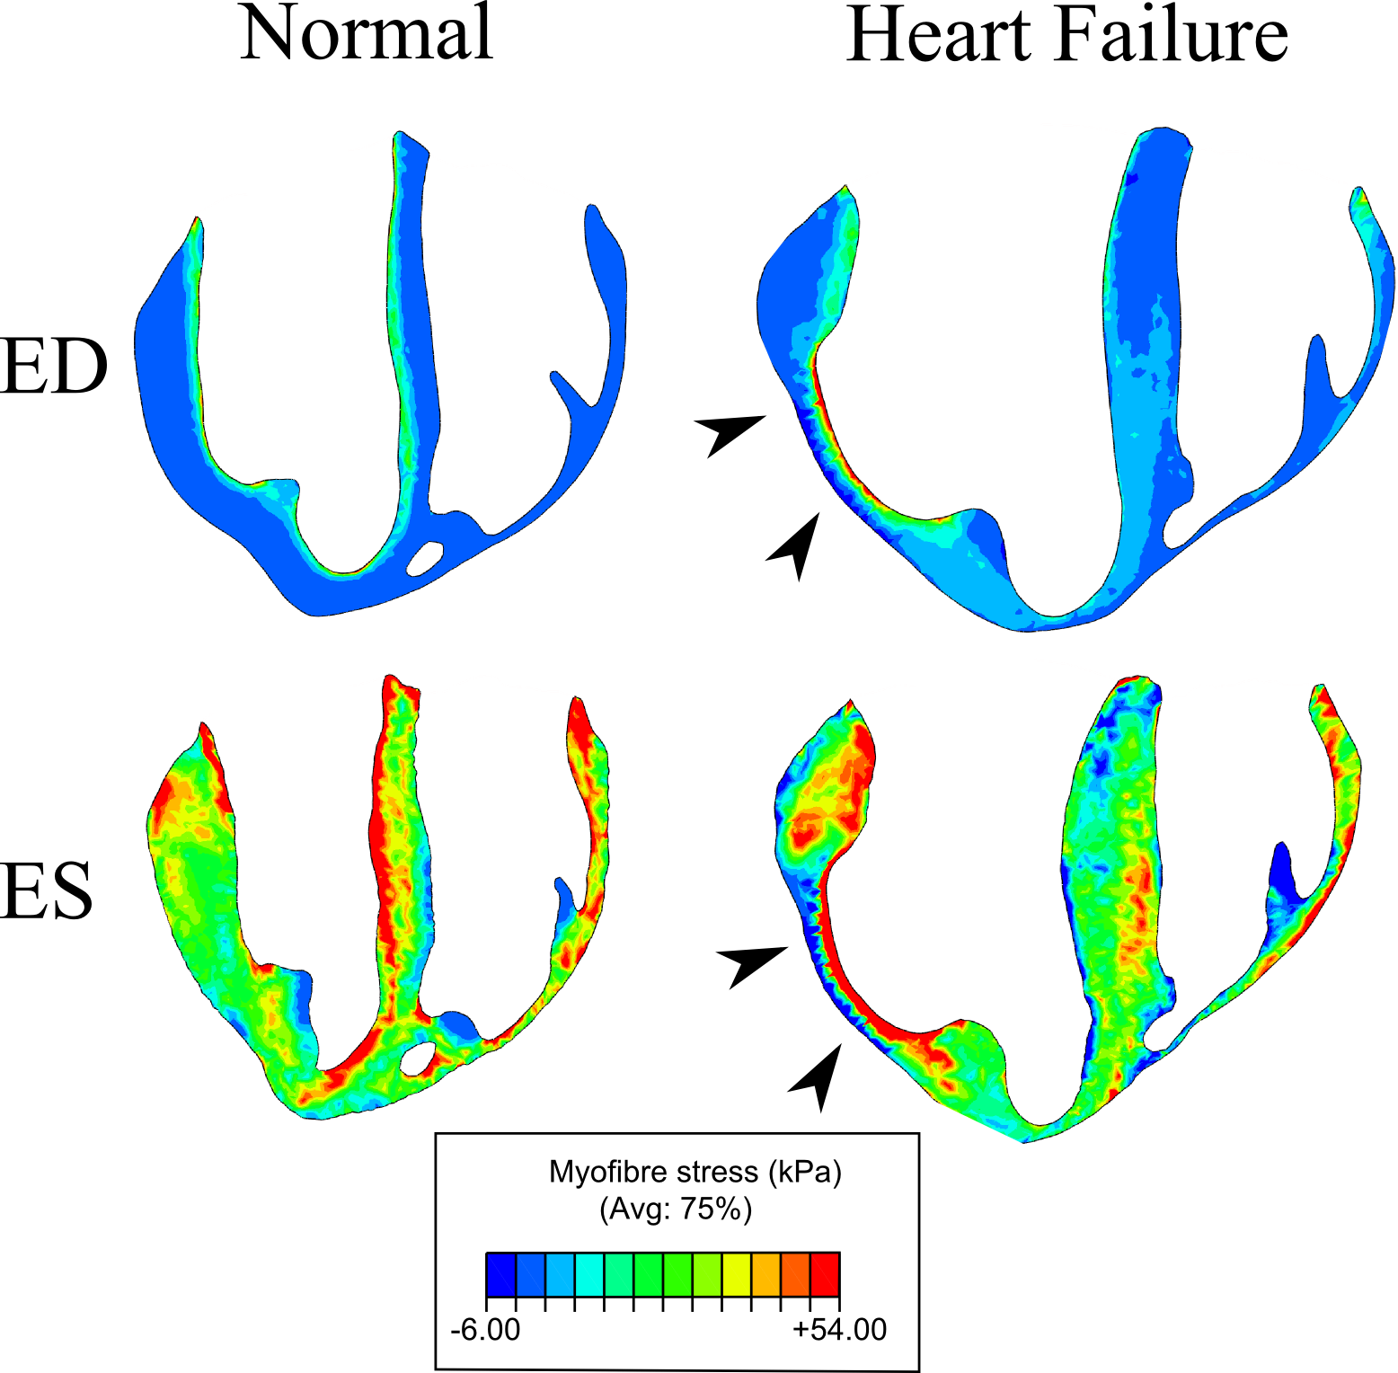
Multi-scale Laws of Myocardial Growth and Remodeling computational: Guccione (UCSF), Kuhl (Stanford) experimental: Kassab (California Medical Innovations Institute, San Diego)
Challenge #8: Problem-driven multiscale models that require high performance computing
We have demand for HPC as we create pig biventricular unit finite element models with 100,000 higher-order (10-noded tetrahedral) elements from ex-vivo high-resolution diffusion tensor MRI scans.
We used $20,000 to purchase 5 years of unlimited time on a 96-core cluster, housed and maintained at nearby UC Berkeley.
We use Abaqus, which scales well with the number of cores used, and user-defined constitutive laws (Sack et al. 2016).
We would have preferred not spending so much in direct costs for time on a local cluster— HPC resources at the NIH would be preferable.
Sack et al Partial LVAD restores ventricular outputs and normalizes
LV but not RV stress distributions in the acutely failing heart in silico.
Int J Artif Organs 2016 Oct 10;39(8):421-430,
DOI: 10.5301/ijao.5000520, PMID: 27546633

Slide 21
Challenge #8 HPC for MSM
P
PI(s) and Model | Code format | Reference(s) | Source Code | HPC NEEDS
Kirschner and Linderman Hybrid ABM of tuberculosis infection in the lungs | C++ with graphical interfaces | 15501468, 3182770, 3127549 | http://malthus.micro.med.umich.edu/GranSim/ | 1 million core hours per year
Guccione, Kassab and Kuhl Finite element models of pig biventricular units | Abaqus solver with user-defined material laws | 27646633, 26043672, 25984248 | https://simtk.org/projects/alginate/ | 1 million core hours per year
Zawieja and Moore Transport Phenomena in the Lymphatic System | C++ | In progress | In progress

Slide 22
Challenge #8 HPC for MSM
PI(s) and Model | Code format | Reference(s) | Source Code | HPC NEEDS
PI: George Karniadakis Model: _{USER}MESO (A GPU-accelerated extension package to LAMMPS) | C++ with GPU | PMID: 29104303 | https://github.com/AnselGitAccount/USERMESO-2.0 | 20 million core hours per year
PI: George Karniadakis Model: OpenRBC (A lipid-resolution molecular dynamics simulator of human red blood cells) | C++ with OpenMP | PMID: 28538143 | https://github.com/yhtang/OpenRBC | 10 million core hours per year

Slide 23
Challenge #8 HPC for MSM
PI(s) and Model | Code format | Machines | Source Code | HPC NEEDS
Danny Bluestein Multiscale DPD-CGMD Model for Deformable Platelets | C++ | Stony Brook University SeaWulf Cluster and LI-Red Cluster, XSEDE Comet & Stampede | http://lammps.sandia.gov/ (modified LAMMPS to enable our models) | 1 million core hours per year
Danny Bluestein Multiscale DPD-CGMD Model for Platelet Aggregation | C++ | Stony Brook University SeaWulf Cluster and LI-Red Cluster | http://lammps.sandia.gov/ (modified LAMMPS to enable our models) | 1 million core hours per year

Slide 24
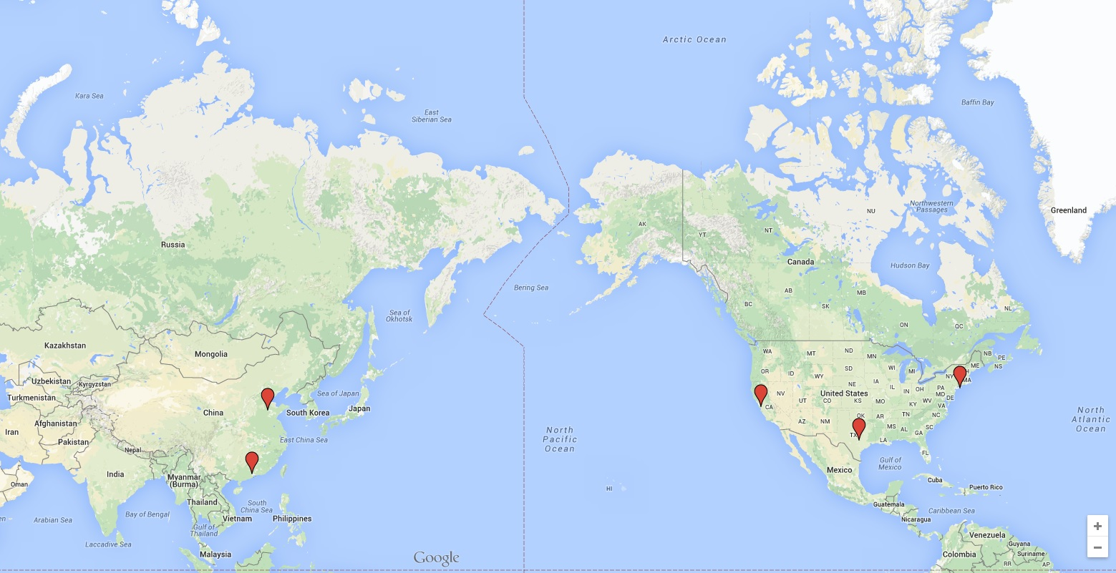
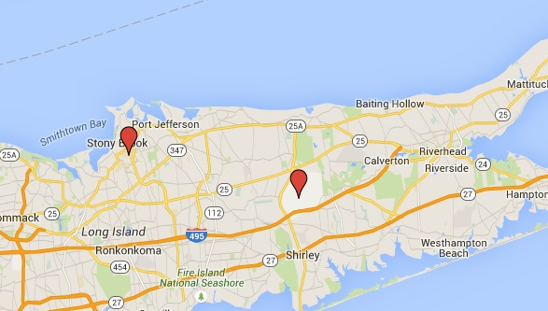
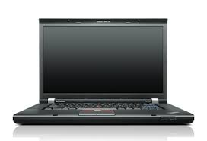
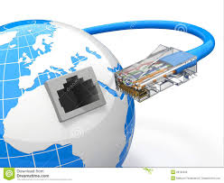




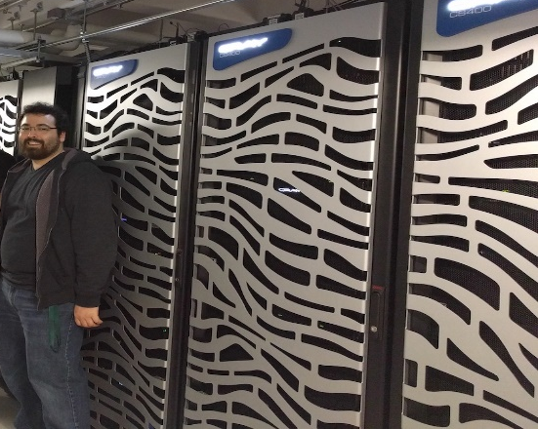




Challenge #8 HPC for MSM
Computer Resources
Around the World
13 mi
Sunway
Seawulf
Platelet
Flipping
Platelet
Modeling
Multiscale Simulations
2600 mi
7100 mi
1500 mi
Platelet Activation
Platelet
Aggregation
8000 mi
Tianhe-2
Stampede

