Slide 1



Multiscale Modeling of Blood Flow and Platelet Mediated Thrombosis:
Model Credibility Plan
Start Date: May 1, 2016
Danny Bluestein¹
Peng Zhang¹, Jawaad Sheriff¹, Prachi Gupta^{2,} Chao Gao¹, Na Zhang²,
Marvin Slepian^{3,1}, Yuefan Deng²
¹ Biomedical Engineering Department, Stony Brook University, NY
² Applied Mathematics Department, Stony Brook University, NY
³ Departments of Medicine and BioMedical Engineering, University of Arizona, AZ
IMAG 10th Anniversary Multiscale Modeling (MSM) Consortium meeting 2017 NIH, Bethesda, MD
Notes:
A Predictive Multiscale Model for Simulating Platelets Activation in Shear Flows

Slide 2
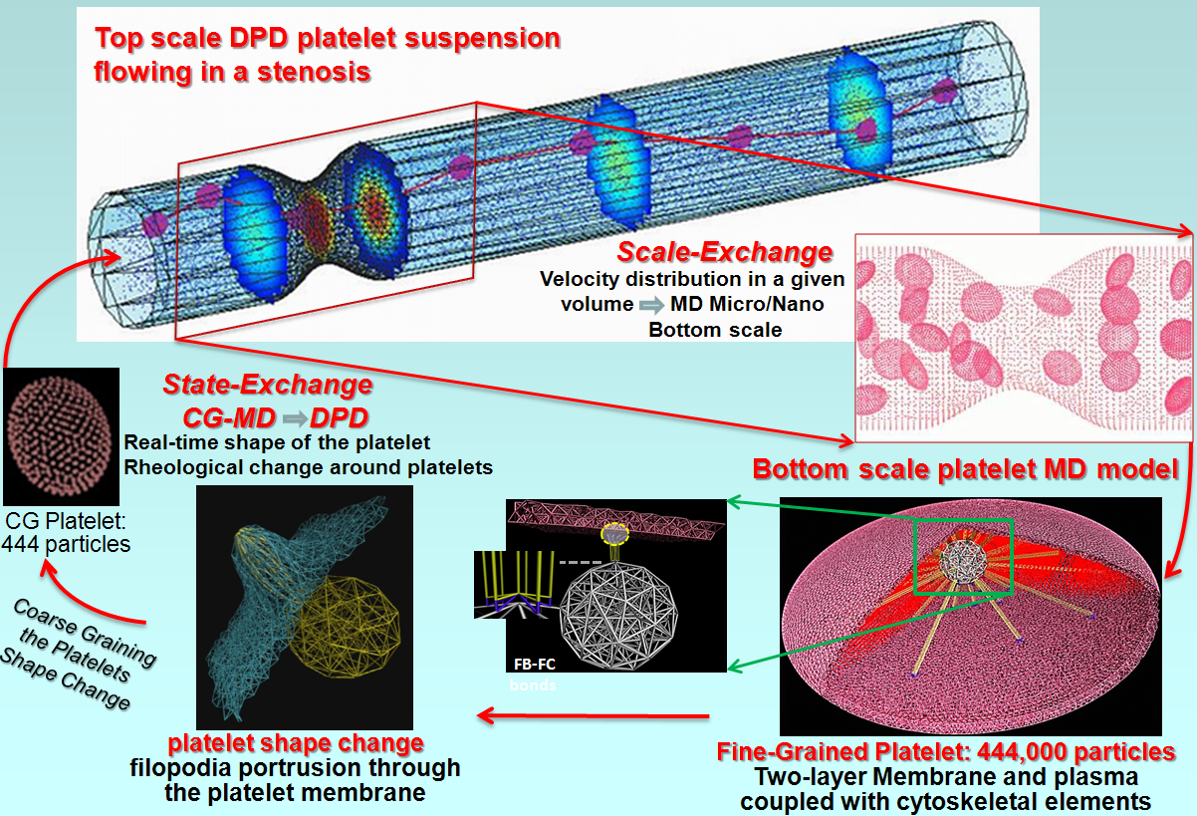
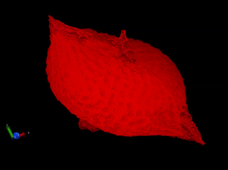
Overview of Platelet Multiscale Model
Covered Spatiotemporal Scales: Spatial nm mm Temporal ps ms
Simulation Methods Employed
  Dissipative Particle Dynamics (DPD): Flows and Blood Vessels
  Coarse Grained Molecular Dynamics (CGMD): Bilayer Viscoelastic Membrane
  Morse Potential: Viscous Cytoplasm
  Molecular Dynamics (MD): Cytoskeleton (filopods and microtubule coil)

Slide 3
Model Utility and Audience
Utility: Integrated dissipative particle dynamics (DPD) and coarse-grained molecular dynamics (CGMD) approach - bridging the gap between macroscopic transport scales and ensuing molecular events involved in platelet activation
  Model predicts changes in platelet morphology upon shear mediated platelet activation, biomechanical transduction, interaction with clotting factors, aggregation with other platelets, and adhesion to blood vessel and device surface
Audience: The model can be used by:
  Clinicians and scientists to predict initiation of arterial thrombosis under circulation conditions
  Developing new approaches for targeting mechanotransduction pathways for developing pharmacological management of thrombosis
  Cardiovascular device engineers - next generation of devices with better thromboresistance

Slide 4
Model Credibility Plan
Validation of model parameters
  Geometrical, rheological, and material properties using in vitro experiments and literature
  Shear-mediated platelet shape change using Hemodynamic Shearing Device (HSD) and scanning electron microscopy
  Flow-mediated platelet flipping, aggregation, and adhesion in microchannels with videomicroscopy
  Antiplatelet agents-induced membrane fluidity with dielectrophoresis (DEP)
Uncertainty quantification (UQ) and parameter sensitivity analysis
Independent Third Party Evaluation (3rd year onward)

Slide 5
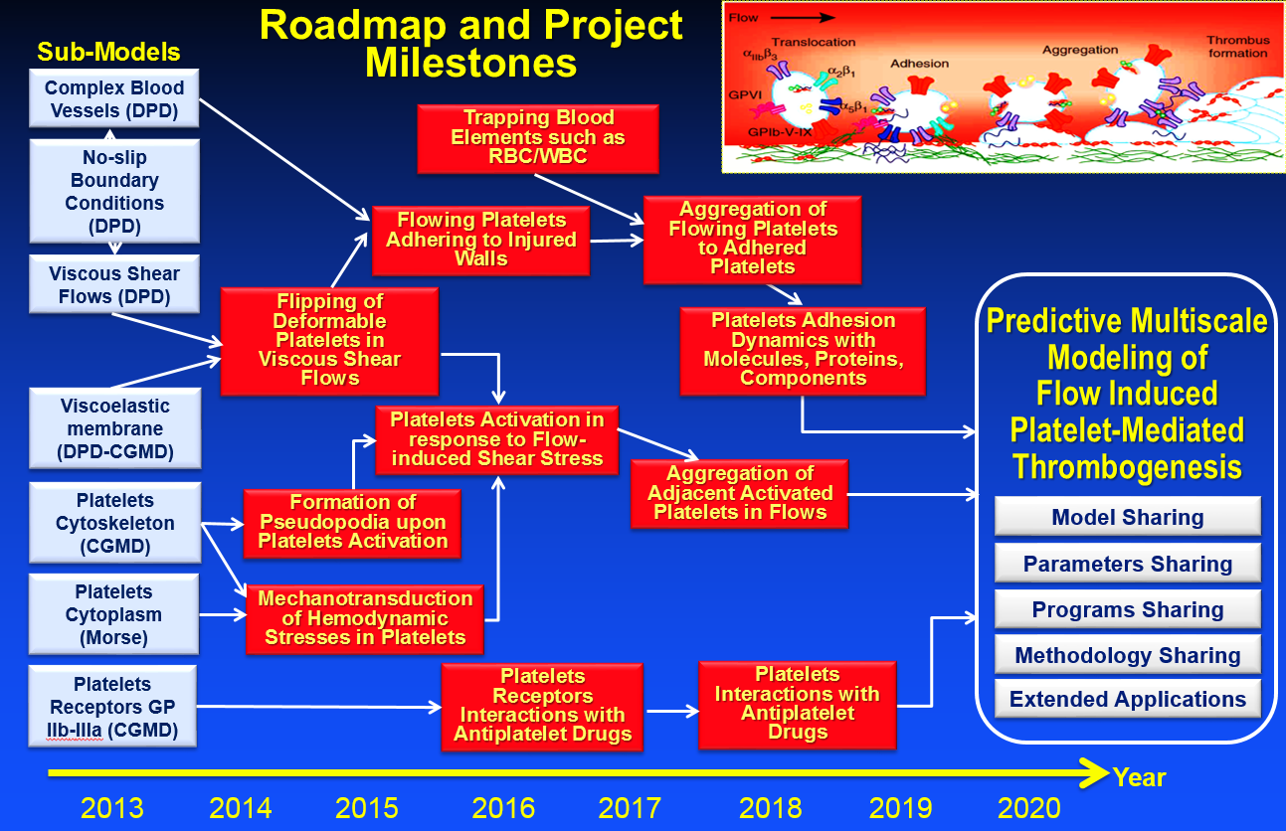
Timeline and Milestones
Project Milestones | Months
SA1 Top model of DPD of blood flow interfaced to shape change of CGMD platelet model, extending DPD flow range and scales | 0-36
SA2 Bottom fine-grained Model of platelets including subcellular components, mechanotransduction => shape change | 0-30
SA3 Modeling platelet mediated thrombosis, including membrane receptors, wall interactions, pharmacologic effects | 6-54
SA4 Experimental validation: platelet shape change database, platelet kinematics, adhesion dynamics, pharmacologic effects | 0-54
SA5 Developing tools for optimizing multiscale computational efficiency in HPC, error and sensitivity analysis, shared codes and tools | 6-60

Slide 6
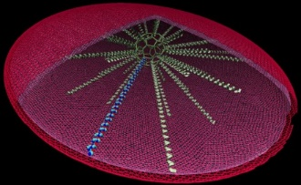
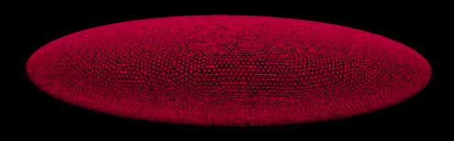
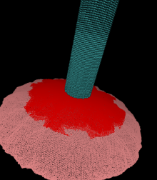
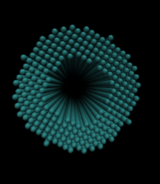
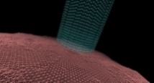
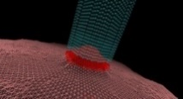
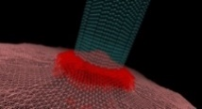
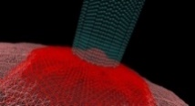
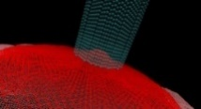
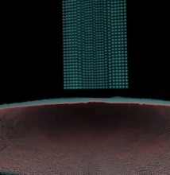
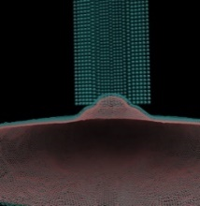
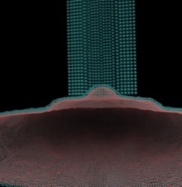
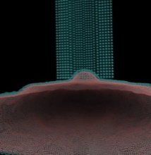
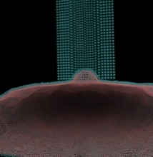


Platelet Model: Geometry, Material Properties, and Rheology
Year 1 Progress
Micropipette Aspiration Simulation:
Shear elastic modulus
(dyne/cm)
1 $μm$
External pulling force (pN)
$$4 μm$$
Experimental Parameters
Quiescent platelet geometrical measurements: scanning electron microscope (SEM) images and literature
Membrane stiffness = (2.9 ± 1.4) x 10⁻² dyne/cm: micropipette aspiration experiments (Haga, 1988)
Plasma viscosity = 1.1~1.3 mPa∙s (Kesmarky, 2008)
Cytoplasm viscosity = 4.1~23.9 mPa∙s (Luby-Phelps, 2000)
Inner pipette radius: 0.18 µm
Outer pipette radius: 0.32 µm
Length of pipette: 3.77 µm
Enlarged:
Cross section:
Increase in the pulling forces of the micropipette …

Slide 7

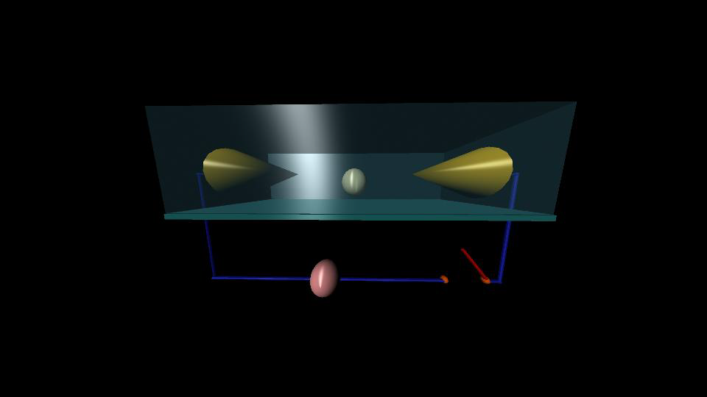
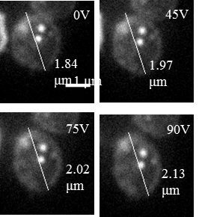
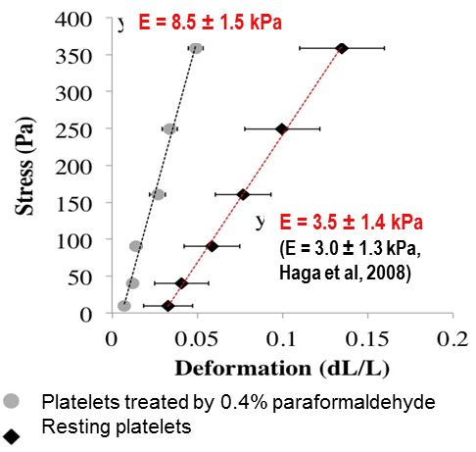
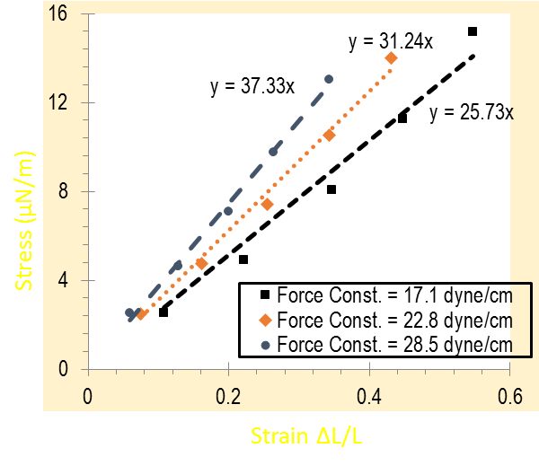
In Silico to in Vitro V&V (validation and verification)
Dielectophoresis (DEP) - Mediated Electrodeformation
No physical contact with platelets, minimal activation
Actin filament stretching experiment.
Voltage Dependent Platelet Deformation
Platelet membrane stretching simulation
Membrane stretching:
E = (1.5 ± 0.6) ×10³ dyn/cm²
Experimental (Haga et al):
(1.7 ± 0.6) ×10³ dyn/cm²
Young modulus E:
(whole platelet- including MT, cytoskeleton, cytoplasm, etc)
Notes:
Figure: Numerical experiments for testing the biophysical properties of the CGMD platelet model. Here (a) and (b) are the Green Kubo autocorrelation $C_{αβ}\left(t\right)$ and radial distribution function $g\left(r\right)$ for cytoplasm. (c) shows the membrane stretching experiment and results. (d) shows the relationship between the membrane force constant (dyne/cm) and the Young’s module (µN/m). (e) shows the platelet deformation results under the axial stretching forces. Last, (f) illustrates the schematic for the actin filament stretching experiment.

Slide 8
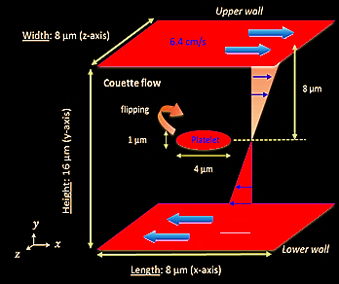
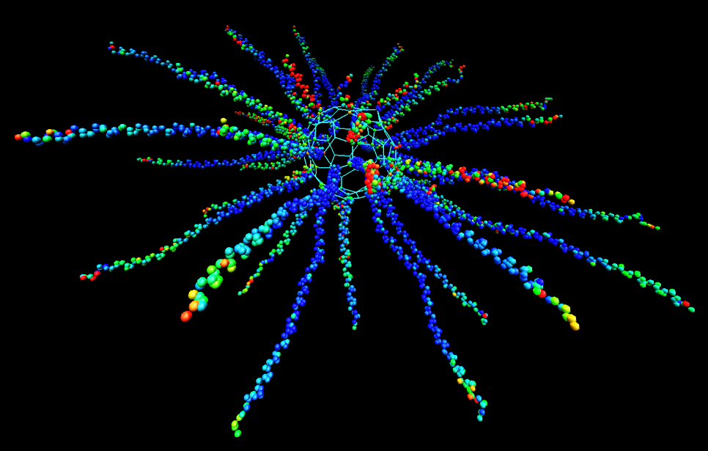
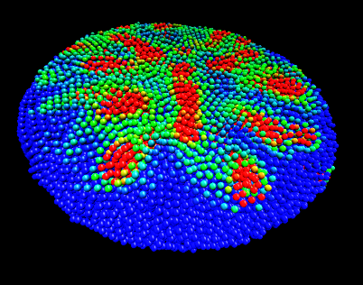
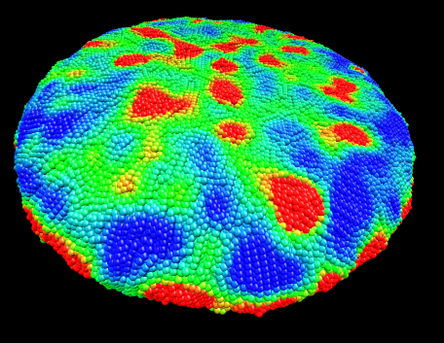

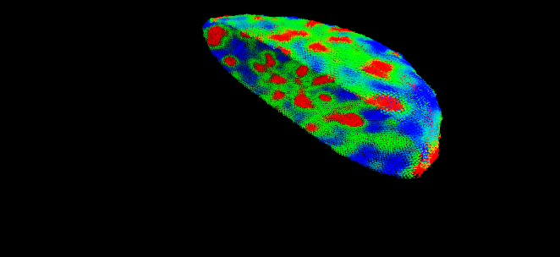
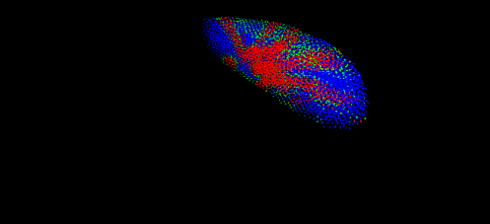
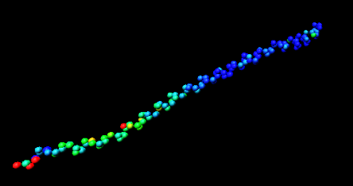
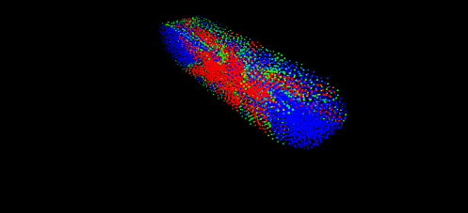
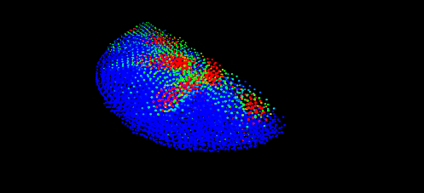
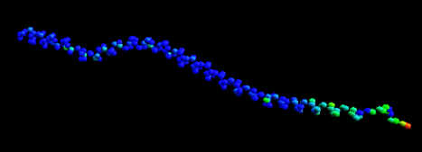
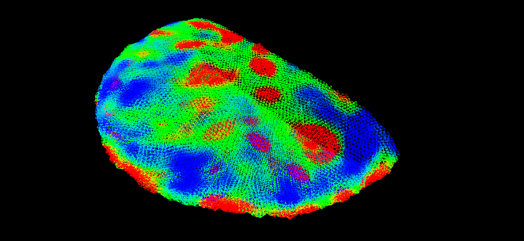
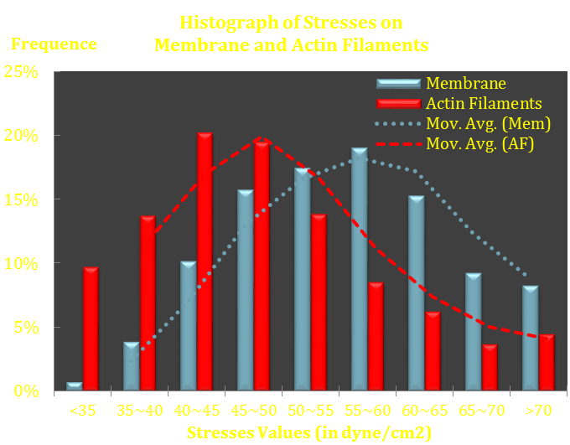
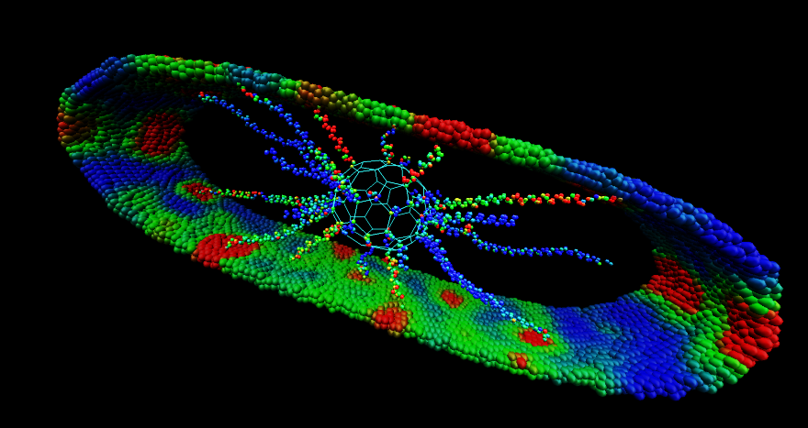


DPD and CGMD formulation, a hybrid DPD-CGMD force field interfacing the surface membrane and the flow
Dynamic Stress Distribution
on Actin Filaments
τ= 45 dyne×cm⁻²
Dynamic Stress Distribution
on the Cytoplasm
Dynamic Stress Distribution
on the Membrane
y
x
z
Mechanotransduction of Flow Stresses <=> Platelets Activation
  Stresses transduced through membrane to actin filaments
  Formation of filopodia in response to stress accumulation
Stress Distributions on Membrane and Actin Filaments (Below)
Stress Distributions on Membrane and Cytoplasm
Color Map for Stresses ($dyne∙cm^{−2}$):
40
50
60
70

Slide 9
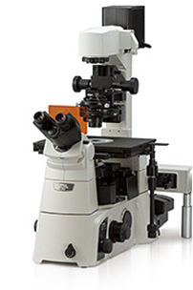
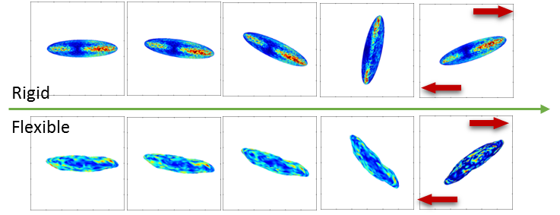
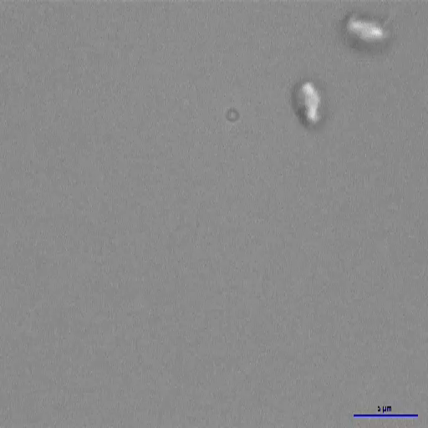
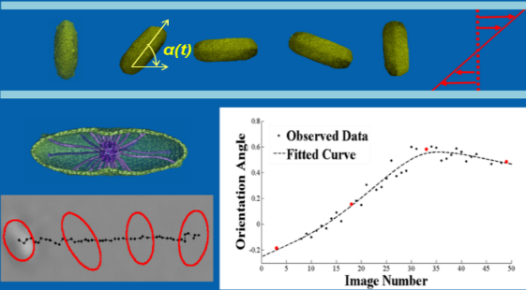
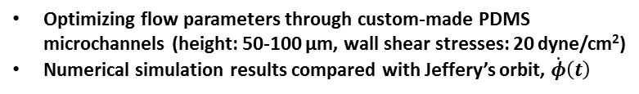
Platelet Kinematics under Flow
Experimental Validation
Simulation Results
Stress mapped on the platelet membrane
Reservoir
Gel-Filtered
Platelets
Ibidi/PDMS Microchannel
Syringe Pump
Platelet
Buffer
Video Capture in NIS Elements
Nikon DIC Microscope with
sCMOS Camera (~ 420 fps)
Model
2.6 x
τ_{w} = 5 dyne/cm²
Frame Rate: 420 fps
Duration: 5 s
Tracking in MATLAB
Shear Stress Accumulation (SA)
Flow rate and shear stress
Imaging plane location
Rotational rate/frequency
Optimizing flow parameters through custom-made PDMS microchannels (height: 50-100 μm, wall shear stresses: 20 dyne/cm²)
Numerical simulation results compared with Jeffery’s orbit, $\dot{φ}\left(t\right)$
Time (μs)

Slide 10
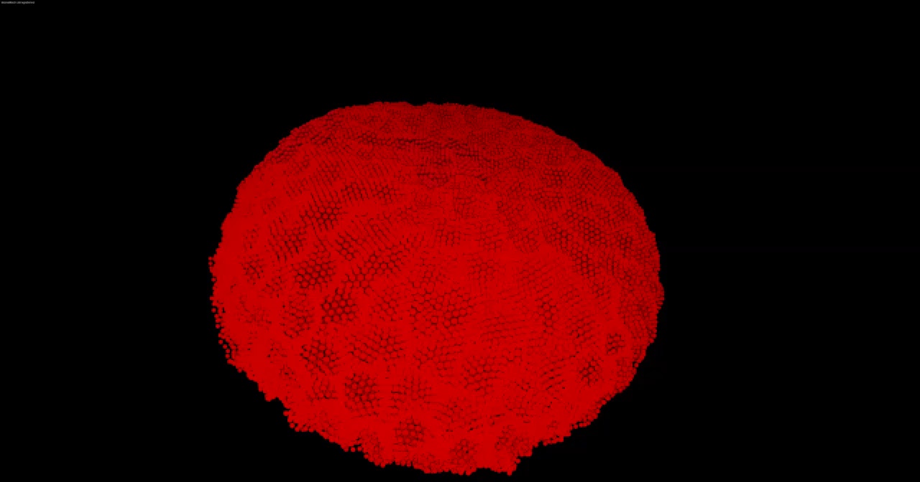
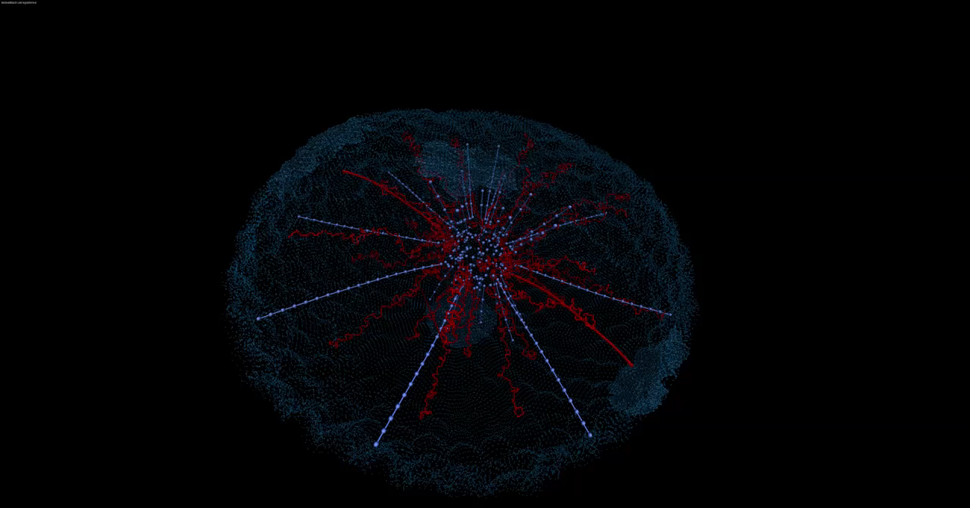
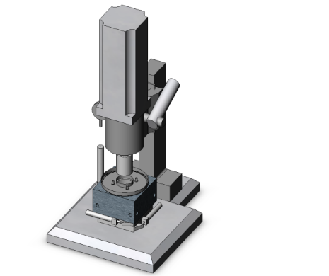
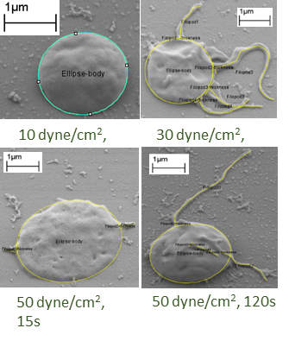
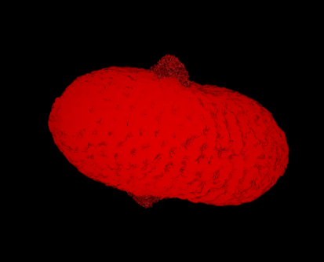
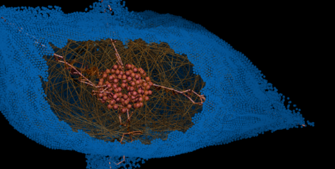
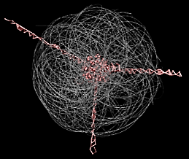


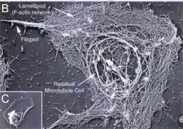
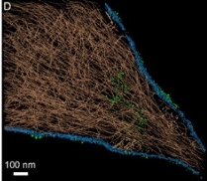

Platelet Shape Change
Experimental Validation – platelet activation database
Simulation of Platelet Activation
Filipodia formation- external
Internal- microtubule reorganization, filopodia growth
τ(t)
Scanning Electron Microscopy (SEM)
Hemodynamic Shearing Device (HSD)
Platelet Activating: Filopodial Initiation, Elongation and Stabilization
Gel-Filtered Platelets (20,000/µl in Platelet Buffer)
Activated Platelet with 2 Filopods
Image Processing in NIH ImageJ
Filopods
Filopod
A
Platelet Activation State (PAS) Assay
Filopod
Scanning Electron Microscope Image for Flow-induced Activated Platelet
Filopod
Shear Stress
Exposure Time
Image ID
Filopod Location
Circularity
Major and Minor Axis
Number of Filopods
Filopod ID
Filopod Length
Filopod Thickness
PAS
Filopods
Microtubule Coil
CGMD Platelet Model
Filopod
B
Database
A: activated platelet model predictions
Filopod
Microtubule Coil
Filopod
B: SEM of cytoskeleton reorganization in activated platelet microtubule coil and filopod (Hartwig’s book and Sorrentino et al)
Database of Geometric Measures of Activated Platelets

Slide 11
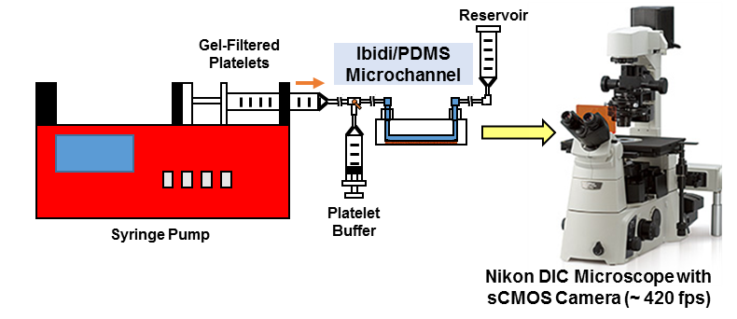
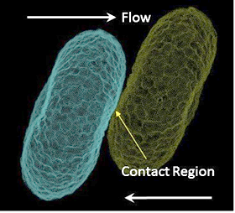


Platelet Aggregation/Adhesion Under Flow
Experimental Validation
Platelets Aggregation: Correlating with in vitro results
coated with collagen/vWF
Contact
Platelet Aggregation: We use a membrane particle to model one αIIbβ3 receptor in activated state, where two particles represent the two heads of the receptor.
Measurements in Simulations
Contact time, area, and the integral of contact time-area.
Measurements in NIH Image J
$$F\left(r_{ij}\right)=\left\{D_{0}\left(e^{−2α\left(r_{ij}−r_{0}^{R}\right)}−2e^{−α\left(r_{ij}−r_{0}^{R}\right)}\right)+f^{A}\left(t_{ij}\right)\left(1−\frac{r_{ij}}{r_{0}^{A}}\right)\right\}e_{ij}$$
Aggregate bond length
Aggregate bond time
Flow rate/shear stress
Collison
Adhesive

Slide 12
Challenges and Opportunities
Lack of techniques to observe platelet deformation, activation, aggregation, adhesion under flow conditions
Large number of model parameters in the simulations
Adapting discrete particle methods (DPD, MD) to describe continuum multiscale phenomena

Slide 13
Third-Party Evaluation Requirements (Year 3)
Uniqueness of Model Credibility Plan
Utilizes in-house equipment (HSD, DIC microscopy, and microchannel setup) to validate
  shear-mediated platelet shape change, kinematics, and
  aggregation/adhesion simulations due to lack of published data
Identifying and quantifying the dominant sources of uncertainties:
  reductionist model assumptions in expressing the true physiology;
  computing uncertainties due to mathematical function truncations and runoff resulting from finite data representations; and
  input parameter uncertainties due to limitations of experimental apparatus.
Minimizing the global uncertainties by
  ensuing the accuracy for local scales and the associated model parameters;
  smoothening the interface between scales;
  stress testing to reduce global uncertainties by adjusting algorithmic and model parameters in broad ranges; and
  collaborating with 3rd party IMAG scientists for independent verification.
Knowledge of LAMMPS molecular dynamics software
Familiar with both MD and DPD theory
Familiar with basics of platelet activation, aggregation, and adhesion
HPC resources for large multiscale simulations

