Slide 1
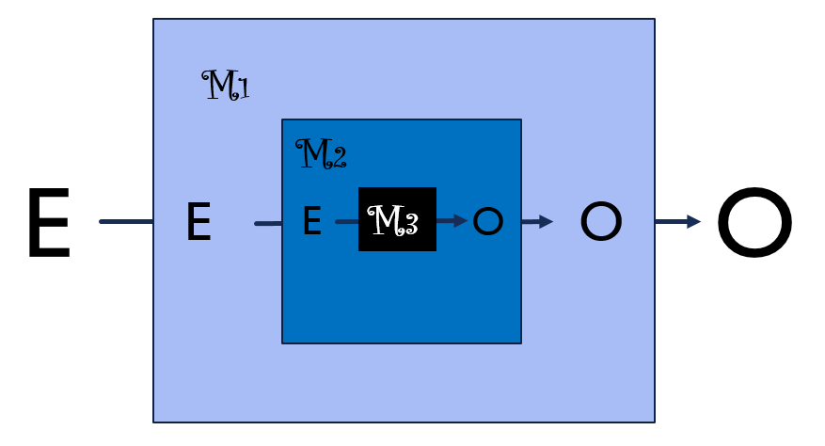

Nested Boxes
Causal-Mechanical Explanation in
Multi-Scale Modeling of Disease Occurrence
Olaf Dammann

Slide 2
Agenda
Prelude: MSM & Systems Medicine
The Big Question
My perspective(s)
Interlude: Causation and Mechanisms
Proposal: Nested Boxes
Postlude: No causes in, no causes out

Slide 3
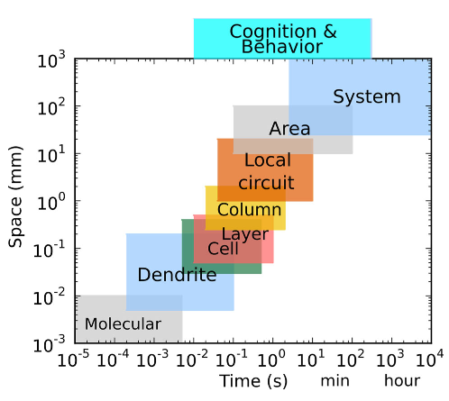
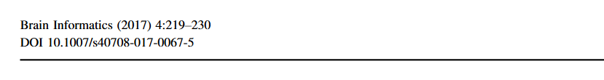
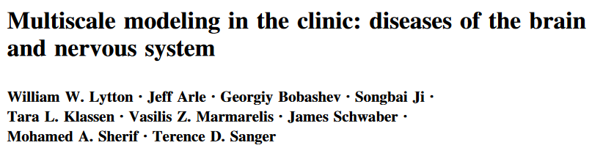
Multiscale Modeling (MSM)
Brain Informatics 2017;4:219-30

Slide 4
Multiscale Modeling (MSM)
opening the ‘‘black box’’ of disease by beginning to explain the many differences seen in patients’ (disease or therapy)
Multiscale modeling is needed because inside the black box is a complex network of interscale causal interactions.
Brain Informatics 2017;4:219-30

Slide 5
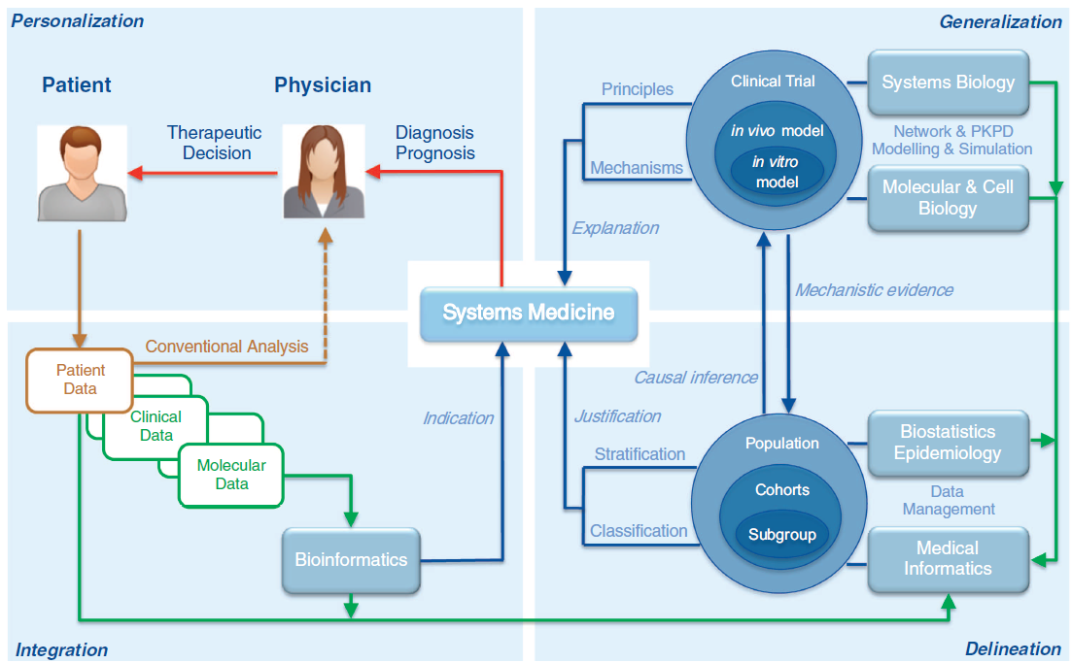
Whither Systems Medicine?
One goal of systems medicine is to explain the emergence and progression of disease phenotypes with the help of molecular, cellular, physiological and environmental data.
In ecology, physics, meteorology and engineering we already rely entirely on predictive models for decision making and understanding of underlying causal mechanisms.
We must first make inferences across multiple levels of structural and functional organization.
How this can be achieved in a rational and practical way, remains an open scientific challenge.
Exp Mol Med. 2018;50(3):e453.

Slide 6
Whither Systems Medicine?
Exp Mol Med. 2018;50(3):e453.

Slide 7
Agenda
Prelude: MSM & Systems Medicine
The Big Question
My perspective(s)
Interlude: Causation and Mechanisms
Proposal: Nested Boxes
Postlude: No causes in, no causes out

Slide 8
The Big Question
???
the overall goal is to go from understanding a biological system to predicting outcome
how to bridge from mechanistic to causal to predictive models?
-- Grace Peng, 2018

Slide 9
Agenda
Prelude: MSM & Systems Medicine
The Big Question
My perspective(s)
Interlude: Causation and Mechanisms
Proposal: Nested Boxes
Postlude: No causes in, no causes out

Slide 10
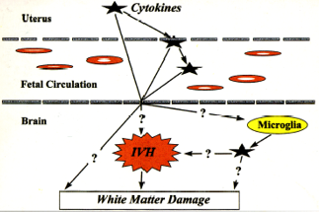
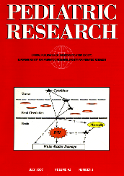
Maternal Intrauterine Infection, Cytokines, and Brain Damage in the Preterm Newborn
Pediatr Res 1997;42:1-8

Slide 11
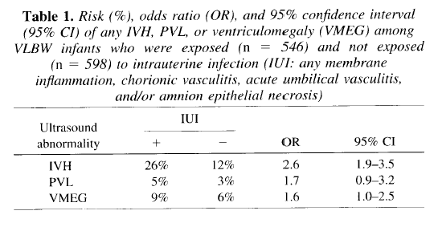
Risk Factor Epidemiology
Pediatr Res 1997;42:1-8

Slide 12
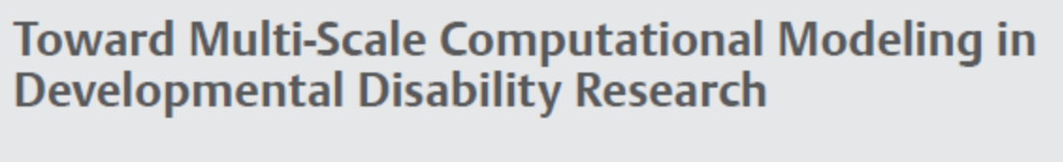
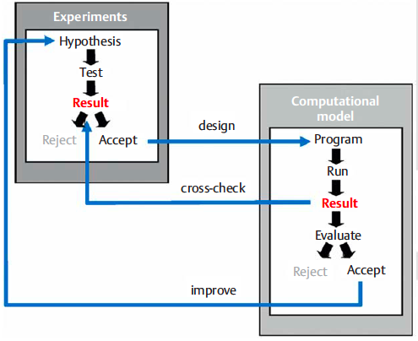

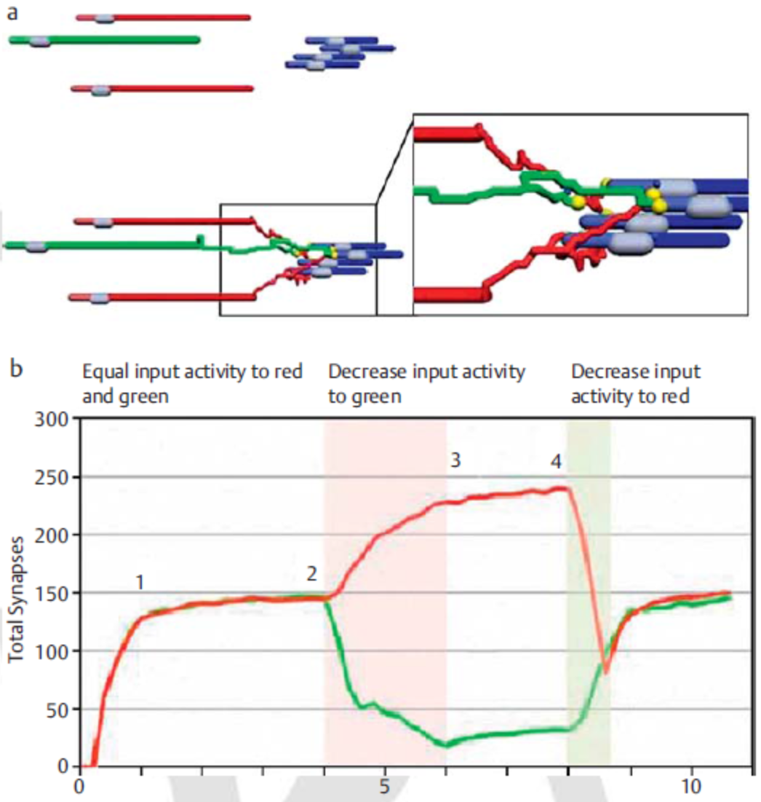
MSM in Neuropediatrics
Neuropediatrics 2011;42:90-96

Slide 13
SYSTEMS
EPIDEMIOLOGY
Online Journal of Public Health Informatics. 2014;6(3).

Slide 14

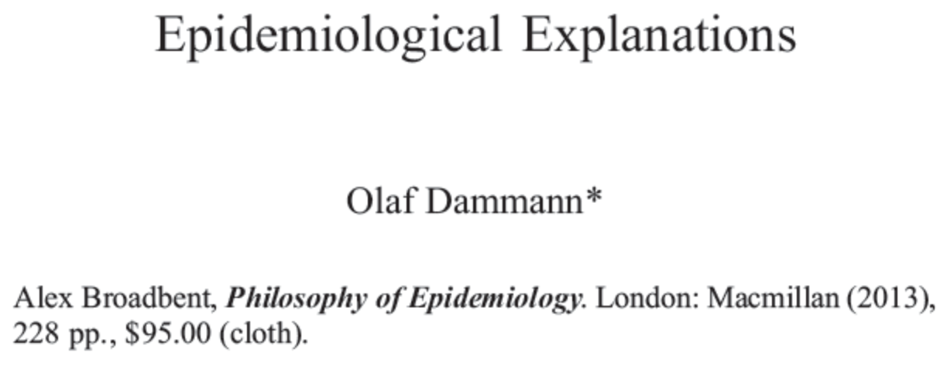
Philosophy of The Health Sciences
Philosophy of Science 2015;82:509-19

Slide 15
Explaining Illness Occurrence
What we see:
Risk Factor
Illness
What we think:
Cause
Effect

Slide 16
“Black Box Epidemiology”
M
Exposure
Outcome

Slide 17
Agenda
Prelude: MSM & Systems Medicine
The Big Question
My perspective(s)
Interlude: Causation and Mechanisms
Proposal: Nested Black Boxes
Postlude: No causes in, no causes out

Slide 18
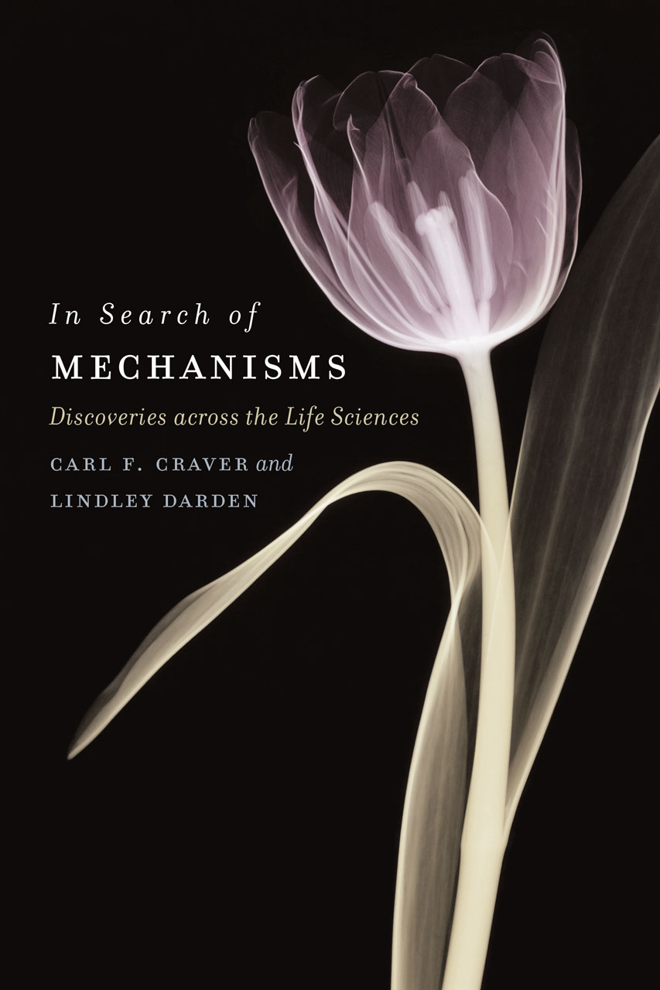
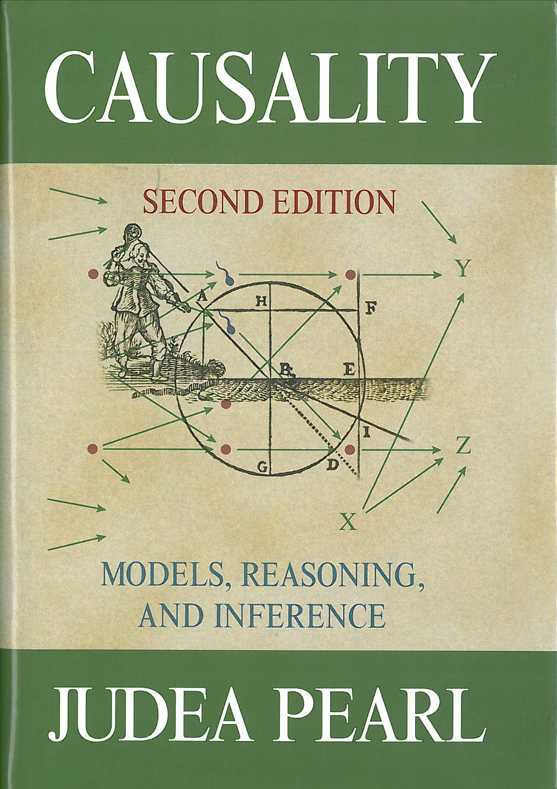

Causation and Mechanisms

Slide 19
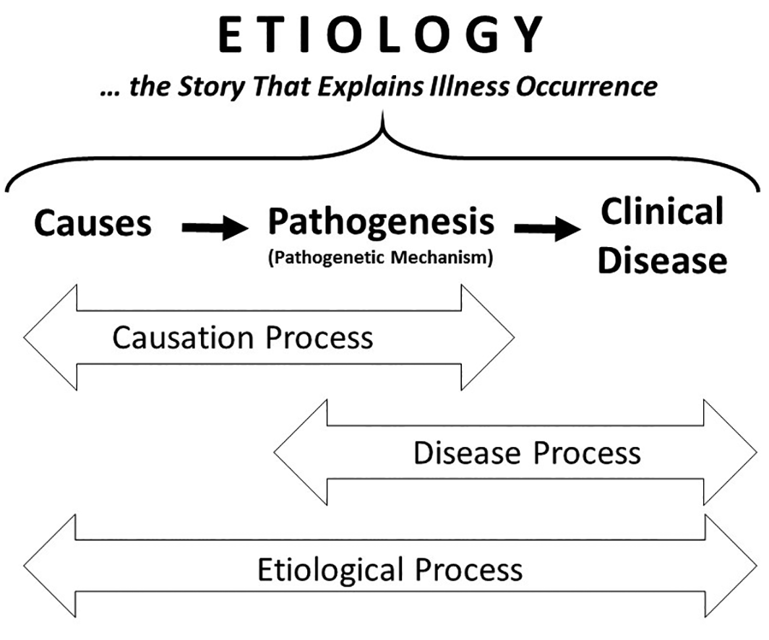
The Etiological Stance
Perspectives in Biology and Medicine 2017; 60 (2): 151–65.

Slide 20
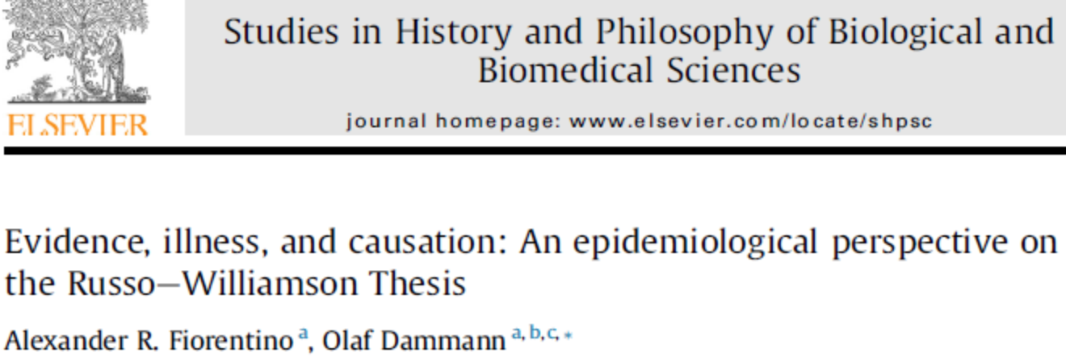
Causation and Mechanisms
RWT
RWT
Stud Hist Phil Biol Biomed Sci 2015;54:1-9

Slide 21
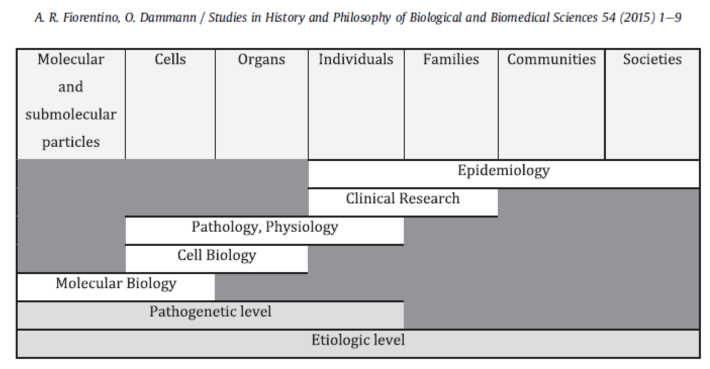
Levels of Evidence Generation

Slide 22
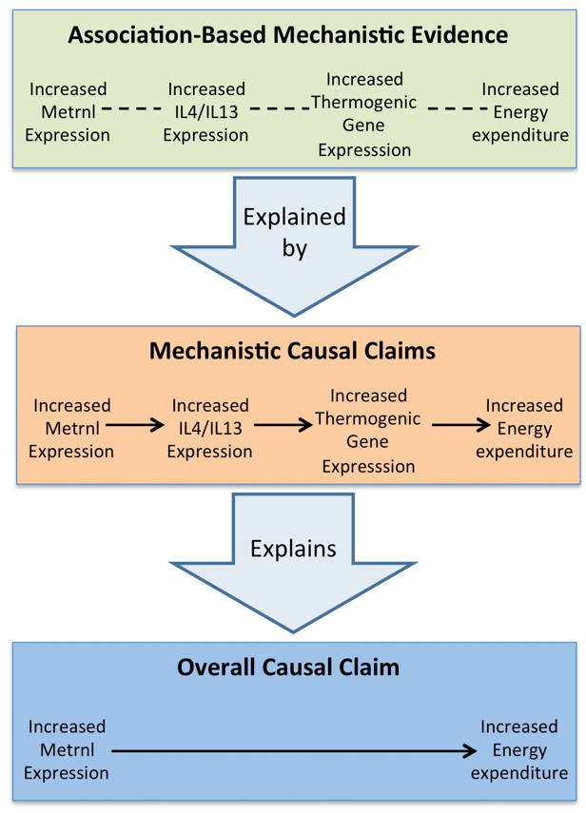
Causal-Mechanical
Explanation
Exposure
M
Outcome
Stud Hist Phil Biol Biomed Sci 2015;54:1-9
Rao et al., Cell 2014;157:1279-91

Slide 23
Agenda
Prelude: MSM & Systems Medicine
The Big Question
My perspective(s)
Interlude: Causation and Mechanisms
Proposal: Nested Black Boxes
Postlude: No causes in, no causes out

Slide 24
Nested Black BoxEs Level 1
M1
Exposure
Outcome

Slide 25
Nested Black BoxEs Level 2
M1
E
M2
O
E
O

Slide 26
Nested Black BoxEs Level 3
M1
M2
E
O
E
E
M3
O
O

Slide 27

Nested Black Boxes Analysis
Simplicity: Model M1 .. Mn using (logistic) regression, yielding odds ratios and confidence intervals
Complexity: Mediation and Interaction Analysis
OUP, 2015

Slide 28

Nested Black Boxes explanatory coherentism & ECHO
background theory for the development of explanatory systems
by integrating epidemiologic evidence with a diversity of other error-independent data
computational formalization in an explanatory coherentist framework
introduce Paul Thagard’s ECHO system
Am J Epidemiol, 2018:1-6

Slide 29
Agenda
Prelude: MSM & Systems Medicine
The Big Question
My perspective(s)
Interlude: Causation and Mechanisms
Proposal: Nested Black Boxes
Postlude: No causes in, no causes out

Slide 30

“No causes in, no causes out”
“You can indeed use statistics to extract causal information if only the input of causal information has been sufficient”
1989:13

Slide 31
Key References
Dammann O, Follett P. Toward multi-scale computational modeling in developmental disability research. Neuropediatrics. 2011;42(3):90-6.
Dammann O, Gray PH, Gressens P, Wolkenhauer O, Leviton A. Systems Epidemiology: What's in a Name? Online Journal of Public Health Informatics. 2014;6(3).
Dammann O. The Etiological Stance: Explaining Illness Occurrence. Perspect Biol Med. 2017;60(2):151-65.
Dammann O. Hill's Heuristics and Explanatory Coherentism in Epidemiology. Am J Epidemiol. 2018;187(1):1-6.
Apweiler R, Beissbarth T, Berthold MR, Bluthgen N, Burmeister Y, Dammann O, et al. Whither systems medicine? Exp Mol Med. 2018;50(3):e453.

Slide 32
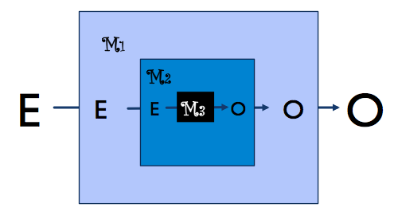
Thank you Very much!

