Slide 1
The Cancer Systems Biology Consortium (CSBC)
2015 IMAG Multiscale Modeling Consortium Meeting
September 9, 2015
Dan Gallahan, Ph.D Shannon Hughes, Ph.D
Deputy Director CSBC Program Director
DCB, NCI

Slide 2
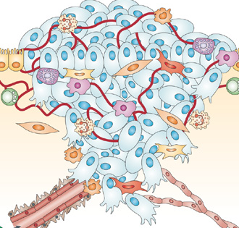
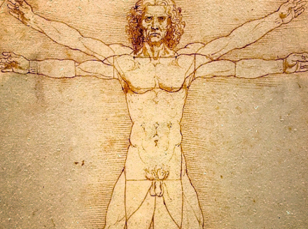
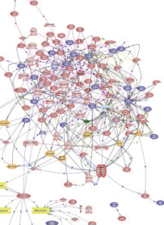
The Cancer Systems Biology Consortium (CSBC)
Purpose:
Development of predictive computational models that integrate across multiple molecular, cellular, organ and temporal scales
Building a community of researchers focused on applying systems approaches to problems in cancer biology
Cellular Interactions
Physiological Systems
Environment
Signaling Networks
Genomic Alterations
Disease development , progression and treatment
Notes:
One of the clear revelations over the past years is that cancer is a very complex disease both to understand and to subsequently treat. While the identification of cancer genes and the tumor environment have been critical in our modern understanding it is clearly not just one gene or one cell that manifests the disease. This is really the definition of a “systems” disease that analyses multiple data sources across time and space, and employing computational models to make new insights and predictions . That can then be tested and validated by rigors of experiment al biology. And that is exactly what this initiative is about utilizing the biology coupled with modeling to generate new insights and testable hypothesis. The major goals are ….
This systems approach has led to many exciting and important discoveries. A few examples..

Slide 3
Scientific Goals of CSBC
Develop predictive mathematical models that generate or test new biological hypothesis in cancer biology (U54 & U01)
Emphasize the use of multi-dimensional information to address complex cancer biology questions
Scope includes all cancer phenotypes and dynamics
Validation of models through experimental biology
Develop a consortium of multi-disciplined investigators and shared data and modeling resources to promote collaborations across and outside of the CSBC (U24)
Support outreach programs for the dissemination of outcomes and to ensure the next generation of systems biologists (U54 & U24)

Slide 4
Examples of Questions Addressable by CSBC Members:
Can epigenetic interactions be identified and their disease phenotypes predicted? Models across ‘the gap’
Can inter-cellular and stromal interactions and their functional consequences in the tumor microenvironment be modeled and predicted? Models across spatial scales
Can metastasis, metastatic niches and dormancy be modeled and predicted? Models across time
Can tumor behavior in endogenous settings be predicted and controlled by modeling multiple cell types and extracellular stimuli? Models within context
Can “–omic” features, regulatory networks and signaling networks of cancer cells be modeled to predict therapeutic response (or resistance)? Identify novel critical mutations?

Slide 5
CSBC Organization
U54
U24
U01
CSBC Research Centers (U54: RFA-CA-15-014)
First application date: November 20, 2015
A centers program supporting research and providing infrastructure in cancer systems biology including outreach activities and research resources for the community
Specialized Research Grants (U01)
Currently Active: Collaborative Research in Integrative Cancer Biology (U01) PAR-13-184, New announcement Spring 2016
Focused on specific problems in basic and clinical cancer research without incorporating the entire infrastructure required of a full center
CSBC/PS-ON Coordinating Center (U24: RFA-CA-15-015)
First application date: November 20, 2015
Responsible for coordination of: Resource curation and availability; Trans-Consortium collaboration pilot project fund; Overall outreach efforts
PSON
Notes:
The 3 components of the PAR that make up the CSBC would be….

Slide 6
Physical Sciences-Oncology Initiative
GOAL: support and nurture transdisciplinary environments and research integrating the perspectives of physical scientists (e.g., engineers, chemists, computer scientists, mathematicians, physicists) and cancer researchers to address fundamental questions in cancer research using approaches and theories from the physical sciences.
Originate and test novel, non-traditional physical sciences-based approaches to understanding and controlling cancer
Generate orthogonal sets of physical measurements and integrate them with existing knowledge of cancer
Develop and evaluate theoretical physics approaches to provide a comprehensive, dynamic picture of cancer

Slide 7
Physical Sciences-Oncology Initiative Research Areas
The Physical Dynamics of Cancer
Overview: Physical properties such as bioelectric signals, transport phenomena, mechanical cues, and thermal fluctuations may regulate initiation and progression.
Relevant Physical Science Approaches: Precision measurements on single-cells and bulk samples, high-dimensional analysis, computational physics
Spatio-Temporal Organization and Information Transfer in Cancer
Overview: Organization of structures across all length scales (e.g., subcellular, cell, tissue, organ) and time scales is required for maintaining the transfer of information that is critical for controlled growth.
Relevant Physical Science Approaches: Advanced imaging and measurements, tissue mimetic and engineering, computational physics

Slide 8
Funding Opportunity Announcements for the Physical Sciences - Oncology Network
Physical Sciences-Oncology Centers (PS-OC) (U54) -- PAR-14-169
U54 mechanism up to $1.5M (DC)/year per center
2-3 Projects/Center
Education/Outreach Unit
Pilot/Trans-Network Projects
3 Receipt Dates – June 9, 2014; February 26, 2015 ;
November 25, 2015
Contact: Sean.Hanlon@nih.gov
Physical Sciences-Oncology Projects (PS-OP) (U01) -- PAR-15-021
U01 mechanism up to $500K (DC)/year per center
1 Project
Pilot/Trans-Network Projects
6 Receipt Dates – February 26, 2015 ; November 25, 2015;
May 26, 2016; September 21, 2016; May 26, 2017; September 21, 2017
Contact: Nas.Kuhn@nih.gov
U54
U01
U01
Transnetwork
Collaborations
U54
U54
U01

Slide 9
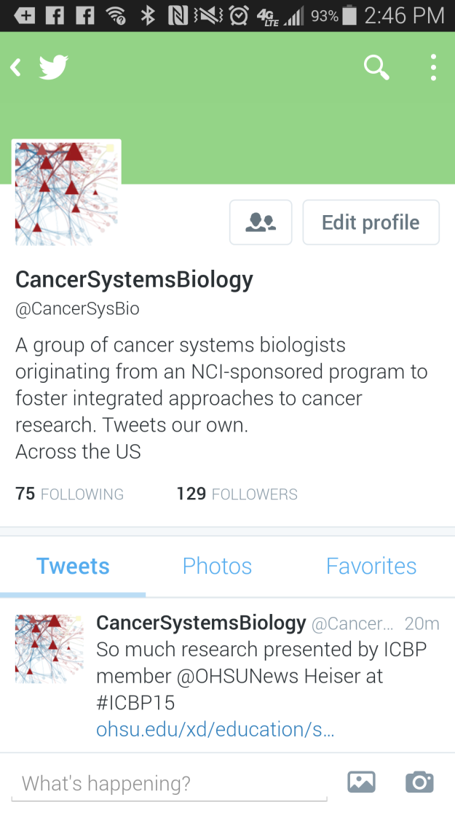
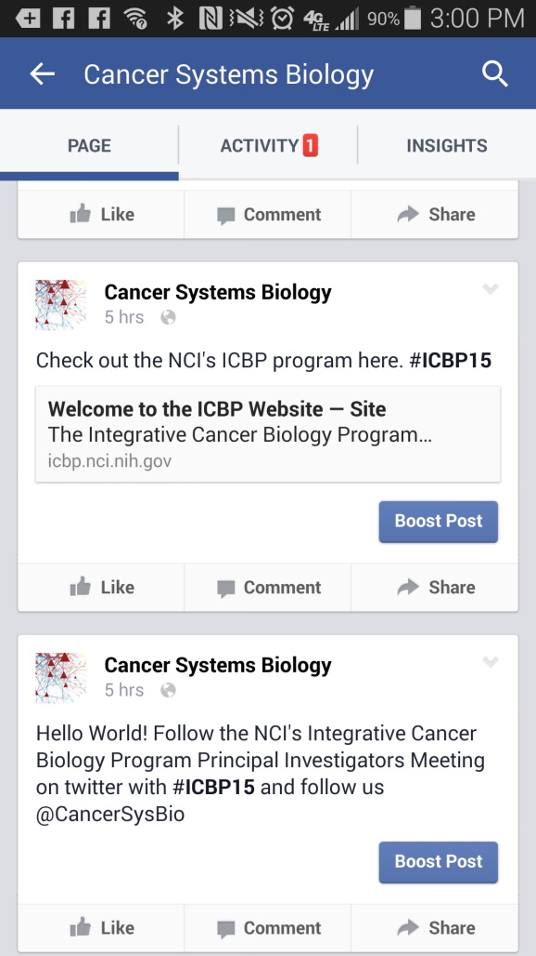
Association of Early Career Cancer Systems Biologists (ECCSB)
Purpose:
Build a larger cancer systems biology community starting from scientists trained as part of the Integrative Cancer Biology Program.
Help ESIs grow a network of like-minded scientists and promote advances by young investigators in the field
facebook.com/CancerSysBio
twitter.com/cancersysbio
@CancerSysBio
Contact: Tenley Archer (tenley@broadinstitute.org)

Slide 10
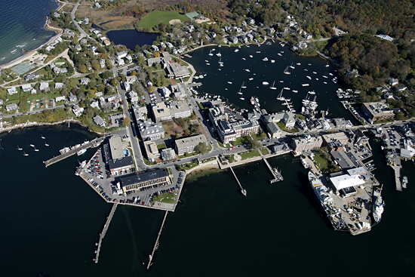
2016 Systems Approaches to Cancer Biology
Hosted by the ECCSB: April 3-6 2016
Conference Chairs:
Elaine Mardis, WUSTL
Joe Gray, OHSU
Doug Lauffenburger, MIT
Scientific Tracks (Posters & Talks):
Migration & metastasis
Tumor heterogeneity
Tumor-host interaction
Signaling networks in cancer
Systems pharmacology
Translational applications of systems biology
Cancer genomics and gene regulation
In Cape Cod, Massachusetts
Look for a conference announcement early Fall 2015

Slide 11
For questions or further information about funding opportunities contact: Shannon Hughes Shannon.Hughes@nih.gov

