Slide 1
Introducing the Center for Reproducible Biomedical Modeling

Slide 2
Reproducibility
MIASE Definition¹
Repeatability
The closeness between independent simulations performed with the same methods on identical models with the same experimental setup.
Reproducibility
The closeness between independent simulations performed with the same methods but with a different experimental setup.
¹Minimum Information About a Simulation Experiment. PLoS Comp Bio, April 2011, Waltemath et al

Slide 3
Overall Objective of the Center
To help journals publish reproducible models.
Encourage reproducibility of model construction, simulation and validation.
Key element: Standards, software and informatic resources will be developed through third-party collaboration.

Slide 4
Structure
Administrative Umbrella
TR&D 1: Data
Services
TR&D 2: Informatics
Driving
Projects
TR&D 3: Simulation
Training
TR&D: Technology Research & Development

Slide 5
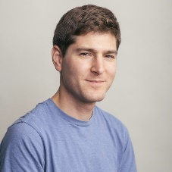
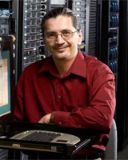
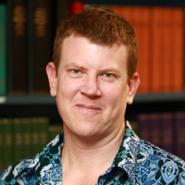
Center Researchers
Mount Sinai: Standardizing data integration, collection and conversion to models.
Jonathan Karr
Herbert Sauro
TR&D 1
UW: Informatics, Outreach,
Project management.
Herbert Sauro
John Gennari
TR&D 2
UConn: Simulation, Visualization.
Ion Moraru
TR&D 3
New Zealand: Model curation,
Journal service.
David Nickerson

Slide 6
BIOMEDICAL DOMAINS
Initially:
Systems Biology
Neurophysiology
Future:
Multicellular systems
Biomechanical systems

Slide 7
Software Products
For the geeks in the audience:
BSD, Apache 2, MIT licenses
All code held on GitHub Repositories
Python, C/C++, Javascript, Java (maybe)
Python access to as much code as possible
Reusable code
Turn-key installations for web based applications

Slide 8
What we won’t do
What we won’t be doing:
We won’t be developing any new simulators, we can however assist in hardening existing simulators.
No new model repositories – we will use existing centers, eg Biomodels, CellML repository.

Slide 9
Technology integration overview

Slide 10
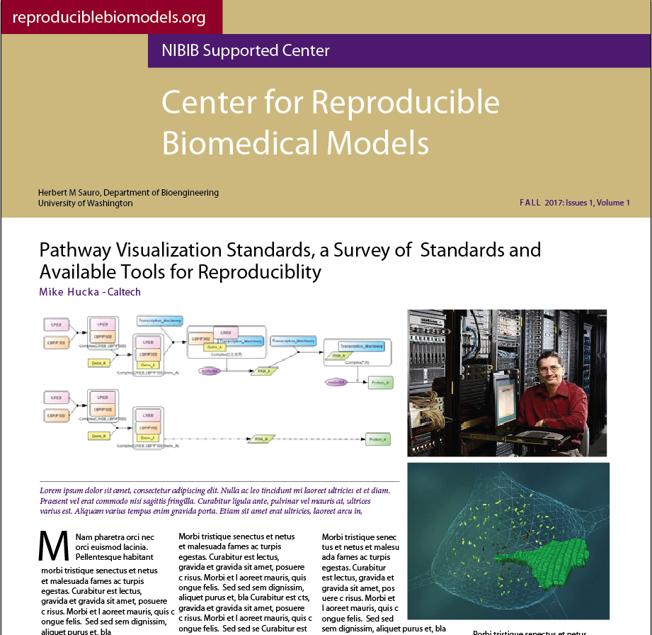
Training and dissemination
Web Site
Modeling Competitions in Collaboration with DREAM,
Biannual Newsletter
Workshops

Slide 11
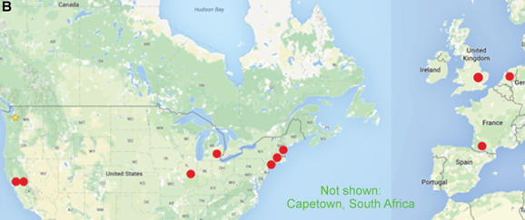
Collaborative projects Driving Projects
Collaborative projects
No. | Title | PI(s) | TR&D
1 | MiniCell - A model-driven approach to minimal cell engineering for medicine | Blanchard, Karr, Lartigue, Lluch-Senar, Serrano, & Stülke | 1
2 | Multiscale, systems modeling of macrophage infection | Covert, Huang, Monack, & Peirce-Cottler | 1
3 | Toward whole-cell models for precision medicine | Birtwistle, Karr, & Wang | 1
4 | The physiological systems dynamics | Beard & Carlson | 2
5 | Multiscale mechanistic simulation of acetaminophen-induced liver injury | Sluka & Glazier | 2
6 | New annotation technology for BioModels | Harmjakob | 2
7 | Refactor JWS Online to allow new backend simulators and simpler redeployment | Snoep | 3
8 | Model annotation and online interactive simulation for Virtual Cell | Loew | 2, 3
9 | Online interactive simulation for BioModels | Hermjakob | 3

Slide 12
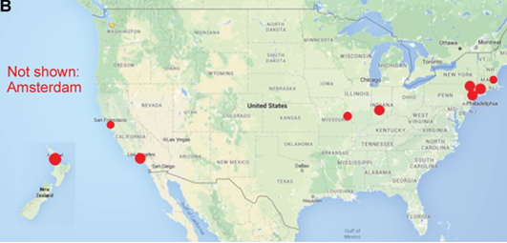
Service projects
Service projects
No. | Title | PI(s) | TR&D
1 | CompuCell3d – Modeling the behavior of multi-cell biological systems using a multi-scale approach | Glazier | 1
2 | Alzheimer modeling simulation support | Bouteiller | 1
3 | Model annotation and curation for PHYSIOME | Hunter | 2
4 | Model annotation, curation, and visualization for Biophysical Journal | Loew | 2, 3
5 | Browser-based simulation and visualization for PRIME | Sealfon | 2, 3
6 | Browser-based simulation and visualization of cell regulatory networks | Iyengar | 3
7 | Online interactive simulation for Cell Systems | Mak | 2, 3
8 | Elucidating Paramyxovirus Pathogenesis | tenOever & Lee | 1
9 | Model provenance and results analysis for Simtk | Ku | 1, 3
10 | Interactive online simulation for Elsevier | Cleeren | 3

Slide 13
Journal Support Last but not least
Of critical importance to the center is working with journals to publish reproducible models.
We have six journals that have expressed interest in collaborating with the center.
We would also love to see PubMed support models accessible from papers, including preprint services such as biorxiv.org
The curation service will work with journals to curate models that authors submit to the journals. Eventually we hope journals will mark papers where the models have been verified as reproducible.

Slide 14
Want to know more?
http://reproduciblebiomodels.org/
Any questions:
hsauro@uw.edu

Slide 15
TR&D 1: Model building Reproducibly Gather Data
A framework for reproducibly aggregating input data
Software tools for reproducibly aggregating data for biochemical models
An input data storage system including APIs and GUIs
A system for reproducibly generating SBML/Other-encoded biochemical models from input data

Slide 16
TR&D 2: Model and simulation annotation Schemas for simulation experiments, simulation results, and model validations

Slide 17
TR&D 3: Online simulation and visualization Web portal
Key Points: Will use existing third-party simulators as plugins.
Will be easily hostable by third-parties, eg Journals.

Slide 18
Services Model Curation Service for Journals and Individuals

