Slide 1
Virtual Population for Obesity Prevention (VPOP) Labs: Computational, Multi-Scale Models for Obesity Solutions
Bruce Y. Lee, MD, MBA
Associate Professor of International Health
Executive Director, GOPC
Email: brucelee@jhu.edu
Grant: U01HD086861
9/27/15-7/31/20

Slide 2
Intended Audience
For obesity prevention and control, simulation models can serve as “Virtual Population Laboratories” (VPOP Labs) for decision makers in a community, city, or region to:
Determine the factors and relationships that may be leading to obesity
Forecast future scenarios and impact
Design and plan obesity-related policies and interventions
Assess the potential impact of policies or interventions, including their potential secondary and tertiary effects and unintended consequences
Guide and prioritize data collection by identifying data gaps and demonstrating the effects of having better information

Slide 3
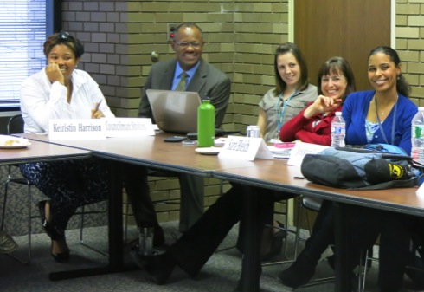
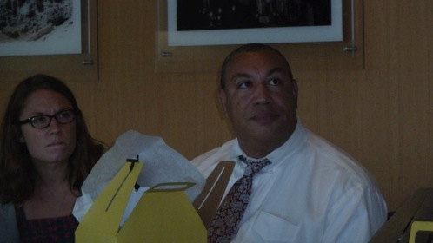
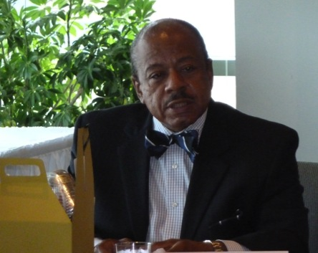
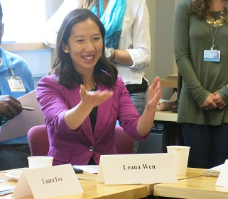
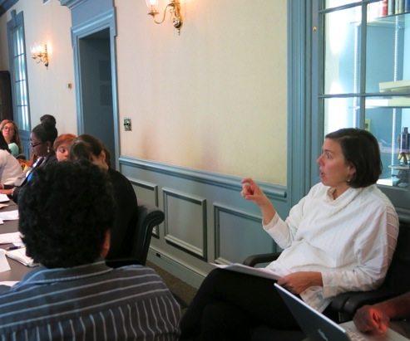


Baltimore and New York City Stakeholder Working Groups
  City Council
  City Health Department
  Baltimore City Public Schools
  Family League
  Recreation and Parks
  Wholesalers
  Retailers
Baltimore City Councilman Carl Stokes
Baltimore City Councilman Bill Henry
Former Baltimore City Councilman Pete Welch
Baltimore City Health Commissioner Leana Wen
Baltimore City Food Policy Director Holly Freishtat
Notes:
Since out kick-off in July 2013, we’ve held 5 meetings with city stakeholders
We have over 30 working group members who attend our quarterly meetings, and they represent various sectors including…{read off list}

Slide 4
Concurrent Studies

Slide 5
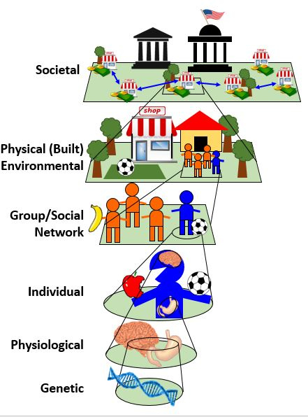
Timeline and Milestones – Part 1 (Years 1-3)
Validate combined Scales 3 (Individual) and 5 (Physical (Built) Environmental) by comparing measured agent activities with daily activity data (e.g., movement, food choices, and physical activity).
Determine how well combined Scale 3, 4, and 2 (Physiologic) model can replicate historical BMI changes.
Compare Scale 4 (Group/Social Network) alone with available data on social connections.
Determine Scales 2-5 combined ability to replicate both daily activity data and BMI change over time data.

Slide 6
Timeline and Milestones- Part 2 (Years 3-5)
Determine how well Scale 6 (Societal) alone can replicate historical data on how the different neighborhoods for Baltimore, Pennsylvania, and NYC have evolved over time.
Validate Scale 1’s connection with the BMR and satiety separately (using literature and epigenetic data) and then integrating into rest of model and determining how well predicts expected variance from genetic diversity.
Compare results from intervention experiments with emerging results from actual implementation of the interventions.

Slide 7
Year 1 progress of Model Credibility Plan
Validate combined Scales 3 (Individual) and 5 (Physical (Built) Environmental) by comparing measured agent activities with daily activity data (e.g., movement, food choices, and physical activity).
Determine how well combined Scale 3, 4, and 2 (Physiologic) model can replicate historical BMI changes.
Replicate historical overweight and obesity prevalence (e.g., Baltimore City: Demographics and Social Determinants of Health).
Replicate daily average caloric intakes of particular items, e.g., SSB consumption (Kit BK, et. al. The American journal of clinical nutrition 2013).

Slide 8
Challenges and Opportunities
Challenge: Different scales have very different types of validation data and associated limitations
Opportunity: Identify gaps, cross-learning opportunities and new ways of harmonizing data
Challenge: Validation data comes from different samples, locations, and time frames
Opportunity: Better understand variability and robustness
Challenge: Model descriptions, presentations, visualizations, etc. must be digestible by wide range of decision makers including the general public.
Opportunity: Engage decision-makers and improve translation
Challenge: Testing policies and interventions that have not been implemented yet
Opportunity: Shape policies and interventions

Slide 9
Uniqueness of Model Credibility Plan
Involve multiple stakeholders
Develop new translation and communications approaches to new sets of stakeholders
New approach to obesity
Pairing of other studies
Iterative engagement process

Slide 10
A systems approach iteratively brings together various disciplines, stakeholders, and methods
Convene Multi-disciplinary Teams
Elucidate Important Factors and Relationships
Create Mathematical and Computational Models to Represent System
Guide and Prioritize Data Collection
Inform Stakeholders
Test Different Policies and Interventions
Update Models
Design and Implement Interventions
Data and results

Slide 11
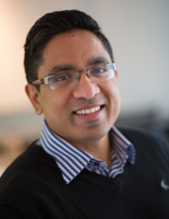
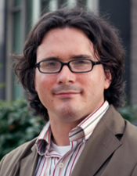
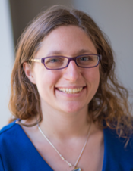
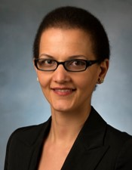
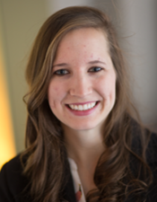
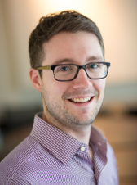
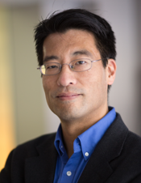
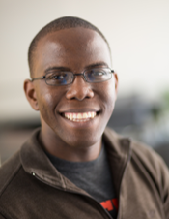
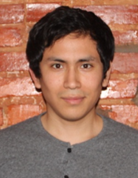
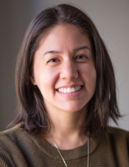
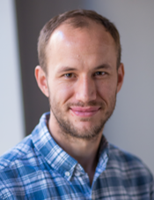

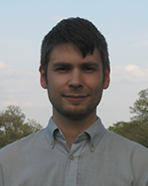

Systems Science Core Team
Atif Adam, MD Shawn Brown, PhD Molly Domino, BA Saeideh Fallah-Fini, PhD Marie Ferguson, MSPH Daniel Hertenstein, BS Bruce Y. Lee, MD, MBA
Sindiso Nyathi, BA Mario Solano Gonzalez, BS Marie Spiker, MSPH, RD Patrick Wedlock, MSPH Michelle Wong, BS Eli Zenkov, BS

Slide 12
Questions and Discussion
Thank you!
www.globalobesity.org
globalobesity@jhu.edu
brucelee@jhu.edu

