Slide 1
2018-2019 Mid-Term Credibility Plan Review
Presented by: Jerry Myers
On behalf of the Committee on Credible Practice of Modeling & Simulation in Healthcare
https://simtk.org/home/cpms
cpmsinhealthcare@gmail.com

Slide 2
Mid-term Credibility Plan Review
Feedback from the 2018 IMAG-MSM meeting identified the need for more consistent communication of model credibility status
In Response CPMS Initiated “Mid-term Review” of credibility status based on the CPMS Ten Simple Rules
Goals :
Improve communicating credibility plan progress
Opportunity to practice communicating credibility
Relate credibility activities to model contextual use
Evaluate tools to promote credibility communication

Slide 3
Ten Simple Rules
Ten Simple Rules
R1 - Define context clearly | R6 - Document adequately
R2 - Use appropriate data | R7 - Disseminate broadly
R3 - Evaluate within context | R8 - Get independent reviews
R4 - List limitations explicitly | R9 - Test competing implementations
R5 - Use version control | R10 -Conform to standards
https://www.imagwiki.nibib.nih.gov/content/committee-credible-practice-modeling-simulation-healthcare-description
Notes:
Down selected from 26 proposed factors and reviewed by community surveys.

Slide 4
Request to IMAG-MSM U01 Grantees
Utilizing the CPMS Ten Simple Rules for Model and Simulation Credibility
Details on credibility plan actions
Summary activities table classified within the CPMS TSR
Description of information gained by each action
Issues/concerns in achieving the standard of credibility
Plans for the next reporting cycle
Identify other factors that contribute to credibility
Notes:
Sent out 8/28/2018; requested by 10/1/2018; collected on 10/8/2018 Details regarding Model Credibility Plan following the CPMS Ten Simple Rules (TSR) List of Model Credibility Plan actions Description of information gained by each action Summary table of activities classified within the CPMS TSR framework Explicitly state why a factor is not being implemented Explain how completed and planned activities lead to a credible model Plans for the next reporting cycle (6 months) Issues/concerns in achieving the standard of credibility Identify other factors that contribute to credibility

Slide 5
Review Scope
The reviewers:
DID NOT
DID
Assess the implemented credible practice or research progress of the M&S projects
CPMS TSR
Opinion: communication sufficiency of credibility plans and accomplishments
Identify areas of improvement of the reporting / review process
Recommend credibility topic areas for discussion in IMAG/MSM community
Notes:
The reviewers DID NOT perform an assessment of the implemented credible practice of the M&S projects.
Do not associate the scoring with the credibility of individual studies.
The reviewers DID:
Provide an opinion on the sufficiency / insufficiency of the communication of plans and accomplishments wrt the CPMS-TSR
Identify areas of improvement of the reporting / review process
Identify credibility topic areas recommended for further discussion in IMAG/MSM community

Slide 6
Reviewers Scoring Rubric For Each TSR
Sufficient
Path toward evidence of this factor/rule appears to be sufficient
Insufficient
Path toward evidence of this factor/rule appears to be insufficient
Not Available
No evidence is described or an argument is made that the credibility factor did not apply
Ancillary evidence and provided development history could be considered in assessing sufficiency of communicating content in each TSR factor
Notes:
Sufficiently Described - Path toward evidence of this factor/rule appears to be sufficient
Insufficiently Described - Path toward evidence of this factor/rule appears to be insufficient
Not Available - No path toward evidence is described or an argument is made that the credibility factor did not apply to this model
Reviewers could supply any or no comments with respect to the scoring. In most cases comments were supplied.

Slide 7
Review Overview
35 Credibility Plan Mid-Term Updates Submitted
100% of submissions with 1 review
85% of the submissions with 2 reviews
11/20/2018: Outbrief IMAG-MSM Steering Committee
12/18/2018: All feedback posted to IMAG Wiki
Notes:
This slide can be skipped of skimmed to save presentation time

Slide 8
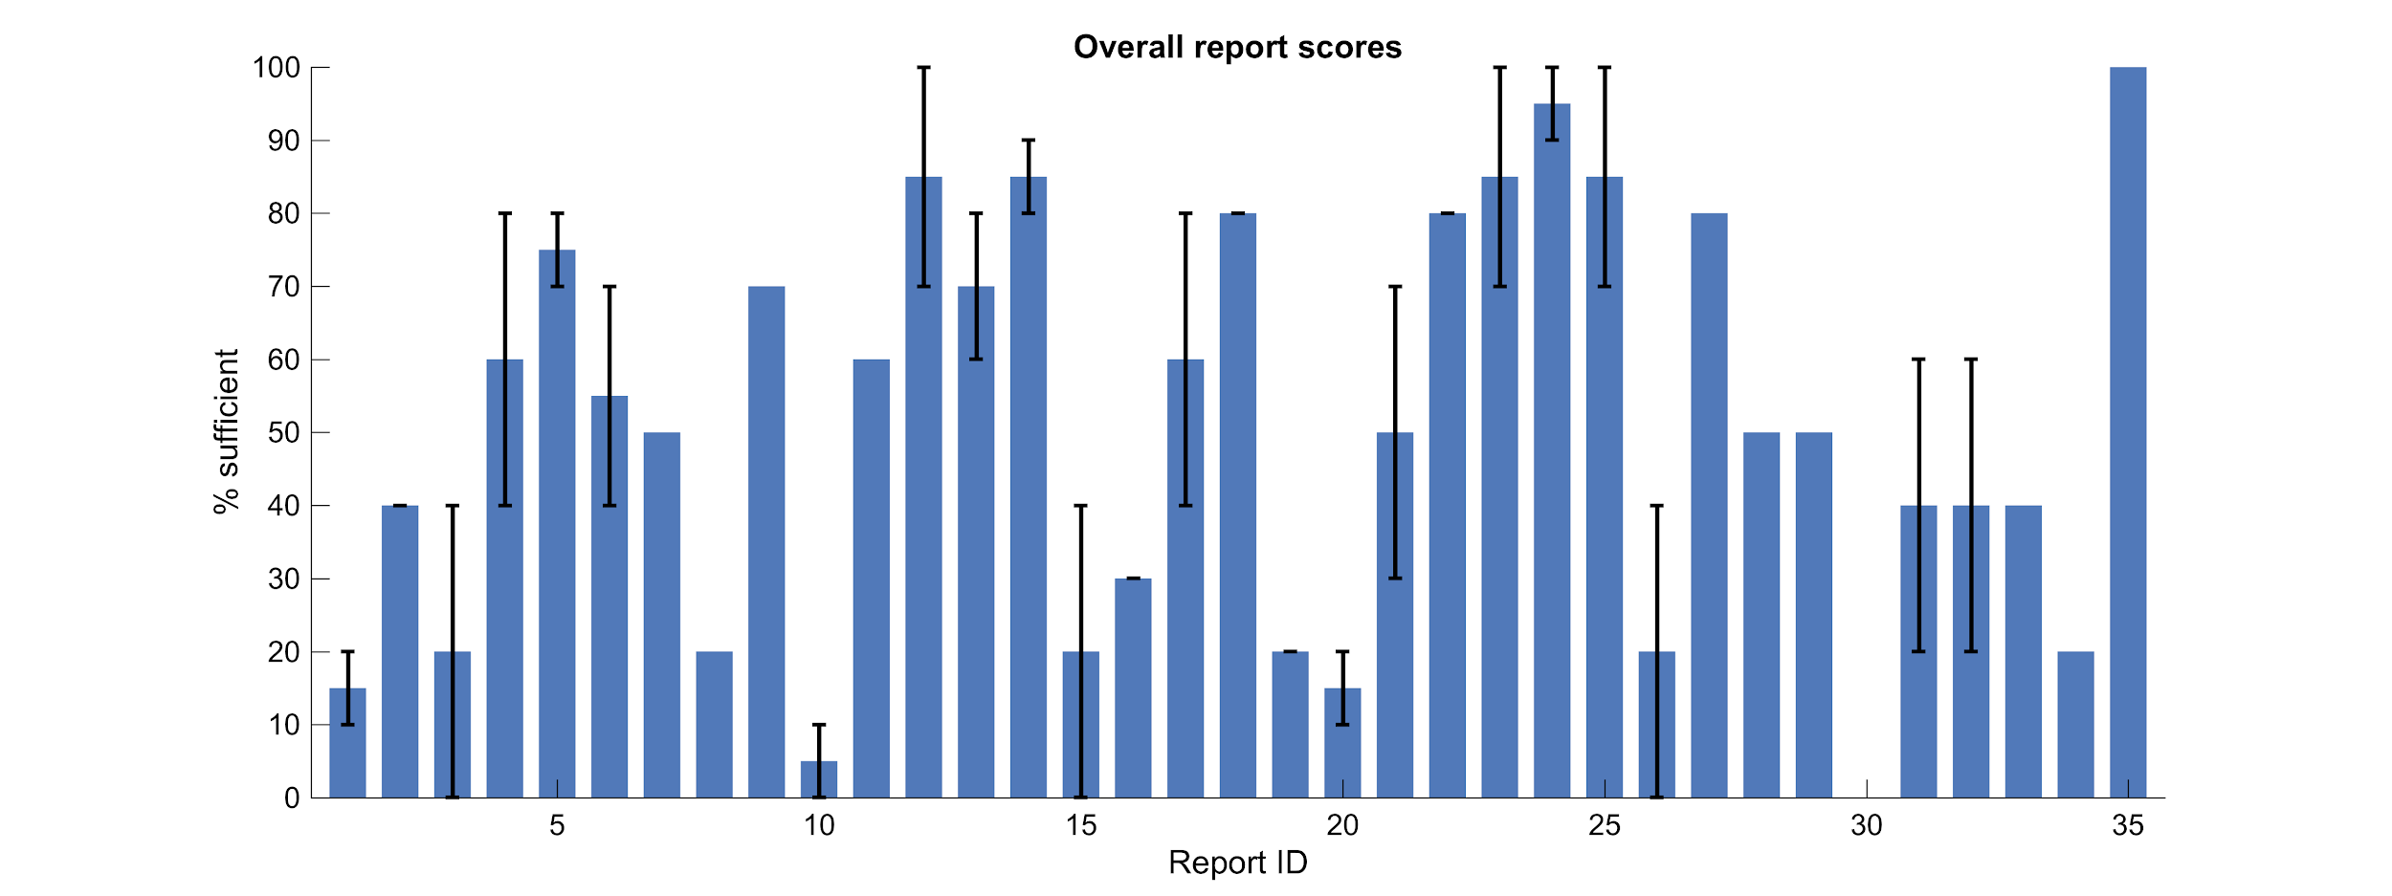
Scores: % of Rules Marked as “Sufficient”
Total count of reviews in TSR category = 60
Average % sufficient scores, error bars denoting the full range
Notes:
Overall score (basically of the 10 simple rules in each report, the percent the were scored sufficient - equivalent to class grade distribution). ~45% of the scores were 7/10 or above, which means ~55% < 7/10

Slide 9
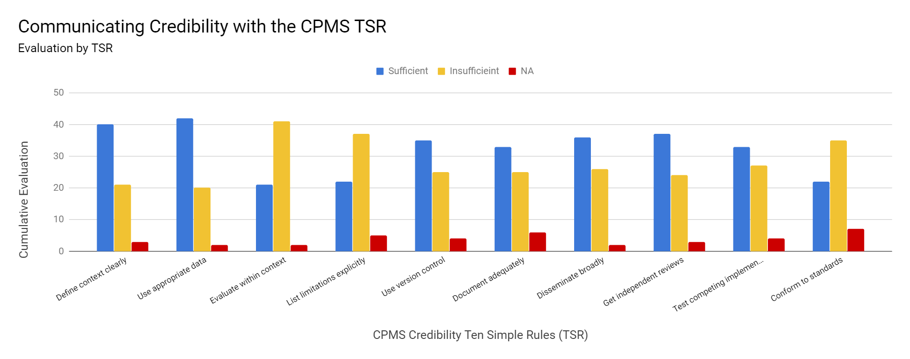
Final Scores by TSR
*Total count of reviews in TSR category = 64
Updated 12/16/2018
Notes:
Across the board - reviewers are seeing and communicating aspects of credibility well. The downside seems to be that the communication level is not consistent across the TSR.
Many PIs emphasized on evaluation in context, however struggled to clearly communicate all aspects of that rule (such as verification or UQ)
Similar struggles were seen in expressing the documentation of Limitations and assumptions

Slide 10
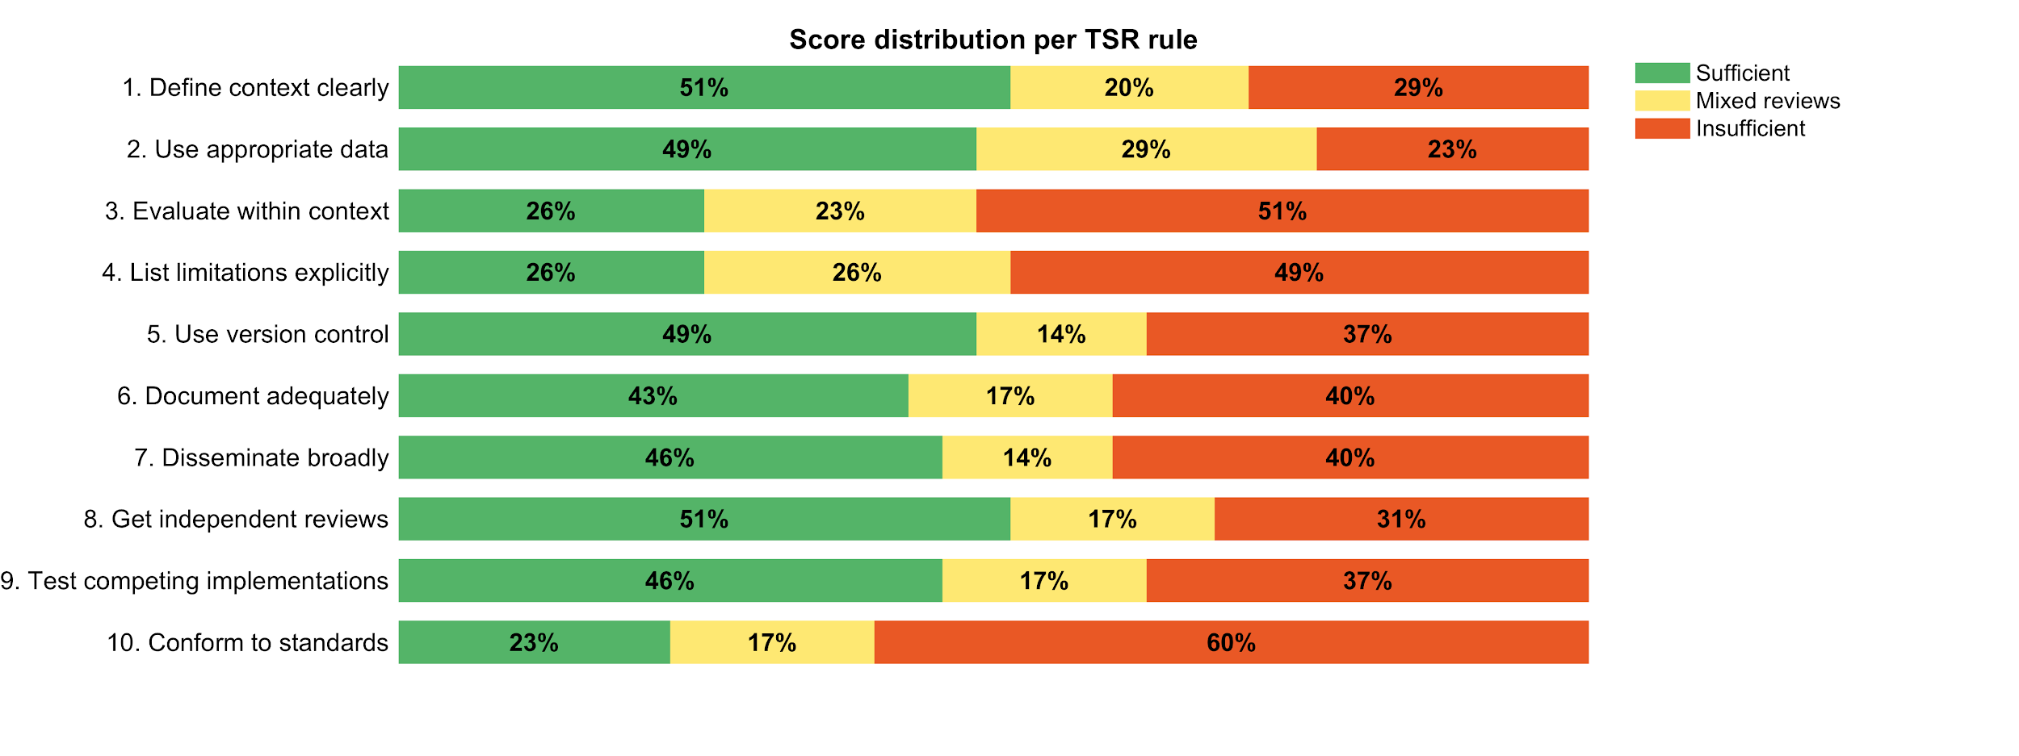
Distribution of Scores Based on Reviewer Agreement
Chart illustrates agreement between reviewers in evaluating the TSR credibility category. Yellow indicates the 2 reviewers split on evaluation

Slide 11
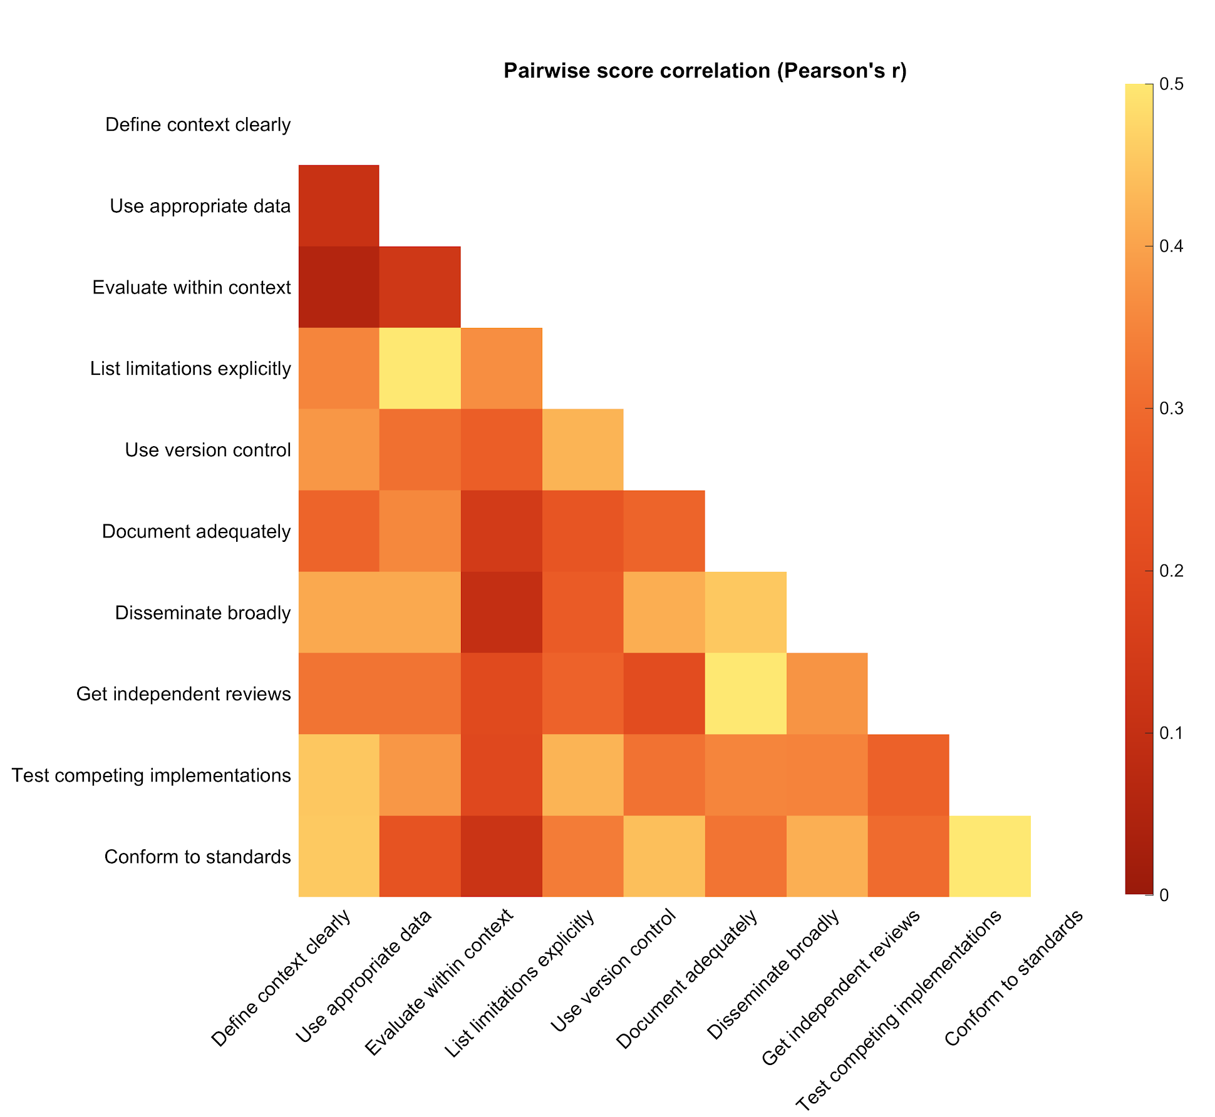
Cross-Correlation between TSR
Correlated TSRs
List Limitations Explicitly / Use Appropriate Data
Get Independent Reviews / Document Adequately
Conform to Standards / Test Competing Implementations
Higher Correlation

Slide 12
Reviewer Observations
- Appreciative and Impressed with each PI team - Still areas where improvement can be achieved
PI experienced challenges in providing detail
Project or plan implementation started recently
PI had difficulty with template and/or instructions
PIs reported on project progress, not model credibility activities
PIs had difficulty articulating planned versus completed activities

Slide 13
TSR Satisfactory Description
The more detailed the information provided in each TSR category, the more likely a reviewer would score a provided description as “sufficient to allow credibility to be assessed”
...although these were often accompanied by comments and caveats from the reviewers.
Notes:
Joy:
High-level: You might want to save this for the one-on-one discussions rather than get into this level of detail here.
If you keep the slide, some additional comments:
Is this actually a good example for “disseminate broadly”? I thought we also wanted to see mention of model/data sharing….
Consider using color for some of the text so slide is more compelling
Instead of putting both examples up at once, consider putting on two different slides

Slide 14
Reviewer Observations cont.
PIs grappled with differences in reporting
limitations of the modeling and limitations of data acquisition
documentation of assumptions and key decisions, not just code and data
conforming to standards vs. internal best practices
evaluate within context (V, V, & UQ) and test competing implementations
how some rules apply to their projects
Clarification - Its okay to suggest that a rule does not apply or that a particular credibility activity is not being pursued as long as evidence supports the position.

Slide 15
Recommendations to IMAG-MSM Community
Provide PI guidance / opportunities on approaches to “Documentation” and “Dissemination”
Several PIs illustrated detailed documentation and dissemination approaches
Many PIs rely on peer publications to meet documentation and dissemination
Others described a ”post it online” approach, without discussing curation
CPMS concern: Reliance on peer publication or uncurated posting as the primary means of providing evidence in these categories may be unsatisfactory to the user community

Slide 16
Recommendations to IMAG-MSM Community
Define criteria and facilitate opportunity for implementing independent reviewer processes and what exactly is acceptable to sufficiently “include the user community”
PIs described a range of approaches
Teaming of independent research groups, providing continuous reviews
Seeking internal reviews within one’s organization but not on the project
Hiring external consultants to provide the review
Journal publication peer review
CPMS Concern: If not addressed early in grant it may become unachievable at a level commensurate with community’s credibility expectations.

Slide 17
Recommendations to CPMS
Implement process improvements of mid-term credibility review exercise
Standardize input format to improve ability to provide applicable information
Improve directions on breadth and depth of requested information
Enhance definition of CPMS-TSR, to improve relatability and remove jargon
Provide examples communicating model credibility information in each TSR
Develop and implement TSR rubrics estimating TSR compliance level
Target to have all these by 9/2019, including a TSR Papers - outlining the TSR development and implementation process
IMAG – MSM 2019 One – on – One Session Individual Consults and Some group led discussions

Slide 18
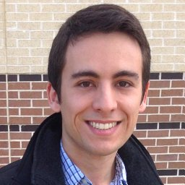
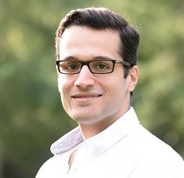
Acknowledgements: CPMS Reviewers
Invaluable contributions to meta-analysis of all collected data
Bruno Rego, PhD candidate
University of Texas at Austin
Amir Khalighi, PhD
University of Texas at Austin

Slide 19
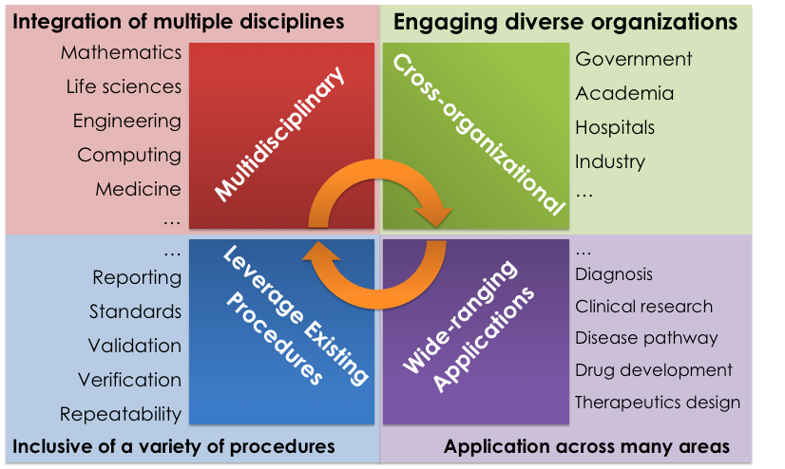
QUESTIONS?
Feedback can be found at https://www.imagwiki.nibib.nih.gov/content/multiscale-modeling-u01-projects

Slide 20
CPMS TSR Rubric - Draft
Outreach Capability
Outreach to Application-domain experts that may not be M&S practitioners | Outreach to M&S practitioners that may not be Application-domain experts | Outreach to Application-domain specific M&S practitioners | Outreach to Application-domain specific M&S practitioners | None/Too little
Comprehensive | Extensive | Adequate | Partial | Insufficient
Compliance Level
Note: Specific interpretation being tailored to each TSR rule

Slide 21
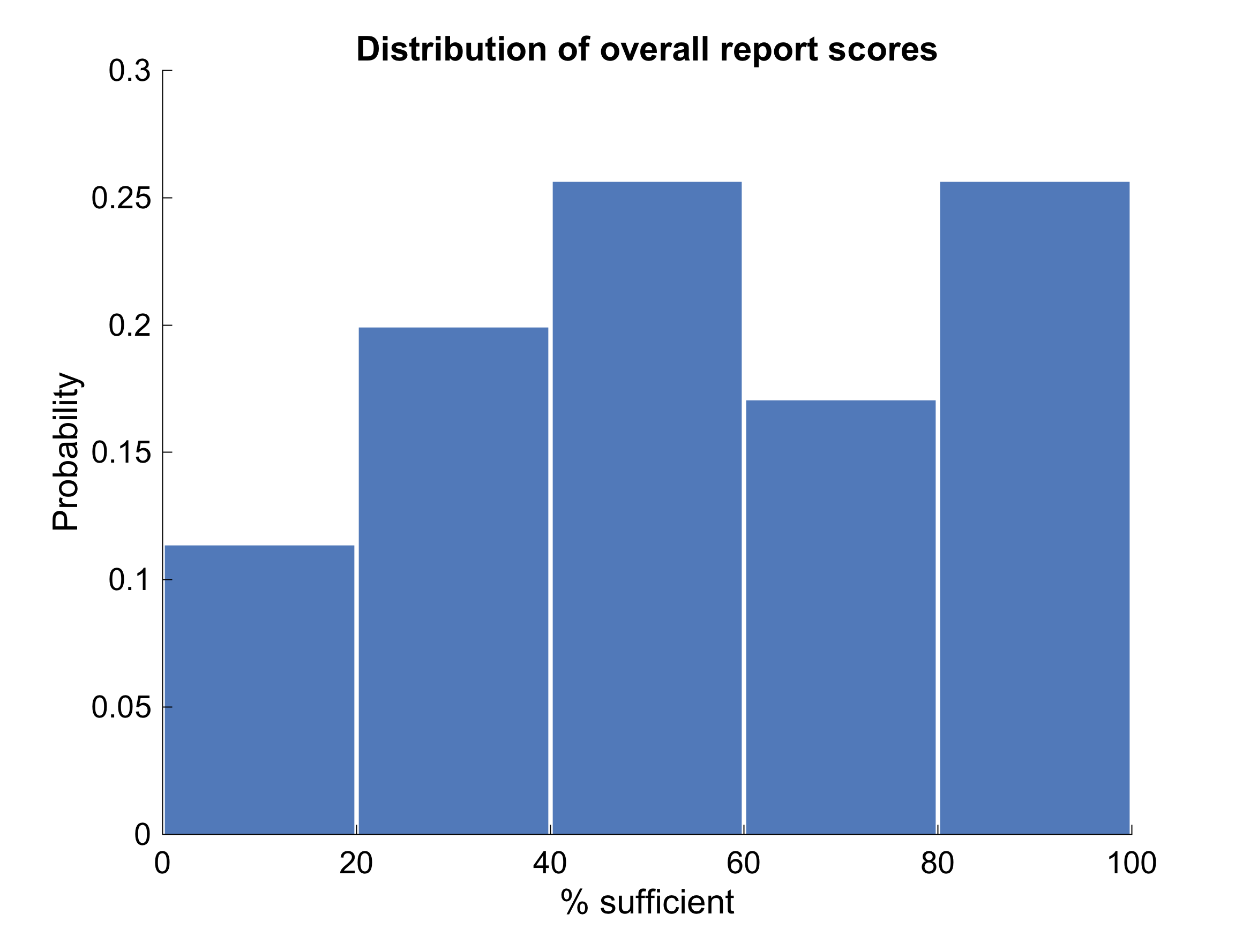
Distribution of “Sufficient” Rate Scores
Notes:
Overall score (basically of the 10 simple rules in each report, the percent the were scored sufficient - equivalent to class grade distribution). ~45% of the scores were 7/10 or above, which means ~55% < 7/10

Slide 22
PI Observations
“Model credibility is best evaluated by the unbiased user who needs the information coming out of the model the most. If there is a way to identify these people during the model building process and solicit their feedback more regularly, that would be very beneficial to ensuring model credibility.”
There seems to be gaps between the standard developed and that of medical doctors for clinical applications.
Involve MDs to bridge the gaps between modelers and MDs
Face-to-face visit beyond annual IMAG meeting

