Slide 1
Department of Defense (DoD) Medical Simulation and Training Updates
NIH-IMAG
Kevin Kunkler, MD, MS
Chair, Medical Simulation & Training
Joint Program Committee-1 (JPC-1)
09/14/2015

Slide 2

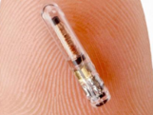
Medical Simulation & Training
The Initiatives
Combat Casualty Training Initiative
Advancing combat casualty training with emphasis on multi-trauma & mass-casualty scenarios: model appropriate responses; develop High State of combat medical readiness tools; resiliency training prior to deployment; & create more efficient & effective ways to deliver team training.
Medical Readiness Initiative
Development of medical training systems & competency assessment for sustained military medical readiness. R&D efforts for ethical, accurate, and appropriate pre-intervention rehearsal models. Efforts in this domain should strive towards measurable outcomes..
Health Focused Initiative
Develop & test self-care (patient) technologies: whenever & wherever they choose. Manage personal health and wellness with simulation solutions. Advance user interface & interactive technologies for healthy living, preventative disease management, & patient rehab.
Tools for Medical Education
Transformational open source advanced developer tools to reduce development costs and democratize access to technology. Improve patient safety, maximize system & organization-level return on investment, and minimize training burden
09/14/2015

Slide 3
Identify Gaps, Evaluation Criteria, Metrics, & Evaluation Studies
Training Assets for Continuously High State of Readiness
Fostering Clinical Excellence (Competency & Certification)
Health Focused Initiative (HFI)
Combat Casualty Training Initiative (CCTI)
Tools for Medical Education (TME)
Medical Simulation & Information Sciences
Medical Modeling, Simulation & Training
Health IT and Informatics
Medical Readiness Initiative (MRI)
Tissue Fidelity & Physiological Response
Pre-Intervention Rehearsal
Assessment / Tutor Systems
H.E.L.P. Tools: Health Challenges – Education & Training
Technologies for Healthy Individuals (Promotion)
Patient Empowerment / Advocacy
Medical Model Libraries
Open Source / Architecture & Resource Sharing
Training Platforms / Tools (Delivery of Content / Avatars)
Resiliency Training (Performance under Stress)
Translational Research: Clinical Outcomes
Public Health Measurements & Promotion
Team (Collective) Training
09/14/2015

Slide 4
Recent Announcements…
Related to Multi-Scaling
Joint En Route Care Training System of Systems Initiative
  W81XWH-15-DMRDP-JPC1-JRoute
  CLOSED
Metrics: Transitioning Training to Reality (RealMETRX)
  W81XWH-15-DMRDP-MSIS-REALMETRX
  CLOSED
Adaptive Tutor Using Methodologies for Neuroplasticity
  W81XWH-15-DMRDP-MSIS-ATUMN
  Pre-Proposal/Pre-Application Deadline: 5:00 p.m. Eastern time (ET), September 10, 2015

Slide 5
Joint En Route Care Training System of Systems Initiative
  Designs, plans, frameworks, or architecture that could support a comprehensive Joint En Route Care Training Systems of Systems program where multiple patient hand-offs and patient transfers occur
  A System of Systems designs, plans, frameworks, or architecture that could be converted later, as an interoperable approach, to a continuum of care simulation training system
  ANNONCEMENT CLOSED

Slide 6
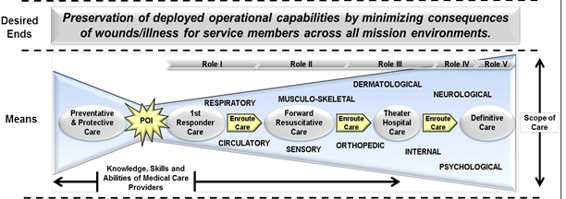
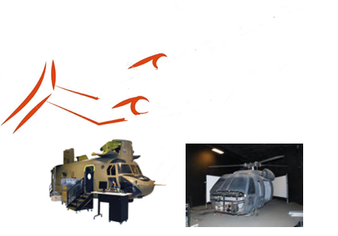
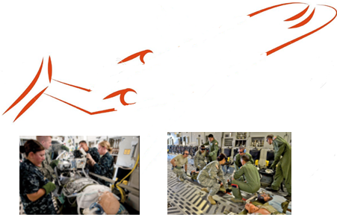
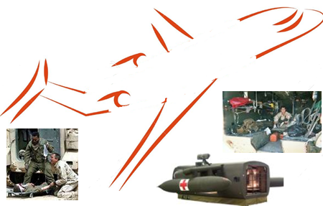
Joint Evacuation Training Simulation (JETS - System of Systems)
JETS Program
09/14/2015

Slide 7
Metrics: Transitioning Training to Reality (RealMETRX)
Use statistical approaches to determine the best metrics and evaluation criteria that will objectively assess and measure the transition from training using medical simulation systems to that of actual medical practice
Advance a novice's training to the level closer to an experienced provider and that his/her performance is more predictive of positive patient/clinical outcomes after use of training on medical simulation systems
Long-term vision: medical simulation systems connected together within a System of Systems concept and allow data from several systems to be analyzed to formulate more holistic and predictive metrics that better represent patient outcomes [and not the disease]
ANNOUNCEMENT CLOSED

Slide 8
Adaptive Tutor Using Methodologies for Neuroplasticity
Tutor must accurately and appropriately understand where the learner is within the learning curve versus the course curricula, objectives, and anticipated outcomes, and understand where the learner needs to go versus the course curricula, objectives, and anticipated outcomes
The tutor must identify viable and course-appropriate route(s) on how to navigate from current position to end position
The proposed tutor needs to continuously evaluate the progress and re-plan/re-route as appropriate versus the course curricula, objectives, and anticipated outcomes
The compensatory/adaptive medical tutor prototype needs to be modular, flexible, robust, and reliable, and needs to incorporate open source/license/architecture
ANNOUNCEMENT CLOSES 10-SEPT-2015 @ 5:00 PM EASTERN

Slide 9
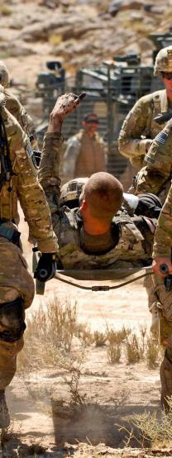

Contact Information:
Dr. Kevin Kunkler
kevin.j.kunkler.civ@mail.mil

Slide 10
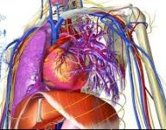
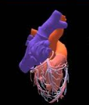


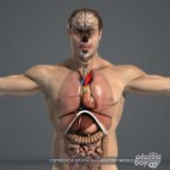
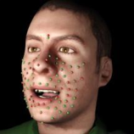
‘Tissue’ Fidelity and Physiological Response
BioGears
Tissue Characteristics Initiative
Virtual Tissue Advance.
Sensor Integration
In Vivo Properties via Smart Tool
Virtual Reality Models
Material Properties
Increased Tissue
Characteristics
09/14/2015

