Slide 1
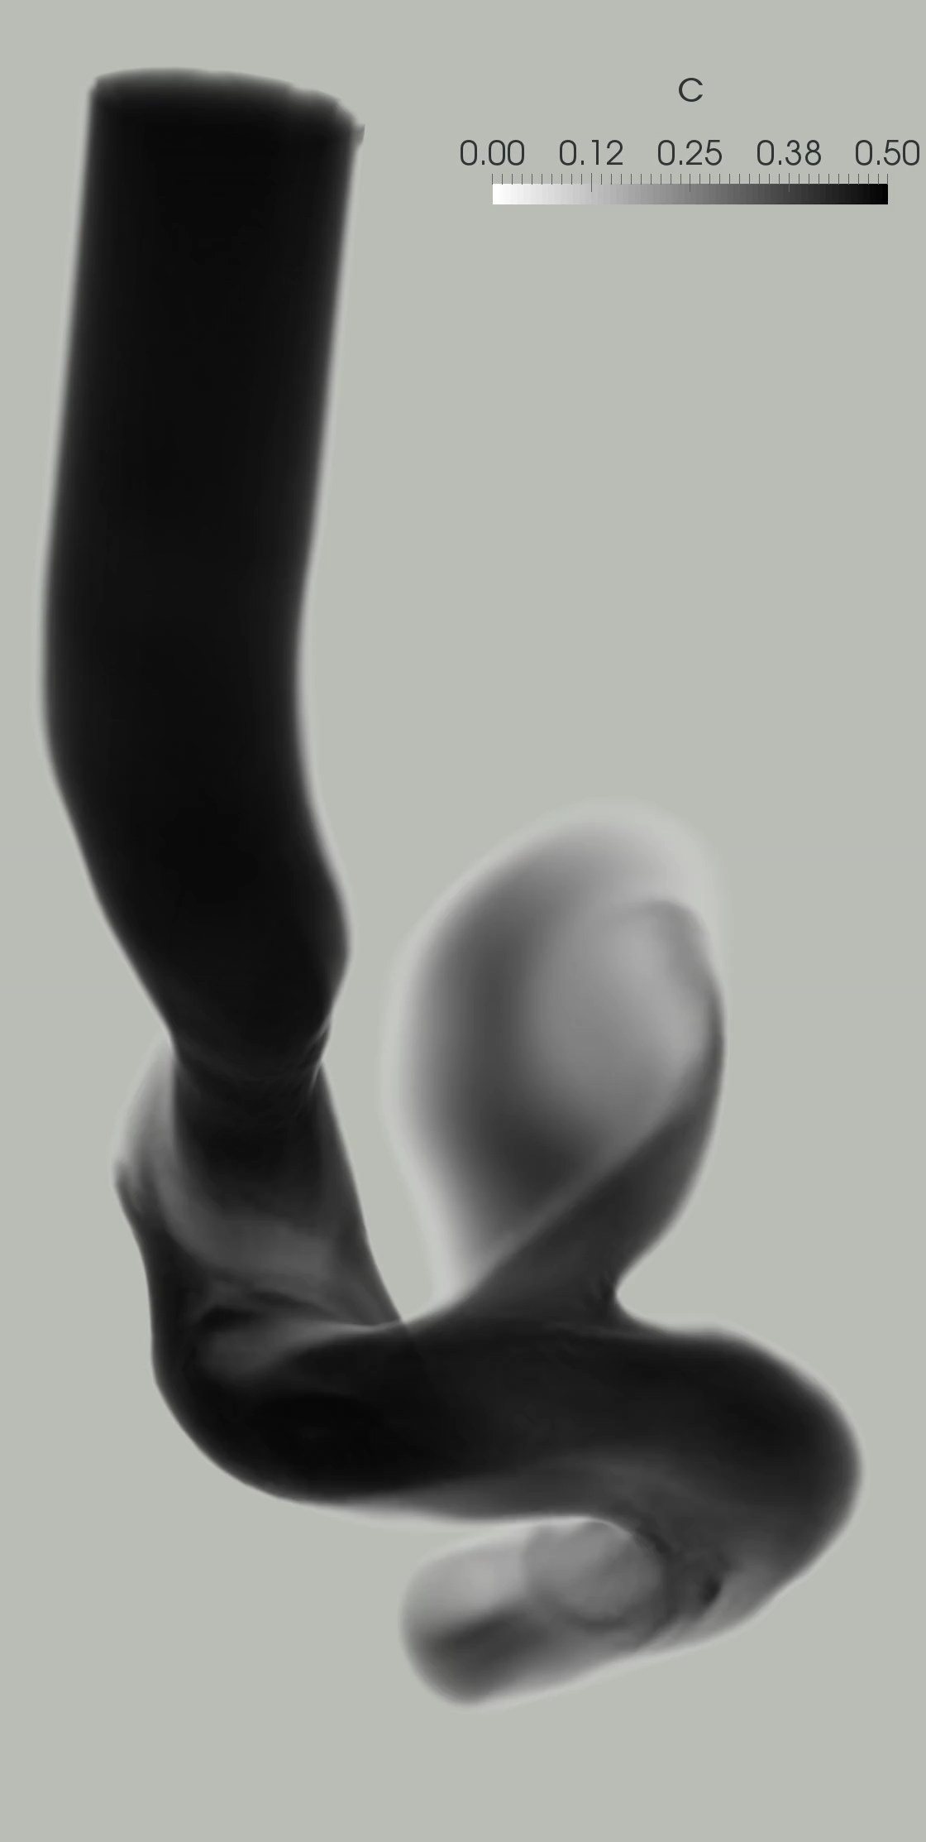


PINNs: Physics-Informed Neural Networks for Biomedical Applications
(Learning from small data)
George Em Karniadakis
Division of Applied Mathematics, Brown University
Also @MIT and @PNNL
The CRUNCH group: Home of “Math + Machine Learning + X”
https://www.brown.edu/research/projects/crunch/home

Slide 2
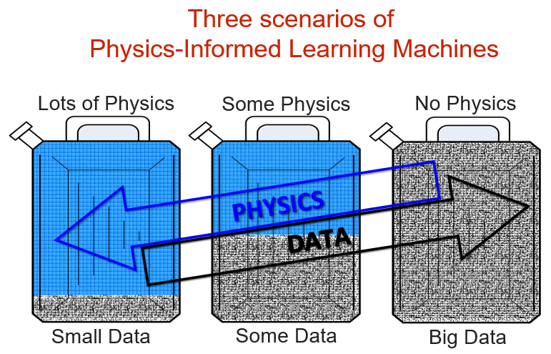
Data + Physical Laws

Slide 3
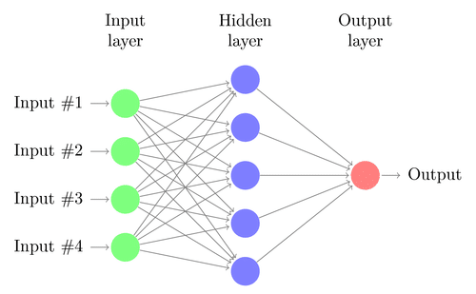
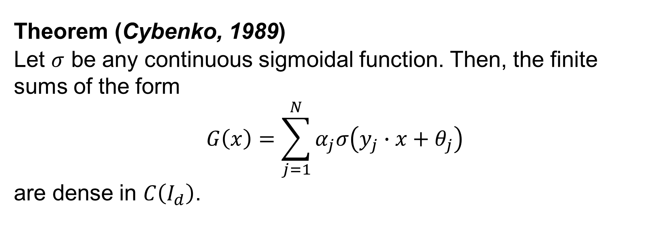
Neural Networks are Function Approximators, Not Predictors!
Theorem (Cybenko, 1989)
Let $σ$ be any continuous sigmoidal function. Then, the finite sums of the form
$$G\left(x\right)=\sum_{j=1}^{N}{α_{j}σ\left(y_{j}∙x+θ_{j}\right)}$$
are dense in $C\left(I_{d}\right)$.
G. Cybenko, “Approximation by superpositions of a sigmoidal function”, Mathematics of Control, Signals and Systems, 303-314, 2(4), 1989
Hornik et. al., 1989; Barron (1994); Mhaskar (1996)

Slide 4
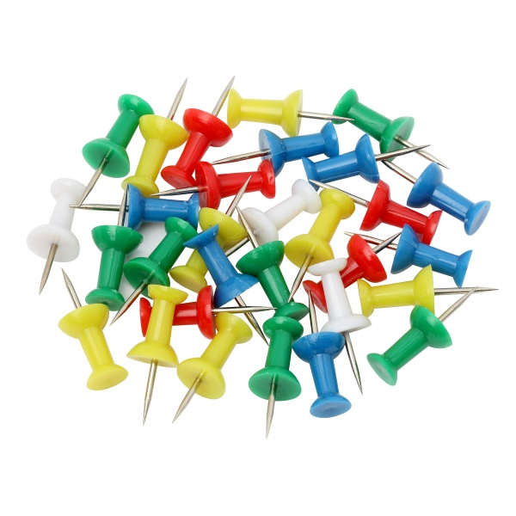
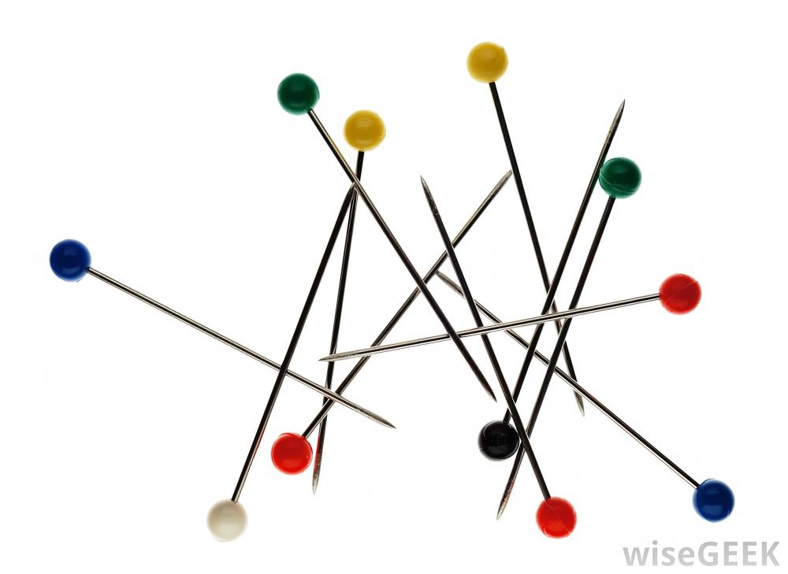
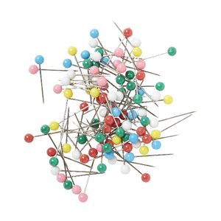

Physics-Informed Neural Networks (PINNs)
sPINNs: stochastic PINNs
fPINNs: fractional PINNs
LePINNs: Levy process PINNs
nPINNs: Nonlocal PINNs…

Slide 5
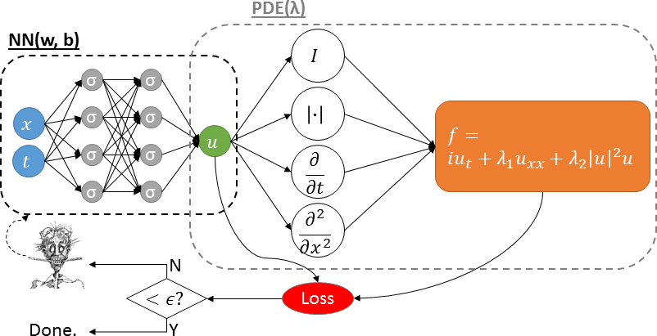
What is a PINN? Physics-Informed Neural Network
We employ two (or more) NNs that share the same parameters
Minimize:

Slide 6
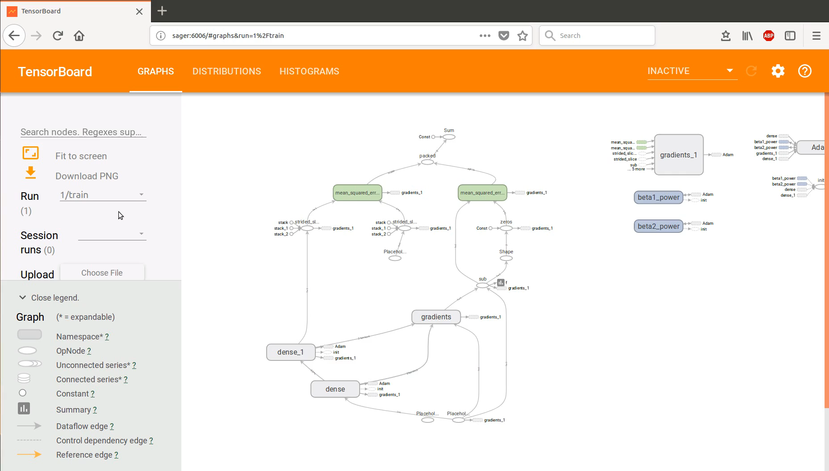
dy/dx= y

Slide 10
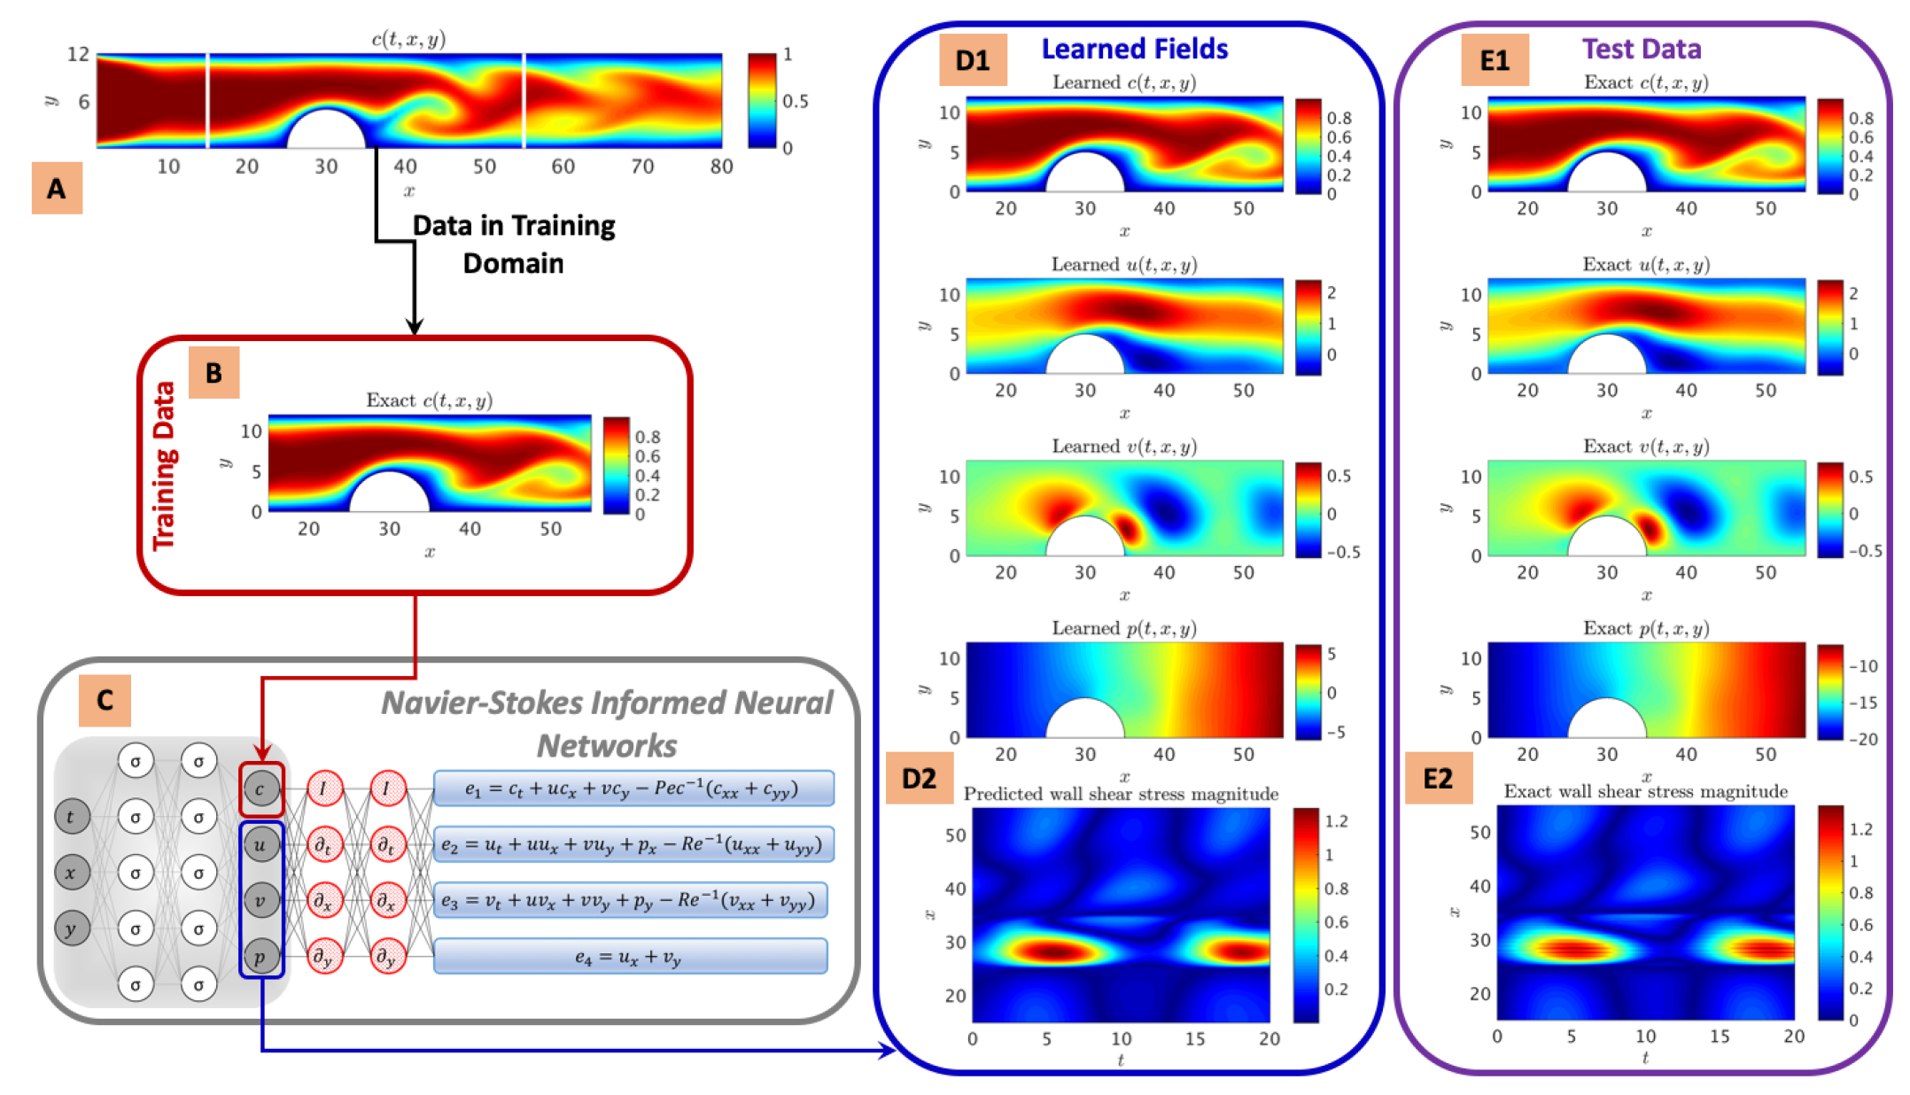
From Dye Visualizations to Wall Shear Stress Inference
Physics-informed Neural Networks: Inverse Problems and Inference
Directly assimilate data such as the visualizations of bolus dye transported in the vessels and aneurysms to infer the latent fields such as wall shear stresses.
Infer parameters of interest in systems biological models for which a system of equations already exists and using observations on a few species only.
Notes:
More recently and inspired by the developments in physics-informed neural networks, I have been able to leverage the governing equations of fluid mechanics to infer the latent quantities of interest such as the velocity and pressure fields as we train the neural network using data from visualizations of a passive scalar only.
This offers a promising alternative to the conventional optimization methods. Here, the passive scalar could be the bolus dye that is typically injected to the blood stream for the purpose of blood flow monitoring and medical imaging.
This algorithm is capable of accurately reconstructing the velocity and the pressure fields without having access to any observations of these fields as shown by the comparison of the learned fields against the exact fields in the last two columns.
I will extend this framework to address a variety of problems:
Frist, I will directly assimilate data such as the visualizations of bolus dye transported in the vessels and aneurysms to infer the latent fields such as wall shear stresses.
Infer parameters of interest in systems biological models for which a system of equations already exists and we use observations on a few species only.

Slide 11
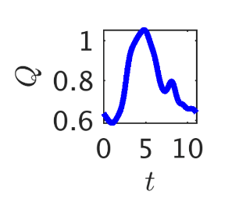
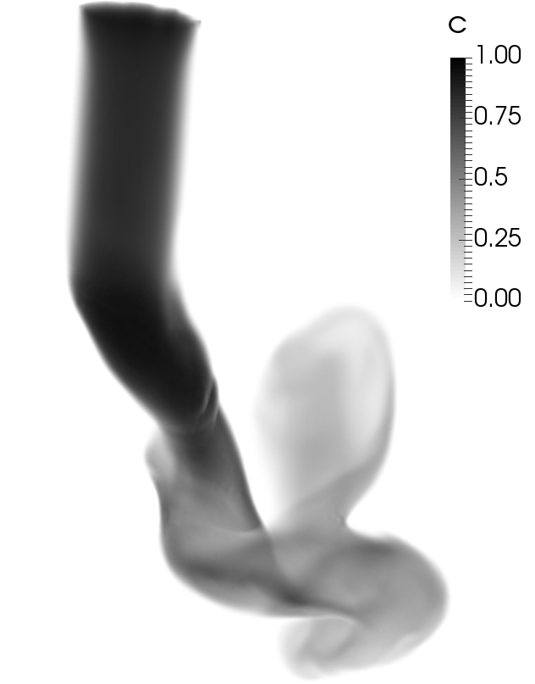
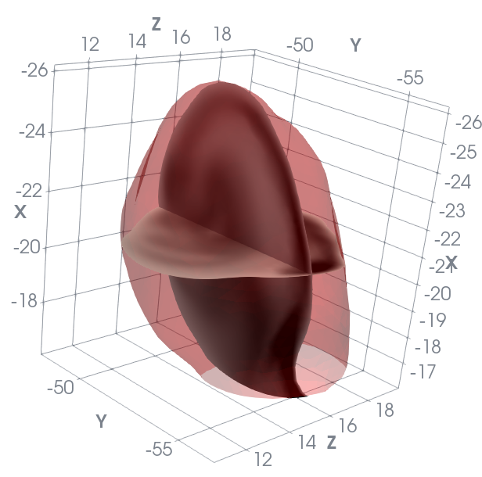
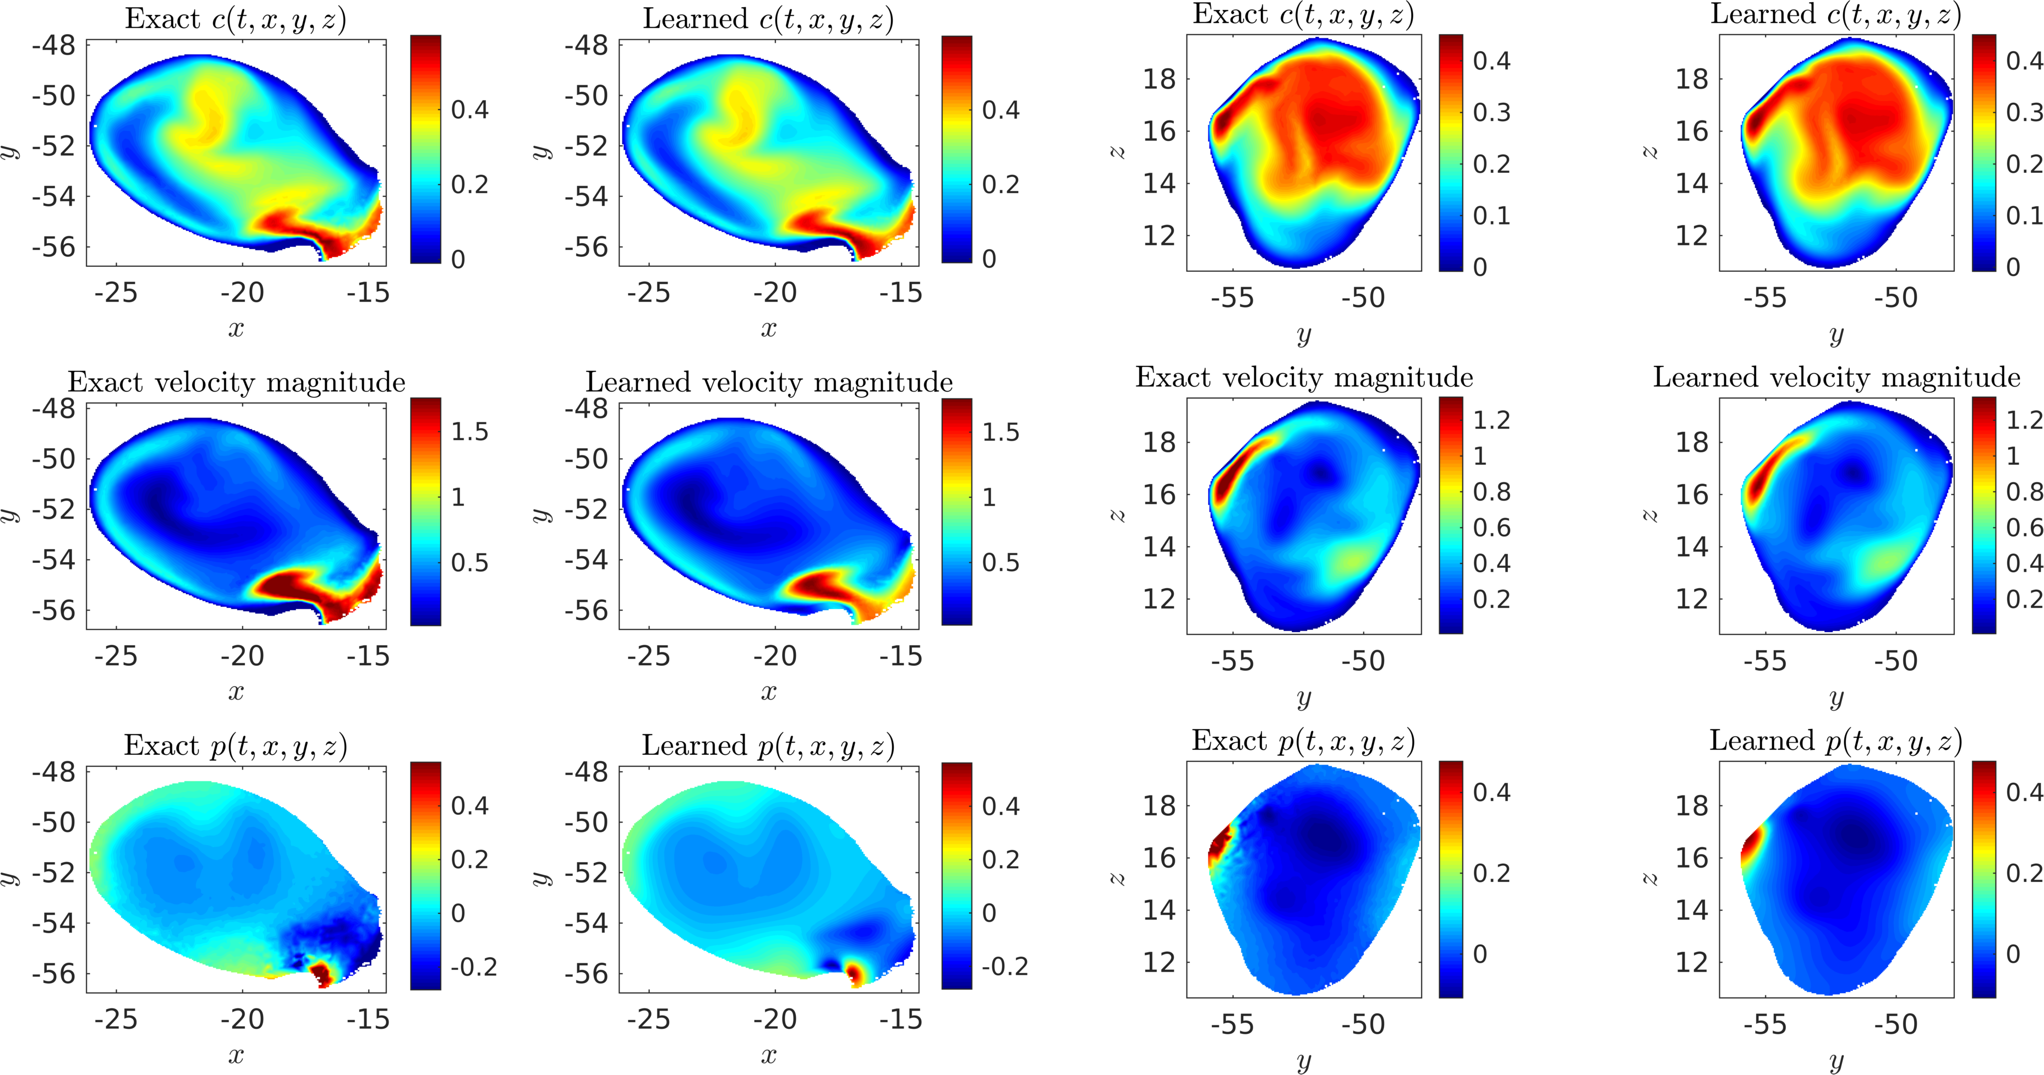
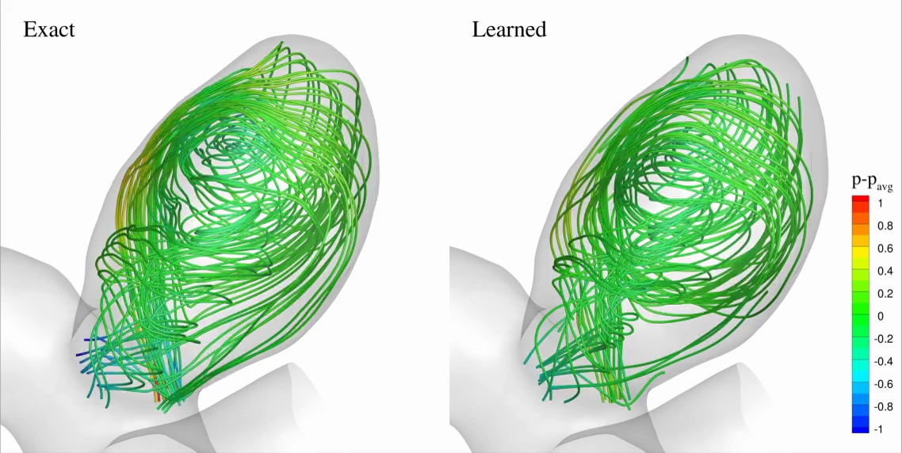
Hidden Fluid Mechanics: flow dynamics in an intracranial aneurysm
Training Data
Inferred Hidden Physics
Notes:
We consider 3D physiologic blood flow in a realistic intracranial aneurysm, where exact concentration fields are generated numerically using realistic boundary conditions.
At the outlet, zero-Neumann boundary conditions are imposed for velocities and concentration, whereas a Windkessel type boundary condition is used for the pressure to represent the truncated geometry downstream. Re = Pec = 98.
It is possible to focus only on the regions where velocity and pressure fields are needed, which will signficantly reduce the size of data and the cost of training.

Slide 12
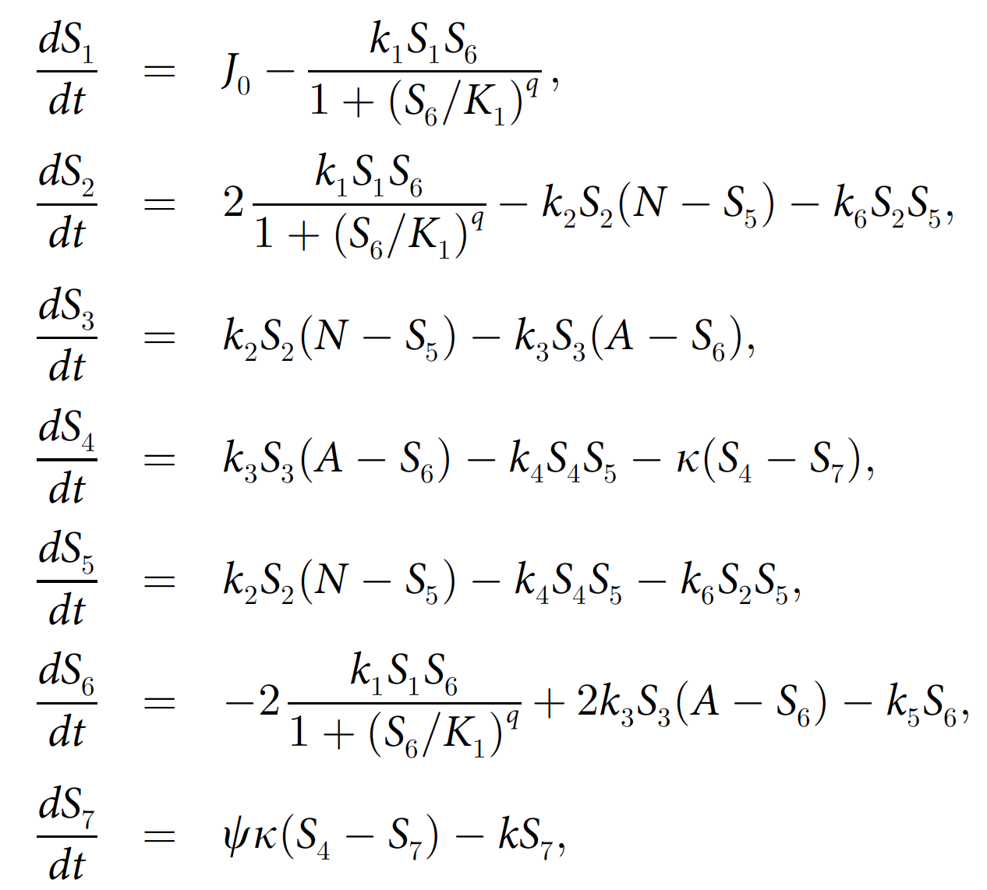
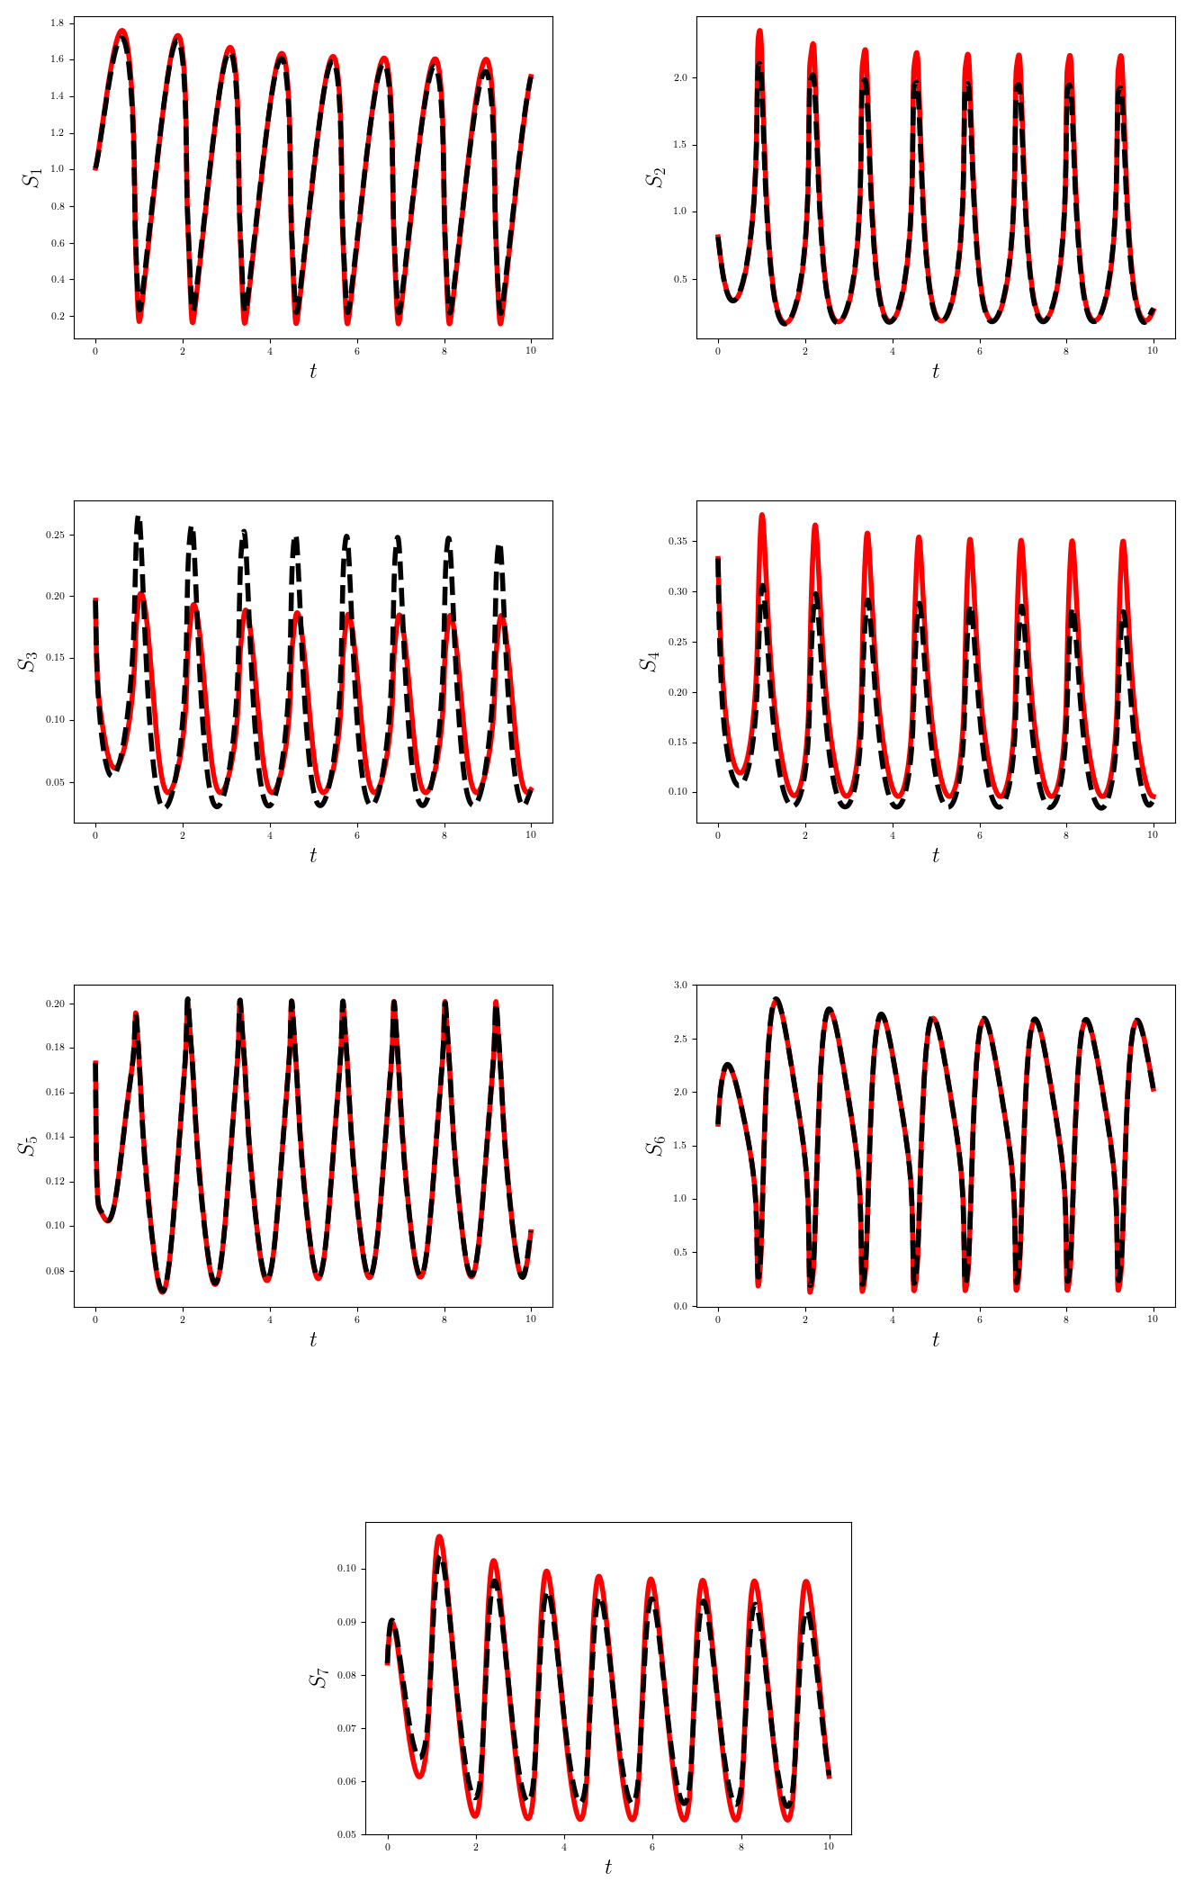
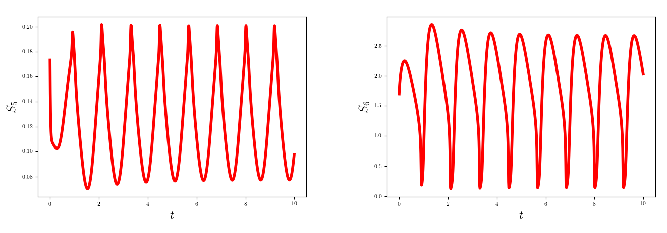
Yeast Glycolysis Oscillator
PINNs in Systems Biology
BioPINNs
The nonlinearity of dynamics in systems biology makes it hard to infer them from experimental data.
Knowing the system of ordinary differential equations and with PINNs algorithm, we are able to infer the unknown parameters.
Notes:
The nonlinearity of dynamics in systems biology makes it hard to infer them from experimental data. However, having the ordinary differential equations (ODEs) that describe the time-evolution of biochemical species, and encoding them into a PINNs algorithm, we are able to infer the unknown parameters with little amount of scattered data. We have tested tested this approach by inferring the dynamics of yeast glycolysis, which has become a standard test case for biochemical dynamics inference.
Ultradian model of glucose-insulin dynamics
Blood glucose and nutrition data were collected retrospectively from six participants, four with type 2 diabetes and two without diabetes, using custom-designed mobile applications for capturing self-monitoring data.

Slide 13
arXiv:1903.00104v1

Slide 16
Twenty-Dimensional Function Approximation
Use only 5,000 HF and 30,000 LF points

Slide 17
Learning the Dynamics from Data Only

Slide 18
Learning the Dynamics from Data Only

Slide 19
Two-dimensional Damped Oscillator

Slide 20
The Lorentz System

Slide 21
Hopf Bifurcation

Slide 22
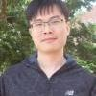
Generative Adversarial Networks
          Stochastic Process
      Stochastic PDEs
Yang Liu
arXiv:1811.02033

Slide 29
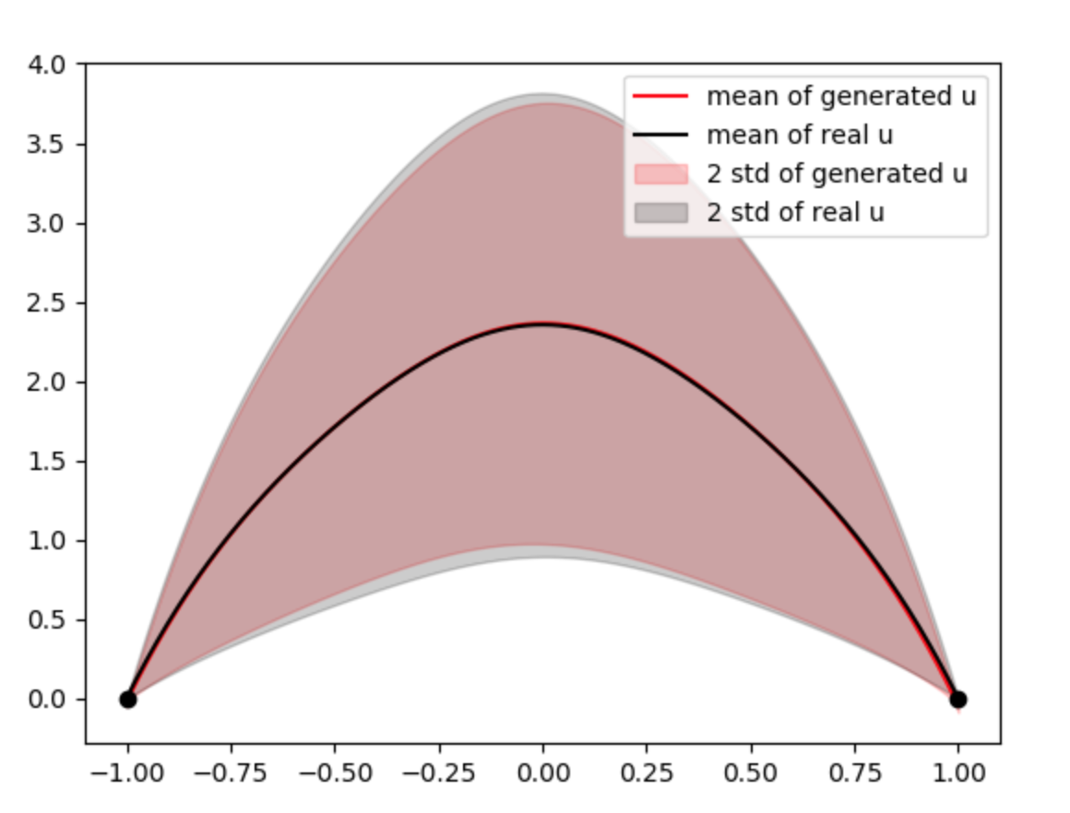
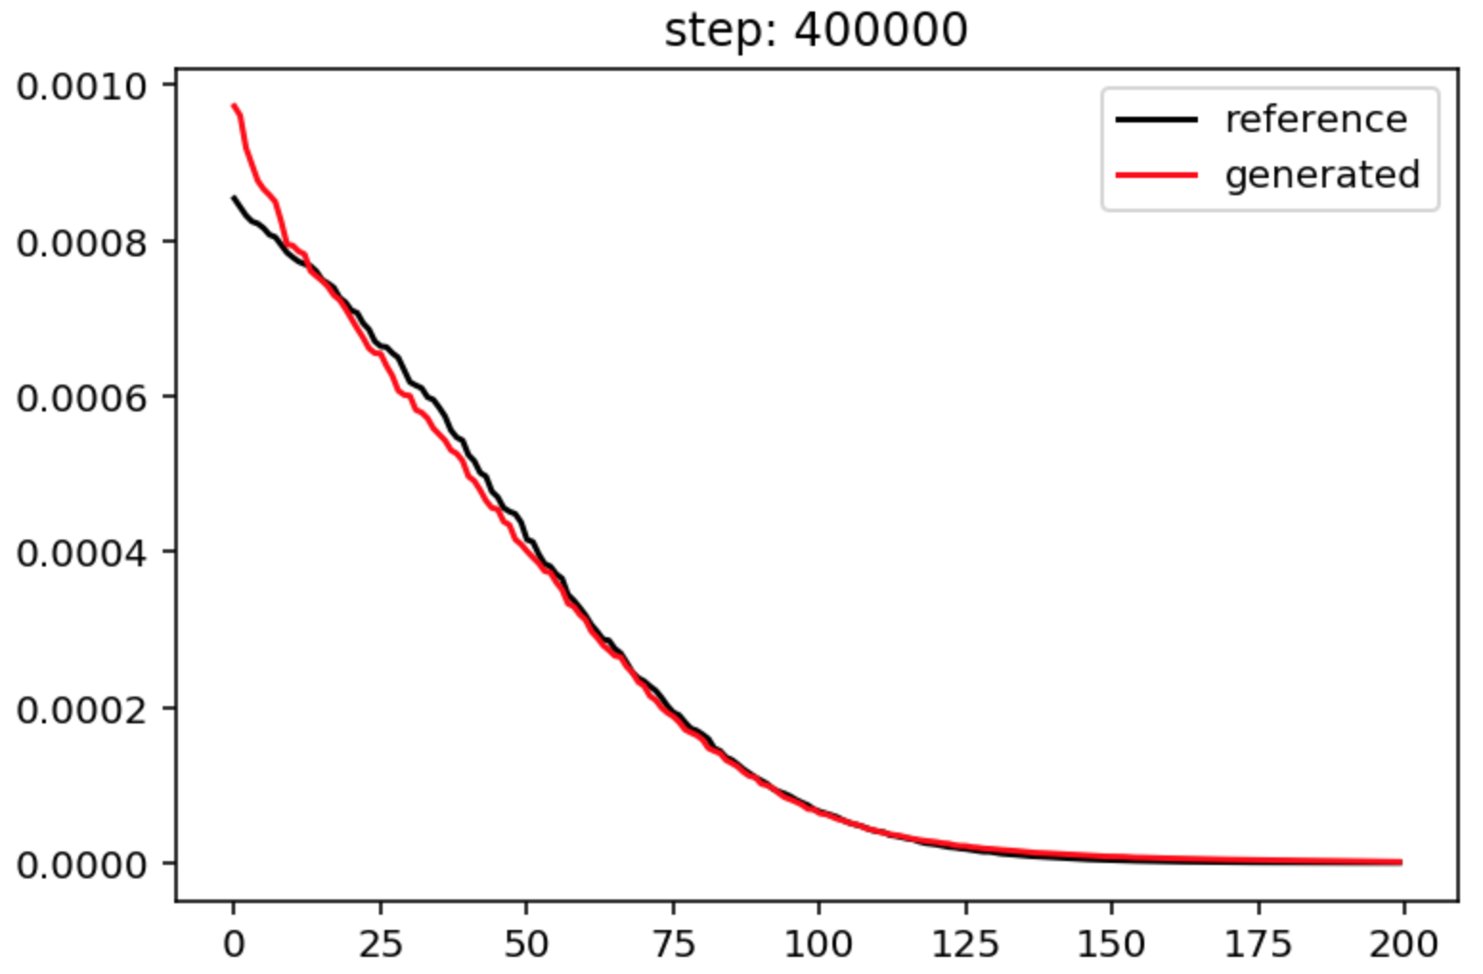
Scaling up: 120 dimensions ~ polynomial complexity
Increase depth of neural network from 4 to 8
Use ResNet
Increasing training steps from 2e5 to 4e5
Using Leaky Relu for the discriminator
Challenges for higher dimensions:
Already using up the memory of 12 Gb
May need to use other neural networks, like dense net.
We may spend a lot of time on tuning the neural networks...

Slide 30

Conclusions
PINNs integrate seamlessly data + mathematical physics
Same formulation for forward and inverse problems
Overcome the curse of dimensionality
Can be used in any scientific field
Can discover new dynamcal systems equations

