Slide 1
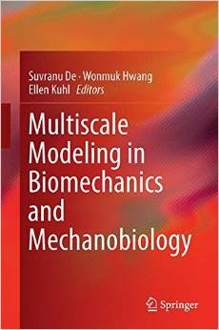
Theoretical and Computational Methods Working Group Suvranu De and Vasilis Marmarelis
Activities in 2013-2014
Springer book
Title: Multiscale Modeling in Biomechanics and Mechanobiology
Co-editors: Suvranu De, Wonmuk Hwang, Ellen Kuhl
Status: in press (11 chapters)
IDEAS Workshop on Virtual Surgery
Nov 23, 2013, Beth Israel Deaconess Medical Center, Boston, MA
Organizers: Dan Jones (BIDMC), Suvranu De (RPI)
Three groups: Clinicians, Technology, Federal agencies (Grace from NIH and Harvee from TATRC)
MSM Webinar
Nov, 2013, Speaker: Ellen Kuhl, Stanford University
SAGES 2014 Annual Meeting
April 2-5, 2014, Salt Lake City, Utah
Course : Emerging Frontiers of Virtual Surgery (for CME credits)
Minisymposia in the World Congress on Computational Mechanics
July 20-25, 2014, Barcelona, Spain
Minisymposium: Computational Bioengineering
Biomedical Simulations Resource Workshop on “Model-based Diagnostic Physiomarkers”
April, 2014; USC
Hardcover: 331 pages
Publisher: Springer; 2015 edition (November 14, 2014)
Language: English
ISBN-10: 1447165985
ISBN-13: 978-1447165989

Slide 2
Theoretical and Computational Methods Working Group Suvranu De and Vasilis Marmarelis
Planned activities in 2014-2015
Transfer leadership
US National Congress on Computational Mechanics
July 26-30, 2015, San Diego, CA
Organizers: Suvranu De(RPI), Yusheng Feng (UTSA)
Minisymposium: Computational Bioengineering
PANCAM 2015
April 27-29, 2015, Buenos Aires, Argentina
Organizers: Suvranu De(RPI), Sandra Rugonyi (OHSU)
Minisymposium: Computational Mechanics in Biology and Medicine
ICBS 2015 Annual Meeting
International Conference for Bio-Systems:Mechanics, Physics, Structures and Devices
Future Directions: George Em Karniadakis + X
Concurrent multiscale coupling
Propagating uncertainty across domains
Coarse graining/mesoscopic methods
Transition path theory
Electrostatics beyond mean field theory
Machine learning & Multi-fidelity modeling
Parameter estimation under uncertainty
Verification and Validation of multiscale methods

