Slide 1
Accelerating Therapeutics for Opportunities in Medicine
Dr. Amanda J. Minnich

Slide 2



Current drug discovery
Is there a better way to get medicines to patients?
1000s of new molecules go through benchtop design, make, and test loop
Screen millions of functional molecules to inform design
Lengthy in-vitro and in-vivo experiments;
Synthesis bottlenecks
Target
6 years
Human clinical trials
Lead Discovery
1.5 yrs
Lead Optimization
3 yrs
Preclinical
1.5 yrs
33% of total cost of medicine development
Clinical success only ~12%, indicating poor translation in patients
Source: http://www.nature.com/nrd/journal/v9/n3/pdf/nrd3078.pdf
Notes:
Current drug discovery follows a mostly linear, sequential, staged approach, that balances cost and risk.
Millions screened, 1000s made/tested – most fail

Slide 3





Accelerating Therapeutics for Opportunities in Medicine
Building a precompetitive platform to get better medicines to patients faster
Mission
ACCELERATE the discovery & development of more effective therapies for patients
AI with High-performance computing
Vision
How?
Diverse biological data
Emerging experimental capabilities
TRANSFORM drug discovery from experiment-driven, sequential, and high-failure to computation-driven, integrated, and patient-centric
Scope
INTEGRATE
Find the molecule
Platform 1.0: Target to candidate Platform 2.0: Target to patient
Notes:
We are working to accelerate the discovery and development of new therapeutics by transforming the current drug discovery paradigm. We’ll do that by integrating HPC, data, and experiment to create a new pre-competitive platform that will help drug discovery scientists move from an identified target to a molecule ready for the clinic with higher speed and precision.
Integrate diverse datasets & AI insights to generate models which predict pharmacology & developability up front
Rapidly design optimized molecules in silico
Use active learning to drive experiments to increase efficiency and success
Proof-of Concept demonstrations with ground truth data to validate platform and rapidly emerging experimental & computational models

Slide 4
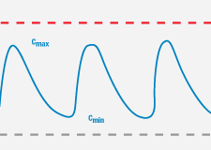

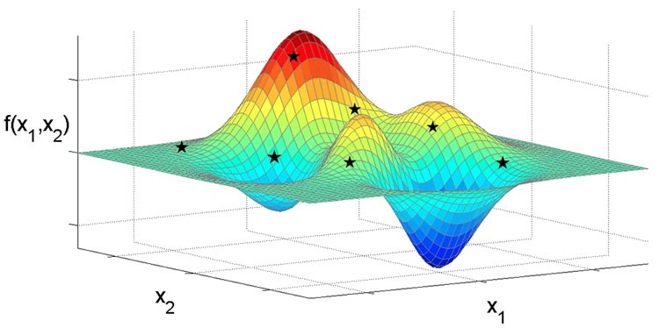


Our platform is an active learning drug discovery framework
  Property Prediction Pipeline
Efficacy
  Multi-Parameter Optimization Loop
Multi-level models
Systems models
Safety
Working
Compound
Library
PK
Design Criteria
Developability
  Generative Molecular Design
proposes new molecules with optimized properties
Active learning decides if/when a simulation or experiment is needed to improve or validate models
Retrain property prediction models
Molecular Feature
Simulations
Simulation
Chemistry Design & Synthesis
Experiment
Human-relevant assays
Notes:
We’re developing an Active learning drug discovery framework that begins with a compound library as the input to our Machine Learning (ML) Pipeline
Grey Loop:
The ML pipeline integrates multi-level models and systems level models of efficacy, safety, and pharmacokinetics as well as developability (an assessment of how “drug-like” a given compound is) to select design criteria for a new drug lead. All of these parameters are simultaneously optimized for the generation of new molecules with optimized efficacy, safety, pk, and developability properties. This multi-parameter optimization loop can be run for numerous cycles.
Active Learning, Teal loop, and Yellow loop:
We then employ an active learning approach that decides if and when a molecular simulation of experiment is needed to improve or validate the models.
Data from these simulations and experiments are then used to re-train our property prediction models
The next slide will zoom in on the grey Multi-Parameter Optimization loop

Slide 5
Our platform is an active learning drug discovery framework
  Property Prediction Pipeline
Efficacy
Multi-level models
Systems models
Safety
PK
Developability
Notes:
We’re developing an Active learning drug discovery framework that begins with a compound library as the input to our Machine Learning (ML) Pipeline
Grey Loop:
The ML pipeline integrates multi-level models and systems level models of efficacy, safety, and pharmacokinetics as well as developability (an assessment of how “drug-like” a given compound is) to select design criteria for a new drug lead. All of these parameters are simultaneously optimized for the generation of new molecules with optimized efficacy, safety, pk, and developability properties. This multi-parameter optimization loop can be run for numerous cycles.
Active Learning, Teal loop, and Yellow loop:
We then employ an active learning approach that decides if and when a molecular simulation of experiment is needed to improve or validate the models.
Data from these simulations and experiments are then used to re-train our property prediction models
The next slide will zoom in on the grey Multi-Parameter Optimization loop

Slide 6
Property prediction pipeline
Will be released open source by November 2019
Data Ingestion + Curation
Model Training + Tuning
Featurization
Prediction Generation
Visualization + Analysis
Data Lake
Model Zoo
Results DB
Notes:
5,964 total models for 41 Safety and Pharmacokinetic datasets
4,696 Neural Net models
1,253 Random Forest models
3,819 Regression models
2,130 Classification models
Models were trained on a wide range of proprietary GSK assay datasets, including ones that are larger than public datasets reported in the literature
Compute resources NN models: 87 days for MOE, 63 days for ECFP and 288 days for GraphConv

Slide 7
Data Ingestion + Curation
Model Training + Tuning
Featurization
Prediction Generation
Visualization + Analysis
Data Lake
Model Zoo
Results DB
Raw pharma data consists of 300 GB of a variety of bioassay and animal toxicology data on ~2 million compounds from GSK
Domain experts created Jupyter notebooks to process data
Serve as both code and record of modifications made to datasets
Notes:
change to mention curation piece instead of data storage requirements

Slide 8
Data Ingestion + Curation
Model Training + Tuning
Prediction Generation
Visualization + Analysis
Featurization
Data Lake
Model Zoo
Results DB
Example Pharmacokinetic datasets
In vitro and In vivo
In vitro
In vivo
We have curated ~150 model-ready datasets
Notes:
Raw pharma data consists of 300 GB of a variety of bioassay and animal toxicology data on ~2 million compounds from GSK
Domain experts created Jupyter notebooks to process data
Serve as both code and record of modifications made to datasets

Slide 9
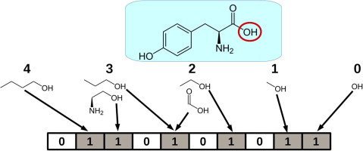
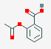
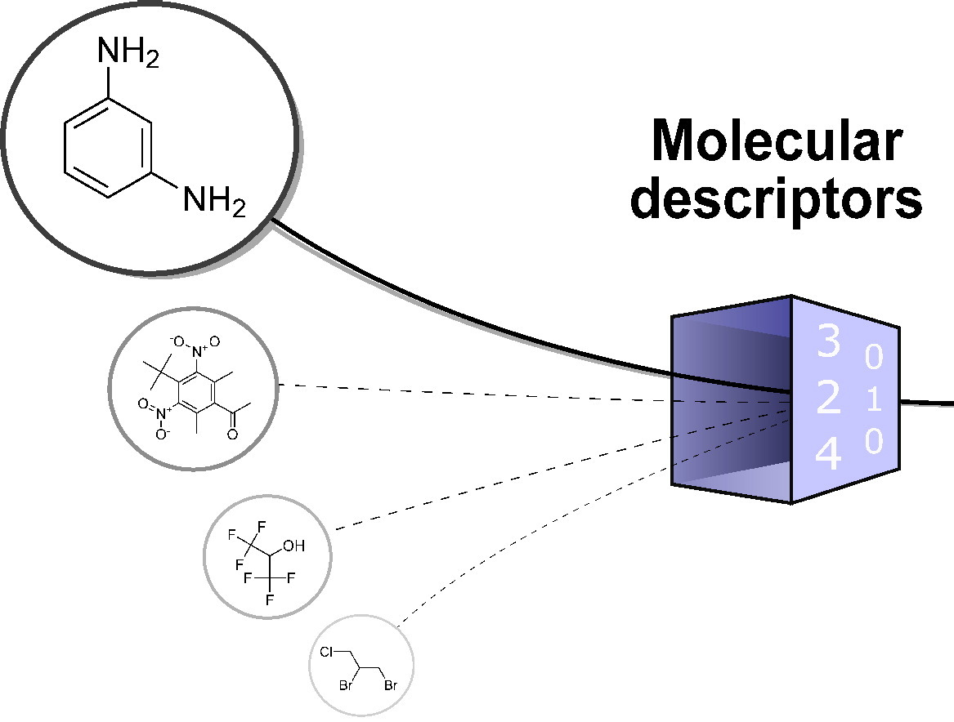
Data Ingestion + Curation
Model Training + Tuning
Featurization
Prediction Generation
Visualization + Analysis
Data Lake
Model Zoo
Results DB
Support loading datasets from either Data Lake or filesystem
Support a variety of feature types
  Extended Connectivity Fingerprint
  Graph-based features
  Molecular descriptor-based features (MOE, Mordred)
  Autoencoder-based features (MolVAE)
  Allow for custom featurizer classes
Split dataset based on structure to avoid bias

Slide 10

Data Ingestion + Curation
Model Training + Tuning
Featurization
Prediction Generation
Visualization + Analysis
Data Lake
Model Zoo
Results DB
Have built a train/tune/predict framework to create high-quality models
Currently support:
  scikit-learn models
  Deepchem models (wrapper for TensorFlow)
  XGBoost models
  Allow for custom model classes
Allow for iterative training of neural nets
Tune models using the validation set and perform k-fold cross validation

Slide 11
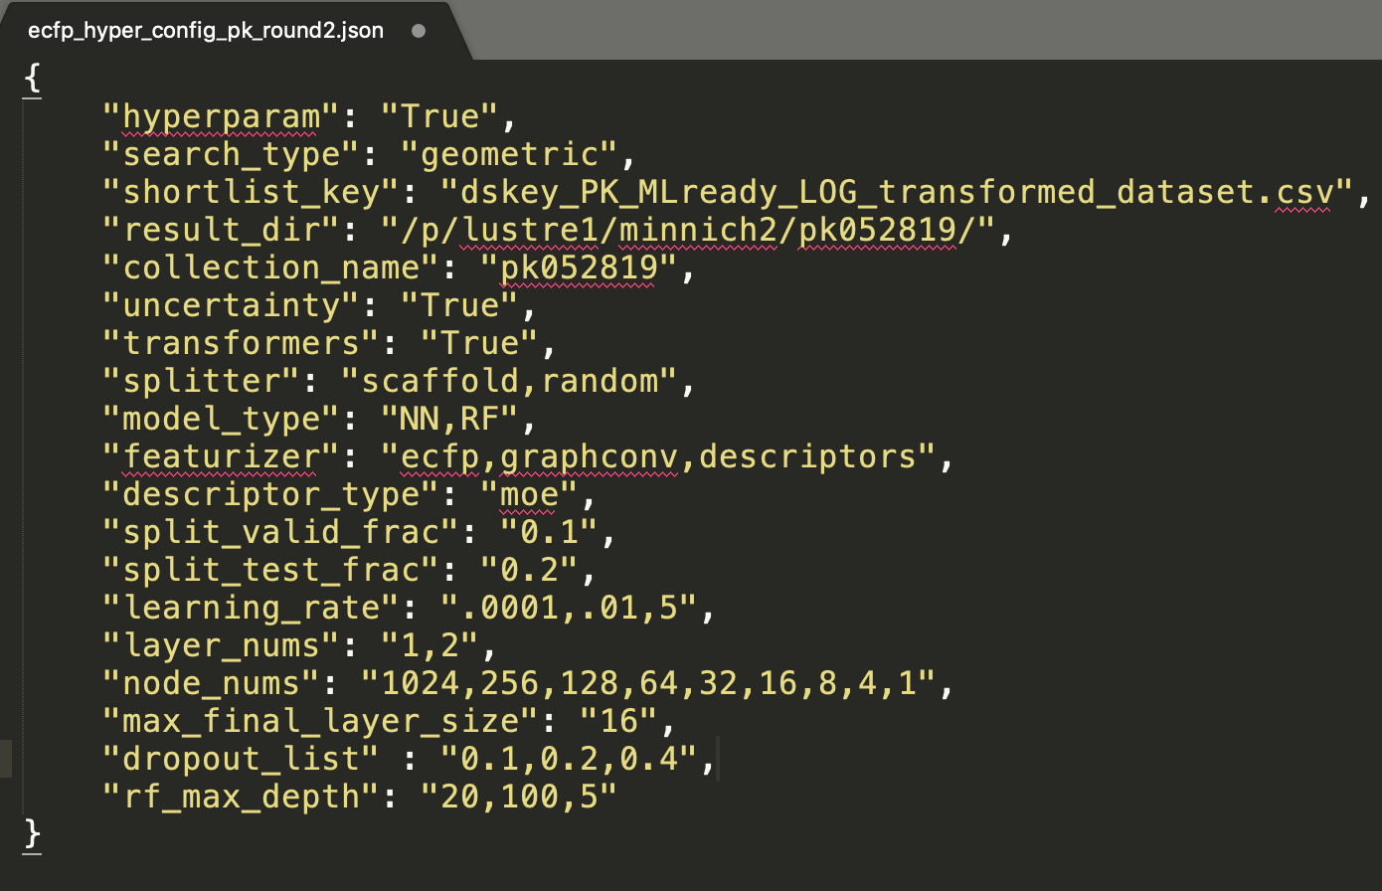
Data Ingestion + Curation
Model Training + Tuning
Featurization
Prediction Generation
Visualization + Analysis
Data Lake
Model Zoo
Results DB
We have a module for distributed brute-force hyperparameter search
Support linear grid, logistic grid, random, and user-specified steps
Specify input with JSON file or command line
Generates all possible combinations of hyperparams, accounting for model type
Groups neural net architecture combinations
Constrains number of parameters in NN based on dataset size
Checks if model already exists in model zoo

Slide 12
Data Ingestion + Curation
Model Training + Tuning
Featurization
Prediction Generation
Visualization + Analysis
Data Lake
Model Zoo
Results DB
Model Portability is key for:
  Releasing to the public
  Sending to partners for testing with internal data
  Incorporating into Multi-Parameter Optimization Loop for generative molecular design
Serialized models are saved to model zoo or disk with detailed metadata
Support complex queries for model selection
One command generates queries from dictionary or JSON file, searches model zoo, and loads matching models

Slide 13
Data Ingestion + Curation
Model Training + Tuning
Featurization
Prediction Generation
Visualization + Analysis
Data Lake
Model Zoo
Results DB
Our models predict
  Binding activation/inhibition values for safety-relevant proteins
  Pharmacokinetic parameters for input into QSP models
  Also working on hybrid ML/Molecular Dynamics models
Calculate model-based uncertainty quantification metrics
If ground truth provided, calculate a variety of prediction accuracy metrics
All predictions and results saved to Results Database or file system based on user preference

Slide 14
Model-building summary
11,552 total models
9,422 Regression models
2,130 Classification models
15 Pharmacokinetic datasets
26 Safety Datasets

Slide 15
PK datasets vary in size and model accuracy
Assays range in size from 71 to 123,759 compounds
5 of the assays show improvement with NN
Descriptors and Graphconv outperform ECFP
Test set R² ranges from <0 to 0.7

Slide 16
Classification performance shows high accuracy
Assays range in size from 187 to 9173 compounds
23 of 28 of the assays show improvement with NN
KCNE1 shows largest improvement
Classification accuracy appears to be relatively high ( >0.8 ROC-AUC)

Slide 17
The second piece is the multi-parameter optimization loop for generative molecular design
  Property Prediction Pipeline
Efficacy
  Multi-Parameter Optimization Loop
Multi-level models
Systems models
Safety
Working
Compound
Library
PK
Design Criteria
Developability
  Generative Molecular Design
proposes new molecules with optimized properties
Notes:
We’re developing an Active learning drug discovery framework that begins with a compound library as the input to our Machine Learning (ML) Pipeline
Grey Loop:
The ML pipeline integrates multi-level models and systems level models of efficacy, safety, and pharmacokinetics as well as developability (an assessment of how “drug-like” a given compound is) to select design criteria for a new drug lead. All of these parameters are simultaneously optimized for the generation of new molecules with optimized efficacy, safety, pk, and developability properties. This multi-parameter optimization loop can be run for numerous cycles.
Active Learning, Teal loop, and Yellow loop:
We then employ an active learning approach that decides if and when a molecular simulation of experiment is needed to improve or validate the models.
Data from these simulations and experiments are then used to re-train our property prediction models
The next slide will zoom in on the grey Multi-Parameter Optimization loop

Slide 18
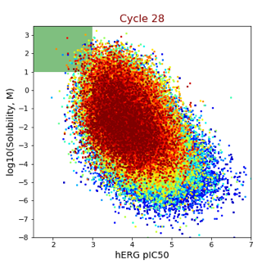




Generative Molecular Design (GMD)
Iteratively generate new compounds with better properties
Property Prediction
Working compound library improving at each cycle
hERG pIC₅₀
Design Criteria
Working Compound Library
Cycle #
Aqueous Solubility
hERG pIC₅₀ < 3
Solubility > 10M
Generative Molecular Design Process
Molecules meeting design criteria
Out
New structures ready for predictions
Optimize
In
Structures with predicted properties
Decode
Encode
Junction tree variational autoencoder transforms molecules into continuous vector
Genetic algorithm perturbs these vectors to create new molecules

Slide 19
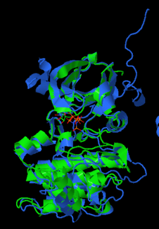
Prediction & Design loop validation
Proof-of-Concept
Generative molecular design of AURK B inhibitors
Starting point:
Early program data
Lead Optimization
End point: Experimental validation
PILOT 1
Why Aurora Kinase?
Cancer relevant: >30 clinical trials are ongoing or completed for AURKA selective, AURKB selective, and AURKA/B dual inhibitors
Internal data available: Potency data on ~24k compounds available for AURK B and/or AURK A
Pharmaceutical discovery relevant problem: Selectivity between kinases is an important and common pharmaceutical discovery problem
Structure overlay of AURK A and AURK B
Notes:
Main goal of pilot: test ATOM’s Generative Molecular Design (GMD) workflow (does it work? Does it generate new compounds? Are the molecules druglike? Can they be validated through experimentation?)
Data Used: this experiment (and the amount of input data available) doesn’t reflect a realistic lead optimization program. Efficacy and encoders were trained with all 24k compounds with AURK assay data (from the 2M compound GSK-ATOM set). Safety and PK models were trained on all data within the 2M compound set.
Aurora Kinase is a family of cell growth and proliferation regulators associated with tumorigenesis
AURK-A: centrosome function
AURK-B: mitotic spindle attachment
AURK-C: germ line cell associate (exact function unknown)
Over 30 clinical trials are ongoing or completed for AURKA selective, AURKB selective, and AURKA/B dual inhibitors for indications in both solid and blood born cancers.
Current best in class molecules have A/B selectivity >100 fold and potencies in the low nM range
Overexpression of each AURK class is associated with different types of cancer and developing A/B selective candidates is a problem typical of lead optimization

Slide 20
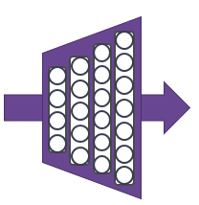

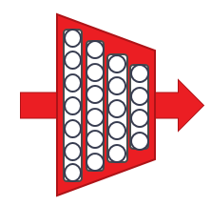
Design Criteria
Proof-of-Concept
Candidate Quality Panel
Efficacy
AURK B (pIC50 > 9)
AURK B/A Selectivity > 1000
Safety
BSEP (pIC₅₀ < 4)
hERG (pIC₅₀ < 4)
PK
Solubility (>10uM)
CL_{int} (<3 mL/min/g)
Developability
Solubility (>10uM)
SAS: Synthetic Accessibility Score
QED: Quantitative Estimation of Druglikeness
Initial Compound Library
(3k compounds)
Property Prediction Pipeline
Efficacy
Safety
Working Compound Library
PK
Developability
Design Criteria
Molecular Optimizer
Decoder
Encoder
Notes:
24k compounds used to build the autoencoder and efficacy models, 3k compounds used to initiate the loop
Machine Learning models were built for each of the parameters on the right.
Candidate Quality panel includes typical criteria that might be set for some parameters. We can adjust these parameter criteria points, and can add many additional parameter models.
Molecular optimizer is an autoencoder that projects into latent space, evaluates structure with parameter predictions, and proposes new chemical structures that get put back through the loop for evaluation.
Results: In an initial 24-hour run, >600k compound structures were generated and evaluated by the Generative Molecular Design platform.
Of those, 36k compounds were unique SMILES strings (not duplicates). >90% of the 36k were novel and not in the GSK-ATOM compound set (2M) or the full GSK compound set at GSK.

Slide 21
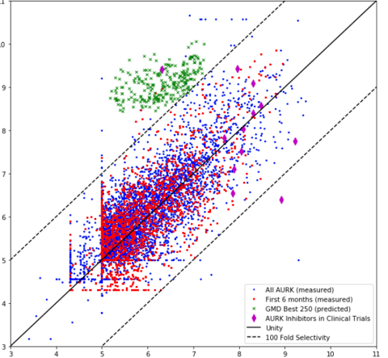
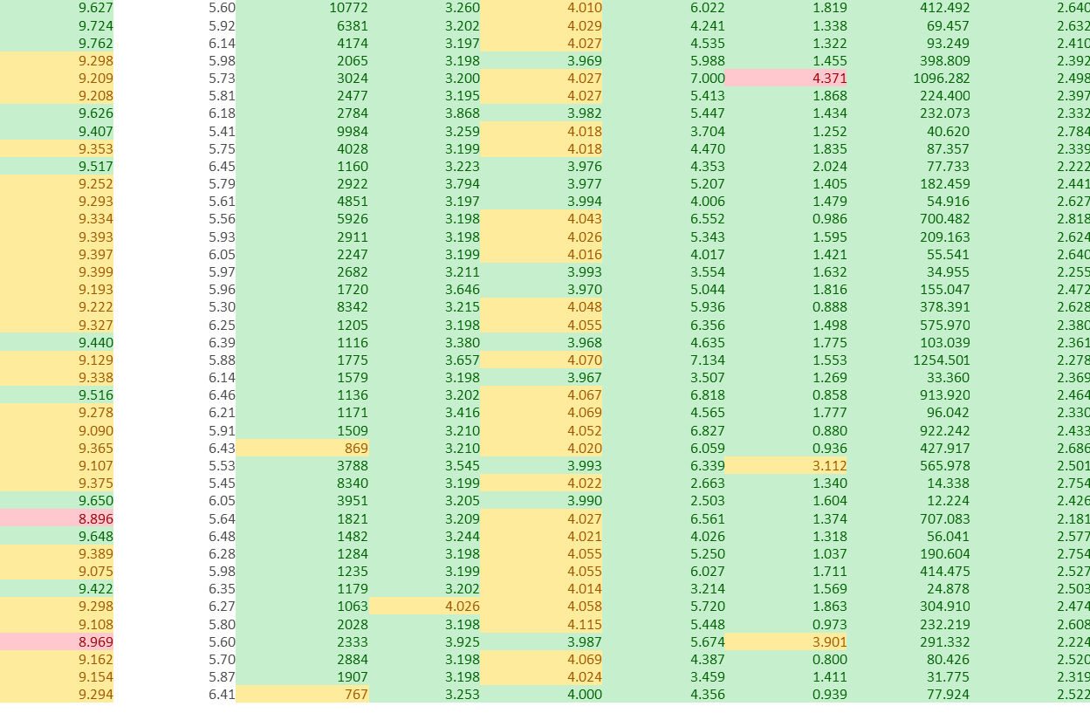
Initial results: >200 new potent, selective AURK B compounds with favorable other properties
Proof-of-Concept
AURK B vs. AURK A pIC50
11
Other design criteria for top compounds:
B pIC50
A pIC50
B/A
hERG
BSEP
PK Sol
CL
Dev Sol
SAS
10
9
8
B pIC150
7
6
5
Legend:
All AURK (measured)
First 6 months (measured)
Best 250 Designed (predicted)
AURK in Clinical Trials
Unity
100 Fold Selectivity
4
3
criteria met
3
4
5
6
7
8
9
10
11
close to criteria
A pIC150
criteria not met
Notes:
Results: The scatter plot shows AURKB pIC50s vs AURKA pIC50s with blue points representing the total compounds in the GSK-ATOM data set that had both AURKA and AURKB IC50 data. The red points represent the first 3k compounds in the working compound library that kicked off the design loop. The dotted lines show A/B selectivity >100 fold. For comparison only, the pink diamonds show compounds in clinical trials, which typically have pIC50 values >8. (note – we did not come up with or produce any of these clinical compound structures). The green points are >250 of the best potent, selective AURK B inhibitors that were generated by ATOM’s GMD platform (out of the 36k generated compounds). A common chemical structure scaffold did emerge in the top compounds, similar to a lead-like series.
The chart on the right shows that these top compounds also scored well against the other parameters we set in our criteria. Green = met criteria. Yellow = close to criteria. Red= did not meet criteria.
Next steps for validation: In comparing our results to previously generated experimental data that exists outside of the ATOM dataset, r2 = 0.74 for AURK B predictions (ground truth data). We are experimentally making and testing 100 of the top compounds and should have those results in a few months.
Follow up work is ongoing to reduce the number of compounds in the training data for the autoencoder and efficacy model to see how well GMD would do with less training data.

Slide 22
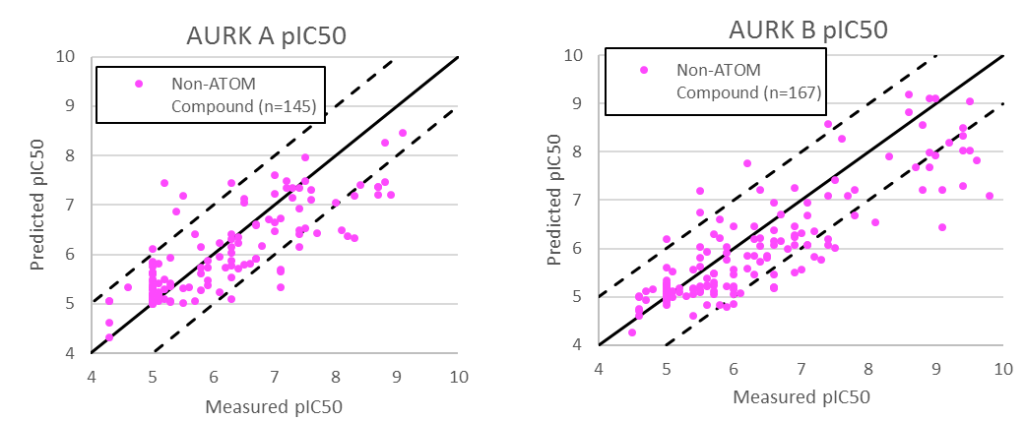
Generated compounds with existing data for comparison
High actual vs. predicted values for AURK
Generated compounds not in our internal dataset are well predicted
R²:
AURK A : 0.68
AURK B: 0.75

Slide 23
Initial Results for Make/Test Cycle Generally Favorable at Meeting Criteria
Criteria | Target | Total Returned | In Target Range (Predicted) | Within 1 log of target
AURK B | pIC₅₀ > 9 | 37 | 15 (9) | 33 (36)
Selectivity | >1000 fold | 38 | 4-6 (2) | 7 (11)
hERG* | pIC₅₀ < 4 | 57 | 10 (33) | 40 (55)
BSEP | pIC₅₀ < 4 | 55 | 9 (1) | 23 (36)
CL_{int} | < 3 mL/min/g | 0 | N/A | N/A
Solubility | >10 ug/mL | 0 | N/A | N/A
* hERG LLQ is <4.3, all compounds at LLQ considered in target
GMD Ranking | AURK B pIC50 | Selectivity | hERG pIC50 | BSEP pIC50 | AURK A pIC50
36 | >10.6 | >316 | <4.3 | 3.7 | 8.1
37 | >10.6 | >3162 | 5.5 | 5.7 | 7.1
38 | >10.6 | >1259 | 4.6 | 5.5 | 7.5
42 | >10.6 | >631 | 6.3 | 4.1 | 7.8
48 | >10.6 | >3162 | 5.8 | 4.4 | 7.1
68 | >10.6 | >1995 | 4.9 | 5.1 | 7.3
47 | 10.2 | 158 |  |  | 8.0
23

Slide 24
Next step: incorporating active learning
  Property Prediction Pipeline
Efficacy
  Multi-Parameter Optimization Loop
Multi-level models
Systems models
Safety
Working
Compound
Library
PK
Design Criteria
Developability
  Generative Molecular Design
proposes new molecules with optimized properties
Active learning decides if/when a simulation or experiment is needed to improve or validate models
Retrain property prediction models
Molecular Feature
Simulations
Simulation
Chemistry Design & Synthesis
Experiment
Human-relevant assays
Notes:
We’re developing an Active learning drug discovery framework that begins with a compound library as the input to our Machine Learning (ML) Pipeline
Grey Loop:
The ML pipeline integrates multi-level models and systems level models of efficacy, safety, and pharmacokinetics as well as developability (an assessment of how “drug-like” a given compound is) to select design criteria for a new drug lead. All of these parameters are simultaneously optimized for the generation of new molecules with optimized efficacy, safety, pk, and developability properties. This multi-parameter optimization loop can be run for numerous cycles.
Active Learning, Teal loop, and Yellow loop:
We then employ an active learning approach that decides if and when a molecular simulation of experiment is needed to improve or validate the models.
Data from these simulations and experiments are then used to re-train our property prediction models
The next slide will zoom in on the grey Multi-Parameter Optimization loop

Slide 25
Future work
Molecular design loop
  Multi-target profile QSAR and model sharing framework
  Scaled up generative models
  Integrate human systems-level PK and safety models
Active Learning Loops
  Experiment - automated chemical synthesis and assay loop
  Computational- Optimal experimental design and integration of mechanistic models
Pilot design studies of increasing complexity
  Genomic target efficacy models
  Network-based design initialization
  Broader chemical space design models

Slide 26

Thanks to our partners and funding organizations
Notes:
Members
25 FTE from 4 member orgs
Sit in office space in Mission Bay
Critical Skills
Computational Chemistry, Systems Modeling, Pharmacology, Drug Discovery, Data Science, Machine Learning, HPC, Software Engineering, Small Molecule Assay Development, Biophysics-based Simulation
different partners are bringing synergistic skills to this collaboration
Funding
2 yrs old, several million per year spread across different institutions

