Slide 1
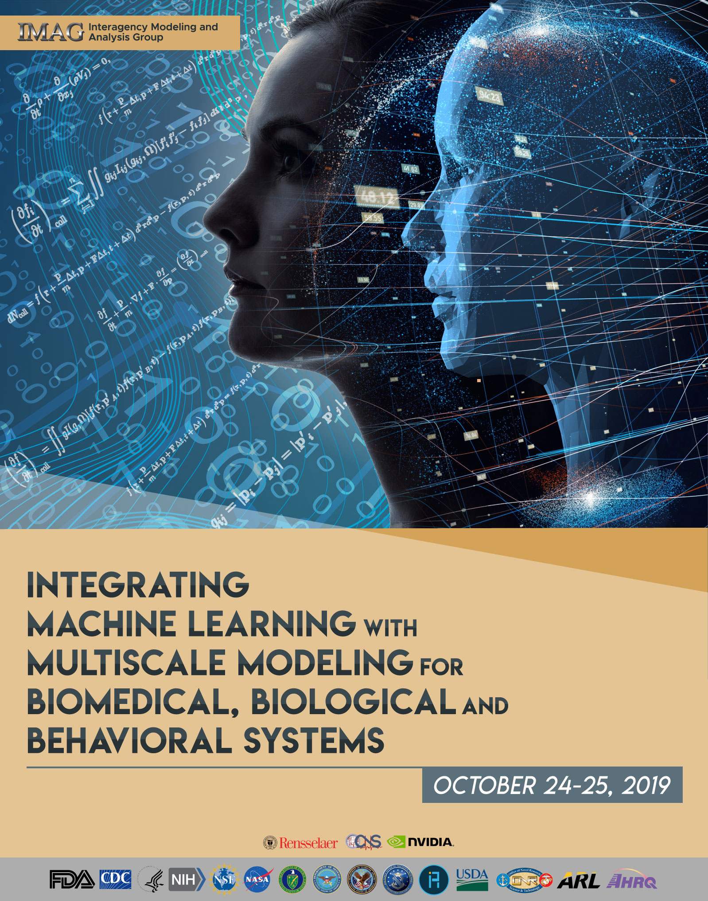
IMAG
Government Panel

Slide 2
Digital Twin – Leonardo Angelone
https://www.imagwiki.nibib.nih.gov/content/digital-twin-overview

Slide 3
Human Safety – Rachel Slayton
https://www.imagwiki.nibib.nih.gov/content/human-safety-overview

Slide 4
Grace Peng (NIBIB) & Dana Anderson (NIDDK)
PA-19-065 Funding opportunity announcement information for applicants and reviewers
Medical Simulators for Practicing Patient Care Providers Skill Acquisition, Outcomes Assessment and Technology Development (R01 Clinical Trial Not Allowed)
Jose Serrano, M.D., Ph.D.
NIDDK
Telephone: 301-594-8871
Email: serranoj@mail.nih.gov
Dana K. Andersen, M.D.
NIDDK
Telephone: 410-868-0638
Email: dana.andersen@nih.gov
Grace C.Y. Peng, PhD.
NIBIB
Telephone: 301-451-4778
Email: grace.peng@nih.gov
Merav Sabri, PhD.
NCCIH
Telephone: 301-496-2583
Email: merav.sabri@nih.gov
Robert Tamburro, MD, MSc.
Eunice Kennedy Shriver NICHD
Telephone: 301-480-2619
Email: robert.tamburro@nih.gov

Slide 5
Focus Areas:
PA-19-065
1. Skill Acquisition - Applications which assess the processes of skill acquisition, skill maintenance, and skill enhancement for practicing clinicians and healthcare providers.
procedural error analysis
error prevention
time course of skill acquisition and maintenance by experienced clinicians
2. Outcomes Assessment - Applications which assess the skills of experienced clinicians and correlate the simulation-based assessment of skill levels with the quality of care experienced by patients treated by these care-givers
safety (e.g., morbidity and mortality)
outcomes (e.g., being free of disease/condition, recovery and rehabilitation from interventions)
costs (e.g., length of hospital stay, cost of treatment)
Comparative studies of clinical skill measurement by simulation methods with the outcomes of patients treated by those practitioners whose skills have been assessed
3. Technology development – next generation simulator development
“virtual coaches” incorporating intelligent methods into existing simulators to provide adaptive, cognitive assistance to coach experienced practitioners in retaining, retraining and improving performance levels in the context of the user environment
Simulators that incorporate artificial intelligence with theory-driven, physics-based, physiologically realistic models
Simulators replicating “real life” workflows, including planning, warm-up exercises, and rehearsal leading up to the actual procedure
Simulators based on physiologically realistic models that operate in real-time, capable of seamless integration in a variety of provider environments → e.g. rural and low-resource settings.
Note: End users are part of the technology development team

Slide 6
Fariba Fahroo (AFOSR) & Virginia Pasour (ARL)
DoD BAA FY2020
Topic 19: (AFOSR) Machine Learning and Physics-Based Modeling and Simulation
Topic 21: (AFOSR) Modeling, Prediction, and Mitigation of Rare and Extreme Events in Complex Physical Systems
Topic 11: (ARO) Adaptive and Adversarial Machine Learning

Slide 7
Steven Lee (DOE): Pre-Meeting Webinar AI for Science Town Halls
Organized by Argonne, Oak Ridge and Berkeley with participation from all the DOE laboratories ...
Four “Town Halls” on AI for Science
Community input on opportunities & requirements in computing with a focus on convergence between HPC, Data, & AI
July (Argonne), August (Oak Ridge), September (Berkeley), October 22-23 (Washington DC)
Meetings cover roughly the same ground & distributed to enable local participation
Applications in science, energy, & technology
Software, math and methods, hardware, data management, computing facilities, infrastructure, integration with experimental facilities, etc.
About 300 people per meeting
Report to guide strategic planning at Labs and DOE
ML-MSM Relevant Topics ML Foundations & Open Problems
Data Lifecycle & Infrastructure
Biology and Life Sciences Software Environments & Research Support for AI at the Edge AI “Killer Applications” – Synth Biology

Slide 8
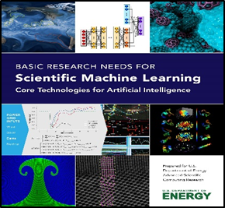
DOE Scientific AI/Machine Learning: Priority Research Needs
Scientific Machine Learning:
Foundations
Domain-Aware: Leverages & respects scientific domain knowledge. Physics principles, symmetries, constraints, uncertainties & structure-exploiting models
Interpretable: Explainable and understandable results. Model selection, exploiting structure in high-dimensional data, use of uncertainty quantification with machine learning
Robust: Stable, well-posed & reliable formulations. Probabilistic modeling in ML, quantifying well-posedness, reliable hyperparameter estimation
Scientific Machine Learning:
Capabilities
Data-Intensive Scientific ML: Scientific inference & data analysis. ML methods for multimodal data, in situ data analysis & optimally guide data acquisition
Machine Learning-Enhanced Simulations: ML hybrid algorithms & models for predictive scientific computing. ML-enabled adaptive algorithms, parameter tuning & multiscale surrogate models
Intelligent Automation and Decision Support: Adaptivity, automation, resilience, control. Exploration of decision space with ML, ML-based resource management, optimal decisions for complex systems
January 2019
Advances in 6 Priority Research Directions (PRDs) are needed to develop the next generation of machine learning methods and artificial intelligence capabilities.
https://www.osti.gov/biblio/1478744

Slide 9
Junping Wang (NSF-DMS) & Chi-Chi May (NSF-BIO)
https://www.imagwiki.nibib.nih.gov/webinars/2019-ml-msm-pre-meeting-webinar-nsf-programs

Slide 10
SYSTEMS & SYNTHETIC BIOLOGY PROGRAM DIVISION OF MOLECULAR AND CELLULAR BIOSCIENCES
Program Directors:
Systems and Synthetic Biology
Division of Molecular and Cellular Biosciences
Elebeoba (Chi-Chi) May, David Rockcliffe
Anthony Garza, Devaki Bhaya, Alias Smith
Notes:
Welcome and thank you for agreeing to serve on one of our advisory panels. The National Science Foundation relies on its volunteer peer reviewers, such as yourself, to maintain the high standards of review for which we are recognized both nationally and internationally.
There is much information on the slides to be presented, and I cannot talk about all of the details in the time allotted for this presentation. So please make sure that you have studied these slides and have understood them and, of course, we will be happy to answer any questions you may have.

Slide 11
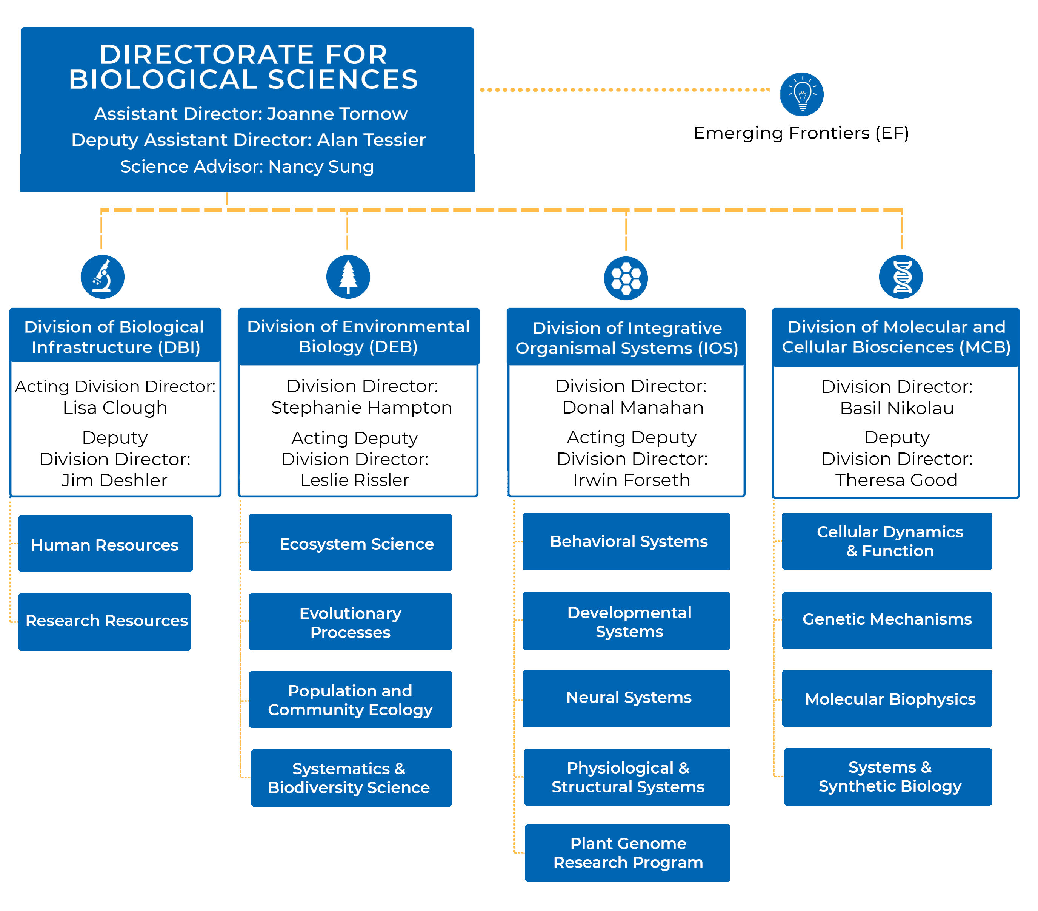
NSF BIO vs NIH
Missions (basic science vs. biomedicine)
Review criteria
Details of review process
Role of program directors (review vs. program)
Process of award recommendation
Budgets (NSF<NIH) and award durations
To enable discoveries that advance the frontiers of biological science for understanding life, and provide a theoretical basis for original research in other scientific disciplines.
Notes:
The mission of the BIO Directorate is to enable funding of discoveries in life sciences to push forward the frontiers of U.S. science and engineering research, and drive discovery and innovation. 69% of academic basic research in non-medical biology is supported by NSF, including BIO.
BIO supports basic research to understand life across scales of biological organization, ranging from atoms and molecules, to cells, organisms, populations, communities, ecosystems and biospheres.
Integral to this mission is the support of both research and education, broadening participation in science, and promoting and fostering collaborations within the U.S. and with international partners.
Our focus is on basic research….
BIO is sub-divided into Divisions that relate to the scales of biological organization and process, ranging from molecules and cells, to organisms and tissues, to organisms interacting with each other or with their environments. BIO is unusual, compared to other Directorates, in that we also have a division devoted to infrastructure, providing dedicated support for human resource and research needs. Finally, our Division of Emerging Frontiers provides support for innovative activities like NSF’s Ten Big Ideas, which I will mention later.
So…let’s take a little close look at the kinds of research supported by the BIO Divisions.

Slide 12
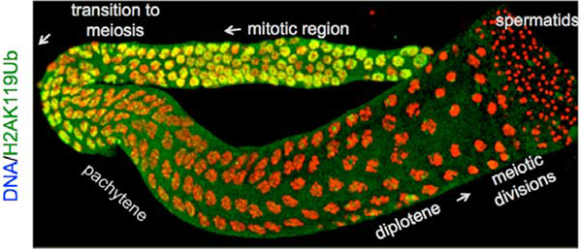
Molecular and Cellular Biosciences (MCB)
https://www.nsf.gov/funding/programs.jsp?org=MCB
The Genetic Mechanisms cluster supports inventive, quantitative research on the structure, dynamics, function and evolution of genes and genomes from diverse organisms.
Areas of interest include: Chromatin- and RNA-mediated regulatory mechanisms; Dynamics and spatiotemporal coordination of genome replication, repair, chromatin modification, transcription, and translation; Origin and evolution DNA, RNA and proteins.
The Molecular Biophysics cluster supports fundamental research on the interplay between structure, dynamics and function of biomolecules, and the principles governing their interactions, mechanisms and regulation.
Areas of interest include: Large scale computations with experimental constraints; Development of multiple time- and length-scale molecular dynamics that inform function; Structures and interactions of large biological assemblies in atomic or molecular detail.
The Systems and Synthetic Biology cluster supports experimental and computational research aimed at understanding complex interactions within biological systems across different scales, facilitated by the use of novel tools in systems and synthetic biology.
Areas of interest include: Mechanistic modeling of regulatory, signaling, and metabolic networks; The origins of life, the minimal cell and emergent behaviors; Novel tool development; Molecular to system-wide scale rules of assembly and function.
The Cellular Dynamics and Function cluster supports theory-driven research using physical, chemical, mathematical and computational approaches for integrative insight into cellular functions.
Areas of interest include: Predictive understanding of the behavior of living cells; Evolutionary approaches to rules governing cellular functions; Integration of function with emerging cellular properties across spatiotemporal scales.
Supports quantitative, predictive and theory-driven research to understand complex living systems at the molecular, subcellular, and cellular levels
Credit: Beckman Institute for Advanced Science and Technology
Credit: Diana Chu, San Francisco State Univ
Notes:
Please remember that you cannot participate in the review of a proposal if you have a conflict of interest. These conflicts include, but are not limited to, mentorship of a PI as your former student or postdoc, and these are lifetime conflicts.
If you have an active collaboration with a PI or a Co-PI, this is a conflict. And, if you have an authorship or co-authorship with a PI or a Co-PI in the previous 48 months, this also constitutes a conflict.
If within the last 12 months you have served on a panel with a PI or Co-PI, this is a conflict.
And, as noted on this slide, financial, family, and employment issues also raise conflicts. Please look at this information carefully, and ask us if you have any questions.
We ask you to return the signed conflict of interest form that we sent to you before the panel starts.

Slide 13
NSF BIO/MCB Programs (ML-MSM)
NSF 18-585: MCB investigator-initiated research projects **NO DEADLINES
Rules of Life Proposals (RoL; BIO) : supports integrative research and training that identifies underlying general principles that operate across hierarchical levels of living systems
Engage or enable innovative approaches to fundamental questions in biology;
Seek to discover, enable and/or test foundational principles (rules, theory) that explain or predict the emergence of complex phenomena in biology; and
Integrative approaches that span levels of biological organization beyond a single BIO Division.
MODels for Uncovering Rules and Unexpected Phenomena in Biological Systems (MODULUS; MCB/DMS)
Novel mechanistic mathematical models to guide biological exploration and discovery of new rules in living systems
Encourage new, substantive collaborations between mathematical and biological scientists
Pushing the boundaries in SSB and MathBio programmatic areas
MODULUS Proposal Submission
Math Biology Program PD 18-7334 (September 5) / MCB/SSB NSF 18-585 (Submission window - Anytime)
Submit prior to April 1st 2020 for FY20 funding consideration / Include “MODULUS” in title
Notes:
Please remember that you cannot participate in the review of a proposal if you have a conflict of interest. These conflicts include, but are not limited to, mentorship of a PI as your former student or postdoc, and these are lifetime conflicts.
If you have an active collaboration with a PI or a Co-PI, this is a conflict. And, if you have an authorship or co-authorship with a PI or a Co-PI in the previous 48 months, this also constitutes a conflict.
If within the last 12 months you have served on a panel with a PI or Co-PI, this is a conflict.
And, as noted on this slide, financial, family, and employment issues also raise conflicts. Please look at this information carefully, and ask us if you have any questions.
We ask you to return the signed conflict of interest form that we sent to you before the panel starts.

Slide 14
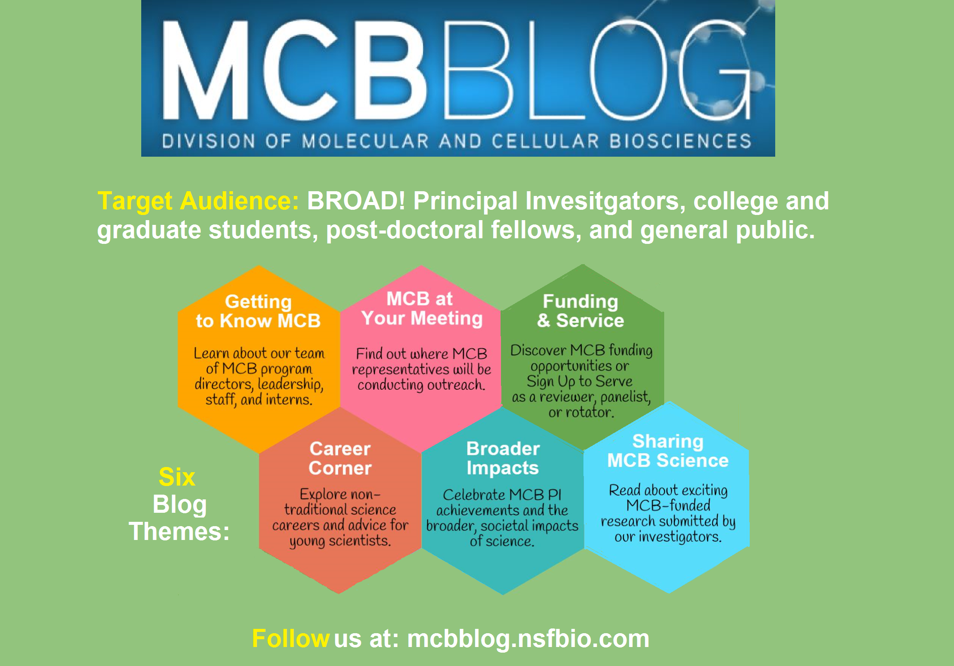

Slide 15
David Miller (NCI) & Jennifer Couch (NCI)
https://www.imagwiki.nibib.nih.gov/content/mechanistic-multiscale-modeling-information

Slide 16
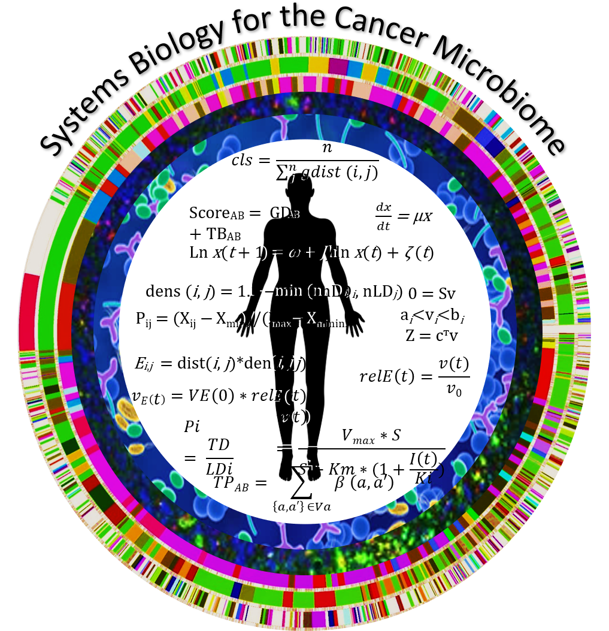
Exploring Emerging Areas for Cancer Systems Biology
2020 Innovation Lab (date TBD):
Advancing cancer biology at the intersection of Deep Learning and Mechanistic Models
Watch for updates at @NCISysBio
Goals:
Bring together researchers from diverse fields – scientific convergence
Intense, boot-camp science setting to encourage broad idea generation
Promote new collaborations

Slide 17
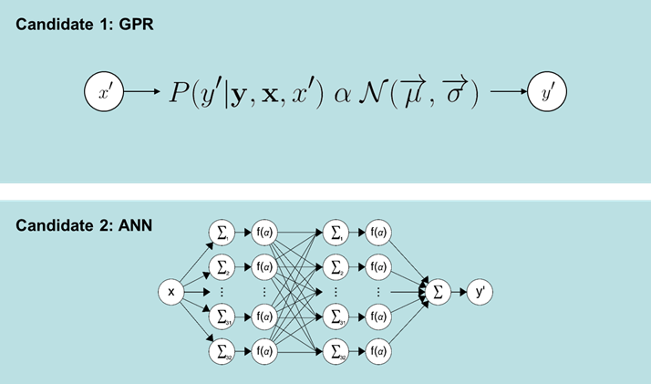
Jerry Myers (NASA)
GRC Human Research Program Computational Models
Central nervous system – Behavioral Medicine – Sensorimotor (CBS)
Requirements/Need
Quantify effect of higher levels of integrated space flight stressors including altered gravity, radiation, and isolation/confinement on cognition, motor function, behavior and mood, and neurological function.
Approach
Develop CBS computational framework.
Integrate translational models and spaceflight data from both clinical operations and research into CBS computational framework.
Ensure computational simulations can be used to inform permissible outcome levels and permissible exposure levels to protect the integrated central nervous system.
Via identification, modification, or de novo simulations, provide models that translate effects from measurable biomarkers to relevant performance metrics specified by the CBS portfolio.
Candidate 3: SVM
17

Slide 18
Joshua Elliott (DARPA)
Artifacts
Universal
Actionable
Abstract
Knowledge
Problem Statement
Scientists construct artifacts that trap scientific knowledge in papers and code that cannot be readily extended, composed, or explored.
Papers
Visualization
EMMAA
COSMOS
Structured
Knowledge
AutoMATES
AMIDOL
AutoMATES
AMIDOL
COSMOS
EMMAA
Executable
Knowledge
Code
Execution
Approach
Extract structured knowledge from these artifacts into a universal framework for metamodeling tasks, providing an innovative vision of:
Scientific model development
Teaching computers to understand science.

