Slide 1
A Model Repository

Slide 2
Introduction
This session will be a discussion on the merits of model repositories.
Stop me at any time with questions, points of clarification or statements you’d like to make.

Slide 3
Model Repositories
A place where researchers can search for and download published models, and where applicable associated data sets.
Some already exist: ModelDB, Biomodels, CellML Repository, and JWS Online. These are specifically quantitative and simulatable models databases and include models across all organisms. All are fairly large repositories.

Slide 4
Model Repositories
BiGG: Large Stoichiometric models of metabolism
DoD: BLAST INJURY RESEARCH PROGRAM COORDINATING OFFICE. Planning a registry of human centric models.
Do we need another repository or would it be better to strengthen existing ones?

Slide 5
Model Repositories
A good idea or not? IMAG is a large group of modelers, do we think such a repository would be useful?
Maybe it’s not important.
Maybe it is important to only a small number of people in IMAG?
The purpose of this session is to gauge interest and constructive input from the IMAG community.
The end result will likely be a white paper summarizing our discussions.

Slide 6
Model Repository
Is there a problem that actually needs to be addressed?

Slide 7
Is there a Problem that Needs Solving?
What are the current problems?
Models are scattered throughout the literature.
The majority of models are inaccessible because they are published in an incomplete form or contain hard to identify errors.
There is no quality control at the review stage when a paper is submitted.
The code for a model is not always uploaded with the publication.
Large sums of tax dollars are wasted through inefficiencies and loss of research effort.

Slide 8
Playing Devil’s Advocate
Arguments and Counter Arguments to a Repository:
Models would be guaranteed to work in a repository
Getting a model to work is a good exercise for a graduate student
I believe most published models do work, quality control at the review stage is sufficient
Models would be more easily searchable
I can use Google/Bing for all my model searches
It would be in the national interest to have a repository
I don’t think so because…
It would make research more efficient and in the long term lead to more discoveries.
I think what we have now is efficient enough.

Slide 9
Playing Devil’s Advocate
Arguments and Counter Arguments to a Repository:
1. We don’t need any special infrastructure, just upload everything to GitHub.
Response: Have you actually tried using GitHub? Most biologists would be lost.
2. GitHub is currently free because the owner deems it so, in the future this may not be true
Response: If GitHub dies we’ll move to the next shiny free thing and store out models there. At UW we have ‘unlimited’ Google drive storage, we can upload all our models there.

Slide 10
Playing Devil’s Advocate
Arguments and Counter Arguments to a Repository:
What evidence is there that such a repository would even be used or useful?
For 2018, 75,000 models a month were downloaded from the Cambridge Biomodels site.
In addition, roughly half that from the Caltech mirror. About 1,000,000 downloads a year
Comparison: PDB 143,839,718 downloads in 2017

Slide 11
Other Issues: Funding
There have been past attempts to set up model repositories in the US but they folded when funding came to an end. Everything disappeared, including the infrastructure and any models they had. All that remains are a couple of published papers. Well intentioned efforts but critically flawed.
A repository cannot be easily funded by an R01 or other similar mechanism. There needs to be a clear and credible sustainability mechanism.
Possible Solution:
One option is to team up with an existing partner and distribute the risk. If one partner were to falter the other would continue and vice versa. The stress inherent in trying to sustain such a resource would be diminished. Managing a long term resource is not fun.

Slide 12
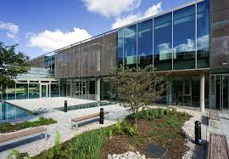
Introduction to Biomodels
Biomodels was setup in: 2005
Nicolas Le Novère Benjamin Bornstein Alexander Broicher Mélanie Courtot Marco Donizelli Harish Dharuri Lu Li Herbert Sauro Maria Schilstra Bruce Shapiro Jacky L. Snoep Michael Hucka
EBI hosts biomodels and is based near Cambridge, UK
The initial batch of curated models (about 100 I believe) came from myself, Mike Hucka and Nicolas Le Novere. Since then Biomodels has been funded internally from EBI and is now a long term resource.
Basic stats: 650 curated (guaranteed to work) and over 1000 noncurated models (2017)
They are now on their 31st release.

Slide 13
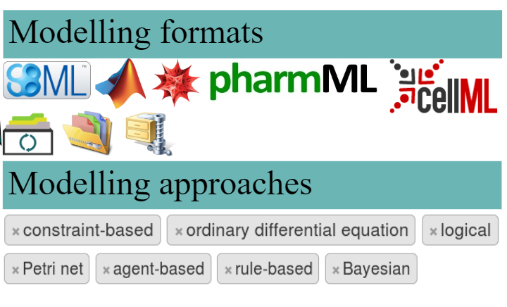
Introduction to Biomodels
Basic stats: 650 curated and over 1000 noncurated models (2017)

Slide 14
Going Forward
1. Develop a white paper summarizing the state of the field and future opportunities. Anyone who would lime to be part of this, contact me at
hsauro@uw.edu
2. I would also suggest investigating partnering with Biomodels in Europe and/or other initiatives (e.g the proposed DoD repository). I know Biomodels is open to such partnering.
The advantage of partnering with Biomodels is that it has an compute infrastructure in place, and it has considerable curation expertise.

Slide 15
What would such a Repository hold?
The primary focus of Biomodels has been subcellular non-spatial models.
As a partner the US could focus on spatial, neurophysiology, biomechanics (possibly with SimTk) and multicellular models. This would complement Biomodels. We would also expand to include any associated.
The repository would not be restricted to an particular language, deployment mechanism, or exchange format, particularly since there are no standard means to represent models beyond subcellular.

Slide 16
Most Important Aspects of a Repository
In my view there are two critically important aspects of a model repository without which there is no point in even thinking about one. These include:
1. Long term sustainability
2. Curation of models. There must be quality control of all models deposited at the repository.

Slide 17
Most Important Aspects of a Repository
In my view there are two critically important aspects of a model repository without which there is no point in even thinking about one. These include:
1. Long term sustainability
2. Curation of models. There must be quality control of all models deposited at the repository.

Slide 18
Minimum Curation Requirements
Does the model run and repeat the reported results?
Is there adequate documentation on how to run the model?

Slide 19
Desirable Attributes of a Repository
Are the models curated, i.e do they work as published?
How easy is it for someone to download the model and get the modeling running on their computer?
Are the model reusable, i.e can parts of the model be separated out or can the model be used to build larger models?
Are the models readable (i.e they are not just a mass of impenetrable computer code)?
Is the model in a form that would allow it to be reproduced, i.e is it possible to recreate the results of the model based on the given biological description and assumptions?

Slide 20
Desirable Attributes of a Repository
Is the repository fully searchable?
Are model annotated in any way?
What other metadata other than annotation is provided with the models?
Are any data or modeling standards used or is it just ad hoc code and data?
Are model sunder version control
Compliance Ranking of Models. E.g use criterion from the CPMS%, MIRIAM#, MIASE* etc.
%Committee on Credible Practice of M&S in Healthcare #Minimum information required in the annotation of models *Minimum information about a simulation experiment

Slide 21
Committee on Credible Practice of M&S in Healthcare (CPMS)
Rule 1 – Define context clearly.
Rule 2 – Use appropriate data.
Rule 3 – Evaluate within context.
Rule 4 – List limitations explicitly.
Rule 5 – Use version control.
Rule 6 – Document adequately.
Rule 7 – Disseminate broadly.
Rule 8 – Get independent reviews.
Rule 9 – Test competing implementations.
Rule 10 – Conform to standards.
Other:
Build system clearly described
How to repeat published results
Source of data
Uncertainty quantification

Slide 22
Long term advantages of a repository?
A one-shop site for all published biomedical models, possibly federated
PubMed would be able to directly link papers to curated models
It might encourage more standardization of models beyond subcellular

Slide 23
What might be the long term advantages of a repository?
A repository would become a valuable resource for doing metastudies
Models could be more easily compared and contrasted
New studies would be easier to do because they could be based on existing models

Slide 24
What organizations might assist in the US?
NLM is clearly a prime candidate to help with such an initiative
There could be inputs from NSF, DOE, DoD, NASA

Slide 25
Additional Points from Jim Bassingthwaighte
1. Spreading the idea that sharing is critical is going counter to parochial behavior.
2. Financially, there is huge redundancy in biological research.
3. What should a repository contain and how should the material be curated?
4. Where should it be positioned from the US point of view for long term operability, security and endurance? The NLM might be ideal, but the processes of quality control, verification, and the provision of data for validation testing present difficulties. This is tougher to do than PubMed.
5. The gist of this message is that it is in the national interest to create some permanence in biological research that is more integrative than individual published papers.

Slide 26
Discussion

