Slide 1
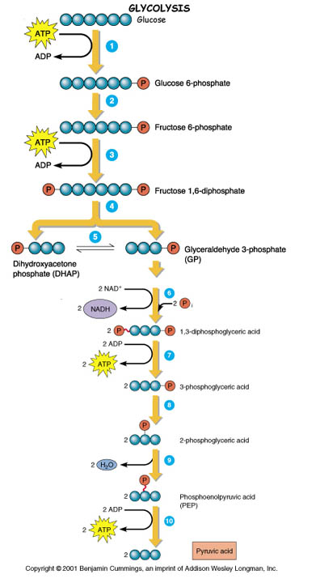
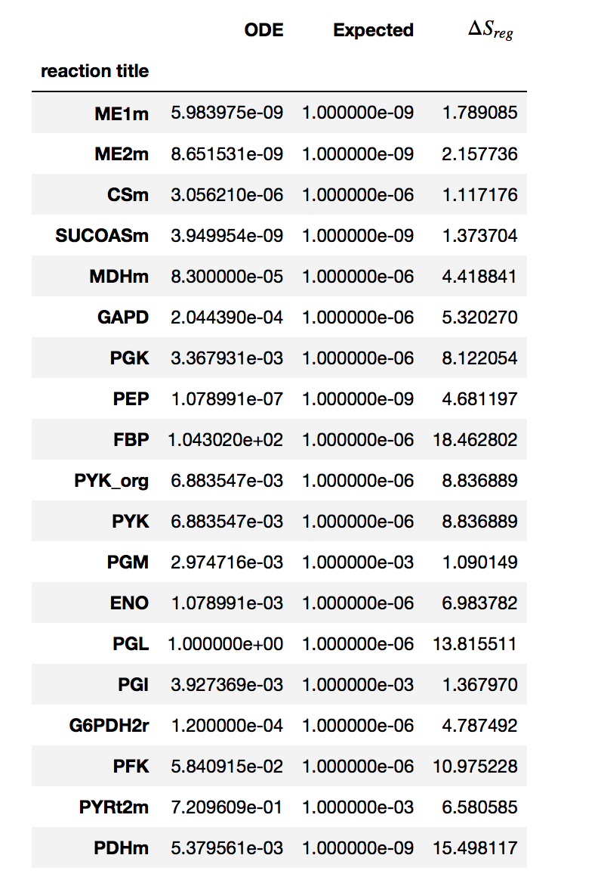
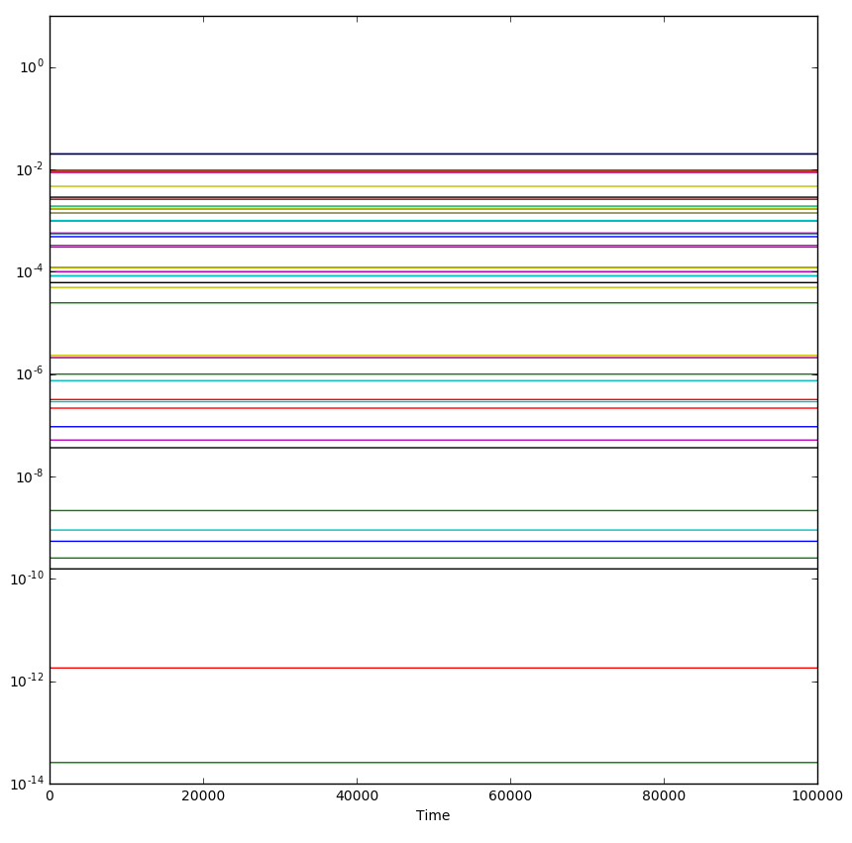
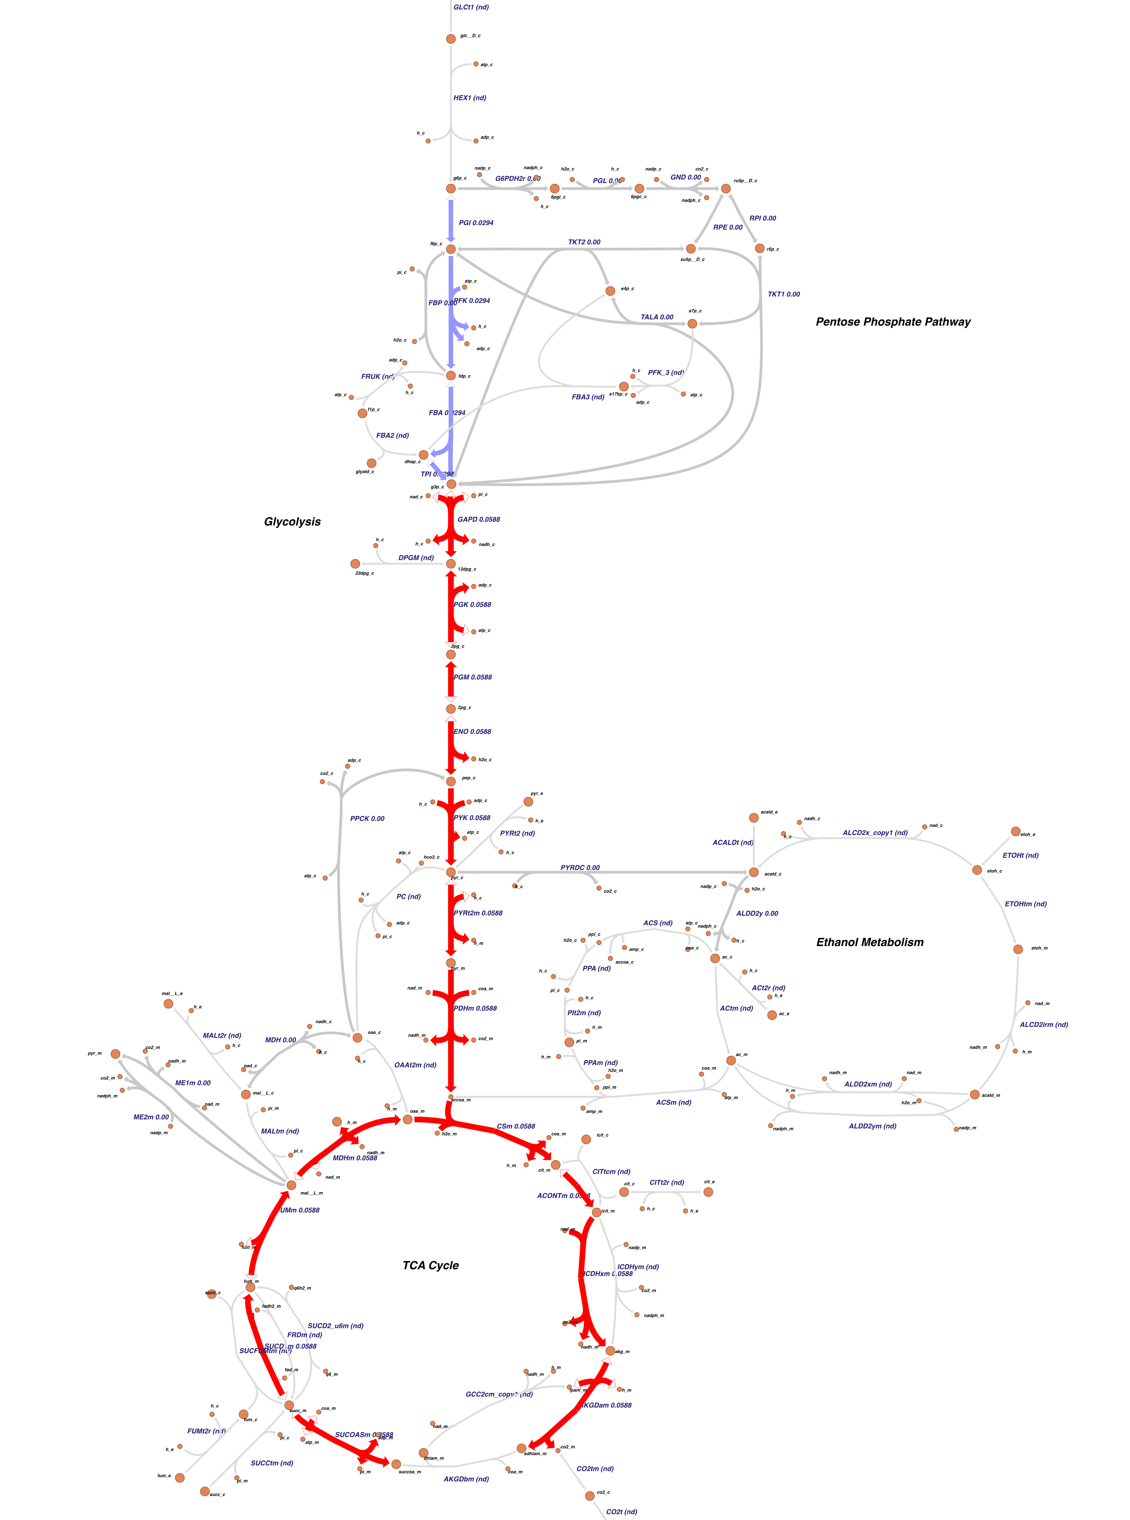
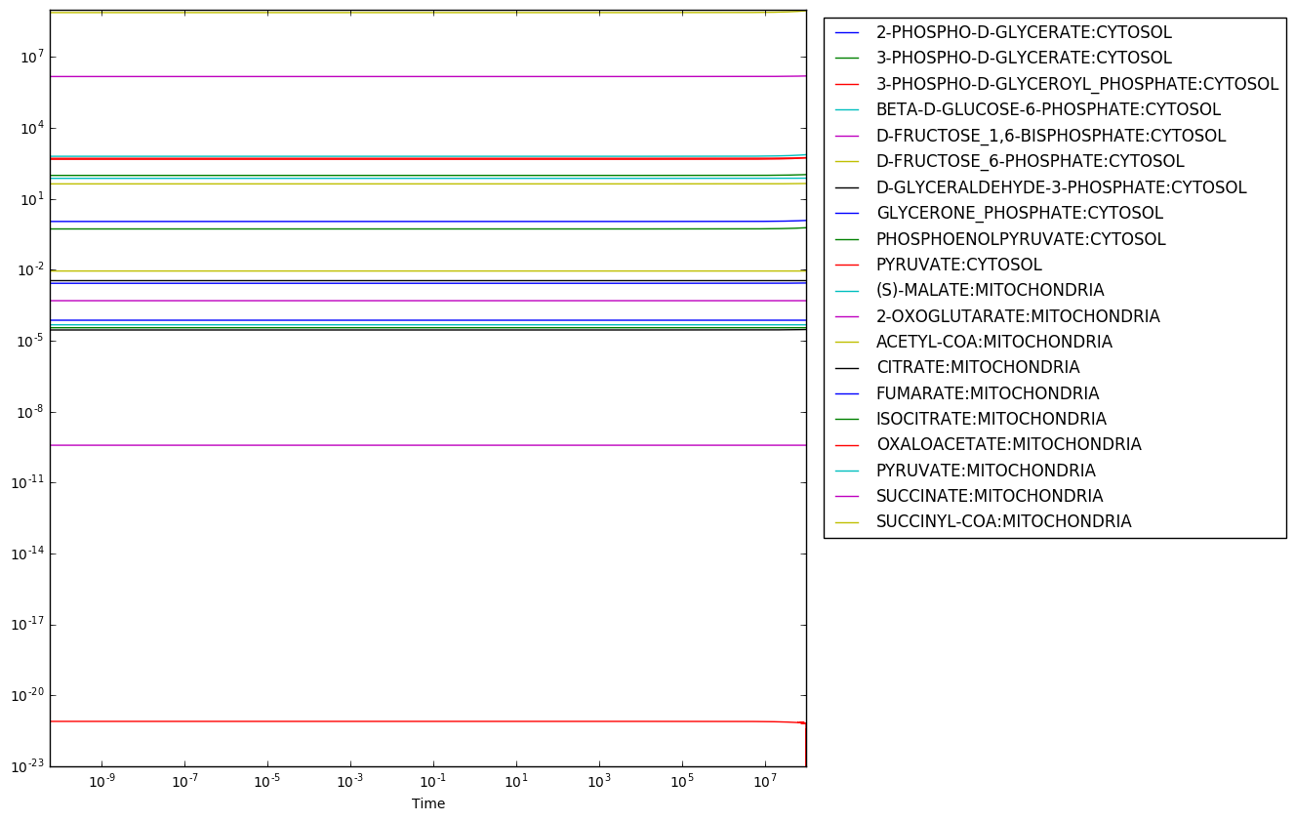
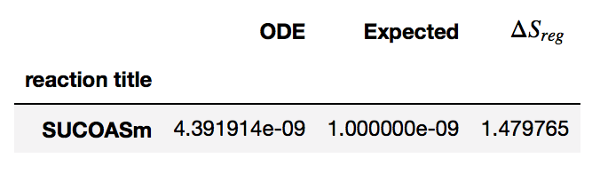
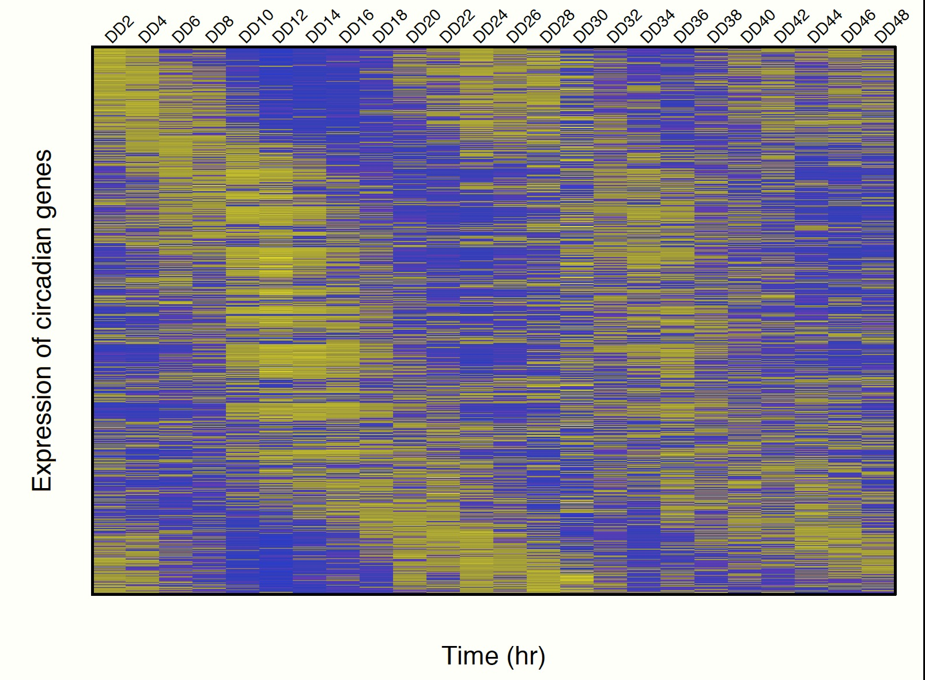
Multi-scale Modeling of Circadian Rhythms:
Model Credibility Plan
Bill Cannon^{1,}*, Jennifer Hurley², Jeremy Zucker¹, Neeraj Kumar¹ & Jay Dunlap³
¹ Pacific Northwest National Laboratory, ² Rensselear Polytechnic Institute, ³ Dartmouth University
Prediction of Dynamics & Regulation
The new approach to the law of mass action does not require rate parameters but instead uses chemical potentials (1). Due to the statistical formulation of the theory, the approach can directly integrate metabolomics and proteomics data.
Prediction of Regulation
Metabolite Concentrations
Simulation Procedure
Optimization and Maximum Entropy Production
Experiment
Before Regulation
After Regulation
Metabolite Concentrations
Simulation
1 mM
How similar is the simulation to experimental measurement when averaged over the experimental data?
The Marcelin Equation sets each of the decay rates of the forward and reverse forces to the same rate. Assuming the same decay rate for all reactions removes any kinetic bottlenecks in phase space of the system such that the dynamics are governed only by the thermodynamics
1 mM
Simulation Time
Purpose and Intended Use of Models
Math: New ODE formulation of the law of mass action based on statistical thermodynamics
  ODE: instead of k₊ and k₋ ‘s use μ’s (chemical potentials) .
  making steady state the reference state, enabling the expanding and collapsing of reaction networks as needed, and hence expanding and collapsing time scales as well.
Intended Use:
  Cellular metabolism
  Non-metabolic process such as regulation and protein expression.
  Two Use Case scenarios
    Experimental data on metabolite concentrations are available.
    No data available – uses a maximum entropy production rate assumption
In principle, (1) can be used for any sets of coupled reactions, but not (2).
Key Components of the Plan
Mathematical Model
  Uncertainties in chemical potentials (parameters)
    Dependent on cytoplasm solvent properties
  Test Impact of uncertainties of chemical potentials on reaction rates?
Biological Model
  Impact of parameters on cell dynamics, specifically the time dependence of
    the metabolic reactions,
    regulation and
    clock time.
  Use case scenario 2: Characterize impact of maximum entropy production rate assumption on replication energetics and natural selection.
Progress of the Plan
  Discussed Uncertainty Quantification with DOE Center on Uncertainty Quantification
  Ensemble modeling of parameters
  Others:
    Bayesian modeling
    Polynomial Chaos Expansion (stochastic system)
    Circadian Response Analysis
Challenges and Opportunities: Biological Validation
Opportunities: Proteomic state
  Proteomic state: key clock proteins can be measured.
    Are simulations and experiments congruent?
Challenges: Metabolic state
  Getting experimental data: C13 Metabolic fluxes from a filamentous fungi
  Chemostat with filamentous fungi is problematic.
  Alternate validation:
    Comparing simulations with experimental clock protein data.
    E. coli MFA
Working with Wayne Curtis (Dept. of Chemical Engineering, PSU) on metabolic flux analysis.
Timelines and Milestones
Will test in final year. Could test mathematical model sooner.
  Two evaluations
    Matlab script for simple mathematical model to test general concept
    Python notebook and/or C library for biological model using same math.
3 weeks of funding for credibility testing for a third party
  We expect that the testing actually take less time.
Testing: Flexibility to barter within the MSM consortium.
Uniqueness
(Hypothesis) Evaluation of maximum entropy assumption also provides insight into natural selection.
Potentially team with DOE UQ Institute for uncertainty quantification.
File Name // File Date // PNNL-SA-#####
References
1. Cannon WR & Baker SE (2016) Non-Steady State Mass Action Dynamics Without Rate Constants Physical Biology, 14, 055003, 2017, DOI: 10.1088/1478-3975/aa7d80.
2. Dreyfuss JM, Zucker JD et al. (2013) Reconstruction and validation of a genome-scale metabolic model for the filamentous fungus Neurospora crassa using FARM. PLoS Comput Biol 9(7):e1003126.
3. Hurley JM, Loros JJ, & Dunlap JC (2016) The circadian system as an organizer of metabolism. Fungal Genet Biol 90:39-43.
4. Hurley JM, et al. (2014) Analysis of clock-regulated genes in Neurospora reveals widespread posttranscriptional control of metabolic potential. Proc Natl Acad Sci U S A 111(48):16995-17002.
Notes:
.
Discussion of table in proposal vs recent results that include respiration, etc.
Discussion of maintenance energy definition – McCarty, and recent objections
Discussion of Biotic General Equilibrium Theory (BGET) (Tasoff 2015)
Discuss proposed proxies for energetics:
Enzyme expression (vitamin B12 requires elaborate enzyme machinery but relatively tiny amounts of flux
ATP utilization (Akashi and Gojorobi 2002) (tryptophan requires more phosphate bonds to break than glycine, for example)
Flux diverted from biomass
Degree of reduction due to electron donors and acceptors (Rittman & McCarty)
Imagine a co-culture consisting of two organisms, Roseibaca calidicalus HL-91 and Halomonas sp HL-48, which produces two metabolites of identical quality. In HL-48, the more efficient organism, it is possible to produce Alanine and B12 with less energetic cost than it would take to produce the same quantities in HL-91. However, the relative costs of producing these two metabolites differ between the organisms:
Organism Alanine B12
HL-91 100kJmol 120kJmol
HL-48 90kJmol 80kJmol
In this illustration, HL-91 could commit 100kJ to produce 1 mole of Alanine or produce 56 moles of B12. HL-48 could commit 90kJ to produce 1 mole of Alanine or produce 98 moles of B12. So, HL-48 possesses an absolute advantage producing Alanine due to less energetic cost, and HL-91 has a comparative advantage due to lower opportunity cost.
In the absence of trade, HL-91 requires 220kJ to both produce and consume one mole each of Alanine and B12 while HL-48 requires 170kJ to produce and consume the same quantities. HL-91 is more efficient at producing Alanine than B12, and HL-48 is more efficient at producing B12 than Alanine. So, if each organism specializes in the metabolite for which it has a comparative advantage, then the global production of both metabolites increases, for HL-91 can spend 220kJ to produce 2.2 moles of Alanine while HL-48 can spend 170kJ to produce 2.125 moles of B12. Moreover, if both organisms specialize in the above manner and HL-91 trades a mole of its Alanine for 56 to 98 moles of HL-48's B12, then both organisms can consume at least a mole each of Alanine and B12, with 0 to 0.2 moles of Alanine and 0 to 0.125 moles of B12 remaining in each respective organism to be consumed or exported. Consequently, both HL-91 and HL-48 can consume more Alanine and B12 under free trade than in autarky.

