Slide 1
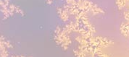
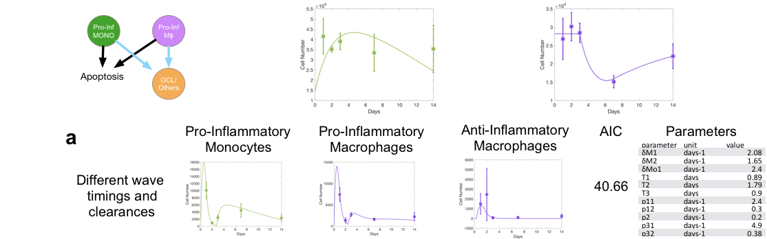
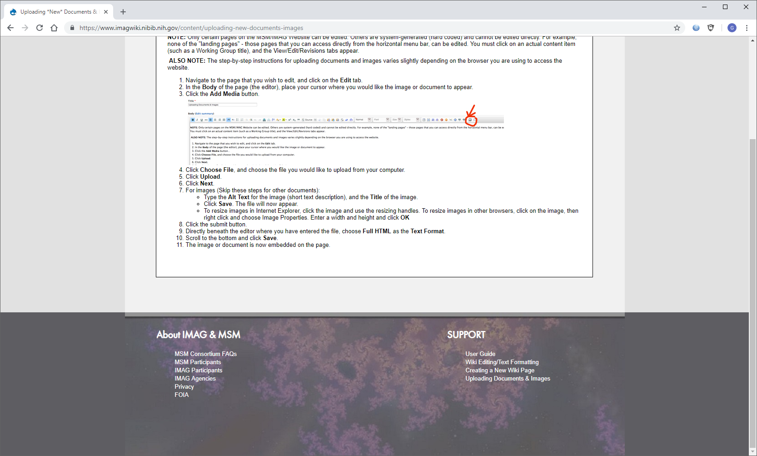
Macrophages and the cancer bone ecosystem
The model An Ordinary Differential Equations (ODEs) multiscale framework describing the cells in the bone ecosystem and the signals that mediate bone homeostasis. The framework is designed to allow for the exploration of novel hypotheses regarding macrophage polarization in the bone.
What is new inside? Whave used a flexible ODE framework to systematically explore novel hypothesis of bone macrophage polarization to uncover new biological hypothesis.
How will this change current practice? Many novel cancer treatments are beginning to take macrophages into consideration but their role and polarization in the bone ecosystem remains unknown yet. Our work allows us to understand how cancers take advantage of this polarization, how treatments impact it and how to better apply treatments to allow for macrophages to hinder tumor progression.
End Users The team is made of modelers, experimentalists and oncologists. In this stage the users are bone biologists and, as model-generated hypothesis are tested. Oncologists delivering treatments to patients with primary and metastatic bone cancers.
Conor Lynch & David Basanta. Moffitt Cancer Center
U01CA202958-01 IMAG MSM}
Notes:
Top figure shows some of the relevant stages involved in injury repair in the bone that the multiscale model captures. The bottom figure shows an example of hypothesis that our framework allows us to quickly explore and contrast to the experimental data.
To include in NOTES section
define/explain it enough for a non-scientific person to explain to the general public (2-3 sentences): Most biological and mathematical models of cancer neglect the ecosystem in which tumors grow. This is an important omission as this ecosystem determines how the tumor will evolve and how treatments will impact it and influence the emergence of phenotypes that are resistant to the treatments. Multiscale mathematical models can bridge the gap between biological data and clinical needs by incorporating environmental and bone ecological data in a way that allows for hypotheses testing and exploration.
List future challenges or next steps after your project is done (1 sentence): We are currently testing model-generated hypothesis on how existing IFN-Gamma treatments would impact bone recovery after injury. If those are validated we will incorporate emerging data with regards to prostate metastases and explore how macrophage polarization would impact metastatic evolution.
Multiscale modeling: Flow cytometry data is easy to acquire in bone biology but the multiscale processes involved in injury repair and bone homeostasis crucial to explain prostate cancer to bone metastases are hard to elucidate with experimental tools alone. Our ODE framework allows us to efficiently explore many unexplored biological hypothesis connecting various escales of bone biology (molecular and cellular) and contrast model outputs with flow data to determine the most plausible ones. This framework is a highly coupled ODE system ensuring that only a robust approximation to the biological reality will be consistent with the experimental data and that the model predictions will lead to novel experimentally testable hypotheses in regards to treatment.
PI name, email: David Basanta (David.Basanta@Moffitt.org)

