Slide 1
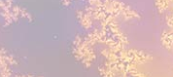
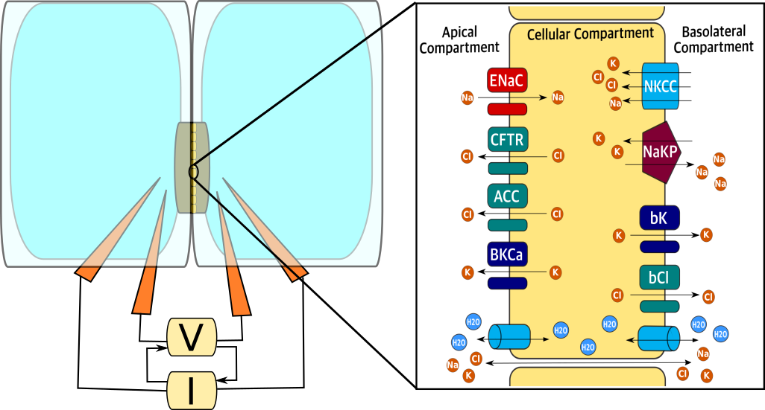
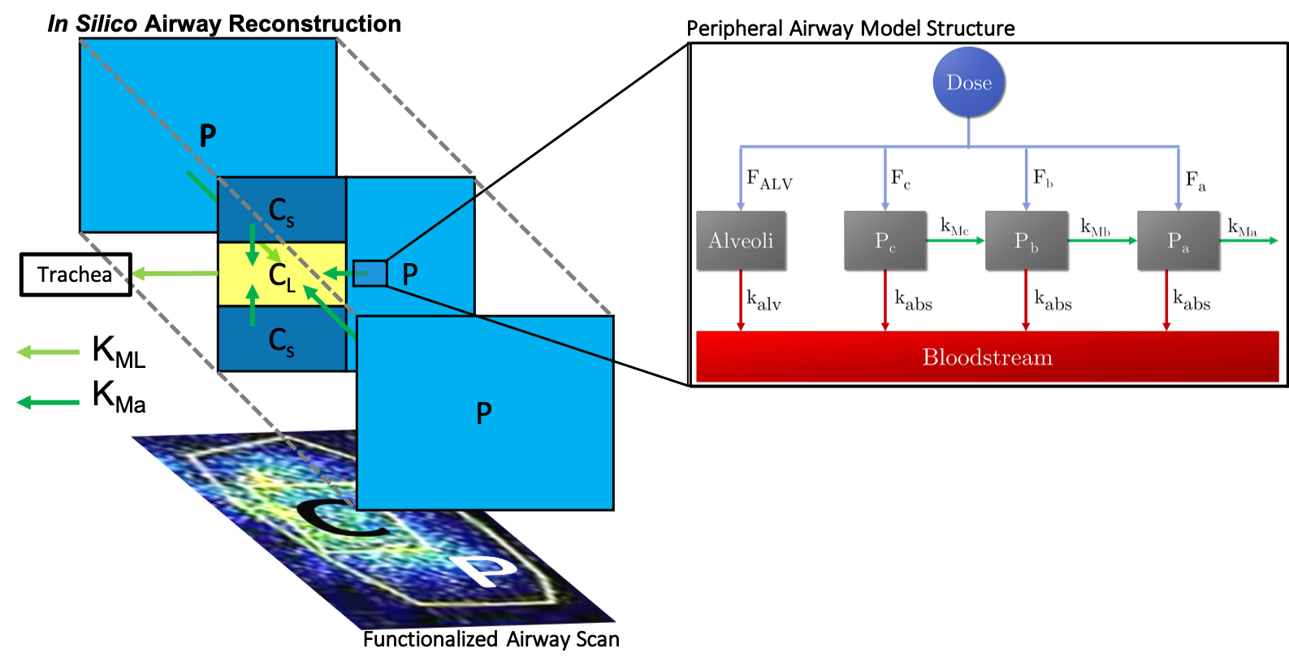
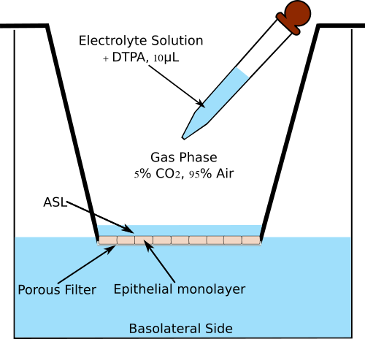
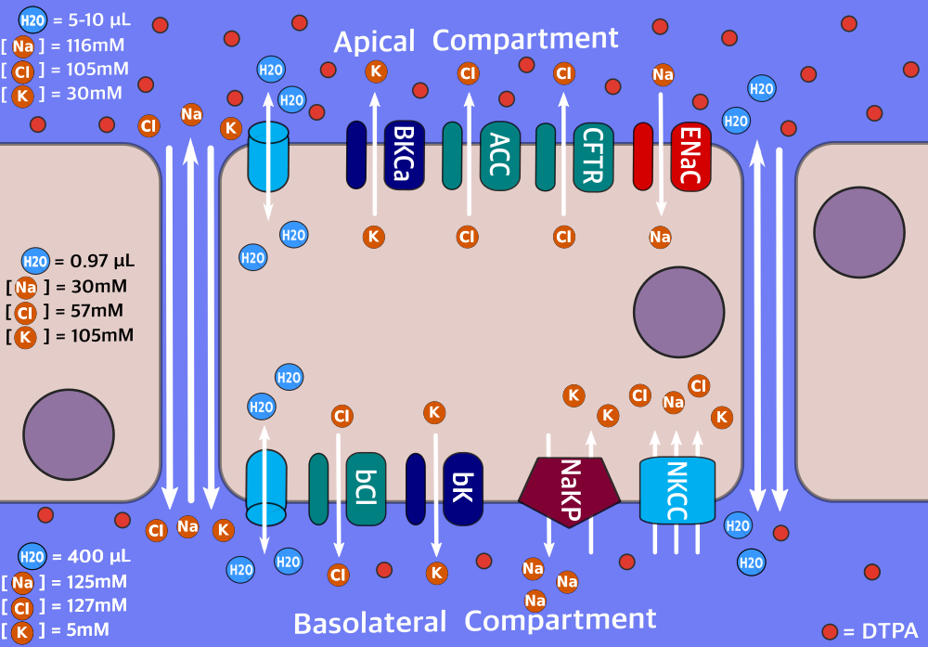
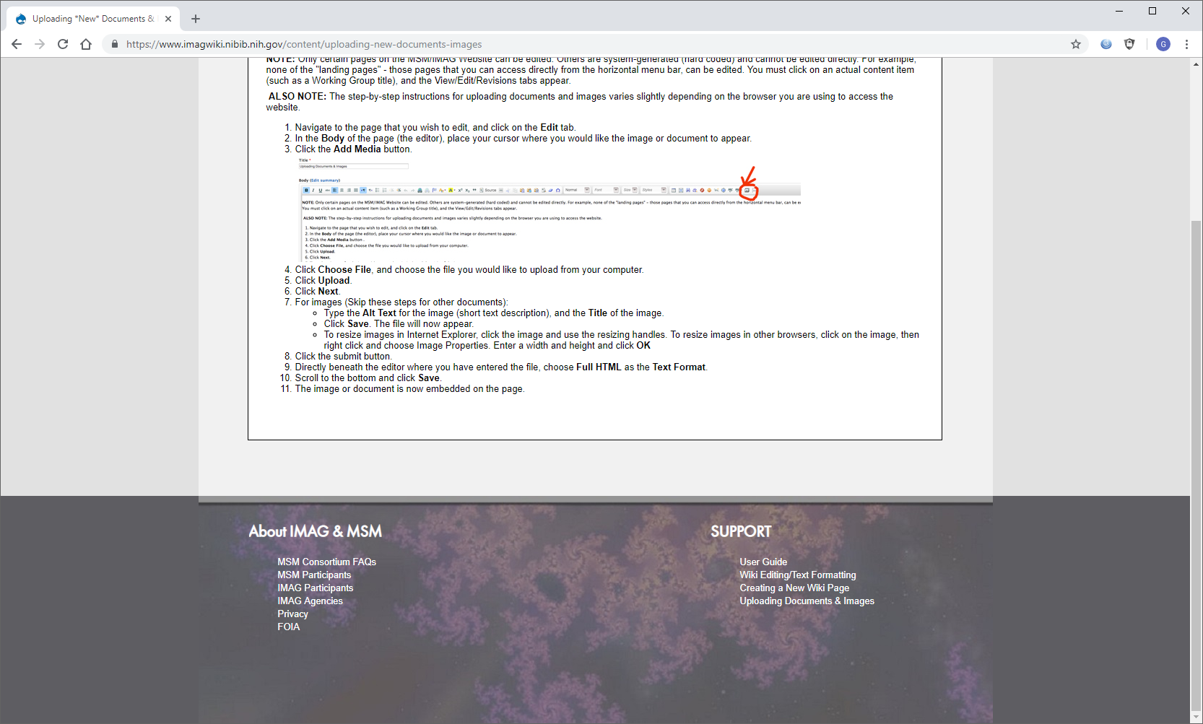
Multi-Scale Mathematical Models of Airway Physiology to Facilitate Cystic Fibrosis Treatment Design
Modular, biophysically-inspired models can help elucidate Cystic Fibrosis (CF) airway pathophysiology across multiple scales and provide a bridge from the benchtop to the clinic
What is new inside? Donor-matched in vitro, in vivo and clinical endpoint measurements are used to independently inform models at distinct physiological scales. Models employ multiple algorithmic tools in order to satisfy physical and biological constraints (pathway boundaries, multidimensional nonlinear optimization) while guaranteeing mathematical robustness and versatility (parameter identifiability and constraint feasibility analysis).
How will this change current practice? Improves understanding of CF pathogenesis and the physiological differences between healthy subjects, carriers, and CF patients; facilitates the design of therapies that address the variety of disease manifestation observed among CF patients; speeds up the characterization and validation of novel disease models.
End Users? Researchers looking to expedite hypothesis generation and testing; Clinicians in
order to design and test phenotype-specific treatment regimens. Once validated, common in vitro
assays will be used to generate in silico descriptors that can predict a patient’s therapeutic response.
Water and solute transport rates
Tissue Scale
Thin Film Dynamics: Liquid and
Small Molecule Transport Model
Organ Scale
Airway Scans: Mucociliary
Clearance and Absorption Model
Cell-Scale
Ussing Chamber: Epithelial Electrophysiology Model
Ionic permeabilities and fluxes
Robert S. Parker, Ph.D. and Timothy E. Corcoran, Ph.D.
University of Pittsburgh
U01 HL131046-01
Notes:
This project aims to develop a platform that uses patient-specific models at the systems and cell scale(s) to conduct in silico assessments of possible treatment strategies to promote airway function in patients with Cystic Fibrosis. An example of a present therapy is inhaled hypertonic saline, which is not very durable. Our multi-scale models, calibrated against inhaled normal and hyperosmotic saline, can be used to design an inhalation protocol to target normal hydration levels for CF patients, based on models calibrated to individual patients. Furthermore, we are testing the model with other hyperosmotic therapies (e.g., inhaled mannitol) to assess durability of action and decrease the burden of repeated treatments.
Machine Learning techniques, in particular clustering algorithms (e.g. kNN, semi-supervised learning), could be used to facilitate the generation of model-based parametric groups that corresponds to clinically-different phenotypic manifestation of CF.
A future challenge for this project is to mathematically describe the spatiotemporal nature of lung function, while also being tied to a functional/clinical readout that could differentiate healthy and diseased individuals, potentially allowing endo/phenotyping of the diseased population into subpopulations based on model-captured differences.
Multiscale Modeling: The development of the models has followed a modular approach. Donor-matched datasets from healthy donors, parents of CF patients (carriers), and CF patients have been used to inform
Physiologically-inspired models at the cell, tissue and organ levels. The dataset was designed such that information most relevant at physiological scale would inform the corresponding model. Thus we provide a robust methodology to extrapolate model predictions from one level to the next. With this approach, we intend to bridge Cystic Fibrosis (CF) associated cell-level ion channel malfunction to the individual and population functional assessment of mucociliary clearance (MCC) from the whole lung.

