Slide 1
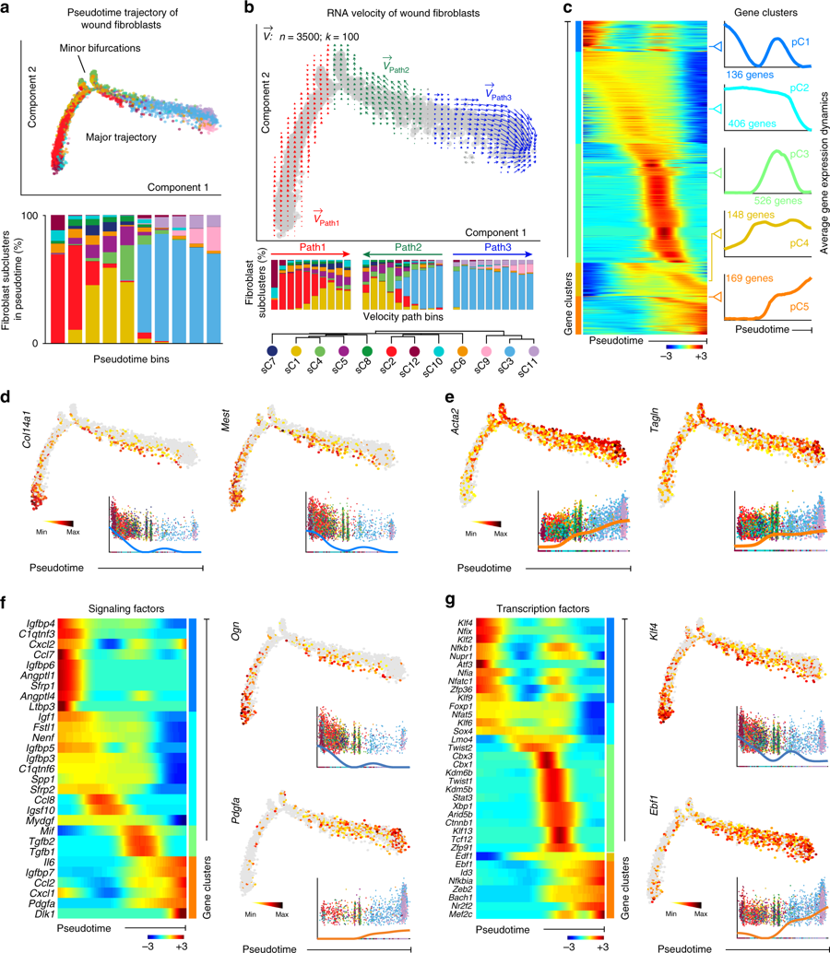
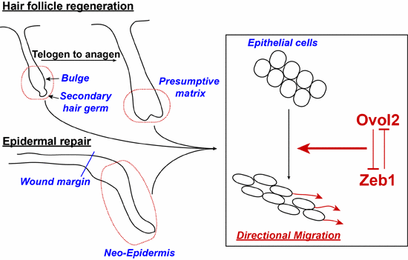
Multiscale Models of Wound Cell
Plasticity for Regeneration – Year One
A first-ever multiscale model of epidermal-dermal interactions during skin wound healing
Experimental Dermatology, 2019
PROJECT GOAL
Identify the critical molecular conditions and multiscale interactions to shift wound repair
toward regeneration and away from scarring
Math tools used in the three papers:
Single-cell analysis reveals fibroblast heterogeneity and myeloid-derived adipocyte progenitors in skin wounds
Nature Communications, 2019
Stochastic ODEs, nonlinear PDEs, optimization, graph theory, statistical physics, dimensional reduction methods, and stochastic processes
Using a panel of single-cell tools as a type of “computational microscope” that examines thousands of individual cells at once, we discovered an unexpectedly high degree of fibroblast diversity. This result suggests possible treatments for scar-free wound healing that target the body’s own blood cells.
An Ovol2-Zeb1 transcriptional circuit regulates
epithelial directional migration and proliferation
EMBO Reports, 2018
Efficient wound repair involves coordinated movements and cellular proliferation of skin epithelial cells. We discovered the EMT repressor Ovol2 has a major role in promoting directional migration and proliferation of adult epithelial cells.
Xing Dai, Qing Nie (contact), Max Plikus, University of California, Irvine
NIAMS U01AR073159 – co-funding NIBIB (9/2018-8/2023)
Notes:
Instructions:
Submit 1 slide by COB Monday 2/25/19
Title - headline your theory-driven, mechanistic model
Multiscale Models of Wound Cell Plasticity for Regeneration
name the specific mathematical or statistical method and variations thereof
Our data-driven multiscale modeling tackles several current critical gaps and major computational and multiscale challenges,
including: (1) characterizing functional cell populations and critical transitions between cellular states from high-dimensional
gene expression space; (2) multiscale interplay among events that occur at tissue (HF
regeneration), cell (cell division), and molecular (gene transcription) timescales; (3) feedback and
communication among different pathways or types of cells; (4) coupled agent-based and continuum model
components; and (5) emerging stochastic dynamics arising from intrinsic and extrinsic variability.
To include in NOTES section
define/explain it enough for a non-scientific person to explain to the general public (2-3 sentences)
An ideal outcome of wound healing is to close the wound through a regeneration process without creating
any scars. Our preliminary data on large wound on mouse skin suggests new hairs and new fate are important elements for such perfect
wound healing. The goal of the project is to identify the critical conditions to shift wound repair toward regeneration
and away from scarring.
mention how can machine learning and AI help your project (2 sentences)
For this project, we are using machine (deep) learning to analyze single-cell RNA-seq data and ATAC-seq data to link
genomic information with the multiple cellular states and their transitions and lineage relationships. We are also
using machine (deep) learning techniques to connect the spatial imaging data that contains information of small number of genes with
non-spatial single-cell genomics data along with spatial multiscale models. In general, deep learning methods serve as a bridge between multiple
Heterogeneous datasets and multiscale modeling.
List future challenges or next steps after your project is done (1 sentence)
Further details for Notes section - For the following communities (2 sentences):
Behavioral modeling: explain the new theories that will integrate within person dynamics with between person dynamics
Multiscale modeling: explain how the math will address methodological challenges (e.g.: crossing scales, sparse data, uncertainty, modularity, spatiotemporal simulation challenges, etc.)
Developing single-cell based multiscale models that integrate genomics information, however, in the context of spatial dynamics and being constrained by cell-cell interactions (in terms of both biochemical signals and physical cues.
Medical simulation: explain the math challenges being overcome (e.g. collision dynamics, cloth dynamics, haptics, etc.)
Analysis: explain how new statistical approaches will provide mechanistic understanding of the system
BRAIN: explain the theory behind the math/stats and how it will be used to understand how the brain works; explain the level of data dependency on your model (e.g.: (a) completely abstract toy model, (b) a coarse-grained model based on a high level view of previous data, (c) a model based directly on one kind of data (e.g., neural recordings) or (d) a model synthesizing multiple data types (e.g., neural recordings and connectomics).
PI name, email: Qing Nie (qnie@uci.edu)

