Slide 1
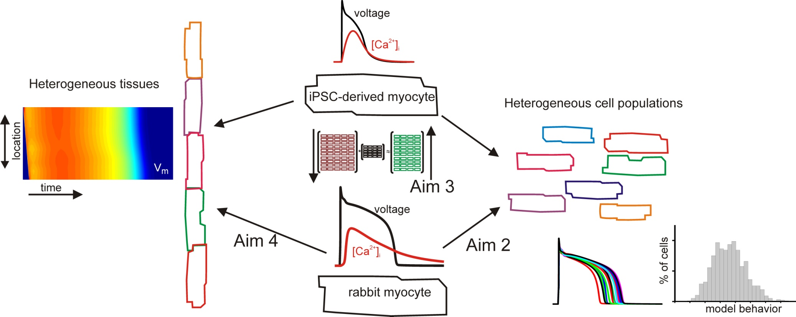
Multiscale modeling to map cardiac electrophysiology between species
The model (1) Improved ODE representations of cardiomyocyte electrophysiology and intracellular calcium
(2) Statistical models of heterogeneous cell populations
What is new inside?
New methods for tuning parameters and building models specific to individual samples
Combined mechanistic ODE models with statistical, machine learning approaches
Impact: Improved methods for validating and tuning models, leading to more credible representations
End users: Cardiologists, cardiac physiologists, safety pharmacologists interested in preventing adverse cardiac events
Eric Sobie, Mount Sinai
David Christini, Weill Cornell
U01 HL 136297
Notes:
Project overview: Cardiac arrhythmias kill hundreds of thousands of people each year, but the heart's inherent complexity prevents experiments from illuminating all aspects of arrhythmias. While computational modeling fills many of the experimental voids, important limitations restrict the utility of these models. The overall goal of this project is to develop novel approaches for multiscale cardiac electrophysiology modeling, including protocols for more predictive models, rigorous representations of variability between samples, quantitative mappings between species, and the effects of heterogeneity at the tissue level.
Machine learning and AI were part of the original research plan and are actively used in this project. Genetic algorithms are used to automatically tune model parameters. Multivariable regression is used to map drug responses across cell types. More recently, algorithms such as random forests and convolutional neural networks are being used to identify sub-populations with increased arrhythmia risk.
Future challenges are the conclusion of this project will be to use models of this type in regulatory decision making, such as during drug development, and to apply the methodologies to additional, clinically-relevant problems.
How will the results be used within particular communities:
Behavioral modeling – Methods to infer molecular level differences between individuals based on phenotypic differences
Multiscale modeling – Application of machine learning will both improve the ODE models provide insight into variability
Medical simulation – Improved understanding of mechanism underlying cardiac arrhythmias
Analysis – Machine learning approaches illustrate gaps in the ODE representations and suggest experiments for improving ML performance
BRAIN – Not Applicable
Submit 1 slide by COB Monday 2/25/19
Title - headline your theory-driven, mechanistic model
name the specific mathematical or statistical method and variations thereof
To include in NOTES section
define/explain it enough for a non-scientific person to explain to the general public (2-3 sentences)
mention how can machine learning and AI help your project (2 sentences)
List future challenges or next steps after your project is done (1 sentence)
Further details for Notes section - For the following communities (2 sentences):
Behavioral modeling: explain the new theories that will integrate within person dynamics with between person dynamics
Multiscale modeling: explain how the math will address methodological challenges (e.g.: crossing scales, sparse data, uncertainty, modularity, spatiotemporal simulation challenges, etc.)
Medical simulation: explain the math challenges being overcome (e.g. collision dynamics, cloth dynamics, haptics, etc.)
Analysis: explain how new statistical approaches will provide mechanistic understanding of the system
BRAIN: explain the theory behind the math/stats and how it will be used to understand how the brain works; explain the level of data dependency on your model (e.g.: (a) completely abstract toy model, (b) a coarse-grained model based on a high level view of previous data, (c) a model based directly on one kind of data (e.g., neural recordings) or (d) a model synthesizing multiple data types (e.g., neural recordings and connectomics).
PI name, email:

