Slide 1
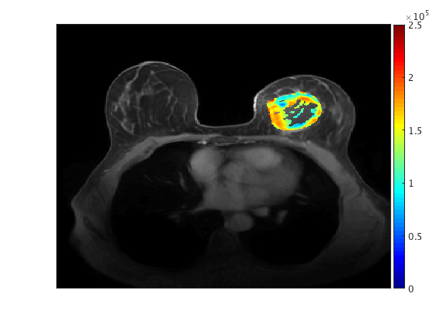
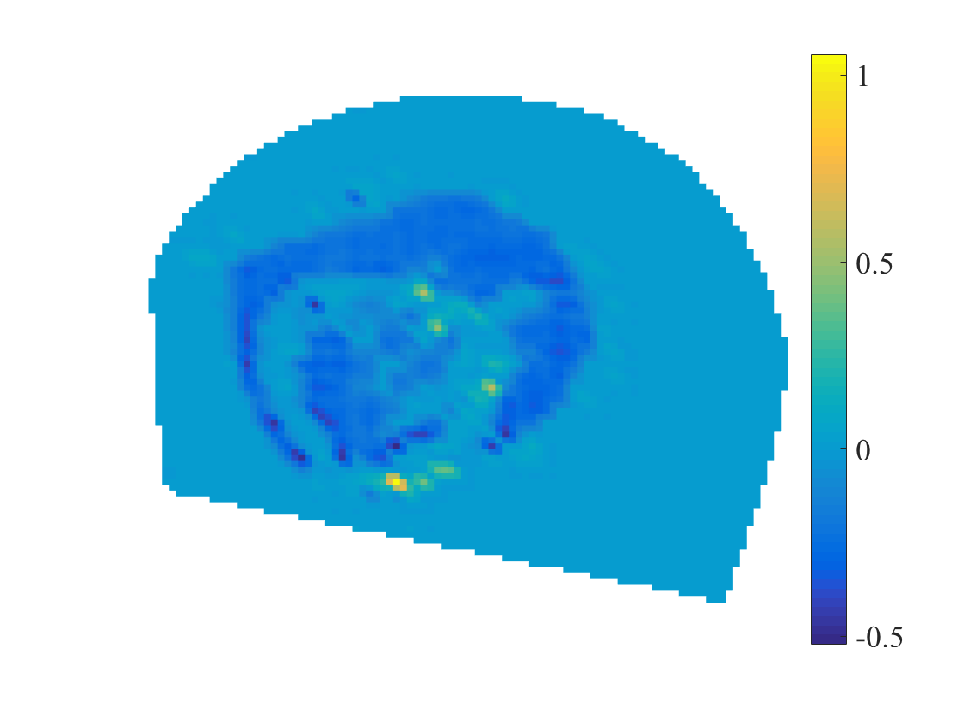
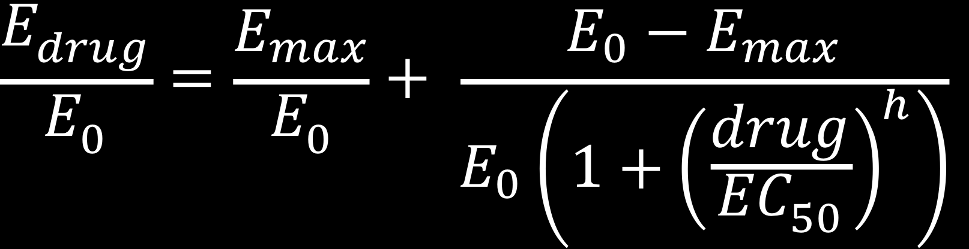
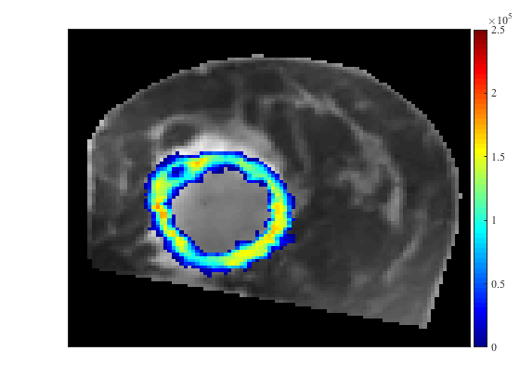
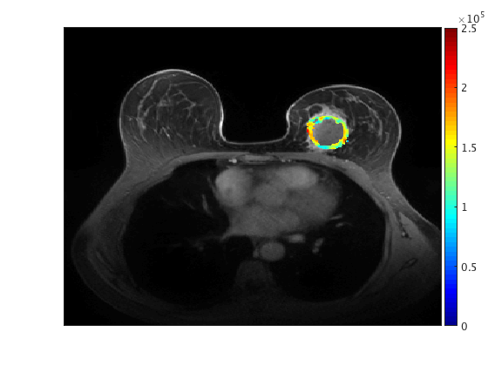
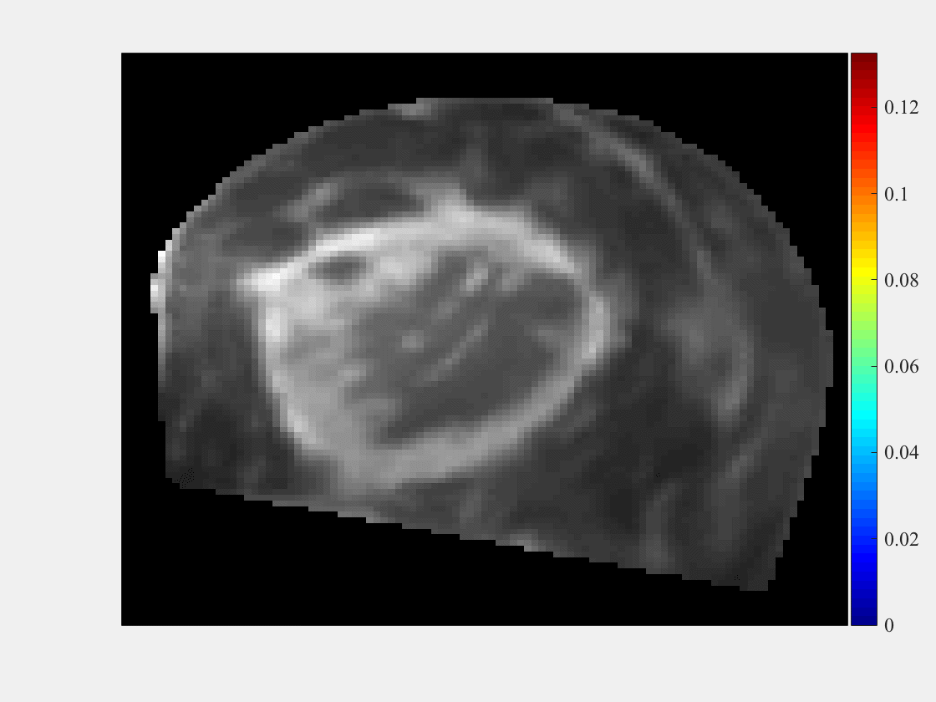
Image Driven Multi-Scale Modeling to Predict Treatment Response in Breast Cancer
The model: A 3D, spatiotemporal tissue and cell scale model of tumor response to therapy for breast cancer
What is new? Cellularity and drug distribution maps derived from quantitative MRI data for individual patients and their therapeutic regimens; integration with sub-cell scale is ongoing
How will this change current practice? Allows for mathematical simulating the effects of therapeutic regimens to enable to optimization of therapy for the individual.
End Users: Clinical researchers aiming to optimize combination therapy for breast cancer
Cellular scale submodel: A model of drug action on rates of cell division and death
Individual patient data at start of therapy
Calibrate parameters
Scan 1
Scan 2
Model prediction for tumor response to therapy
What is new? Expanding dataset of cell-based studies capturing drug concentration-dependent proliferation rates of cancer cell lines as models of human patient tumors
Compare prediction to clinical outcomes
Drug Distribution Map
Each point represents a unique cell line/drug dose–response curve
(43 cell lines X 152 drugs)
Thomas Yankeelov (The University of Texas at Austin) and Vito Quaranta (Vanderbilt University)
NCI U01CA174706
Notes:
NOTES FOR THE CLINICAL BREAST CANCER MODEL (left)
We have previously established a mechanically coupled, reaction-diffusion model at the tissue scale for predicting breast tumor response to therapy. The 3D model is initialized with patient-specific, quantitative, diffusion-weighted magnetic resonance imaging (DW-MRI) data. Additionally, the model includes a tumor cell reduction term due to chemotherapy drug delivery—estimated using dynamic contrast-enhanced (DCE-) MRI data—following individual patient treatment schedules. Machine learning and AI can be used to assess the abundance of clinical data to identify important and driving features for differentiating between tumors that respond to therapy and those that do not to be including in a predictive mathematical model. One limitation of the current established model is that it does not differentiate between the distinct effects of individual therapies. Therefore, to extend this model to explicitly include the effects of specific systemic therapies, we turn to in vitro data collected for breast cancer response at the cellular scale (measured by time-resolved microscopy) to initialize and constrain a multi-scale model of treatment response. Our aim is to leverage tumor cell response data to individual drugs to not only improve the overall spatiotemporal predictive ability of the clinical model but also to explore alternative therapeutic strategies. This requires interlacing experimental data and additional expressions into the tissue scale model to represent drug dynamics at the cellular scale to simulate overall tumor response, where an integrated multi-scale mathematical-experimental approach bridging tissue and cellular scale data can elucidate the optimal strategies for combination therapy for breast cancer. While the results of machine learning and AI cannot simulate tumor progression/response temporally and therefore cannot predict tumor outcomes, much like sensitivity analysis for mathematical models, these data-mining methods can be used to derive the most important characteristics of the data for our focus.
PI name, email:
Thomas E. Yankeelov, thomas.yankeelov@utexas.edu
Vito Quaranta, vito.quaranta@vanderbilt.edu

