Slide 1
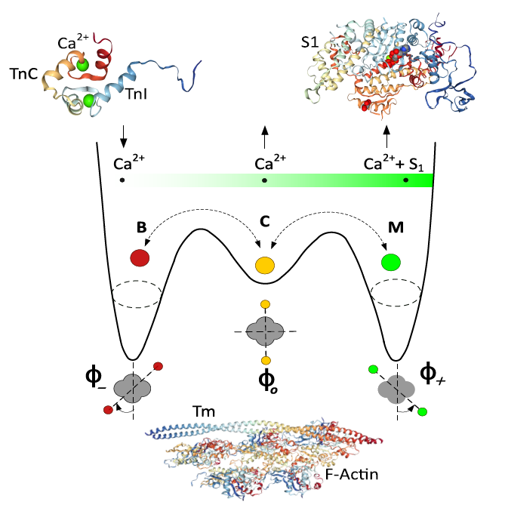
Multi-Scale Modeling of Cardiac Muscle (U01 HL122199, U01 HL126273, U01 HL133360)
Yasser Aboelkassem and Andrew McCulloch, UC San Diego
Objective
To link atomistic molecular models of cardiac contractile proteins to sarcomere scale stochastic models of dynamic calcium dependent cross-bridge cycling, tension development and energetics.
Innovation
New coarse-graining approaches using Brownian and Langevin dynamics are used to bridge scales to elucidate molecular mechanisms of cardiac contractile function.
The model represents the structural arrangement of tropomyosin molecules as a flexible chain and accounts for the spatial interactions among nearest-neighbor regulatory units, which are thought to arise from the structural coupling of adjacent tropomyosin molecules along the thin filament.
The activation of thin filament regulatory units is described by a set of coupled stochastic ordinary differential equations.
Future Work
This approach opens the way for us to make the first multi-scale models of the heart that integrate from molecular to organ system scales. They will be used to address mechanisms of hypertrophic and dilated cardiomyopathies and therapeutic mechanisms of new heart failure therapies.
Aboelkassem et al. 2019:
A New Cardiac Myofilament Model Based on Brownian-Langevin Dynamics.
Pending submission to Biophysical Journal
Investigators: Yasser Aboelkassem and Andrew McCulloch (UC San Diego) PIs: Bassingthwaighte (U. Washington), Clancy (UC Davis), Holmes (UVA)

