Slide 1
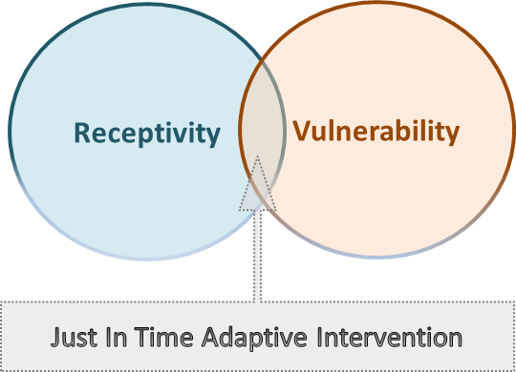
Novel use of mHealth data to identify states of vulnerability and receptivity to JITAIs
1. The health behavior problems we trying to solve?
Smoking → The leading preventable cause of death & disability
90% + of quit attempts are unsuccessful (Fiore, 2008)
Self-regulatory activities can improve the ability to resist temptations and build self-regulatory skills (e.g., Elwafi et al., 2013; Goldberg et al., 2014)
Poor engagement in self-regulatory activities represents a major barrier (Cavanagh et al., 2014)
Our goal: develop a Just-In-Time Adaptive Intervention (JITAI) to enhance real-time, real-world engagement in evidence-based self-regulatory activities
JITAI -> an intervention design that adapts over time to an individual’s changing status
2. Theoretical framework:
Vulnerability: transient tendency to experience adverse health outcomes or to engage in maladaptive behaviors
Receptivity: transient willingness and ability to process, and use a specific intervention.
Latent states, constantly changing based on the constellation and temporal dynamics of emotions, context, and other factors.
Nahum-Shani, Hekler, Spruijt-Metz (2015)
PIs: Nahum-Shani & Wetter
Modeling:
Rehg, Moreno, Wu, Yap, Lam
U01CA229437 NIH/NIC
Notes:
Instructions:
Submit 3 slides by Tuesday 2/19/19. Example ready by the 2/15/19.
Title - headline your theory-driven, mechanistic model
name the specific mathematical or statistical method and variations thereof
NOTES section
define/explain it enough for a non-scientific person to explain to the general public (2-3 sentences)
mention how can machine learning and AI help your project (2 sentences)
List future challenges or next steps after your project is done (1 sentence)
Notes section - For the following communities (2 sentences):
BRAIN: explain the theory behind the math/stats and how it will be used to understand how the brain works
Behavioral modeling: explain the new theory that will integrate within person dynamics with between person dynamics
Multiscale modeling: explain how the math will address methodological challenges (e.g.: crossing scales, sparse data, uncertainty, modularity, spatiotemporal simulation challenges, etc.)
Analysis: explain how new statistical approaches will provide mechanistic understanding of the system
Medical simulation: explain the math challenges being overcome (e.g. collision dynamics, cloth dynamics, haptics, etc.)

Slide 2
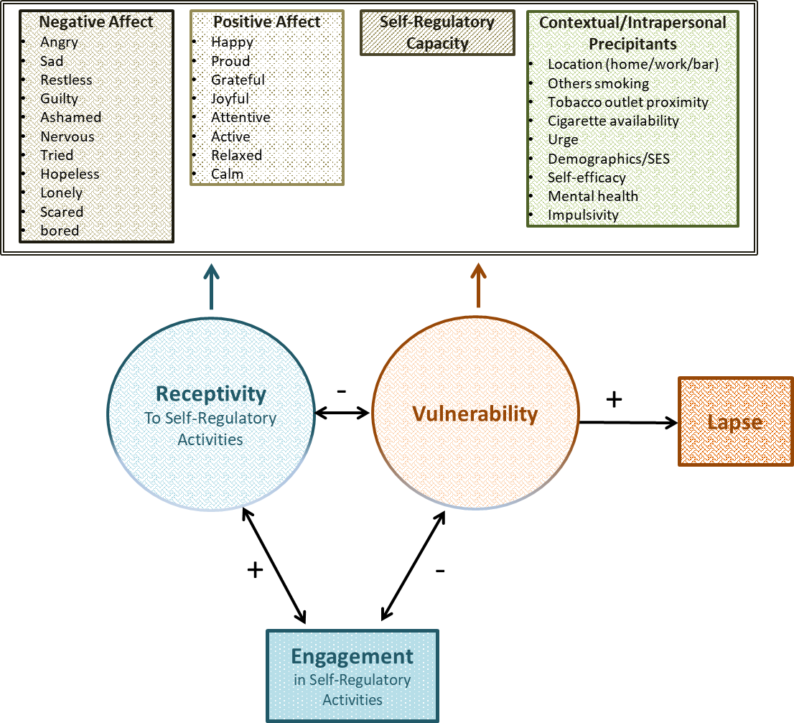
Novel use of mHealth data to identify states of vulnerability and receptivity to JITAIs
3. Data collection design:
Analyze data from 5 studies of ~1,500 smokers attempting to quit:
Macro time scales, include: demographics, SES, mental health, impulsivity, self-efficacy, motivation, stroop task
Micro time scales, include:
AutoSense sensor suite: Smoking, Self-Regulatory Capacity (heart rate variability)
EMA: emotions, urge, self-efficacy, engagement in self-regulatory activities
GPS/GIS: location: home, work, tobacco outlet
PIs: Nahum-Shani & Wetter
Modeling:
Rehg, Moreno, Wu, Yap, Lam
U01CA229437 NIH/NIC
Notes:
Instructions:
Submit 3 slides by Tuesday 2/19/19. Example ready by the 2/15/19.
Title - headline your theory-driven, mechanistic model
name the specific mathematical or statistical method and variations thereof
NOTES section
define/explain it enough for a non-scientific person to explain to the general public (2-3 sentences)
mention how can machine learning and AI help your project (2 sentences)
List future challenges or next steps after your project is done (1 sentence)
Notes section - For the following communities (2 sentences):
BRAIN: explain the theory behind the math/stats and how it will be used to understand how the brain works
Behavioral modeling: explain the new theory that will integrate within person dynamics with between person dynamics
Multiscale modeling: explain how the math will address methodological challenges (e.g.: crossing scales, sparse data, uncertainty, modularity, spatiotemporal simulation challenges, etc.)
Analysis: explain how new statistical approaches will provide mechanistic understanding of the system
Medical simulation: explain the math challenges being overcome (e.g. collision dynamics, cloth dynamics, haptics, etc.)

Slide 3
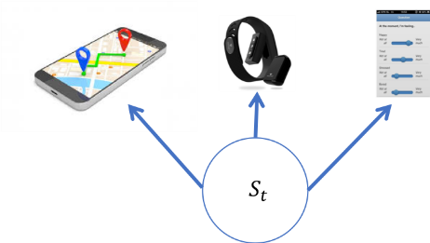
Novel use of mHealth data to identify states of vulnerability and receptivity to JITAIs
4. Modeling Framework (Jim Rehg and Alexander Moreno: Georgia Tech):
Machine learning (for pattern mining) and probabilistic latent variable models
Investigate how the temporal dynamics and interactions of emotion, self-regulatory capacity (SRC), context, and other factors can be used to measure states of vulnerability and receptivity
Joint modeling of EMA, location, sensor, and time-to-event
All a function of two underlying latent states
5. Challenges:
Influence of an old EMA decays at an exponential rate: state inference dominated by sensor
How do we handle new types of missing data introduced by EMA and sensor-based assessments
How to do hypothesis testing in this setting
6. How will this change current practice:
Compared to black box models (e.g., neural networks and deep learning), latent variable models provide interpretability by explicitly representing core theoretical constructs and their relationship to intensive longitudinal measurements.
Latent variable models represent a bridge between black-box machine learning analytics and behavioral theory
PIs: Nahum-Shani & Wetter
Modeling:
Rehg, Moreno, Wu, Yap, Lam
U01CA229437 NIH/NIC
Notes:
Instructions:
Submit 3 slides by Tuesday 2/19/19. Example ready by the 2/15/19.
Title - headline your theory-driven, mechanistic model
name the specific mathematical or statistical method and variations thereof
NOTES section
define/explain it enough for a non-scientific person to explain to the general public (2-3 sentences)
mention how can machine learning and AI help your project (2 sentences)
List future challenges or next steps after your project is done (1 sentence)
Notes section - For the following communities (2 sentences):
BRAIN: explain the theory behind the math/stats and how it will be used to understand how the brain works
Behavioral modeling: explain the new theory that will integrate within person dynamics with between person dynamics
Multiscale modeling: explain how the math will address methodological challenges (e.g.: crossing scales, sparse data, uncertainty, modularity, spatiotemporal simulation challenges, etc.)
Analysis: explain how new statistical approaches will provide mechanistic understanding of the system
Medical simulation: explain the math challenges being overcome (e.g. collision dynamics, cloth dynamics, haptics, etc.)

