Slide 1
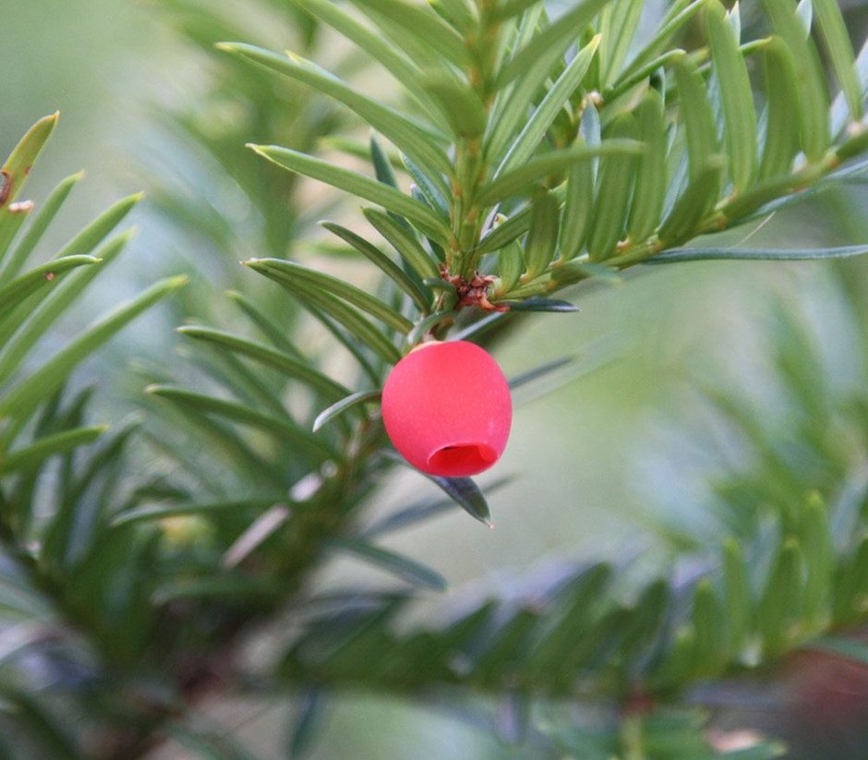
Dr.S
Drug recommendation system (for cell lines)
David Craft, Ph.D.
Massachusetts General Hospital
Oct 25, 2019 ML-MSM
NIH, Bethesda MD

Slide 2
Vision:
A patient walks into the clinic…
… a treatment is prescribed

Slide 3
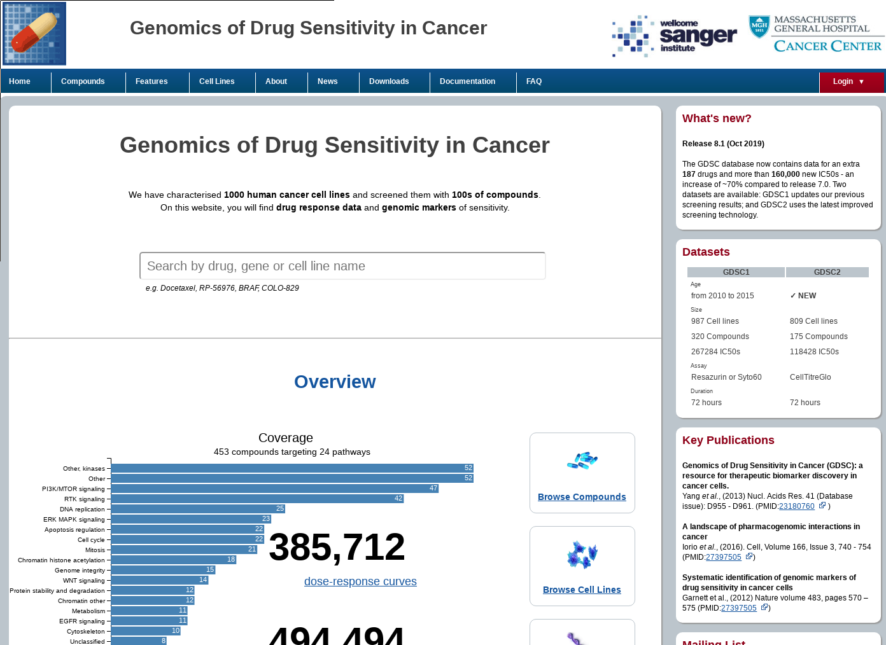
Dataset :
GDSC
~1000 cell lines
42 drugs chosen

Slide 4
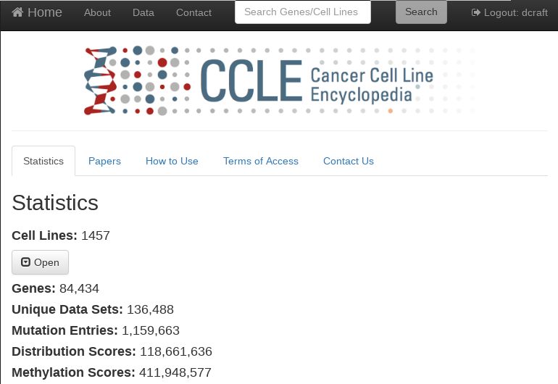
Dataset :
CCLE
~500 cell lines
radiation

Slide 5
Number of samples, number of features
p=number of features
“Nice” looking dataset*
^{* Caveats:}
n=number of samples
Feature data
Well annotated drug response
Notes:
*the caveat: nice looking but nice only if the response is actually a learnable function of the features. Hard to know…
Split into two slides

Slide 6
What does the GDSC dataset look like?
p=number of features
“Nice” looking dataset*
^{* Caveats:}
n=number of samples
Feature data
Well annotated patient response to a drug
What we actually have:
p=number of features
n=number of cell lines
Feature data
Notes:
*the caveat: nice looking but nice only if the response is actually a learnable function of the features. Hard to know…
Split into two slides

Slide 7
Feature selection in this situation
p=number of features
n=number of samples
Feature data
Notes:
Argue for manual, not data driven.
High chance for spurious correlations.

Slide 8
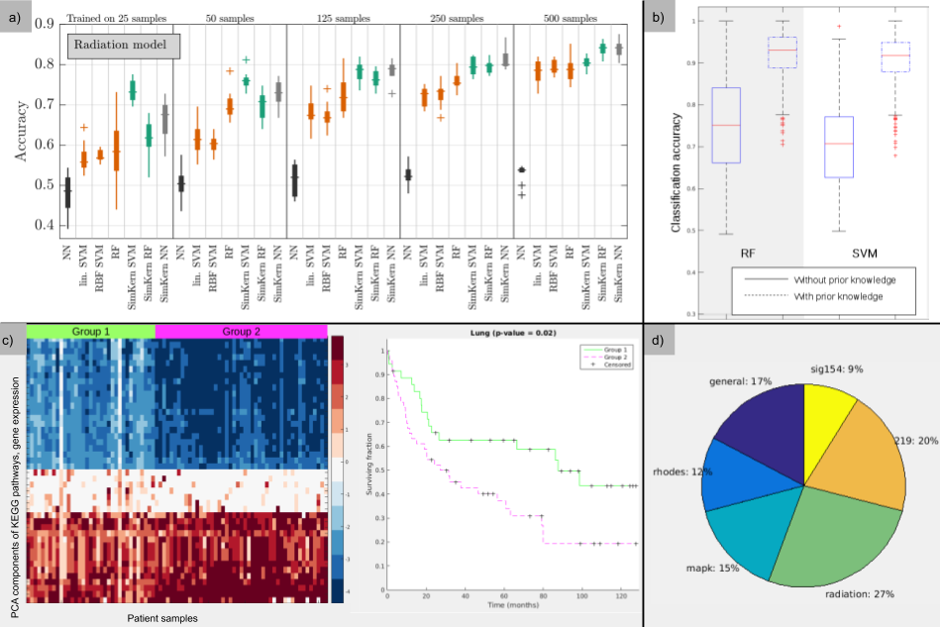
Some demonstrations of the value of prior knowledge:
Deist et al.
Ferranti et al.
Young et al.
Balvert et al.
Notes:
Demonstrations of utility of prior knowledge

Slide 9
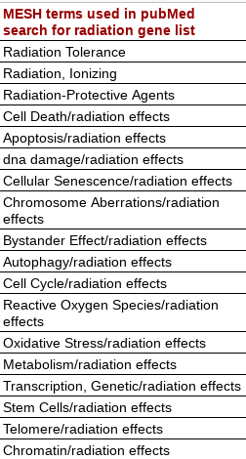
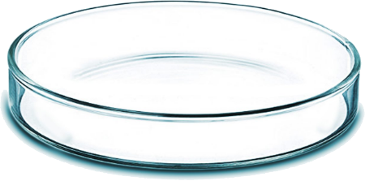
The “Radiation” Gene List
Question: if cancer cells are irradiated, what genes/proteins are most important for dictating the fate of the cells?
Approach: Two scientists, independent brainstorming + an automated pubmed search:
Pubmed search
Radiation gene lists: 263 genes

Slide 10
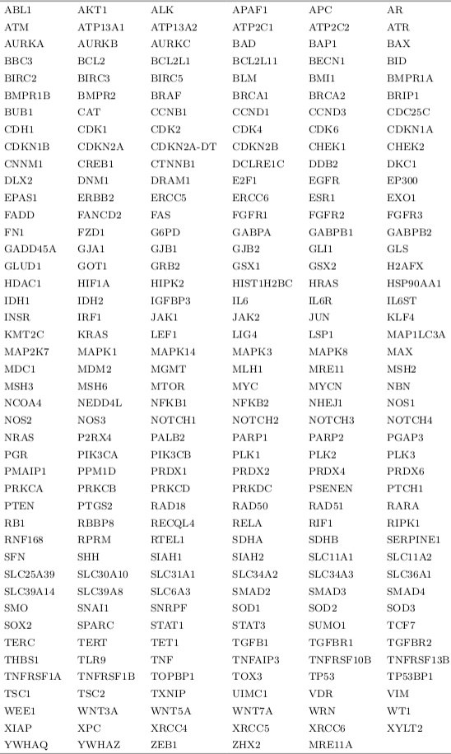
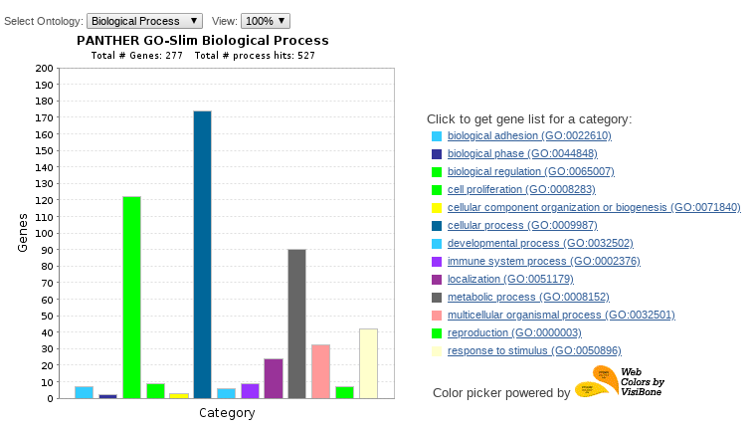
The “Radiation” Gene List

Slide 11
All gene lists we use:
The Cosmic (Catalog of Somatic Mutations in Cancer) gene list contains curated genes from the Sanger initiative Number of genes 222 | Gene list general is manually curated from two text books identifying genes generally important for cancer Number of genes 98
Gene list Rhodes contains genes upregulated in cancer cells Number of genes 65 | Gene list MAPK contains genes in that pathway from biocarta Number of genes 87
Gene list sigcancer is a list of genes useful for identifying tumor tissue origin Number of genes 155 | Gene list Radiation Number of genes 263

Slide 12
All gene lists we use:
The Cosmic (Catalog of Somatic Mutations in Cancer) gene list contains curated genes from the Sanger initiative Number of genes 222 | Gene list general is manually curated from two text books identifying genes generally important for cancer Number of genes 98
Gene list Rhodes contains genes upregulated in cancer cells Number of genes 65 | Gene list MAPK contains genes in that pathway from biocarta Number of genes 87
Gene list sigcancer is a list of genes useful for identifying tumor tissue origin Number of genes 155 | Gene list Radiation Number of genes 263
Discussion topic: is there additional usable knowledge in pathways, etc?

Slide 13
“Combos”
Gene exp of cosmic genes
Copy number of MAPK genes
n cell lines
example:
Gene list:
Cosmic MAPK null
Feature type:
Gene expression copy number mutation
We run all possible combos: 7³ - 1 = 342

Slide 14
Data handling & data splitting
Train a model with this training set, however you’d like
For example, further splitting for tuning hyperparameters
Random 80-20 split
80%
Original full dataset
For a given drug, and a given combo
Test the model on this holdout set
20%
Each outer loop, R² is computed and saved
This is repeated several times!

Slide 15
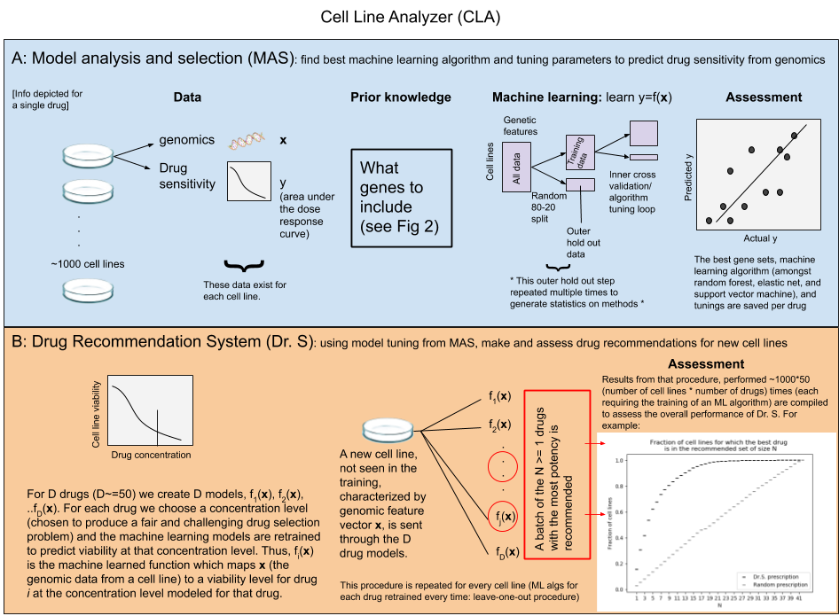
https://github.com/aspatti1257/CellLineAnalyzer

Slide 16
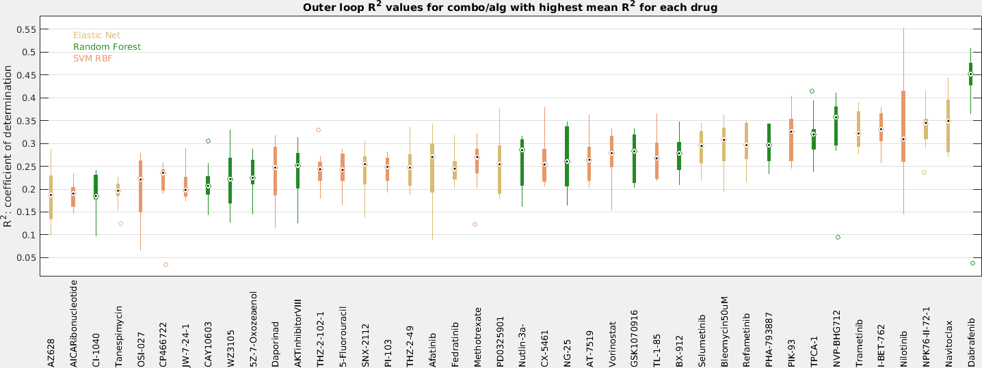
Model Analysis and Selection (MAS) Results
^
-
y_{i} = true drug AUC, y_{i} = model predicted response, y = mean of the true responses in the holdout data

Slide 17
Model Analysis and Selection (MAS) Results
Overall gene list usage in top combos
Single drug all combos example result

Slide 18
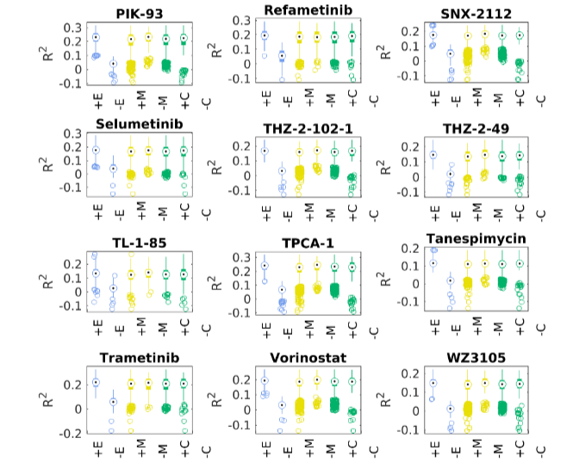
Gene expression is most important genomic type

Slide 19
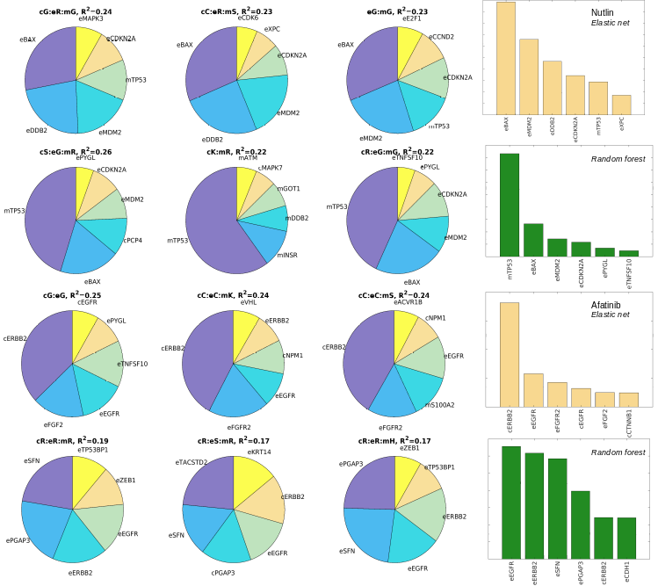
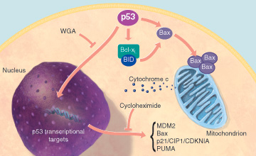
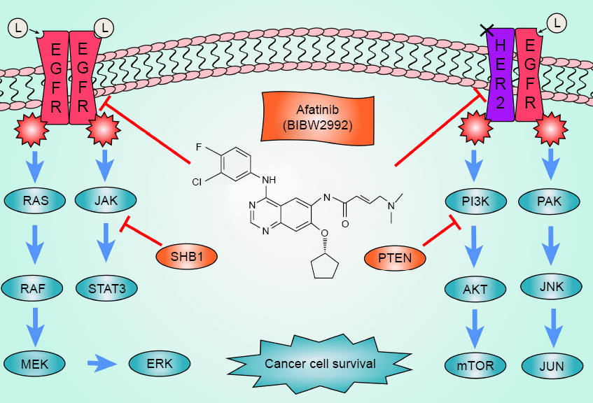
Sample feature importances results
Drug = Nutlin-3A
Drug = Afatinib

Slide 20
https://github.com/aspatti1257/CellLineAnalyzer

Slide 21
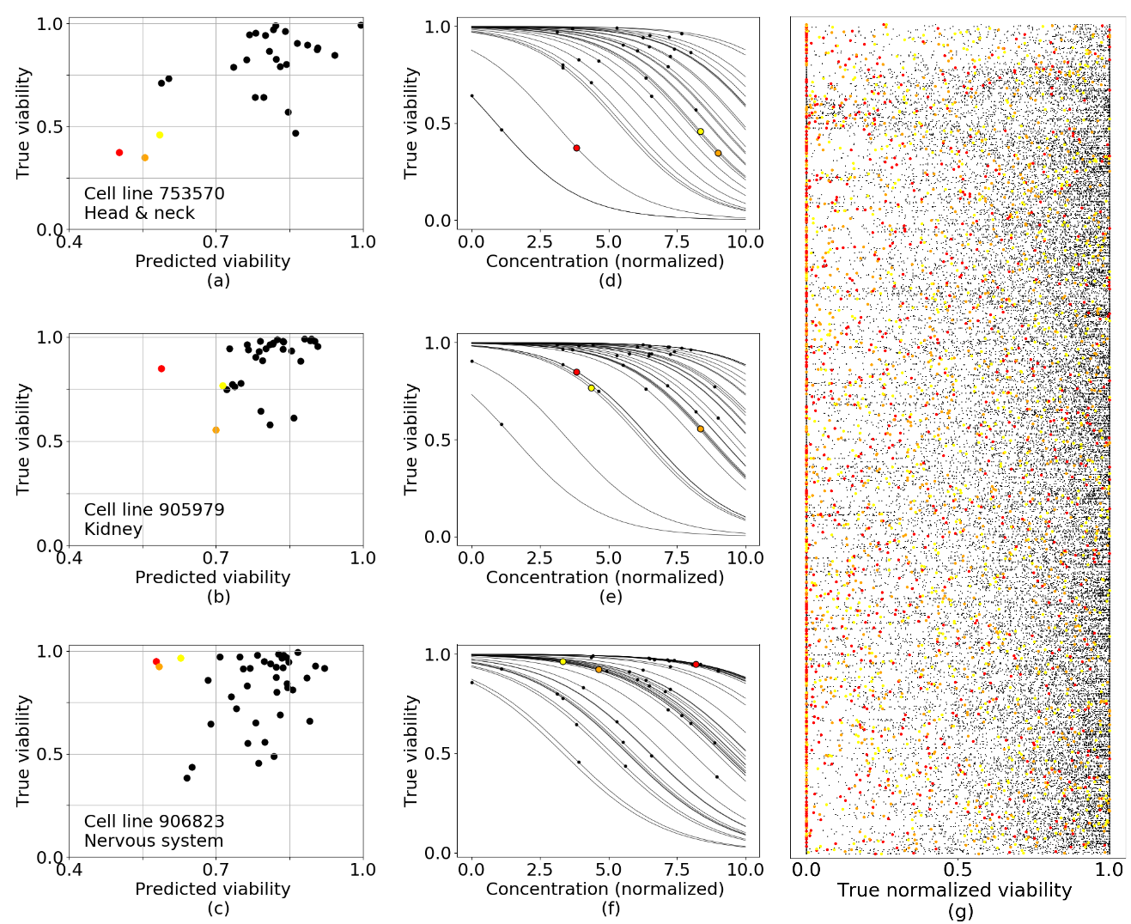
Dr.S results

Slide 22
Dr.S results
Even without great R², we often make good recommendations

Slide 23
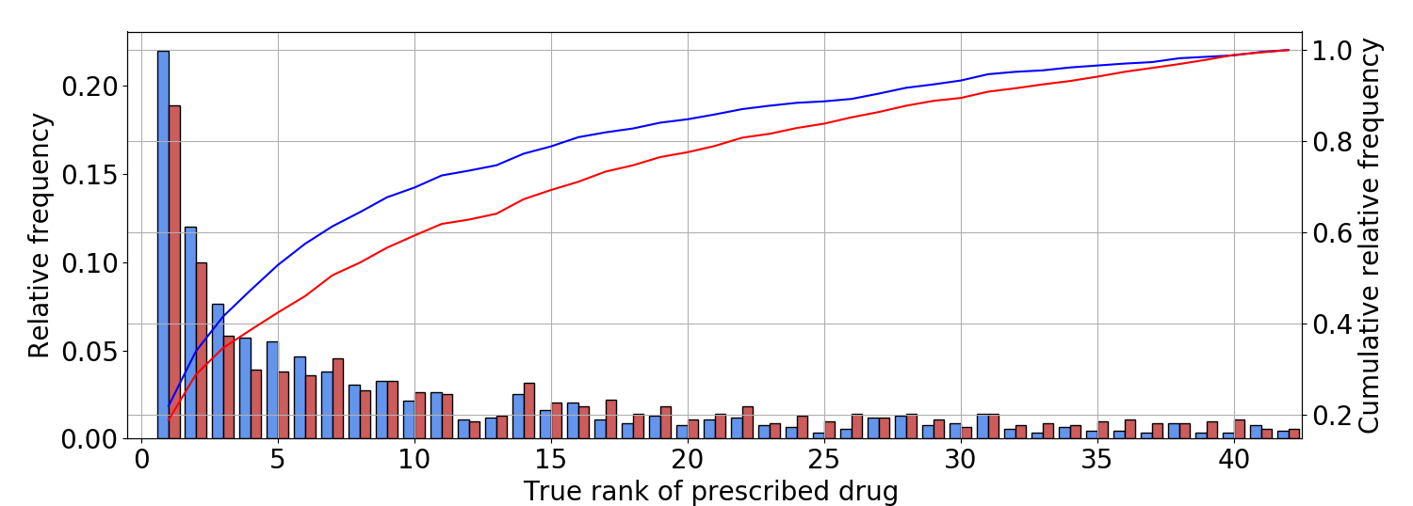
Dr.S results: single drug recommendation
Dr.S is exactly right 22% of the time
53% of the time the single Dr.S recommendation is one of the true top 5 drugs
Dr.S
Tissue based
Notes:
The (cumulative) distribution of the true rank of the single prescribed drug

Slide 24
Contributions / best practice recommendations:
Repeated hold out “triple split”
Single drug (rather than “matrix completion”/multitask) modeling
Incorporation of prior knowledge
Next steps:
Pathway modeling / neural networks / similarity kernels
Other -omics data / other gene sets
Learn entire dose response curve
Clinical patient data / learn drug efficacy and toxicities dose response curves
Pan cancer vs tissue type specific learning?
…

Slide 25
The team
Marleen Balvert - CWI, The Netherlands
Georgios Patoulidis - Master’s student Heidelberg University
Andrew Patti - Software developer, Engage
Timo Deist - post-doc CWI
Christine Eyler - MD, PH.D MGH

Slide 26
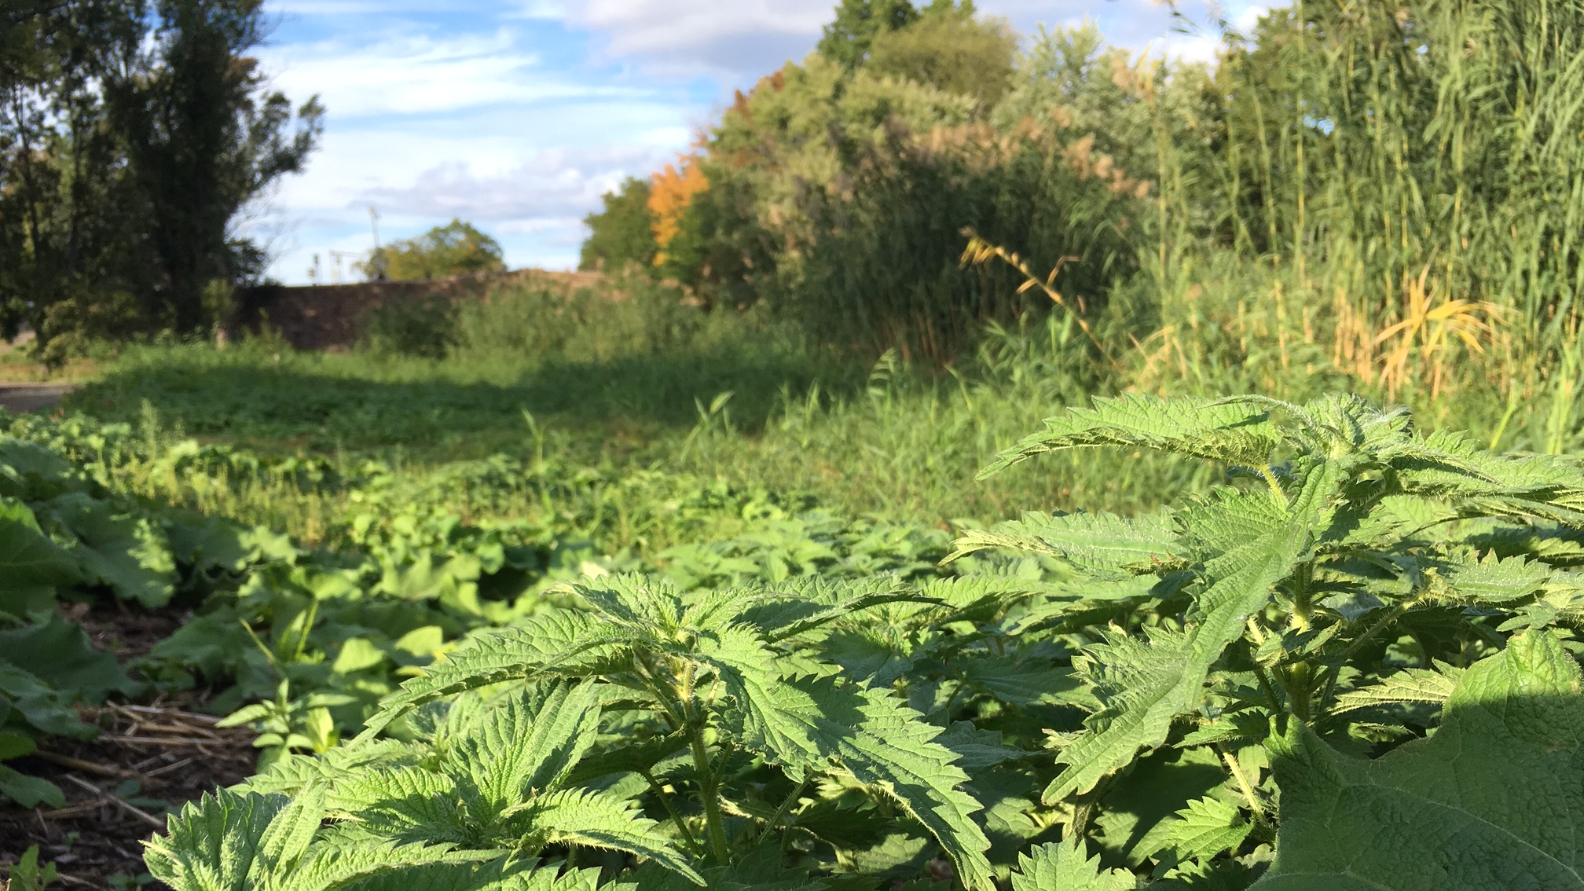
Thank you! Questions/comments?

Slide 27
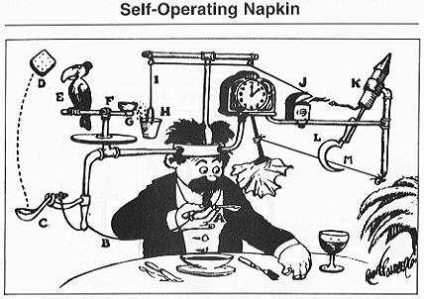
Additional slides
How complicated is biology? Rube Goldberg...

Slide 28
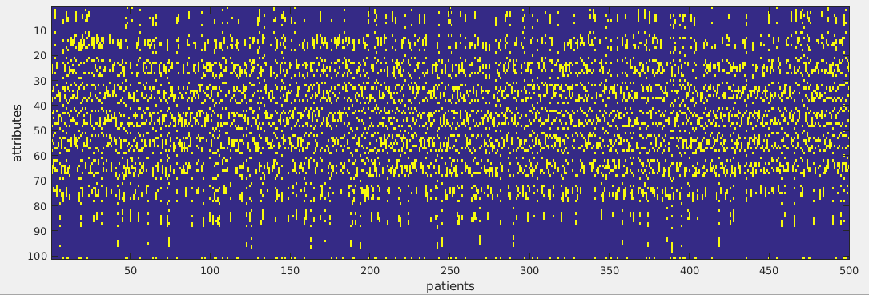
A cartoon example: knowledge helps
Last row gives response to a “drug”
SVM with an RBF kernel,
Average AUC (over 5 drugs)= 0.89
Notes:
These are from cBioPortal talk

Slide 29
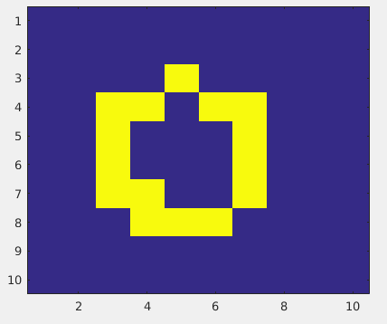
System expert knowledge

Slide 30
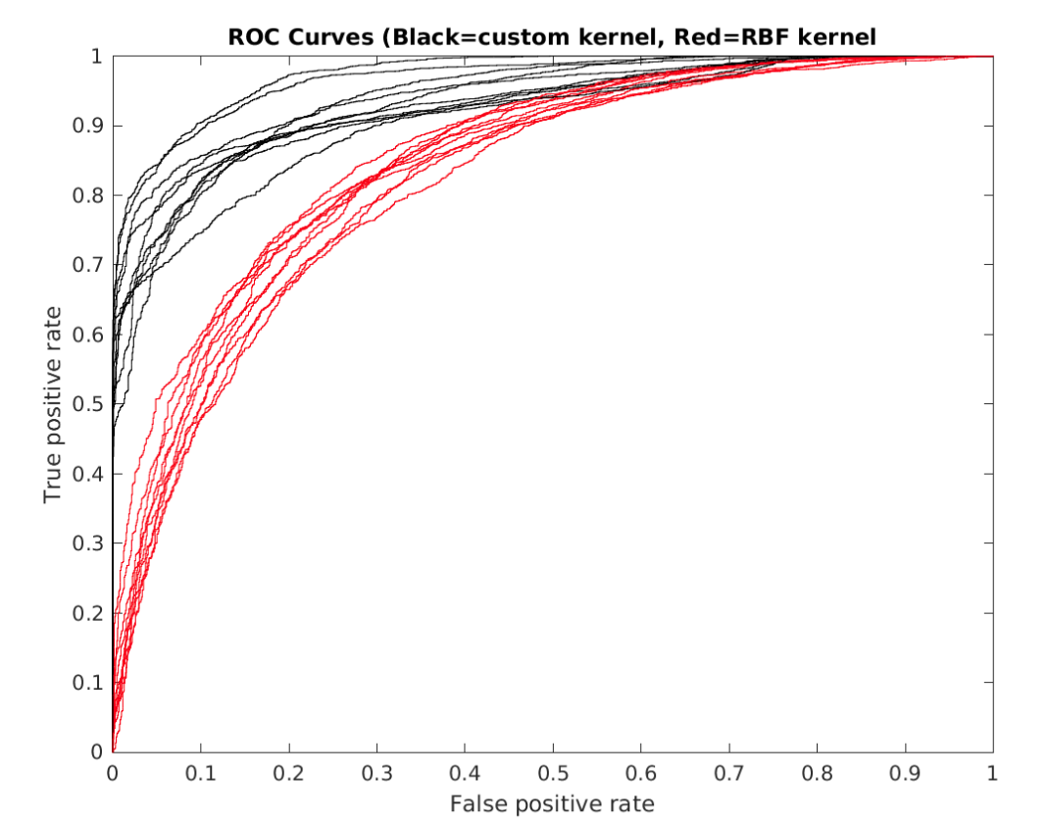
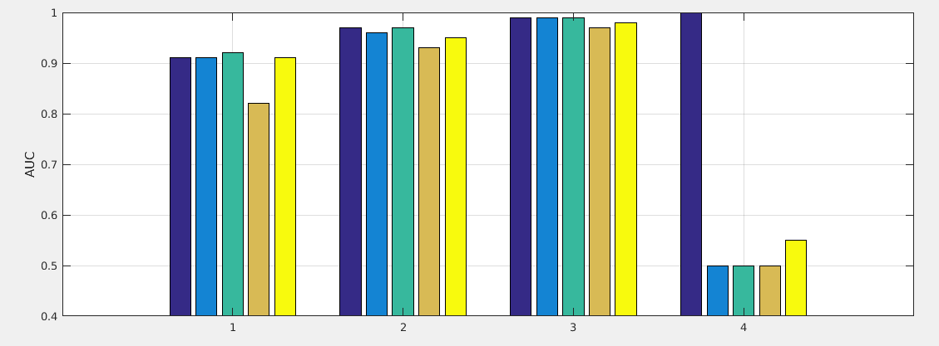
Custom similarity measure → kernelized learning
Two “cell lines” are similar if their circles are similar.
5 different “drugs”
RBF kernel
Custom kernel
Custom kernel2
“Ideal” drug 1 kernel
Average AUC:
0.89 0.96 0.98 0.61

Slide 31
Again, prior knowledge helps

Slide 32
P = number of features
Dynamical Boolean networks demo
n
Bioinformatics (2017)

Slide 33
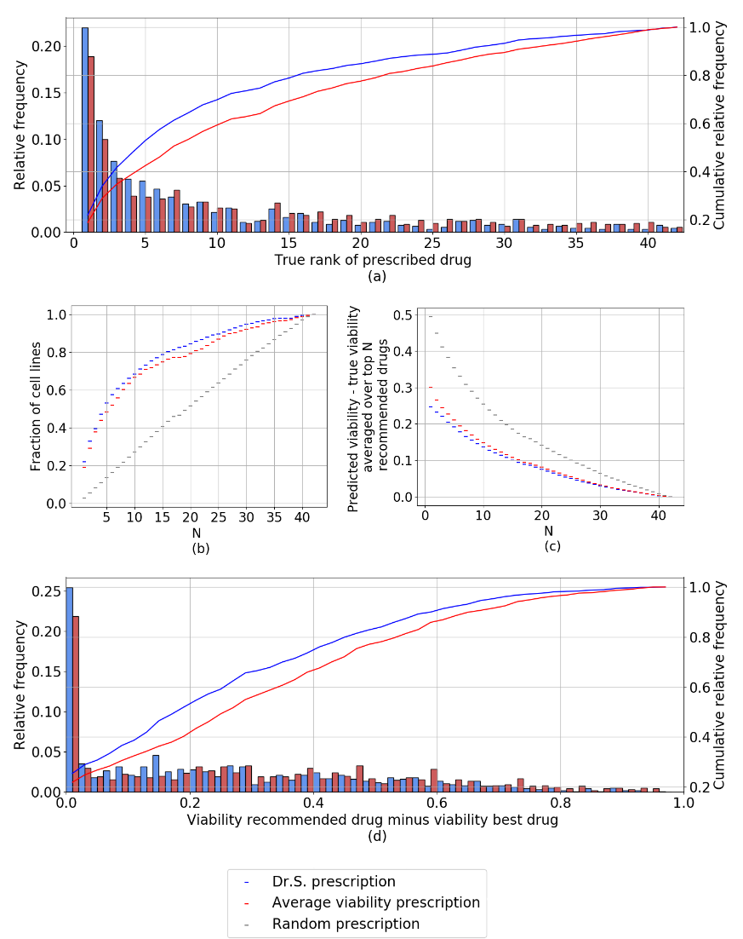
Dr.S results
Comparison of drug recommendations made with Dr.S. (blue), recommendations based on the average viability of other cell lines of the same tissue type from the training data (red) and random drug selection (gray). (a) The (cumulative) distribution of the true rank of the single prescribed drug. (b) The fraction of cell lines for which the single true best drug is among the
N true recommended drugs. (c) The difference in viability between the top N prescribed and the top N true best drugs. (d) The distribution of the difference in viability between the single prescribed and single best drug.

Slide 34
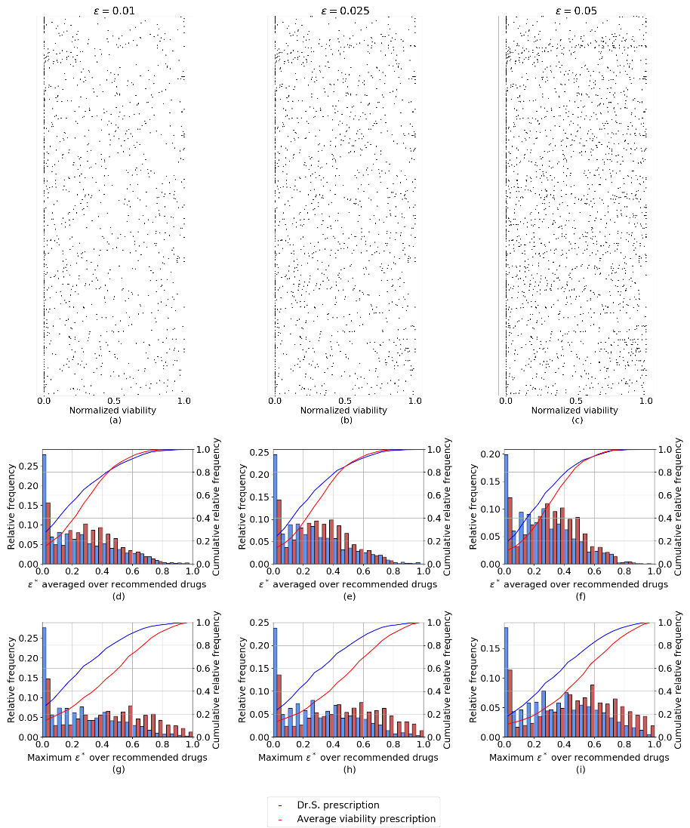
Dr.S results
Results obtained with Dr.S and tissue type based prescription where all drugs with a predicted
viability within of the best predicted viability are in the prescription. In Figures (a)-(c) each row
corresponds to a cell line, and the dots indicate the normalized viability of the recommended drugs where a normalized viability of 0 (1) corresponds to the viability of the best (worst) drug. Figures (d)-(f) show the (cumulative) distribution of epsilon∗ over the cell lines, averaged over the set of recommended drug for that cell line. Figures (g)-(i) show the (cumulative) distribution over the cell lines of the maximum epsilon∗ over the recommended drug for that cell line

