Slide 1
Multiscale Modeling of Circadian Rhythms
Of the model organism Neurospora Spora
Bill Cannon, PNNL
Jennifer Hurly, RPI
Jay Dunlap, Dartmouth
Jeremy Zucker, PNNL
Scott Baker, PNNL

Slide 2
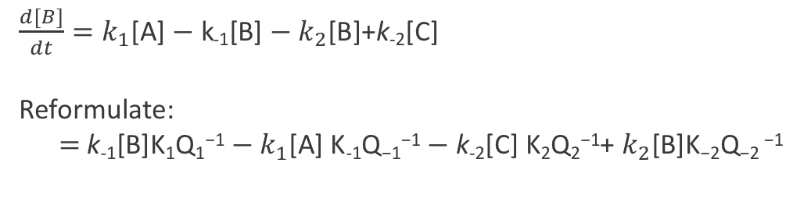
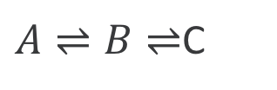
Purpose and Intended Use of Models
Intended Use:
  Cellular metabolism
  Non-metabolic process such as regulation and protein expression.
  Two Use Case scenarios
    Experimental data on metabolite concentrations are available.
    No data available – uses a maximum entropy production rate assumption
In principle, (1) can be used for any sets of coupled reactions, but not (2).
Math: Formulate ODE law of mass action based on statistical thermodynamics
  ODE: Use k₊ and k₋ ‘s OR μ’s (chemical potentials) .
$A⇌B⇌$C
$\frac{d[B]}{dt}=k_{1}$[A] $−$k₋₁[B] $− k_{2}$[B]+k₋₂[C]
Reformulate:
$=$ ${\text{k}\text{−1}\text{[}\text{B}\text{]}\text{K}\text{1}\text{Q}\text{1}\text{−1}−k}_{1}$[A] $\text{K}\text{−}\text{1}\text{Q}\text{−1}\text{−1}−$k₋₂[C] $\text{K}\text{2}\text{Q}\text{2}\text{−1}$+ $k_{2}$[B]$\text{K}\text{−}\text{2}\text{Q}\text{−}\text{2}$ $\text{−1}$

Slide 3
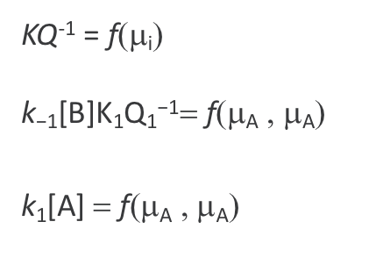
Uncertainty Quantification regarding parameters
KQ⁻¹ = f(μ_{i})
$\text{k}\text{−1}\text{[}\text{B}\text{]}\text{K}\text{1}\text{Q}\text{1}\text{−1}$= f(μ_{A} , μ_{A})
$\text{k}\text{1}\text{[}\text{A}\text{]}$= f(μ_{A} , μ_{A})
Analytical Jacobian
Relate rates to total free energy of the system.
Use MC or Latin Hypercube sampling
Evaluate Maximum Entropy Production Rate as Natural Selection principle as proposed by Lotka, Schrodinger, Dewar and others.

Slide 4
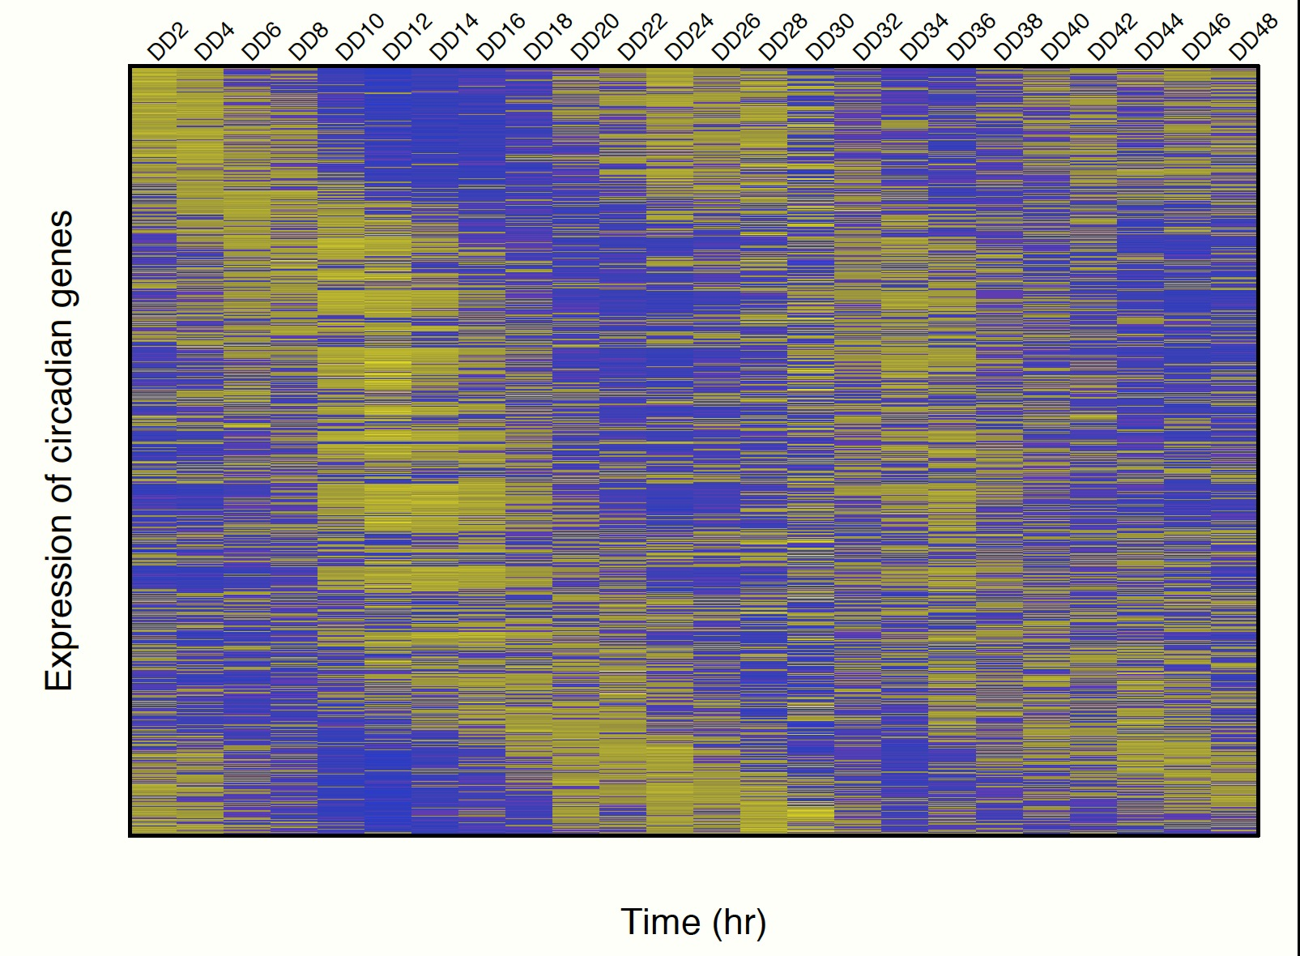
Challenges and opportunities:
Model Uncertainty (Biological Validation)
Opportunities: Proteomic state
  Proteomic state: key clock proteins can be measured.
    Are simulations and experiments congruent?
Challenges: Metabolic state
  Getting experimental data: C13 Metabolic fluxes from a filamentous fungi
  Chemostat with filamentous fungi is problematic.
  Alternate validation:
    Comparing simulations with experimental clock protein data.
    E. coli MFA
Working with Wayne Curtis (Dept. of Chemical Engineering, PSU) on metabolic flux analysis.

Slide 5
Timeline and milestones of the Model Credibility Plan
Will test in final year. Could test mathematical model sooner.
  Two evaluations
    Matlab script for simple mathematical model to test general concept
    Python notebook and/or C library for biological model using same math.
3 weeks of funding for credibility testing for a third party
  We expect that the testing actually take less time.
Flexibility to barter within the MSM consortium.
  We could fund ourselves to evaluate the credibility of others models in exchange for others funding themselves to test ours.

