Slide 1
TOPMed
Present & Future
Pankaj Qasba, Ph.D.
TOPMed Team

Slide 2
NHLBI Trans-Omics for Precision Medicine (TOP Med): Present & Future
Stimulate discovery in high impact disease areas
Ensure well phenotyped and genotyped participants are chosen from traditionally underrepresented populations
Build a Resource for the Scientific Community
Stimulate Systems Medicine Approaches to health and disease research
To Enable/Facilitate Precision Medicine

Slide 3
Goals
Build a Resource
Diversity
Large Sample Size
Ability to Integrate Data
Early Discovery
Focus on Specific Diseases
Focus on Specific Patient Groups
Focus on Underrepresented Groups
Leverage other NIH investments in WGS
Build upon NHLBI investment in existing cohorts
Contribute to other NHLBI genomics efforts

Slide 4
TOPMed Basics
Sequencing Centers:
Broad Institute
University of Washington
NYGC
Illumina
Baylor
Informatics Research Center:
University of Michigan
Data Coordinating Center:
University of Washington
Archive / Bioinformatics Support:
National Center for Biotechnology Information-NCBI

Slide 5
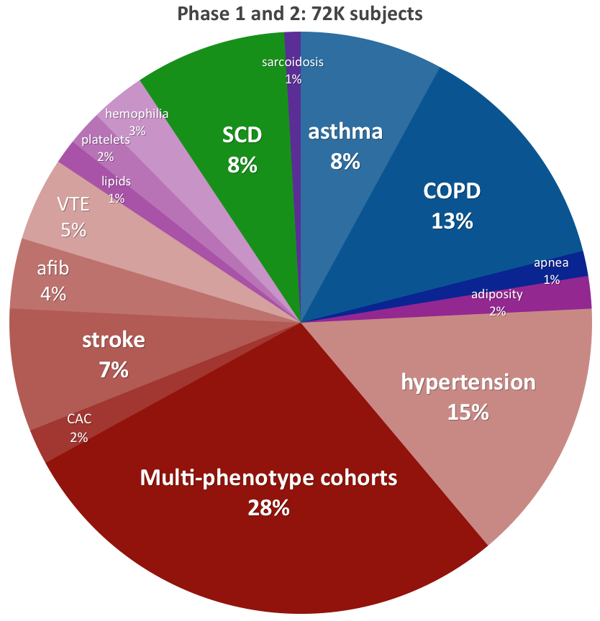
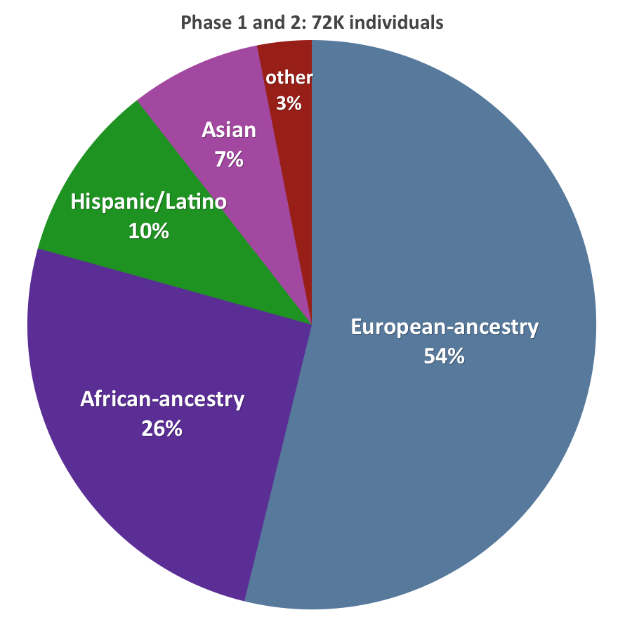
TOPMED - Where Are We Now? Diverse Genome-Phenome Resource
72K Participants (Goal of 100K to 150K)
Phenotype Diversity
Population Diversity
Developing a rich data source representative of the diverse HLBS phenotypes and populations that can enable multi-omics exploration to define the mediator pathways of HLBS disorders and discovery novel therapies.
Notes:
Back up

Slide 6
TOPMed WGS Workstreams at a Glance
Source | FY16 | FY17 | FY18 | FY19 | FY20
Current TOPMed
WGS contract FY15
IDIQ FY16 – FY20 (X01)
NHGRI – NHLBI CCDG co-fund
NHGRI CCDG
72,045
Obesity
EO AFib
Asthma
COPD
SCD
EO MI

