Slide 1
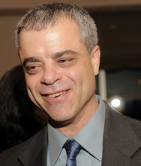
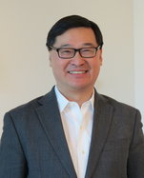
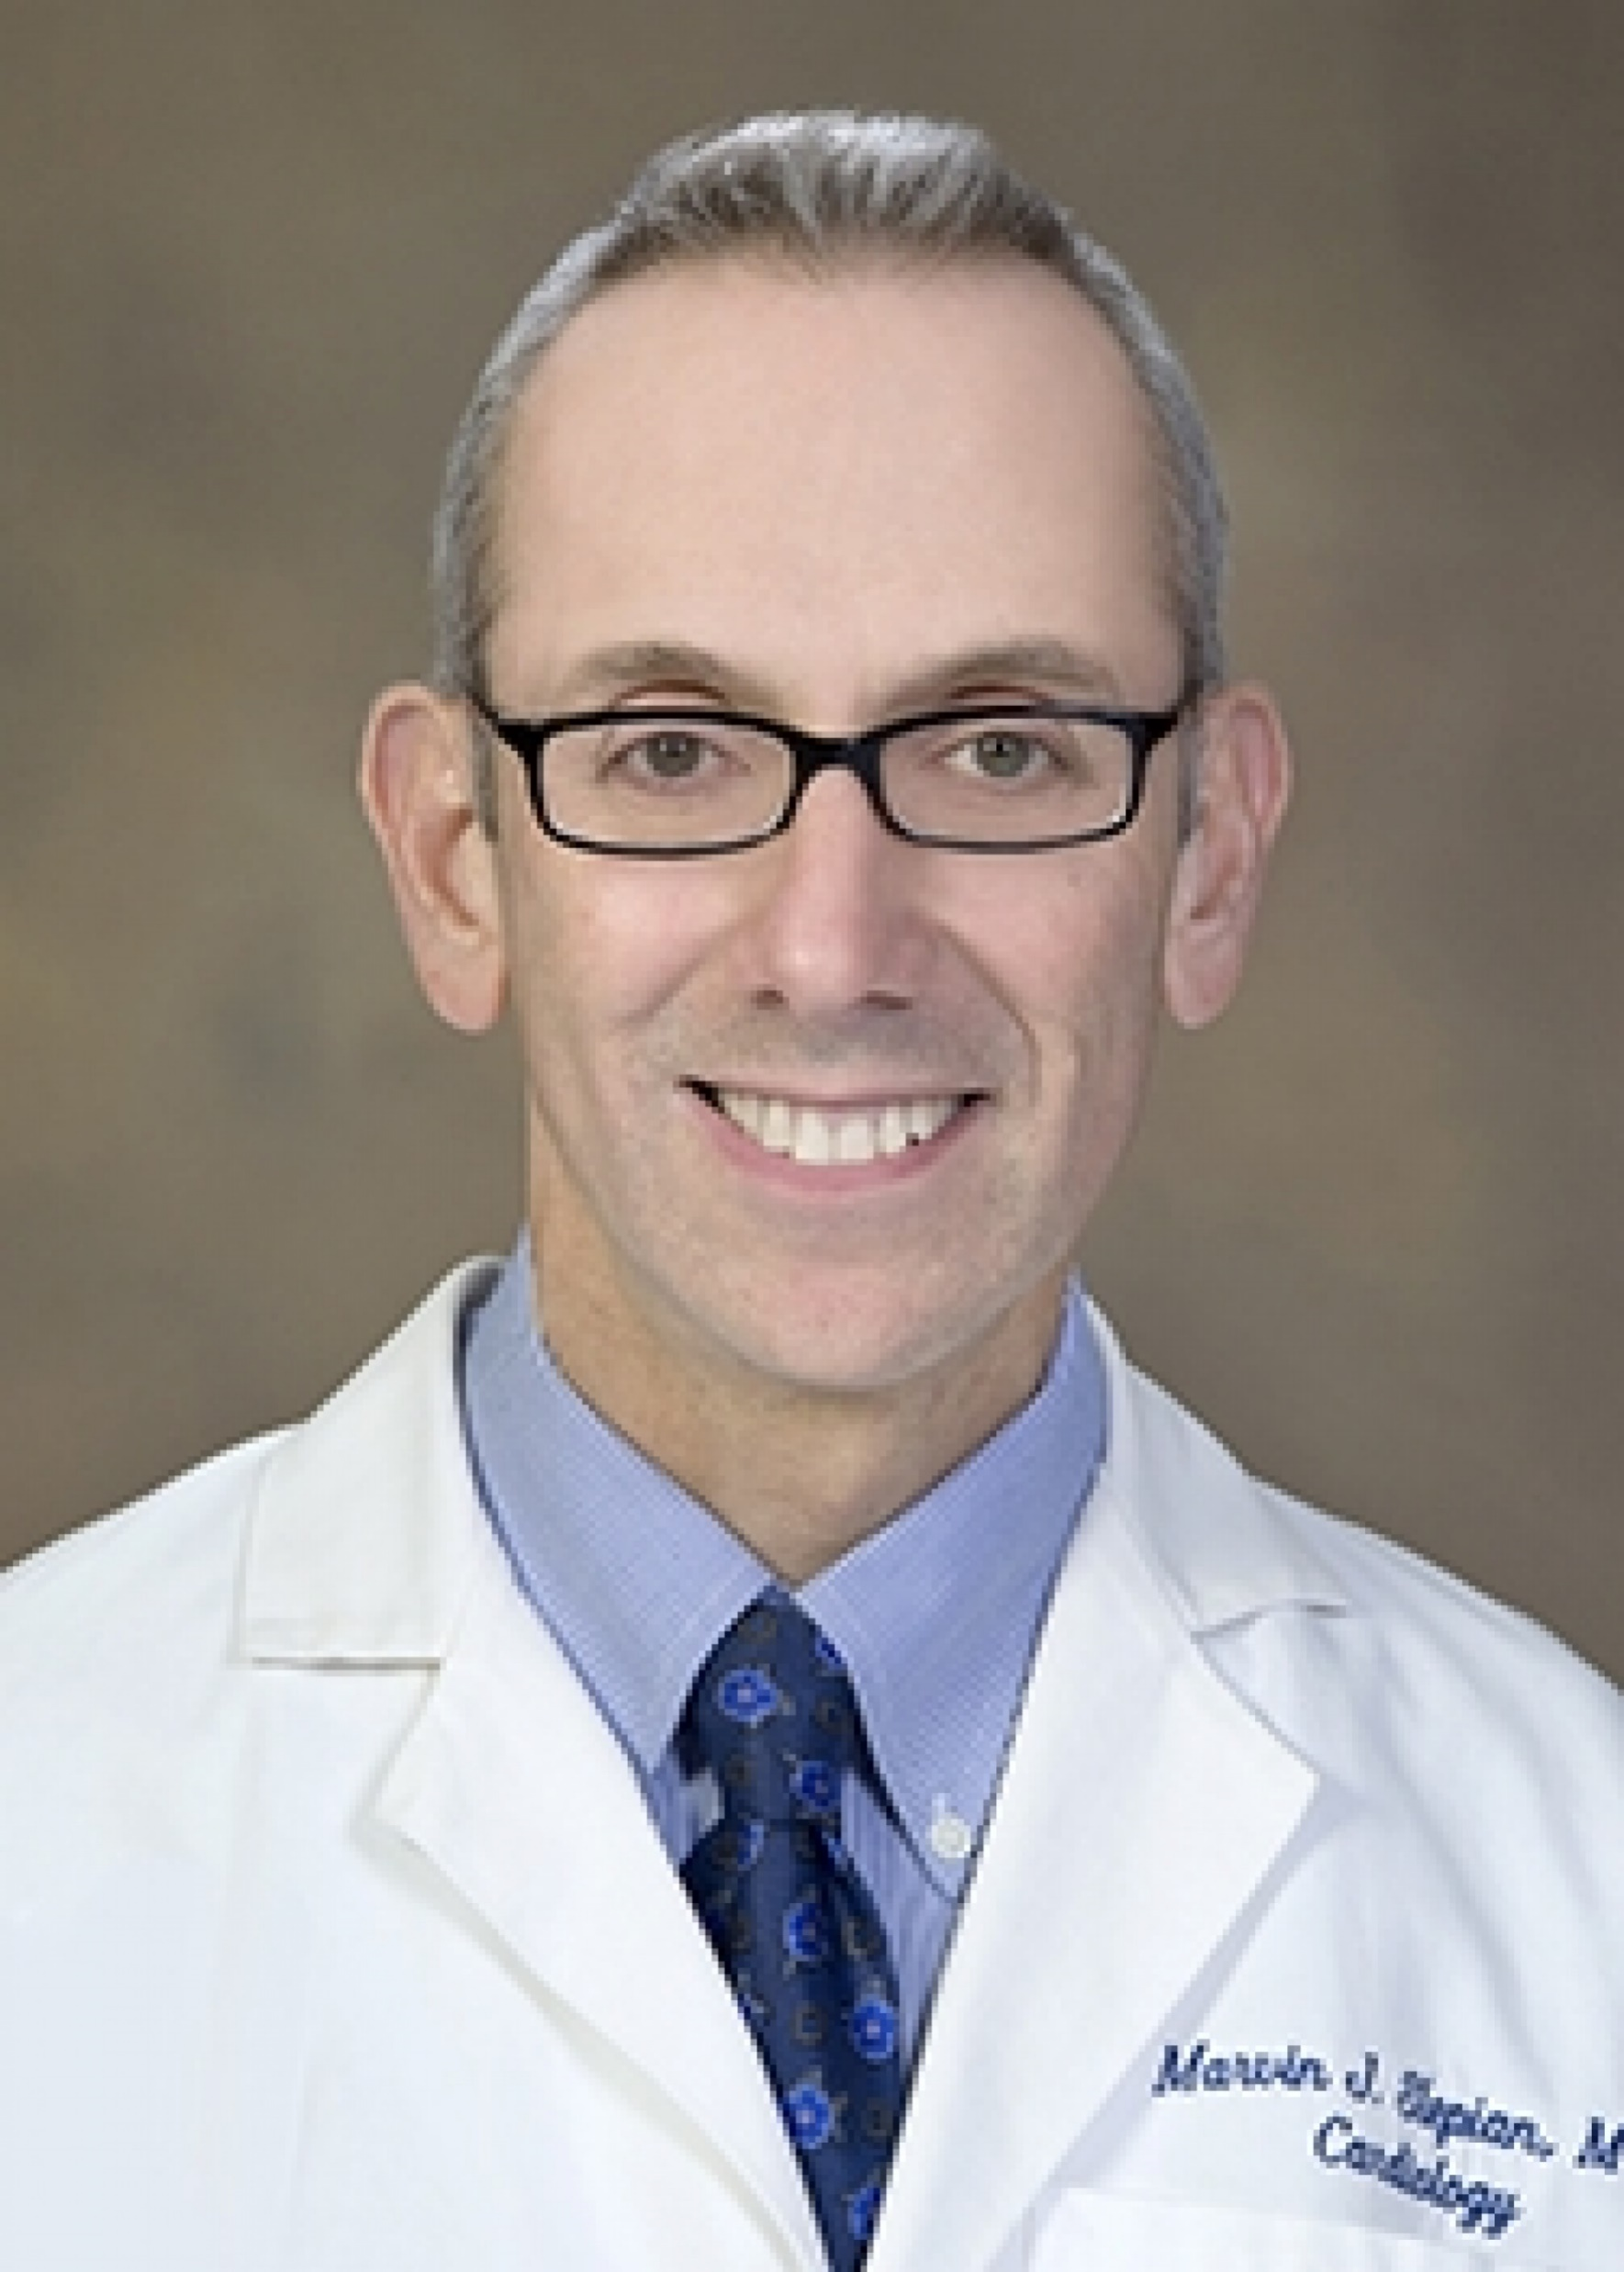
MULTISCALE MODELING OF BLOOD FLOW AND PLATELET MEDIATED THROMBOSIS
The model: We developed a multiscale model for simulating platelet activation, aggregation, and adhesion in viscous blood flow. This model incorporates Dissipative Particle Dynamics (DPD) of viscous flow that interfaces with Coarse Grained Molecular Dynamics (CGMD) of mechanobiology-based platelets to simulate their activation via mechanotransduction pathways, and their aggregation and adhesion to platelets or coagulation proteins deposited onto a blood vessel wall. Machine Learning methods validate model predictions with in vitro results and adapt temporal scales to diverse spatial scales for more efficient simulations.
Danny Bluestein
Stony Brook University
Yuefan Deng
Stony Brook University
Marvin J. Slepian
University of Arizona
Funding Support: NHLBI 5 U01 HL131052
What is new inside? Our approach is the first multiscale numerical method for simulating flow-mediated platelet activation, aggregation, and adhesion that includes receptors on the platelet membrane. Biophysical properties of a platelet are accurately described down to a nm-length and ps-time scale, and the viscous flow is described at a μm-length and ns-time scale.
How will this change current practice? Although platelets are less deformable than red blood cells, this work demonstrates that a rigidity assumption typically used for platelet simulations is erroneous. A mechanobiology-based deformable model allows the development of precise predictive models.
End Users The primary stakeholders are clinical and numerical experts in the flow-mediated thrombosis field who will use the model to predict risk of thrombus formation in cardiovascular diseases and devices. This method can be adapted to model a variety of platelet-based diseases by considering mechanical events triggering biochemical responses.
Activated Platelet with 5 Filopods
Notes:
NOTES
The coagulation cascade of blood may be initiated by flow-induced platelet activation and aggregation, which prompts clot formation in prosthetic cardiovascular devices and vascular disease processes. Continuum methods fail to capture subcellular mechanisms such as filopodia formation during platelet activation, while utilizing molecular dynamics is computationally prohibitive. A multiscale approach offers a means to bridge the gap between the diverse scales encompassing subplatelet mechanisms and the surrounding blood flow field.
We employ machine learning to establish a framework to characterize phase changes involved in platelet dynamics for adjusting timestep sizes in simulations, as well as predict physical characteristics of platelet-driven events, such as contact area during aggregation. This intelligent algorithm makes efficient use of limited computing resources and offers a promising insight for solving massive particle-based multiscale problems.
Future goals include the development of a platelet-mediated thrombus growth model under fluid shear stress that will adapt the molecular-scale properties of our current recruitment aggregation and adhesion models, thus predicting macro-scale properties using micro-scale principles.
Multiscale modeling: Our multiple spatiotemporal model employs a modified DPD to describe viscous blood flow in stenoses and microchannels⁵, and electrical-free CGMD to describe the intra-platelet constituents to study the mechanotransduction process². Spatially, the DPD-CGMD is interfaced by imposing a hybrid force field¹. In this spatial interface, the Lennard-Jones term helps maintain the cytoskeleton-confined shape and the incompressibility of platelets against the applied shear stress of circumfluent flow. The dissipative and random terms maintain the local flow thermodynamic and mechanical properties, and exchange momentum to express interactions between the platelet and the flow. Temporally, an event-driven multiple time-stepping (MTS) scheme⁶ is developed as an efficient numeric solver on top supercomputers^{7.}
PI: Danny Bluestein, Danny.Bluestein@stonybrook.edu
REFERENCES
[1] Zhang, P et al., Cell Mol Bioeng, 7:552-574, 2014.
[2] Zhang, P et al., J Biomech, 50:26-33, 2017.
[3] Pothapragada, S et al., Int J Numer Method Biomed Eng, 31:1-16, 2015.
[4] Gupta, P et al., Cell Mol Bioeng, 2019. (under revision)
[5] Gao, C et al., J Comput Phys, 335:812-827, 2017.
[6] Zhang, P et al., J Comput Phys, 284:668-686, 2015.
[7] Zhang, P et al., Comput Phys Commun, 204:132-140, 2015.

