Slide 1
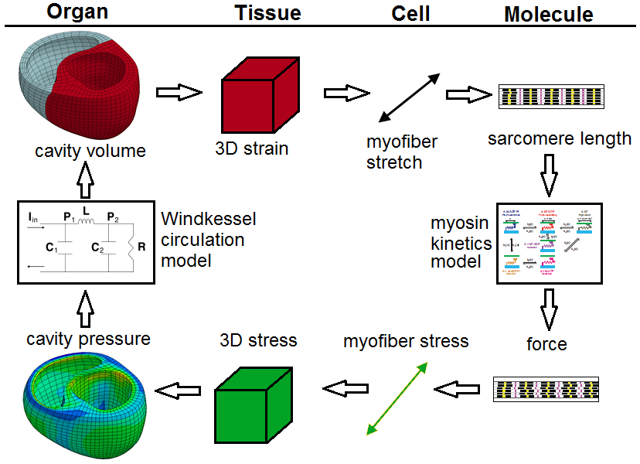
Multiscale Modeling of Inherited Cardiomyopathies and Therapeutic Interventions – NIH U01 HL133359
Objective
To develop and validate a multiscale computational model that can predict how hearts remodel over time in response to genetic or pharmaceutical modulation of myosin function. The modeling will be supported by experiments that measure structure and function at molecular to organ-level scales.
Innovation
The mathematical representation of myosin-level function will include mechanisms that are directly related to genetic mutation and pharmaceutical therapy.
The new growth and remodeling techniques will enable both ventricular structure and function to evolve over a large timescale.
Modular code structure will allow other researchers to enhance the model.
Significance
The new modeling approach could allow more targeted patient-specific treatment plans by testing new small molecule pharmaceuticals in silico.
End Users
Cardiac researchers in the near-term and clinicians in the long-term.
Flowchart of the multiscale model,
showing coupling of data.
Kenneth
Campbell
Jonathan
Wenk
Co-PIs: Kenneth Campbell and Jonathan Wenk (University of Kentucky)
Co-Is: Lik Chuan Lee (Michigan State) and Christopher Yengo (Penn State)
Notes:
Overview: Genetic mutations in the heart can lead to long-term issues, which diminish livelihood. By combining computational simulations and clinical data, new approaches for treatment could be developed that are tailored to each specific patient.
Future Challenges: Translating the model to use clinical data from patients.
PI name, email: Kenneth Campbell (k.s.campbell@uky.edu) and Jonathan Wenk (jonathan.wenk@uky.edu)

