Slide 1
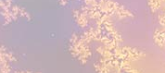
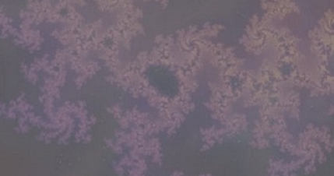
{Insert title – headline}
The model {describe purpose of model or method, describe construct, insert graphical depiction, video of simulation if applicable}
What is new inside? {describe new math, new algorithm}
How will this change current practice? {Why is this important?}
End Users {Who are the stakeholders? What expertise should they have? How will they use it (e.g.: data & platform needed)?}
{Insert investigator images
Names, Institutions
Grant support: Agency, #}
Notes:
Instructions:
Submit 1 slide by COB Monday 2/25/19
Title - headline your theory-driven, mechanistic model
name the specific mathematical or statistical method and variations thereof
To include in NOTES section
define/explain it enough for a non-scientific person to explain to the general public (2-3 sentences)
mention how can machine learning and AI help your project (2 sentences)
List future challenges or next steps after your project is done (1 sentence)
Further details for Notes section - For the following communities (2 sentences):
Behavioral modeling: explain the new theories that will integrate within person dynamics with between person dynamics
Multiscale modeling: explain how the math will address methodological challenges (e.g.: crossing scales, sparse data, uncertainty, modularity, spatiotemporal simulation challenges, etc.)
Medical simulation: explain the math challenges being overcome (e.g. collision dynamics, cloth dynamics, haptics, etc.)
Analysis: explain how new statistical approaches will provide mechanistic understanding of the system
BRAIN: explain the theory behind the math/stats and how it will be used to understand how the brain works; explain the level of data dependency on your model (e.g.: (a) completely abstract toy model, (b) a coarse-grained model based on a high level view of previous data, (c) a model based directly on one kind of data (e.g., neural recordings) or (d) a model synthesizing multiple data types (e.g., neural recordings and connectomics).
PI name, email:

Slide 2
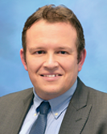
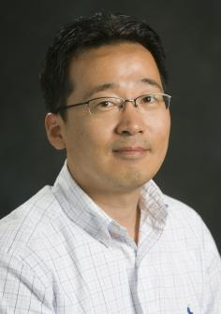
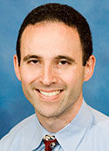
Spatiotemporal Multiscale Model for Cardio-Pulmonary Hemodynamics and Growth and Remodeling
The model
The main purpose of the model is to describe biomechanics of the Pulmonary Arterial Hypertension (PAH) progression. We are developing the spatiotemporal multiscale model of the cardio-pulmonary system (with small, large vasculature and the heart) that accounts for both hemodynamics and tissue growth and remodeling (G&R) using longitudinal clinical human data.
The computational hemodynamics and vessels/heart wall mechanics is implemented with the Coupled Momentum Method (FEM-based FSI) and FEM, respectively. The G&R for vessels walls is described by the constrained mixture theory while for the heart by the growth-tensor. The Fluid-Solid-Growth (FSG) model is described by the temporal multiscale based on time scales separations and linear approximations. The
What is new inside?
Temporal multiscale framework for the FSG model that couples short-time hemodynamics with slow-time G&R of vessels walls in the small pulmonary arterial tree.
Homeostatic optimization of the hemodynamics and wall mechanics parameters accounting for the wall metabolic cost to determine a hemostatic baseline in the arterial tree.
Uncertainty quantification for multi-fidelity models based on statistics and the co-kringing estimator.
How will this change current practice?
This model will interconnect the hemodynamics factors with considerations of G&R observed in pulmonary vessels and right ventricle during progression of PAH. The computational framework will be used for patient-specific modeling and will help in analyzing a biomechanical response of the cardio-pulmonary system to potentially new medical treatments (e.g. vasodilatory agents).
End Users
End product is the computational tool to assist biomechanical engineers, medical scientists and clinicians to investigate the role of hemodynamics and G&R in PAH. The modeling expertize will be required for an engineer as well as a close collaboration with clinicians.
C.A.Figueroa, S.Baek, A.L.Dorfman
Grant NIBIB: U01 HL 135842
Notes:
Instructions:
Submit 1 slide by COB Monday 2/25/19
Title - headline your theory-driven, mechanistic model
name the specific mathematical or statistical method and variations thereof
To include in NOTES section
The multiscale computational framework will be developed to model blood flow and changes in the heart and vessels wall mechanics that are observed in the pulmonary arterial hypertension disease. The model will incorporate the high and low resolution of the small and large vasculature and the heart that are key components of the described cardio-pulmonary system. In the long term, the model will assist with patient stratification based on biomechanical markers, and provide a framework for virtual testing of pharmacological interventions.
We will use machine learning and AI by (1) data assimilation for hemodynamics, (2) uncertainty quantification for multi-fidelity models, (3) uncertainty quantification for parameters evaluated by patients data.
Future challenges consist of (1) full and optimized coupling of the hemodynamics and G&R in small, large vessels and the heart to build unified spatiotemporal multiscale computational tool, (2) automating parameters calibrations, (3) applying the computational model for virtual testing of pharmacological treatments.
Further details for Notes section:
Multiscale modeling: Mathematical framework will help to cross time and spatial scales in a rigorous and consistent way leading to a reliable computational model as well as clarification of the imposed assumptions. This theoretical description will also help to identify numerous model limitations that is usually challenging for the complex multi-physics problem with vascular hemodynamics, G&R, tissues mechanics, and the heart model.
PI : C. Alberto Figueroa (figueroc@med.umich.edu), Seungik Baek (sbaek@egr.msu.edu), Adam L. Dorfman (adamdorf@med.umich.edu)

