Slide 1
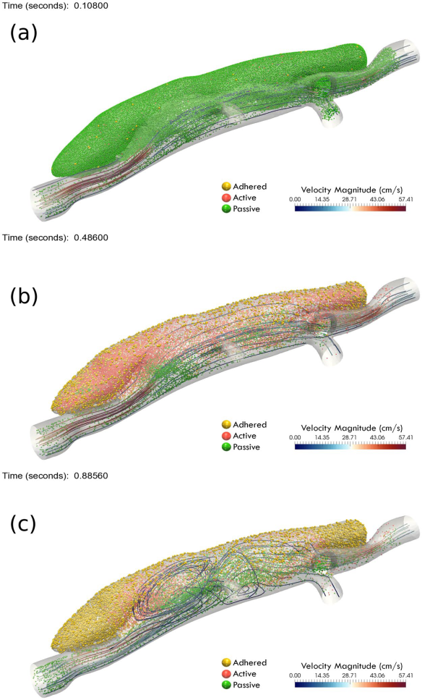
Multiscale Multiphysics Model of Thrombus Biomechanics
in Aortic Dissection
1
The model. The overall goal of this project is to create a new class of computa-tional models to describe and predict thrombus formation and remodeling within the false lumen of aortic dissections. Toward this end, we have developed new multimodality in vivo / in vitro imaging methods to inform (1) continuum modeling of the hemodynamics, which in turn (2) drives new particle-based modeling of the thrombus formation, which we have shown to allow the first description as well as prediction of the formation of intramural thrombus in a common mouse model of aortic dissection (as seen in the images to the right).
What is new inside? The primary novelties in mathematical modeling have been the development of new continuum/particle-based models of both the blood flow (with embedded platelet-like particles) and the arterial wall (with embedded particle-like local accumulations of matrix). For the former, we use a “force coupling method” and for the latter we use a novel extension of “smoothed particle hydro-dynamics” for nonlinear elasticity.
How will this change current practice? Continuum/particle-based models provide a unique method to increase biological resolution while preserving computational advantages of continuum solutions on large spatial domains.
End Users. Primarily bioengineers interested in understanding thrombus bio-mechanics, ultimately with the goal of understanding better to treat dissections.
2
J.D Humphrey (Yale)
G.E. Karniadakis (Brown)
Grant: U01 HL116323
Notes:
Instructions:
Submit 1 slide by COB Monday 2/25/19
Title - headline your theory-driven, mechanistic model
name the specific mathematical or statistical method and variations thereof
To include in NOTES section
define/explain it enough for a non-scientific person to explain to the general public (2-3 sentences)
mention how can machine learning and AI help your project (2 sentences)
List future challenges or next steps after your project is done (1 sentence)
Further details for Notes section - For the following communities (2 sentences):
Behavioral modeling: explain the new theories that will integrate within person dynamics with between person dynamics
Multiscale modeling: explain how the math will address methodological challenges (e.g.: crossing scales, sparse data, uncertainty, modularity, spatiotemporal simulation challenges, etc.)
Medical simulation: explain the math challenges being overcome (e.g. collision dynamics, cloth dynamics, haptics, etc.)
Analysis: explain how new statistical approaches will provide mechanistic understanding of the system
BRAIN: explain the theory behind the math/stats and how it will be used to understand how the brain works; explain the level of data dependency on your model (e.g.: (a) completely abstract toy model, (b) a coarse-grained model based on a high level view of previous data, (c) a model based directly on one kind of data (e.g., neural recordings) or (d) a model synthesizing multiple data types (e.g., neural recordings and connectomics).
PI name, email:

