Slide 1
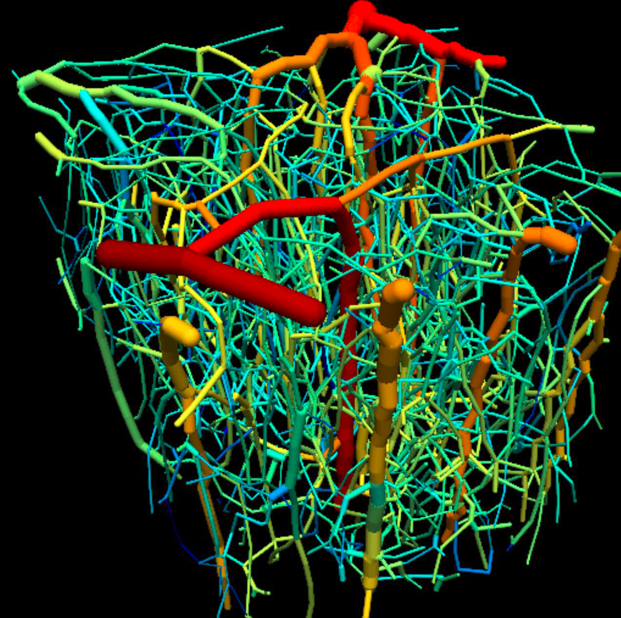
Multiscale modeling of cerebral blood flow and oxygen transport – NIH U01 HL133362
Objective: To gain quantitative understanding of the relationship between neural activation, blood flow and tissue oxygenation in the brain cortex, using multiscale theoretical models for blood flow, oxygen transport and flow regulation (neurovascular coupling) in networks of microvessels.
Innovation
Extensive experimental data on 3D structure of brain microvessel networks, combined with tissue oxygen levels and blood flow rates
Simulations of blood flow and oxygen transport in large networks using GPU-based computing, with algorithms allowing for incomplete boundary conditions
Methods for simulating neurovascular coupling in heterogeneous networks
Significance
BOLD fMRI is used for brain research and clinical purposes. This work will clarify the relationship between fMRI imaging and brain activity.
The effects of deficits in neurovascular coupling in neurodegenerative diseases are poorly understood.
End Users: Modelers and experimentalists studying cerebral blood flow and metabolism. Codes in C++ are made available to other modeling groups.
Region of brain network, 609 × 609 × 662 μm, with 3572 segments and 3130 nodes, color coded for log(flow) in each segment.
Investigators: Timothy W. Secomb (U. of Arizona), Sava Sakadzic (Mass. Gen. Hosp.), David A. Boas (Boston U.)
Notes:
NOTES
Summary: Distribution of blood flow according to the needs of tissues, particularly for oxygen, is achieved by local regulation of blood flow, through the adjustment of diameters of small arteries and arterioles. The overall goal of this project is to gain quantitative understanding of blood flow and oxygen transport to brain tissue through the development of multiscale theoretical models. The insights gained in this project will have potential applications to normal physiology and to a range of conditions in which oxygen transport to tissue is impaired, including stroke, brain injury and neurodegenerative diseases.
Machine learning: Our collaborators are exploring machine learning approaches for reconstructing the connectivity of microvessel networks from optical image stacks, which are noisy and have variable levels of intensity and contrast.
Future challenges: Our models will provide insight into potential mechanisms by which blood flow in the brain is coupled to local neuronal activity. Our results will suggest directions for future experiments, and for applications to brain imaging and treatment of brain disorders.
Methodological challenges in multiscale modeling: A fundamental unsolved challenge in this field is to establish the relationship between parameters measured at the microvessel level, such as capillary flow and oxygen delivery by individual vessels to key tissue-level parameters such as perfusion and oxygen extraction. We are addressing this by coupling microscale regions with “virtual regions” with equivalent overall properties in our simulations.
Brain modeling: Our model is directly dependent on detailed observations of microvessel network structure, blood flow rates and oxygen level in the mouse cerebral cortex. These properties will be measured in both resting and stimulated regions, with and without anesthesia. The theoretical models (including algebraic systems, ordinary and partial differential equations) will be used to simulate oxygen delivery in the brain and test hypotheses regarding the coupling of blood flow to varying neuronal activation.
PI name, email: Timothy W. Secomb secomb@u.arizona.edu

