Slide 1
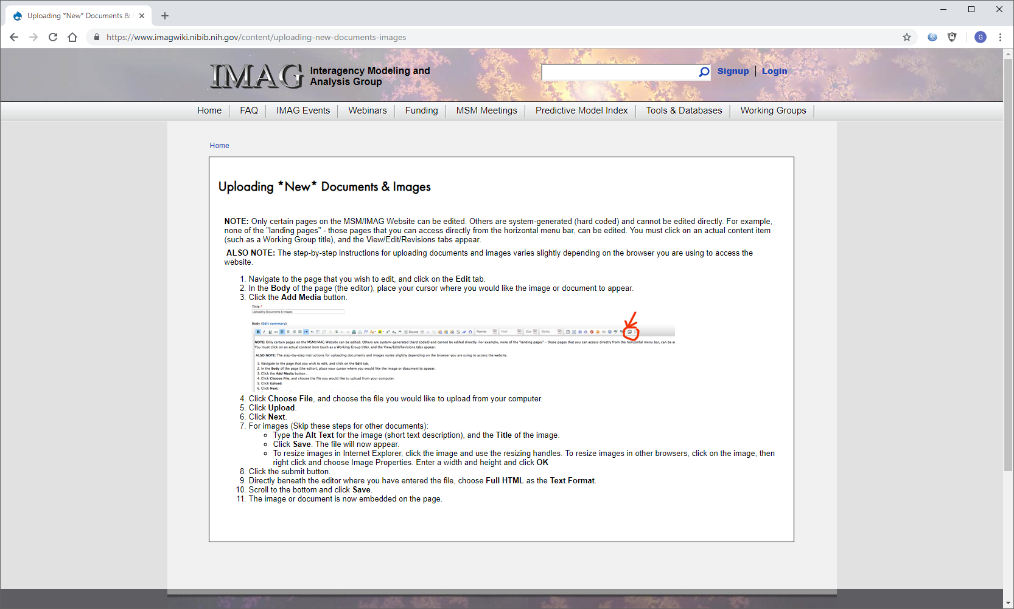
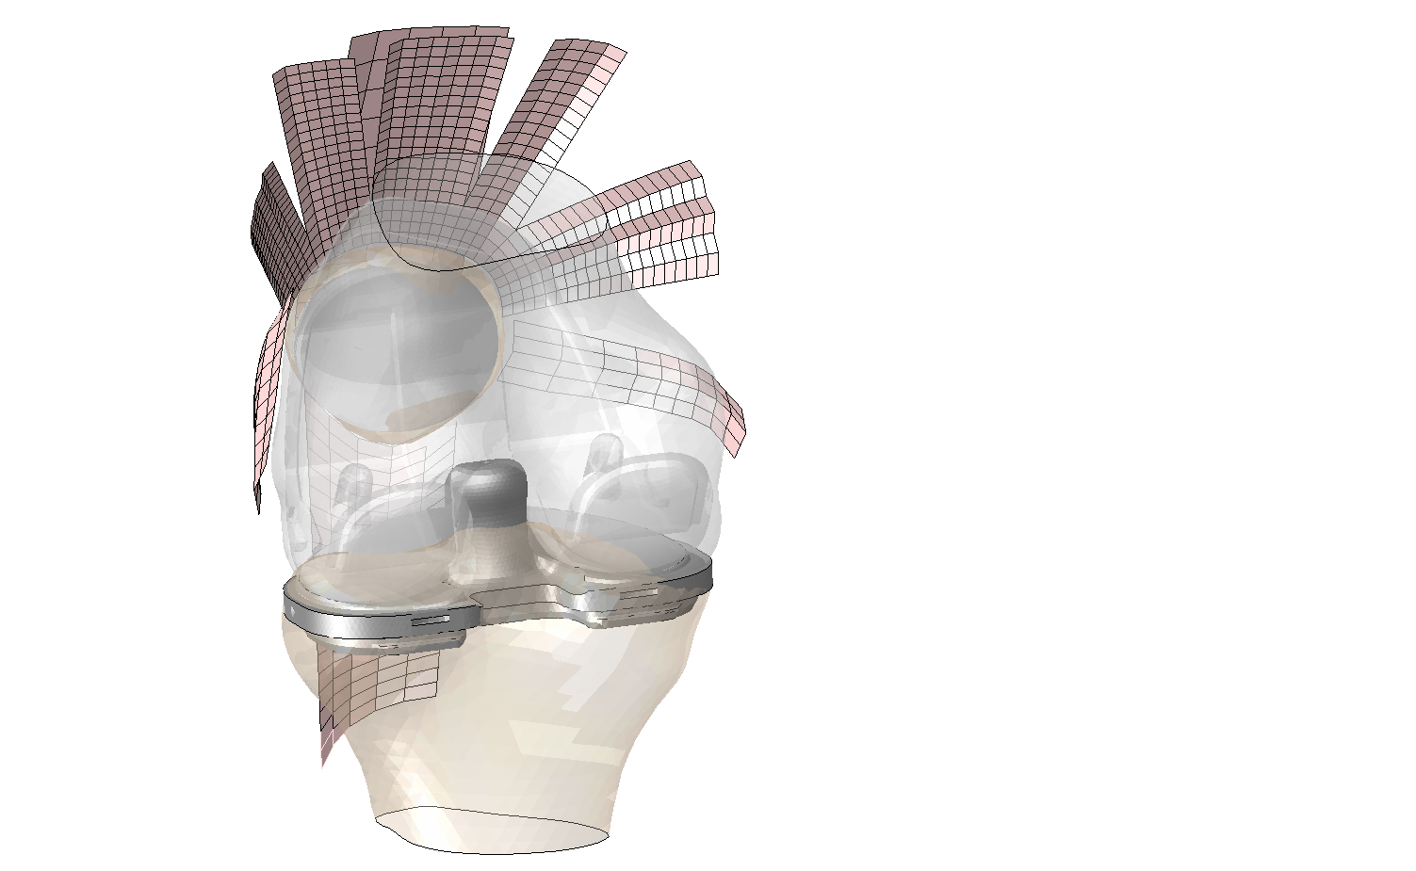
U01 AR072989 A Lower Extremity Neuromusculoskeletal Human Simulator: Addressing Multiscale Challenges
The model: The overall goal is to create and share a comprehensive multiscale musculoskeletal model of the human lower extremity, which includes seamless connection between tissue and whole-body function during dynamic human activities.
What is new inside?
In vivo stereo x-ray tracking of bones and implants with sub-mm accuracy as part of time-synchronized subject-specific multiscale data spanning tissue to whole-body movement
Finite-element models of the human lower extremity representing the detailed 3D geometry and active and passive properties of the tissues
Simulation of human movement requiring optimization and parallel processing to predict human response to pathology and treatment
How will this change current practice? Enables realistic pre-clinical investigations of musculoskeletal disease and treatment
End Users: Clinicians, scientists, therapists, and engineers involved in the diagnosis and treatment of orthopedic pathology, including regulatory overseers of treatment safety and efficacy
Clare Fitzpatrick, Peter Laz, Paul Rullkoetter, Brad Davidson, Chadd Clary, Douglas Dennis, Kevin Shelburne kevin.shelburne@du.edu
University of Denver, Boise State University
Support: NIAMS, NIBIB, and NICHD
Notes:
Instructions:
Submit 1 slide by COB Monday 2/25/19
Title - headline your theory-driven, mechanistic model
name the specific mathematical or statistical method and variations thereof
To include in NOTES section
define/explain it enough for a non-scientific person to explain to the general public (2-3 sentences)
mention how can machine learning and AI help your project (2 sentences)
List future challenges or next steps after your project is done (1 sentence)
Further details for Notes section - For the following communities (2 sentences):
Behavioral modeling: explain the new theories that will integrate within person dynamics with between person dynamics
Multiscale modeling: explain how the math will address methodological challenges (e.g.: crossing scales, sparse data, uncertainty, modularity, spatiotemporal simulation challenges, etc.)
Medical simulation: explain the math challenges being overcome (e.g. collision dynamics, cloth dynamics, haptics, etc.)
Analysis: explain how new statistical approaches will provide mechanistic understanding of the system
BRAIN: explain the theory behind the math/stats and how it will be used to understand how the brain works; explain the level of data dependency on your model (e.g.: (a) completely abstract toy model, (b) a coarse-grained model based on a high level view of previous data, (c) a model based directly on one kind of data (e.g., neural recordings) or (d) a model synthesizing multiple data types (e.g., neural recordings and connectomics).
PI name, email:

