Slide 1
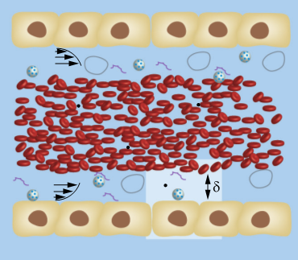
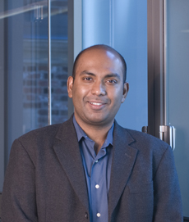
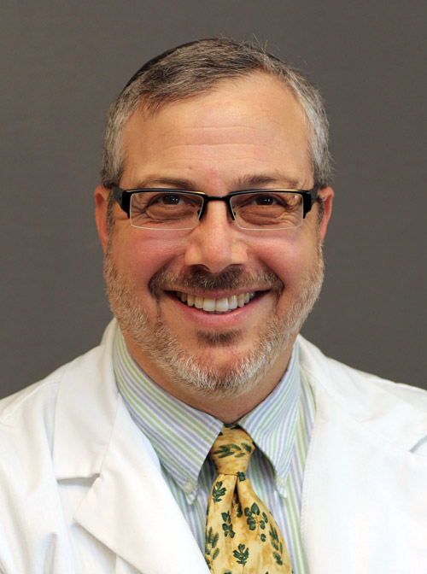
Multiscale Modeling in Nanomedicine and Quantitative Systems Pharmacology
The model. Multiscale model for nanocarrier (NC) design, transport, and adhesion for vascular targeted drug delivery applications
What is new inside? The model combines and bridges robust techniques of molecular simulations and enhanced sampling at the molecular scale with continuum hydrodynamics at the tissue and organ scale. Multiscale bridging is achieved through the use of novel algorithms based on stochastic transport equations (generalized Langevin equations and Brownian dynamics), field theory (dynamical density functional theory, thin shell elasticity), and equilibrium statistical mechanics (Monte Carlo simulations). Model validated using in vitro (cellular constructs in flow), in vivo (murine and equine systems), and physical science (atomic force microscopy, quartz microbalance, ektacytometry) experiments at multiple scales.
How will this change current practice? Current design of nanocarriers utilizes empirical design approach through exhaustive experimentation often involving animals. The multiscale model offers a route to rational design and insight into mechanisms and can be used in streamlining animal experiments in the design of rigid and flexible nanocarriers for efficacious therapeutic delivery.
End Users. The algorithms are implemented using best practices in software architecture in a heterogeneously coupled multiscale framework using process workflow management software, virtual environments, and pipeline for heterogeneous systems. They will be made available through private and general purpose cloud.
Molecular scale models
NC adhesion to live cells
NC margination
In vivo imaging
Radhakrishnan, UPenn
Eckmann, UPenn
Grant: NIBIB, U01EB016027
Notes:
David M. Eckmann, email: David.Eckmann@uphs.upenn.edu
Ravi Radhakrishnan, email: rradhak@seas.upenn.edu
To include in NOTES section
Project Narrative: Nanocarrier based imaging and drug delivery systems for systemic (e.g., intravenous) therapeutic and diagnostic applications are inherently complex. We are tightly coupling in vivo experimentation (mouse and
horse models and human blood sample and imaging analysis) with multiscale numerical methods to validate, predict,
and guide precision in clinical nanoparticle use by developing a computational Predictive Mechanism Based
Nanoparticle Targeting (PMBNPT) model for medical nanocarrier applications.
Nanoscale adhesion: Biophysically inspired model for functionalized nanocarrier adhesion to cell surface: roles of protein expression and mechanical factors, N. Ramakrishnan, D. M. Eckmann, V. M. Muzykantov, P. S. Ayyaswamy, and R. Radhakrishnan, 2016, Royal Society Open Science, 2016, 3, 160260. DOI: 10.1098/rsos.160260;
Nanoscale Transport: Motion of a nanospheroid in a cylindrical vessel flow: Brownian and hydrodynamic interactions, N. Ramakrishnan§, Y. Wang§, D. M. Eckmann, P. S. Ayyaswamy, R. Radhakrishnan, Journal of Fluid Mechanics, 2017, 121, 117-152; DOI: 10.1017/jfm.2017.182;
Molecular scale coupling: Multivalent binding of a ligand coated particle: Role of shape, size and ligand heterogeneity, M. McKenzie, S. M. Ha, A. Rammohan, R. Radhakrishnan, and N. Ramakrishnan, 2018, Biophysical Journal, 114(8):1830-1846. DOI: 10.1016/j.bpj.2018.03.007;
Coupling nanoscale transport and adhesion: Effect of wall-mediated hydrodynamics on the kinetics of activated processes for a Brownian particle predicted using composite generalized Langevin equations, H.-Y. Yu, D. M. Eckmann, P. S. Ayyaswamy, R. Radhakrishnan, Proceedings of the Royal Society A, 2016, 472, 20160397. DOI: 10.1098/rspa.2016.0397;
Multiscale validation with experiments: A Computational Model for Nanocarrier Binding to Endothelium Validated Using In Vivo, In Vitro, and Atomic Force Microscopy Experiments, J. Liu, G. E. R. Weller, B. Zern, P. S. Ayyaswamy, D. M. Eckmann, V. Muzykantov, R. Radhakrishnan, Proceedings of the National Academy of Sciences, 107(38), 16530-16535, 2010. Pubmed ID: 20823256;
Role of machine learning and AI: In silico profiling of activating mutations in cancer, E. Jordan, K. Patil, K. Suresh, J. Park, Y. Mosse, M. A. Lemmon, R. Radhakrishnan, 2019, in review at Cellular and Molecular Living Systems;
Future challenges: Assembling, curating and hosting the multiscale software using best practices in software architecture and high-performance computing and disseminating on the cloud.

