Slide 1
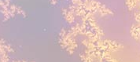
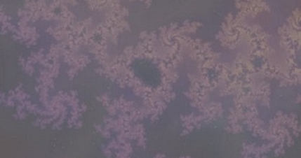
{Insert title – headline}
The model {describe purpose of model or method, describe construct, insert graphical depiction, video of simulation if applicable}
What is new inside? {describe new math, new algorithm}
How will this change current practice? {Why is this important?}
End Users {Who are the stakeholders? What expertise should they have? How will they use it (e.g.: data & platform needed)?}
{Insert investigator images
Names, Institutions
Grant support: Agency, #}
Notes:
Instructions:
Submit 1 slide by COB Monday 2/25/19
Title - headline your theory-driven, mechanistic model
name the specific mathematical or statistical method and variations thereof
To include in NOTES section
define/explain it enough for a non-scientific person to explain to the general public (2-3 sentences)
mention how can machine learning and AI help your project (2 sentences)
List future challenges or next steps after your project is done (1 sentence)
Further details for Notes section - For the following communities (2 sentences):
Behavioral modeling: explain the new theories that will integrate within person dynamics with between person dynamics
Multiscale modeling: explain how the math will address methodological challenges (e.g.: crossing scales, sparse data, uncertainty, modularity, spatiotemporal simulation challenges, etc.)
Medical simulation: explain the math challenges being overcome (e.g. collision dynamics, cloth dynamics, haptics, etc.)
Analysis: explain how new statistical approaches will provide mechanistic understanding of the system
BRAIN: explain the theory behind the math/stats and how it will be used to understand how the brain works; explain the level of data dependency on your model (e.g.: (a) completely abstract toy model, (b) a coarse-grained model based on a high level view of previous data, (c) a model based directly on one kind of data (e.g., neural recordings) or (d) a model synthesizing multiple data types (e.g., neural recordings and connectomics).
PI name, email:

