Slide 1
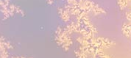
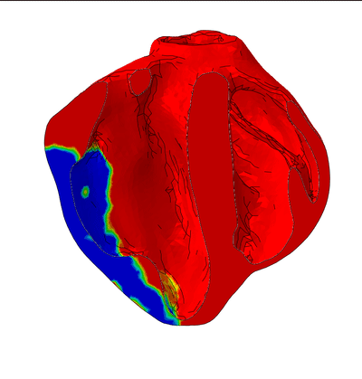
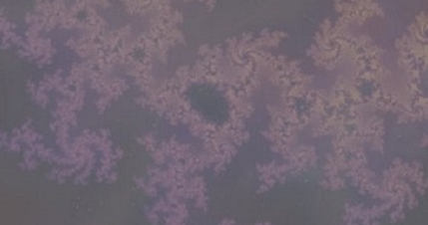
Validated Multi-Scale Model of Ischemic Heart Failure
The model {purpose of model and video of simulation}
To realistically simulate regional mechanics (myocardial stress and strain) during progression of ischemic heart failure (IHF) and chronic response to novel treatments for IHF.
What is new inside? {describe new math, new algorithm}
Model includes unprecedented geometric detail (papillary muscles, trabeculae) based on high-resolution ex-vivo diffusion tensor MRI of porcine biventricular unit following percutaneous creation of multiple myocardial infarctions. It is validated against real-time 3D transesophageal echocardiography (speckle-tracking measurements of circumferential and longitudinal strain in 16 AHA regions/segments).
How will this change current practice? {Why is this important?}
Heart failure (HF) is a worldwide epidemic. The majority of HF cases are due to myocardial infarction. Our validated model of IHF can be used to test the efficacy of existing treatments and design new ones to be tested using our percutaneous clinically-relevant animal model.
End Users {Stakeholders? Needed expertise? Data & platform needed?}
Cardiologists and cardiac surgeons can team up with a mechanical engineer to run the
model using the finite element method and our data on ventricular geometry,
mechanical properties and boundary conditions.
JM Guccione & GS Kassab
UCSF, Cal Med innov. Inst.
Grant support: Agency, #}
NIBIB U01HL119578
Notes:
define/explain it enough for a non-scientific person to explain to the general public (2-3 sentences)
We have developed and validated multi-scale models of multiple failing hearts using the same advanced simulation technology that the automotive, aerospace, energy and hi-tech industries rely on to test their product before they are built. Our model allows for medical devices to be designed and safely tested in the virtual world before ever being tested in the real world. Our model is based on experimental multi-scale measurements with unprecedented detail in a clinically-relevant large animal model of heart failure.
mention how can machine learning and AI help your project (2 sentences)
We have used our physics-based 3D model input and output data to train a machine learning algorithm that can accurately reproduce time courses of heart chamber pressures and volumes, as well as regional distributions of heart muscle fiber force development (stress) and deformation (strain). The machine learning algorithm is 6 orders of magnitude faster than our physics-based 3D model.
List future challenges or next steps after your project is done (1 sentence)
Next steps are to make experimental multi-scale measurements with unprecedented detail in a clinically-relevant large animal model of heart failure after treatment with novel medical devices (e.g., minimally invasive ventricular polymeric injection).
Further details for Notes section - For the following communities (2 sentences):
Multiscale modeling: explain how the math will address methodological challenges (e.g.: crossing scales, sparse data, uncertainty, modularity, spatiotemporal simulation challenges, etc.)
The finite element method is a rigorous (and widely accepted) mathematical method for numerically solving the partial differential equations that govern the mechanics of deformable bodies (conservation of mass and momentum). To reconcile our finite element model with multi-scale experimental measurements such as heart chamber geometry versus heart cell dimensions (diameter, sarcomere length, sarcomere number) we use machine learning (Bayesian inference).
PI name, email: Julius Guccione (Contact PI), Julius.Guccione@ucsf.edu; Ghassan Kassab (MPI), gkassab@calmi2.org

