Slide 1
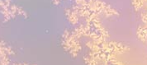
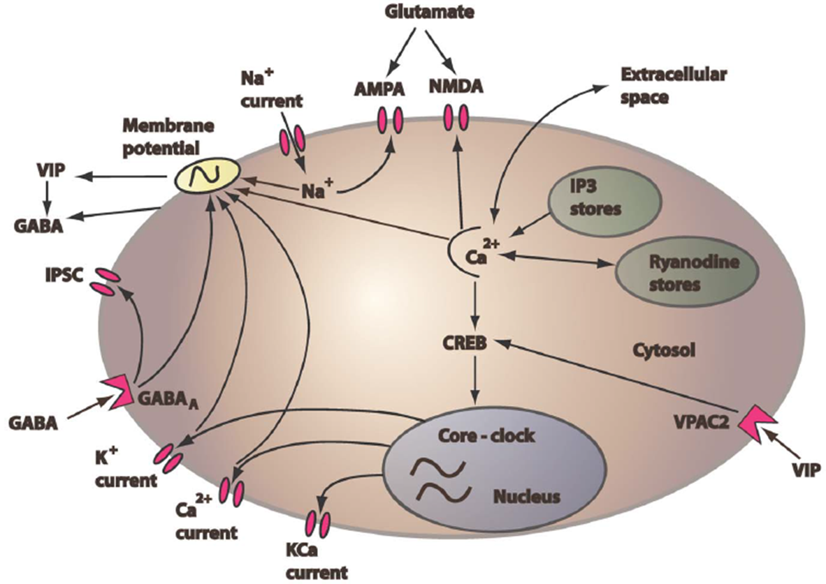
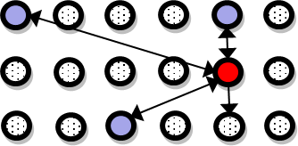
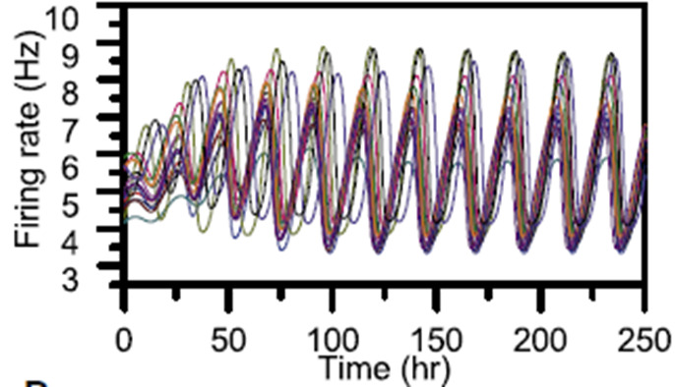

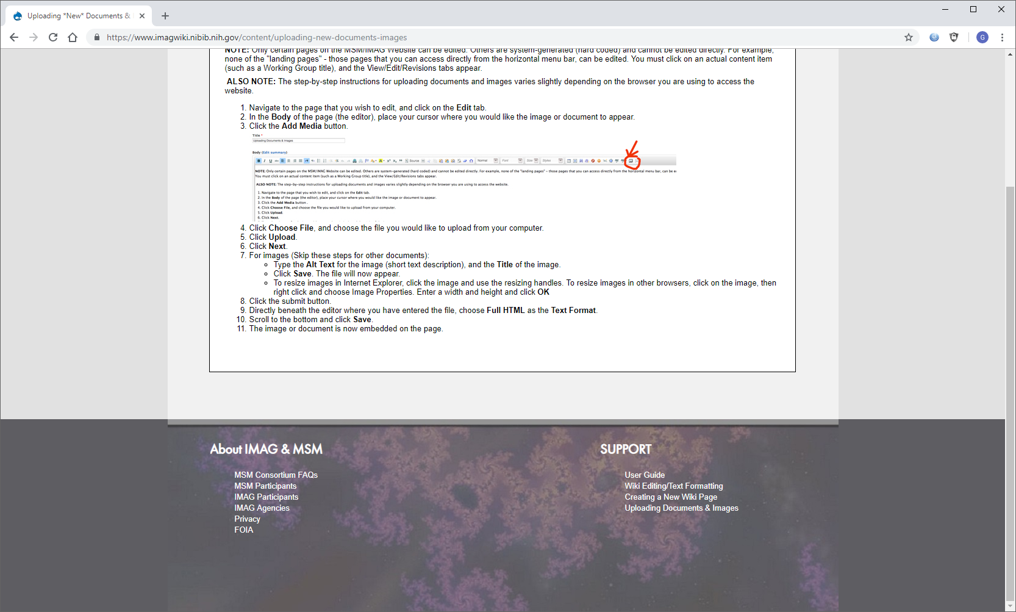


Multiscale Neural Model of the Human Circadian Clock
The model: We are developing a multiscale model of the human circadian clock and novel computational tools to gain improved understanding of neural network connectivity, synchronization and entrainment properties observed in targeted experiments.
+
+
=
Single neuron model
Intracellular model
Network model
Network dynamics
What is new inside? We are developing data-driven techniques for effective order reduction of neural network models and acceleration of network simulation and parametric studies. Multiscale computational techniques being developed include manifold/machine learning tools such as diffusion maps and equation-free simulation techniques.
How will this change current practice? Improved understanding of neural communication in the human clock could help treat circadian disruptions associated with sleep loss, erratic wake times, obesity, diabetes and schizophrenia. Neural network order reduction and accelerated simulation methods could have broad applicability to brain systems.
End Users: Our circadian model and network simulation tools will be valuable to circadian biologists, network scientists and systems biologists interested in exploring clock mechanisms, function/dysfunction and emergent dynamics. All computational models and simulation/analysis tools are being developed in MATLAB and Python.
Michael Henson, U. Massachusetts
Erik Herzog, Washington U.
Yannis Kevrekidis, Johns Hopkins U.
NIBIB U01-EB021956
Notes:
The mammalian circadian clock located in the hypothalamus of the brain consists of approximately 20,000 pacemaker neurons that are coupled together to produce a robust overall rhythm that drives bodily functions such as sleep patterns. The clock represents an ideal model system for studying biological network design and behavior due to accumulating data on individual neurons and their interactions. The goal of this project is to develop a multiscale model of the circadian clock and to integrate this model with targeted experiments and novel computational tools to gain improved understanding of network connectivity, synchronization and entrainment properties.
To perform order reduction and accelerate simulation of the neural network model, we are developing a suite of machine learning tools specialized for heterogeneous neural networks. These techniques include diffusion maps, manifold learning techniques with input-output informed kernels and equation-free simulation techniques. Upon completion of this U01 project, we will be well positioned to combine the the neural network model and accelerated simulation tools to computationally identify promising therapeutic strategies for counteracting circadian dysfunction.
Our multiscale tools will provide effective spatiotemporal simulation of heterogeneous oscillators on heterogeneous networks over time scales ranging from hours to entire seasons. The multiscale modeling framework will allow direct incorporation of sparse data on individual oscillators (e.g. heterogeneous periods and amplitudes) as well as network properties (e.g. average connectivity, degree distribution).
Dr. Michael A. Henson, mhenson@umass.edu

