Slide 1
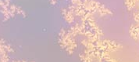
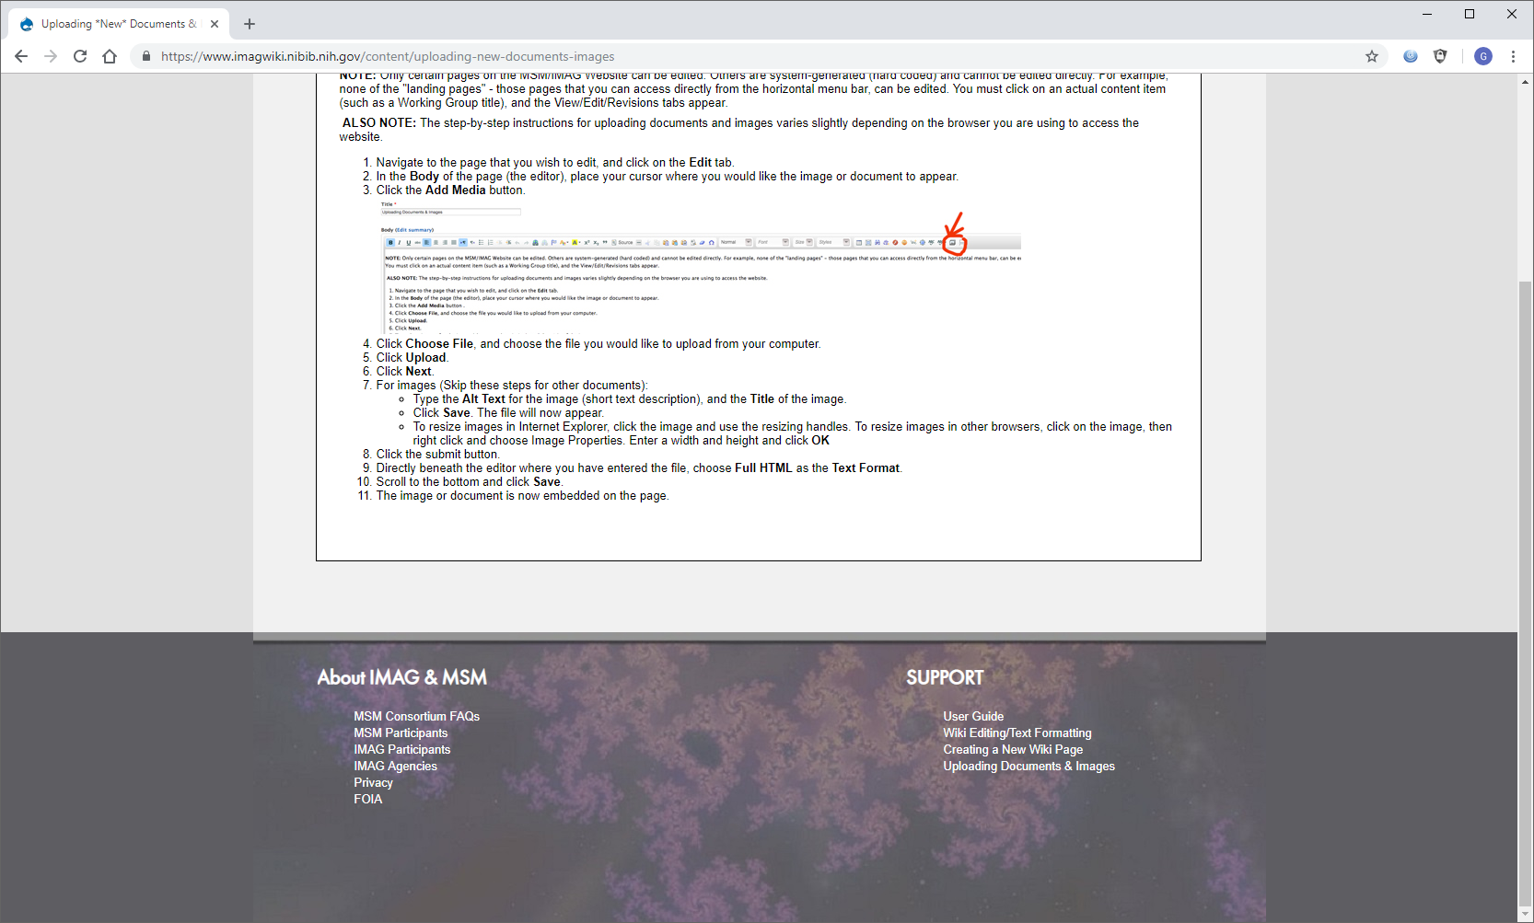
Modeling Multiscale Control of Liver Regeneration
The model
The objective is to incorporate single cell data sets into
a multiscale network model of complex tissue response
dynamics. The model accounts for dynamic transitions
between functional states of multiple liver cell types,
coupled with production, clearance, and signaling of
multiple molecular species.
What is new inside?
Emerging single cell data sets yield unprecedented view
of how cells in a tissue are distributed over a set of
functional states. Our approach takes the snapshot data from single cell omics and infers the dynamics of cell state transitions using a model-based approach.
How will this change current practice?
Potential to usher in a new era of convergence between single cell omics, bioinformatics, and dynamic modeling.
End Users
The next-generation of systems biologists and computational clinicians can use the new methods to bridge the presently divergent fields of bioinformatics and systems engineering.
Raj Vadigepalli and Jan Hoek
Thomas Jefferson University
Grant support: NIBIB, U01 EB023224
Notes:
Technological advances in molecular measurements are enabling an unprecedented view of how individual cells in a complex tissue respond and change in physiological and pathological scenarios. There is an unmet need to translate the insights from these large volumes of data into a mechanistic understanding of disease processes. The potential is to build a whole new class of clinical decision-making tools enabled by biological big data analysis and model-based systems engineering.
mention how can machine learning and AI help your project (2 sentences)
Machine learning and AI can help the project by enabling analysis of large volumes of single cell data sets we and others are collecting in order to derive detailed maps of cell functional states and their dynamic transitions during tissue injury and disease.
List future challenges or next steps after your project is done (1 sentence)
A key future challenge is to scale the approach to multiple tissue contexts so as to build organism-scale reference maps of cell states and state transitions, towards a multiscale molecular and cellular Virtual Physiological Human.
Multiscale modeling: explain how the math will address methodological challenges (e.g.: crossing scales, sparse data, uncertainty, modularity, spatiotemporal simulation challenges, etc.)
The new math will bridge the bioinformatics analysis of the single cell data sets with the dynamic modeling of organized groups of cells in a tissue. The methodological challenge is on how to utilize snapshot data from single cells to infer dynamics of cell state transitions in response to external/physiological stimuli at the tissue level.
MPI name, email:
Rajanikanth Vadigepalli, Rajanikanth.Vadigepalli@Jefferson.edu
Jan Hoek, Jan.Hoek@Jefferson.edu

