Slide 1
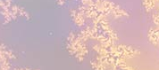

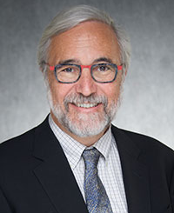
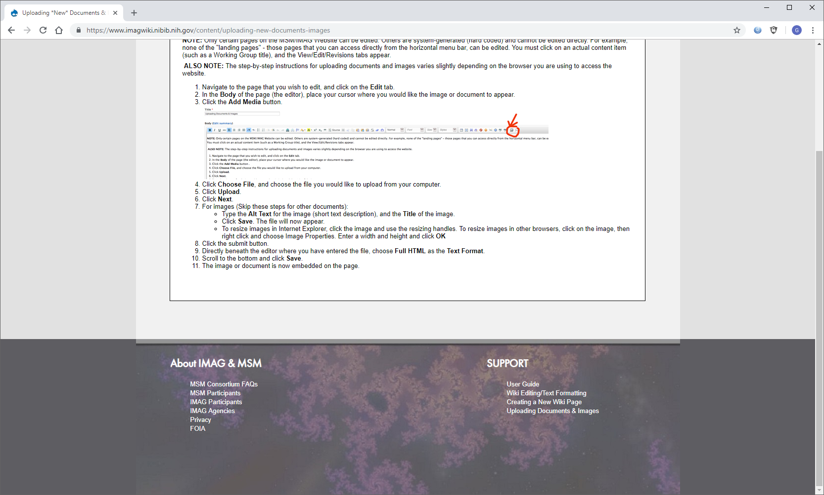
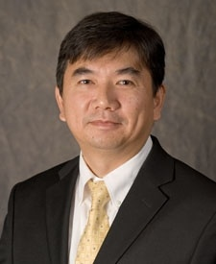
An integrative statistics-guided image-based multi-scale lung model
The model a multi-scale computed tomography (CT) imaging-based lung model based on machine/deep learning to bridge individual and sub-group (cluster) scales in asthma and COPD populations, and explore the notion of cluster-guided computational fluid dynamics (CFD) analysis that generates model-derived flow and particle variables to better understand structure-function relationships in the human lungs by diseased sub-groups.
What is new inside? We overcame the three challenges, including inter-subject variability (due to, for example, gender, age and height), inter-site variability (due to scanner and imaging protocol differences), and definition of novel quantitative CT (QCT) imaging-based metrics at multiple scales (due to alterations at different disease stages) needed for machine/deep learning and use of the cluster membership to guide subject-specific CFD analysis enables an examination of the cluster-specific structural and functional relationships toward precision medicine.
How will this change current practice? The new sub-groups (clusters) for asthma and COPD patients and their disease progressions may provide better treatment targets in the future.
End Users. The CT imaging-based variables could be used by other research groups to develop more sophisticated deep learning neural network (NN) models. The model has the potential to identify clinically-meaningful sub-groups to better understand disease progressions and subsequently develop cluster-specific treatments.
Ching-Long Lin, UIowa
Eric A Hoffman, UIowa
Grant: NHLBI, U01HL114494
Notes:
Instructions:
Submit 1 slide by COB Monday 2/25/19
Title - headline your theory-driven, mechanistic model
name the specific mathematical or statistical method and variations thereof
To include in NOTES section
define/explain it enough for a non-scientific person to explain to the general public (2-3 sentences)
mention how can machine learning and AI help your project (2 sentences)
List future challenges or next steps after your project is done (1 sentence)
Further details for Notes section - For the following communities (2 sentences):
Behavioral modeling: explain the new theories that will integrate within person dynamics with between person dynamics
Multiscale modeling: explain how the math will address methodological challenges (e.g.: crossing scales, sparse data, uncertainty, modularity, spatiotemporal simulation challenges, etc.)
Medical simulation: explain the math challenges being overcome (e.g. collision dynamics, cloth dynamics, haptics, etc.)
Analysis: explain how new statistical approaches will provide mechanistic understanding of the system
BRAIN: explain the theory behind the math/stats and how it will be used to understand how the brain works; explain the level of data dependency on your model (e.g.: (a) completely abstract toy model, (b) a coarse-grained model based on a high level view of previous data, (c) a model based directly on one kind of data (e.g., neural recordings) or (d) a model synthesizing multiple data types (e.g., neural recordings and connectomics).
PI name, email:

