Slide 1
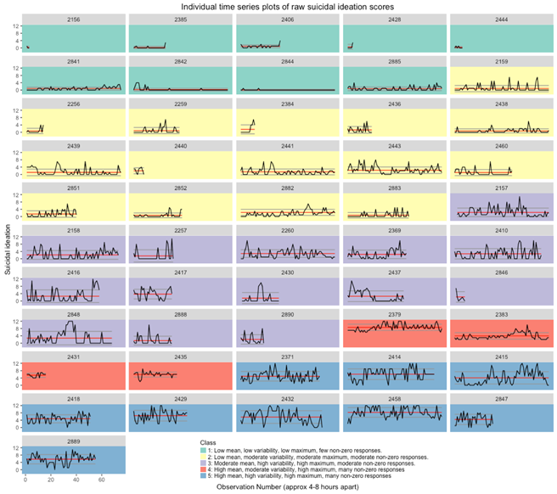
Intensive Longitudinal Monitoring of Suicidal and Related Behaviors (PI: Nock)
Aim 1
Identify digital phenotypes of suicidal individuals
Aim 2
Map the dynamic trajectories of suicidal thoughts and behaviors over time
Aim 3
Identify subjective and objective markers of short—term risk of suicidal thoughts and behaviors
Kleiman et al. (2018).
Depression & Anxiety.

Slide 2
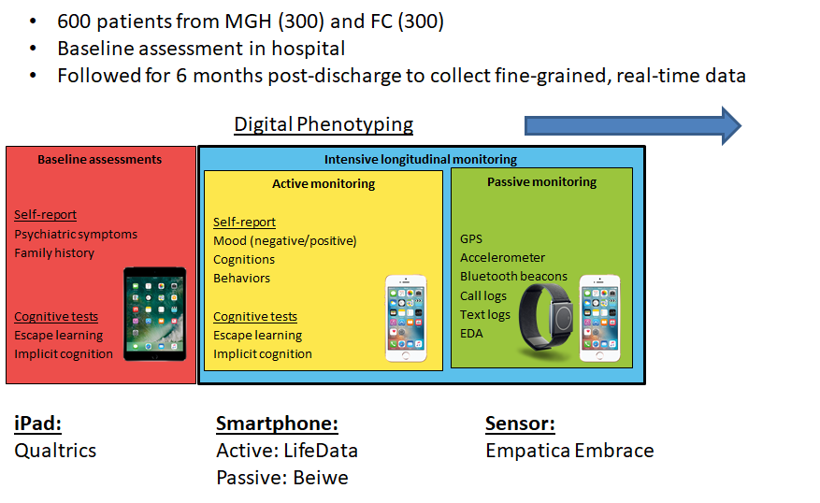
Intensive Longitudinal Monitoring of Suicidal and Related Behaviors

Slide 3
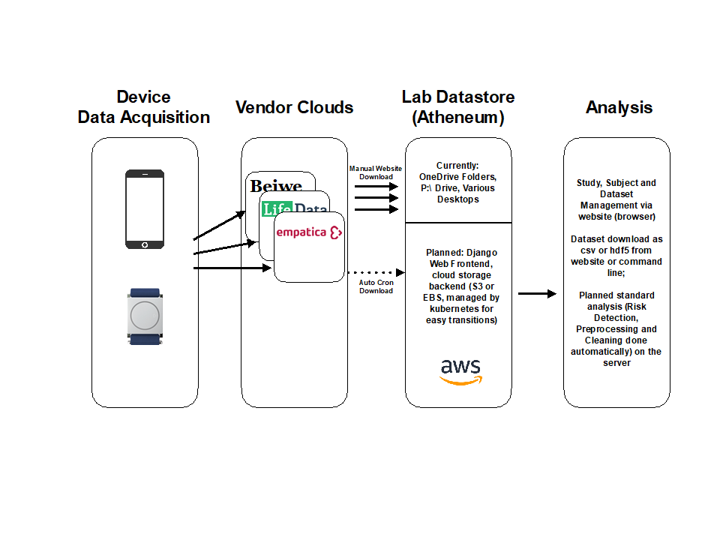
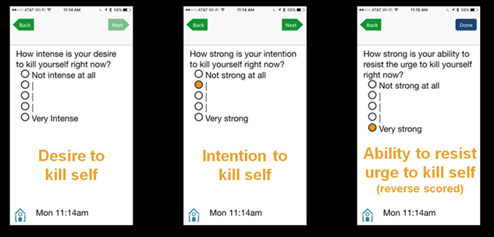
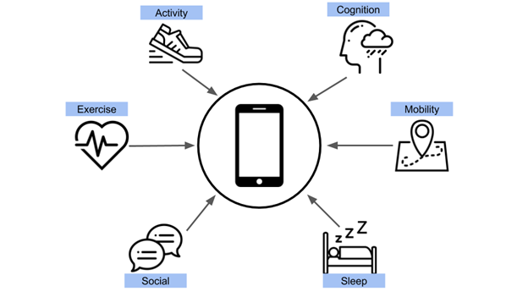

Intensive Longitudinal Monitoring of Suicidal and Related Behaviors

