Slide 1
Data Standardization Update
Ben Dichter, Lead Data Scientist for Team Ripple (Soltesz U19)
Lead of NWB U19 subgroup

Slide 2
Neurodata Without Borders: Neurophysiology (NWB:N)
A data standard for neurophysiology, providing neuroscientists with a common standard to share, archive, use, and build common analysis tools for neurophysiology data.
Designed to store a variety of neurophysiology data, including:
intracellular and extracellular electrophysiology
optical physiology
tracking and stimulus data
Ensure interpretability of data within and across labs
Facilitate collaboration for multiplicative growth of innovation

Slide 3
NWB Update Outline
NWB:N 2.0 released
Using NWB:N in Soltesz U19
Community engagement strategy
Tool integration

Slide 4
Neurodata Without Borders: Neurophysiology (NWB:N) 2.0 recently released
Backwards compatibility supported going forward!
Improvements:
Scalability to large datasets
3D calcium imaging
Time-frequency analysis (e.g., STFT, Hilbert Transform)
Flexible electrode, trial, and neuron meta-data
Schema extensions
(Ruebel et al., biorxiv, 2019)

Slide 5
Team Ripple Using NWB:N
Buzsaki group: Hippocampal electrophysiology recordings from mice during a maze task and analysis of data
Soltesz group: Large-scale simulation of hippocampal regions with detailed cellular morphology and connectivity
Using NWB to steer the simulation to generate neural data with functional properties similar to the Buzsaki data

Slide 6
Overcoming the Energy Barrier of Data Standards
Sticks
Funding ultimatives
Carrots
No standardization
Tools for visualization, analysis, sharing, archiving, etc.
Guidance
Outreach: tutorials, hackathons, support
Interfacing with acquisition systems
Standardization

Slide 7
Tools Integration
Neuroscope: GUI for ephys data vis
Brainstorm: MATLAB electrophysiology
CaImAn: python calcium imaging
NWB explorer widget
DataJoint: working on tutorial for outputting into NWB:N 2.0

Slide 8
Tools Integration
Neuroscope: GUI for ephys data vis
Brainstorm: MATLAB electrophysiology
CaImAn: python calcium imaging
NWB explorer widget
DataJoint: working on tutorial for outputting into NWB:N 2.0

Slide 9
Brainstorm support for NWB

Slide 10
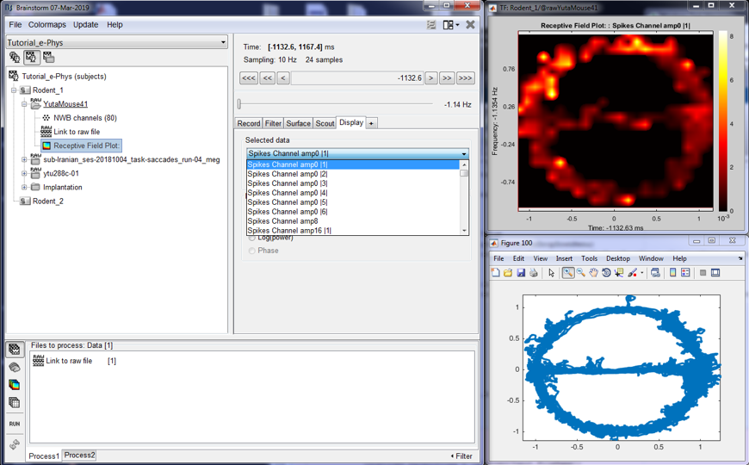
Brainstorm support for NWB

Slide 11
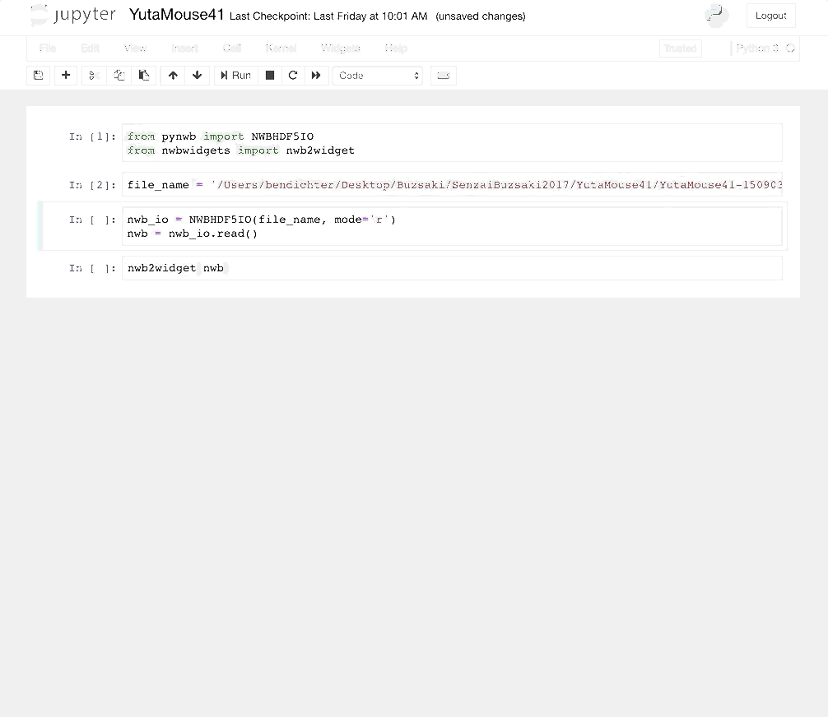
Jupyter widgets
Easy to extend and customize

Slide 12
Get involved!
Free user training workshop, May 13 and 14 at Janelia
Still a few spots open!
Contribute to pynwb and matnwb GitHub repos
Bug reports and contributions welcome!
Kavli NWB seed grants - $10k for NWB:N adoption
Talk to us!
U19 Groups starting to use these resources:
Wolfgang Losert from Maunsell U19, Jochen Weber from Costa U19, Dimitri Yatsenko from Brody U19

Slide 13
Questions?
Thanks to: Ivan Soltesz, Aaron Milstein, Ivan Raikov,
Gyuri Buzsaki, David Tingley, Peter Petersen, Sam McKenzie,
Attila Losonczy, Sebi Rolotti, Mark Schnitzer, Simon Haziza

