Slide 1
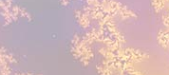
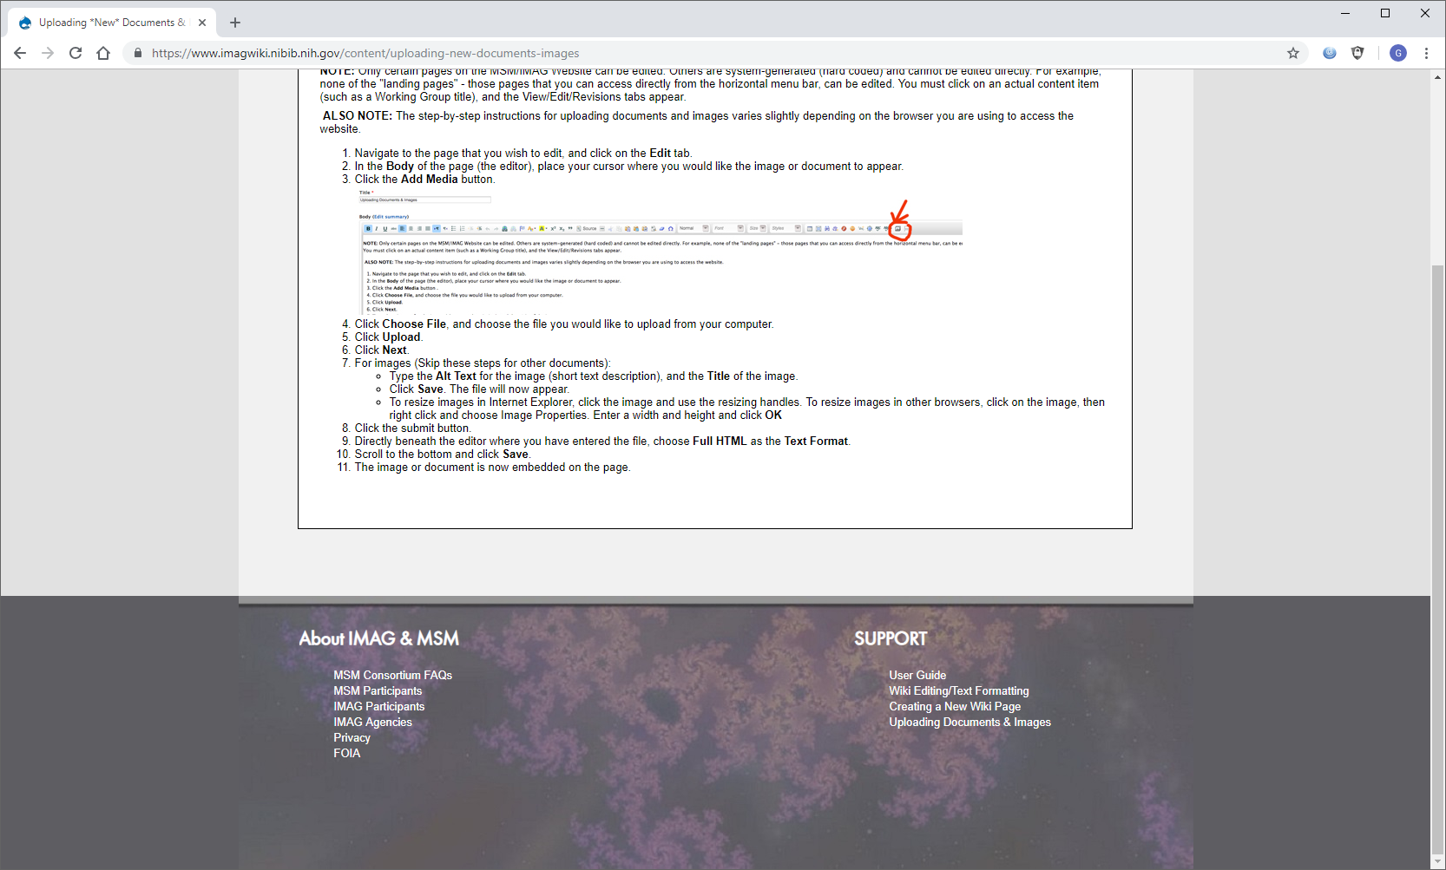
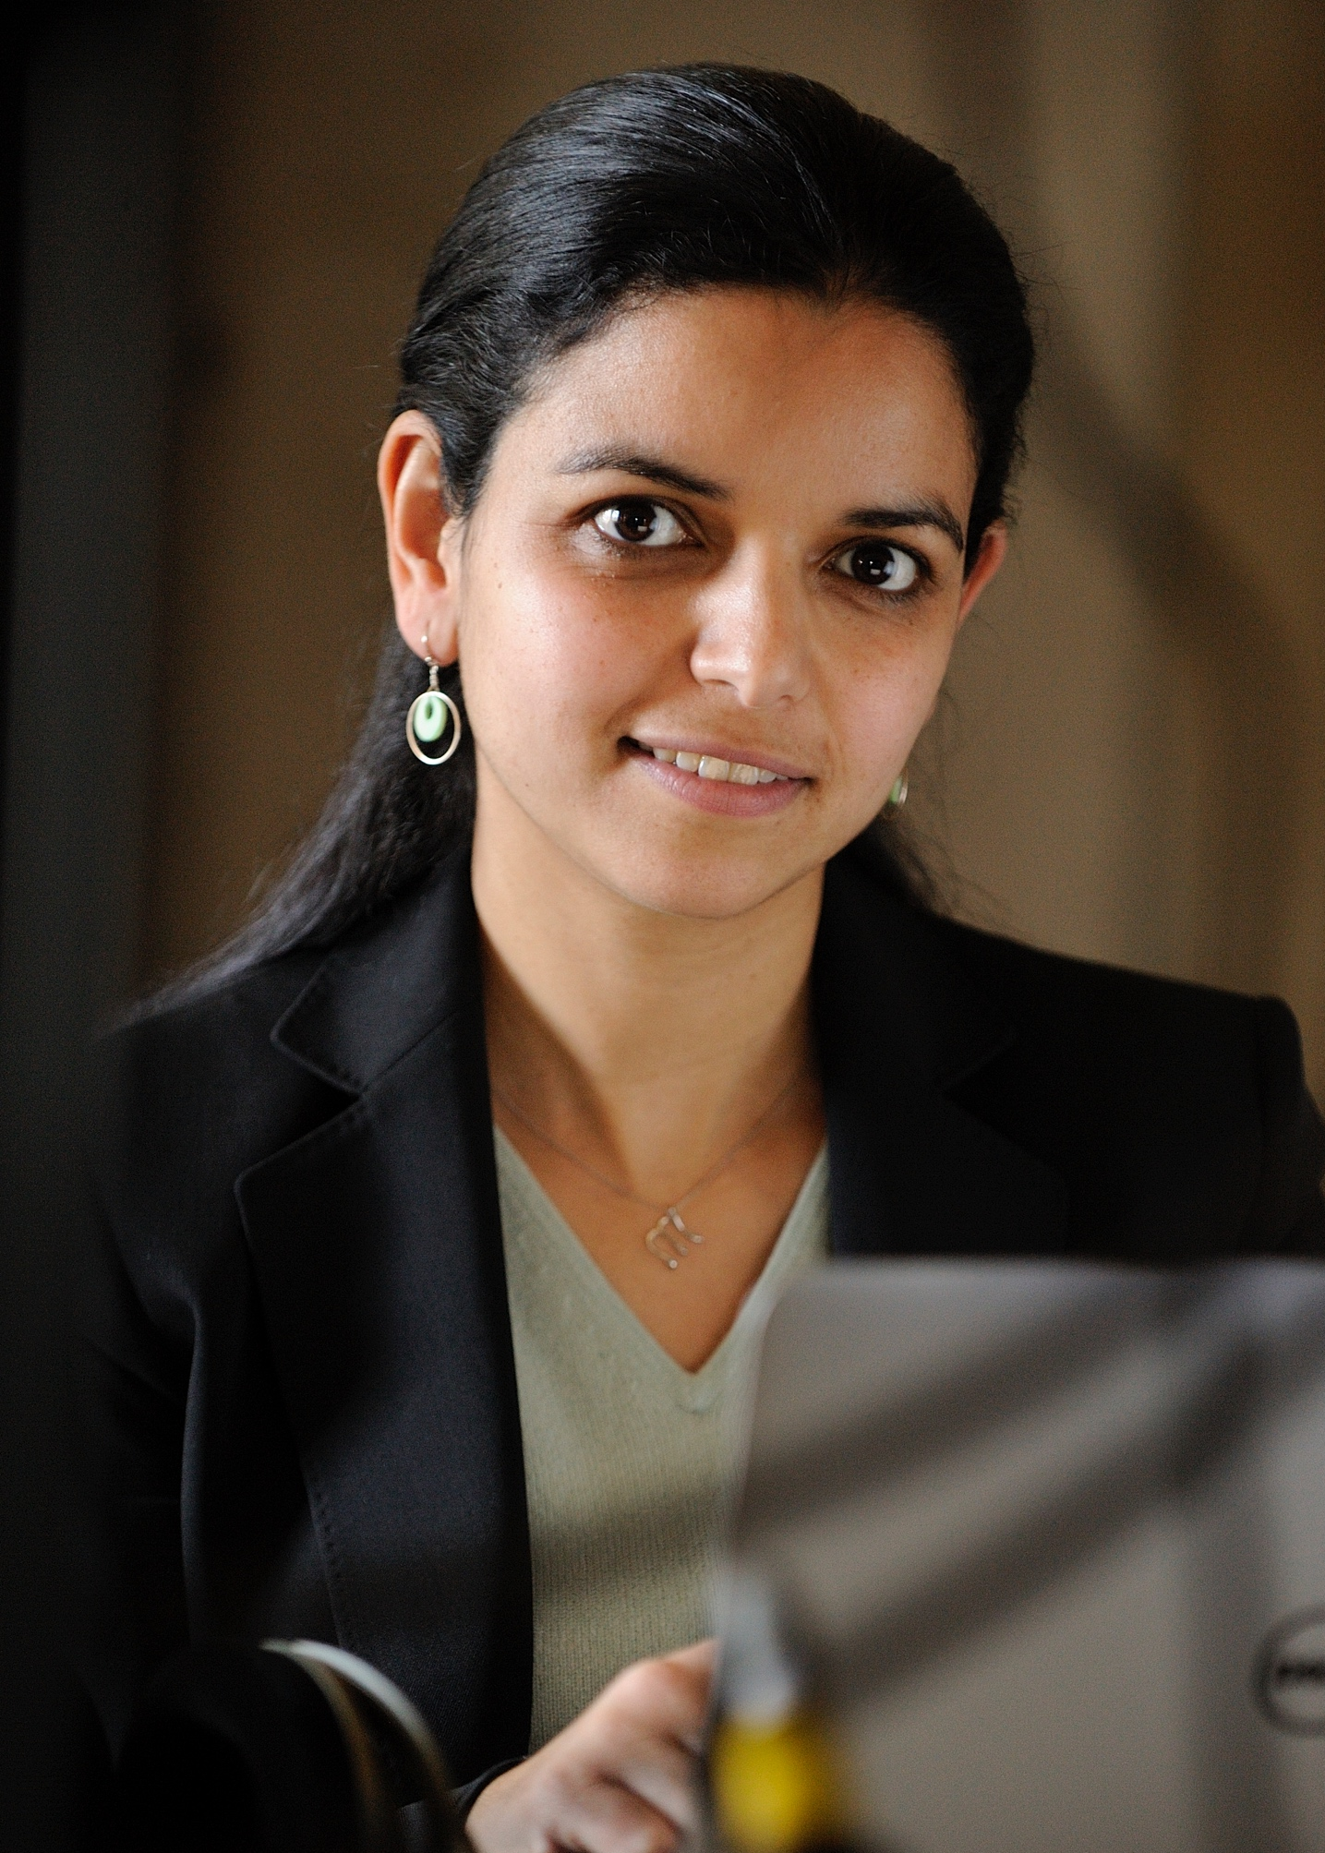
Multiscale modeling of the cocktail party problem
The model: The project develops a dynamical system with
Bayesian statistics to understand mechanisms of auditory scene analysis,
i.e. the brain’s ability to make sense of multitude of sounds that surround us
in everyday life. The model performs a hierarchical inference that encodes auditory scenes
over varying time scales; and mimics brain networks across multiple scales (from single neurons
to cross-loci interactions). Central to this system is the role of cognitive control particularly attentional and memory feedback that shape the sensory representation in the auditory system, via mechanisms of rapid neural plasticity.
What is new inside? The system investigates the role of neural plasticity, as a form of multiscale working memory. In addition, the hierarchical inference framework allows to examine the interplay of sensory and cognitive factors. The modeling effort is closely informed by experimental results both in human listeners and behaving animal model. Model predictions are validated against brain responses at multiple scales, from single neurons to multi-state brain networks.
How will this change current practice? While the problem of auditory scene analysis is very much centered around sensory information (sounds that enter our ear), it invokes brain processes that extend beyond
sensory networks and invokes constructs of memory and attention. Understanding the role of
these cognitive factors can shape how we understand hearing difficulties of special populations
(aging, hearing impaired) as well as how we build novel state-of-the-art sound technologies.
End Users : Computational simulations are provided as open platforms that can be used by
Neuroscientists and audio technology engineers. All tools can be easily adopted as testbeds or front-
end for other systems with broad health and commercial applications focused on sound technologies.
Mounya Elhilali
Johns Hopkins U.
Shihab Shamma
U. Maryland
U01AG058532
National Institute on Aging
Notes:
Notes:
The project explores the neural underpinnings of the so-called cocktail party problem, i.e. the ability of our brain to make sense of multiple sounds that surrounds us in everyday life. Specifically, we develop multiscale models that explore the interaction between brain networks at multiple scales (from single neurons to cross-loci interactions), closely informed by experimental results in human and animal models. The framework offers a springboard to understand how complex soundscapes are parsed into mentally-distinct constructs. As such, it offers a natural front-end to machine learning systems that can infer further knowledge from these separated mental constructs.
The project is closely informed and directly validated against brain recordings both in awake behaving animals (auditory and frontal cortical networks) as well as in electroencephalograhical recordings from human listeners. This data provides a multiscale outlook on interactions across brain networks which directly maps to the multiscale formulation of the model.
- Chakrabarty, D. & Elhilali, M (2019) A Gestalt inference model for auditory scene segregation. PLOS Computational Biology, 15(1):e1006711.
- Elgueda D, Duque D, Radtke-Schuller S, Yin P, David SV, Shamma SA, Fritz JB (2019) State-dependent encoding of sound and behavioral meaning in a tertiary region of the ferret auditory cortex. Nature Neuroscience, 10.1038/s41593-018-0317-8.
Mounya Elhilali, Johns Hopkins University (mounya@jhu.edu)
Shihab Shamma, University of Maryland (sas@umd.edu)

