Slide 1
Annotating Models:
Practical Experiences, Approaches and Future Directions
James Sluka
Biocomplexity Institute
Indiana University
10 September 2015
Notes:
30 minutes

Slide 2
Outline
Why annotate
What to annotate
How to annotate (Tools)
Annotation Standard (MIRIAM)
Examples
1
Notes:
One hour

Slide 3
Outline
Why annotate
  Responsible Conduct of Research
  Describe the biology in a way that allows the model to be;
    found
    understood
    reused
  Units are part of annotation
What to annotate
How to annotate (Tools)
Annotation Standard (MIRIAM)
Examples
Notes:
One hour, “Responsible conduct of research” includes fully describing what was done as well as making all research materials available to others to the greatest extent possible.

Slide 4
Annotation facilitates understanding and reuse
Reuse of existing models, and adherence to standards at particular scales, is an aspect of the Responsible Conduct of Research.
Instead, a complex array of other factors seems to have contributed to the lack of reproducibility. Factors include poor training of researchers in experimental design; increased emphasis on making provocative statements rather than presenting technical details; and publications that do not report basic elements of experimental design*. Crucial experimental design elements that are all too frequently ignored include blinding, randomization, replication, sample-size calculation and the effect of sex differences. And some scientists reputedly use a 'secret sauce' to make their experiments work — and withhold details from publication or describe them only vaguely to retain a competitive edge**. What hope is there that other scientists will be able to build on such work to further biomedical progress?
(from http://www.nature.com/news/policy-nih-plans-to-enhance-reproducibility-1.14586)
http://www.nsf.gov/bfa/dias/policy/rcr.jsp
http://www.jhsph.edu/research/_docs/responsible-conduct-of-research.pdf
http://www.nature.com/news/policy-nih-plans-to-enhance-reproducibility-1.14586
* Carp, J. NeuroImage 63, 289–300 (2012).
** Vasilevsky, N. A. et al. PeerJ 1, e148 (2013).
Notes:
“Responsible conduct of research” includes fully describing what was done as well as making all research materials available to others to the extent possible and practical.

Slide 5
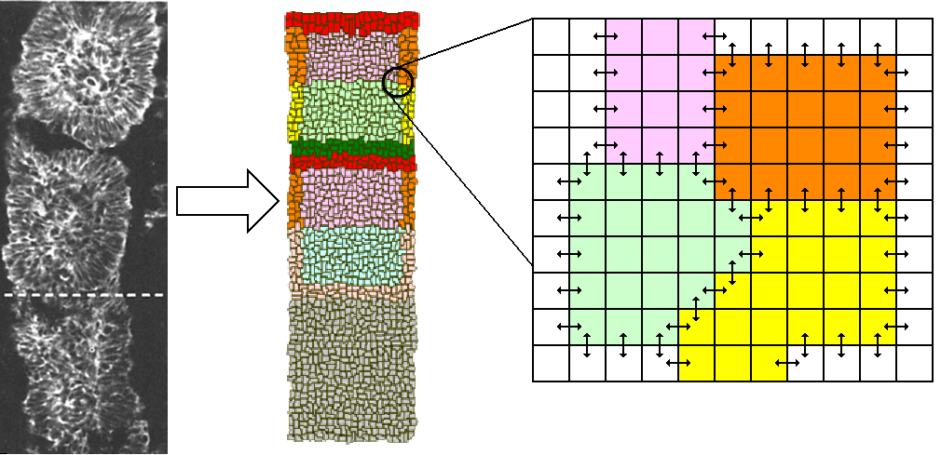
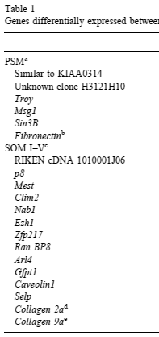
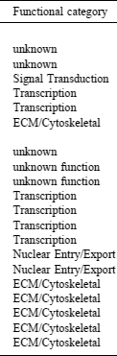
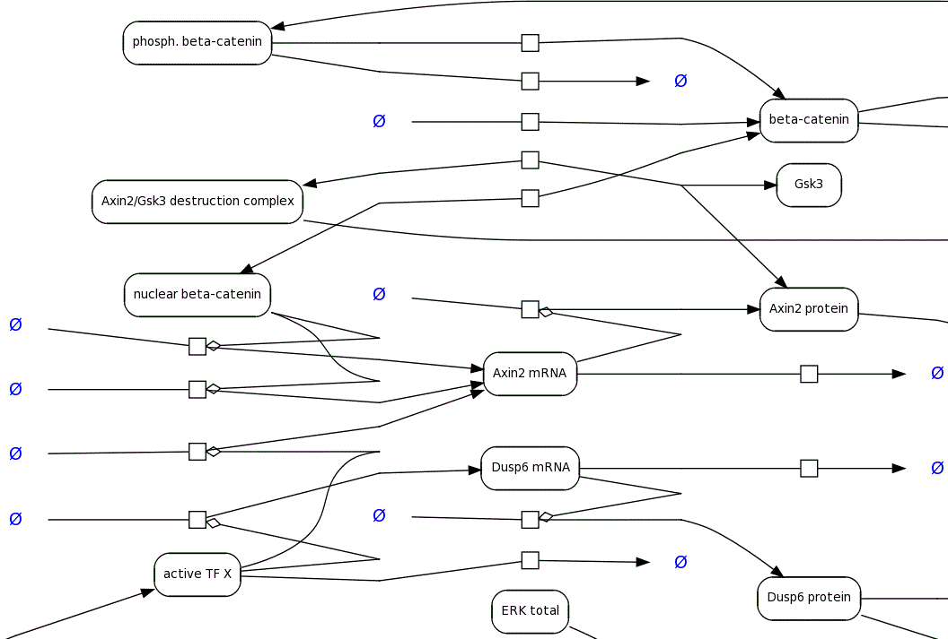
Long Term Vision: Common annotation (description) across multiple data sources (Somitogenesis example)
CC3D Model
Image Data
Microarray Data
SBML Model
Table 1
Genes differentially expressed between psm and somite I–V
identified by microarray and independently confirmed.
Species: chicken
Process: embryogenesis
Sub process: somitogenesis
Species: chicken
Process: embryogenesis
Sub process: somitogenesis
Species: chicken
Process: embryogenesis
Sub process: somitogenesis
Species: chicken
Process: embryogenesis
Sub process: somitogenesis
Semantic Markup
Common markup describing the biological system
Notes:
Annotation requires a defined semantics and syntax

Slide 6
In the CompBio domain:
Description of the Biology versus the Math/Code
e.g., KEGG Pathway
e.g., SBML
Biological Description
e.g., FEBio,
CompuCell3D
MATLAB, C++, Python, …
Mathematical / Computational Description
Notes:
Gene Ontology (GO) might not be a good representative for a descriptive language that is biologically rich but without math/computational info.

Slide 7
Typical Modeling workflow
Biological
Experiments
Biological
Knowledge
Biological
Model
Validation
Mathematical
Model
New Knowledge
Verification
Computational
Model
Simulation
Prediction

Slide 8
Modeling workflow: what often gets published
Biological
Experiments
Biological
Knowledge
Biological
Model
Validation
Mathematical
Model
New Knowledge
Verification
Computational
Model
Simulation
Prediction

Slide 9
Modeling workflow: what we would like to be in the model file itself
Biological
Experiments
Biological
Knowledge
Biological
Model
Validation
Mathematical
Model
New Knowledge
Verification
Computational
Model
Simulation
Prediction
Notes:
This is a hard thing to do but lets not let the challenge of doing it perfectly get in the way of doing something imperfect but useful.

Slide 10
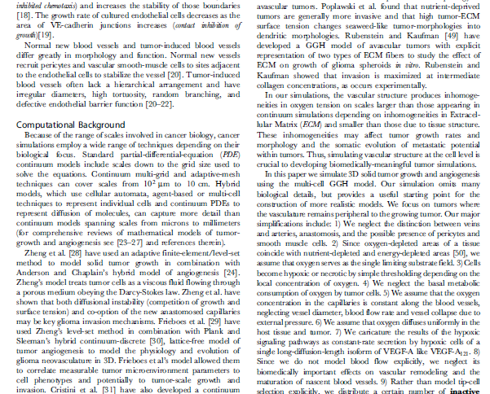
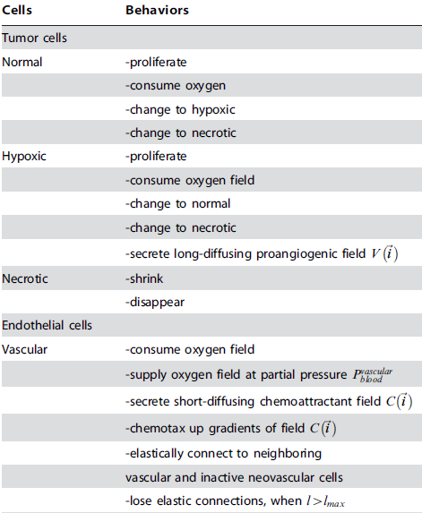
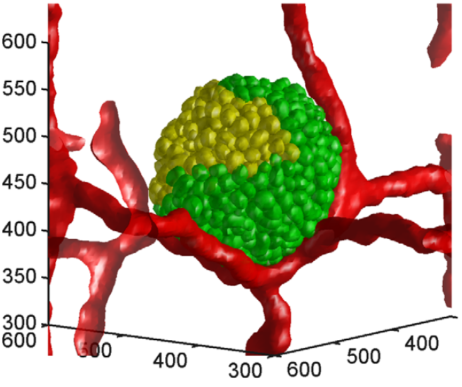
Typical ad hoc biomodel publication modality
class MitosisSteppable(MitosisSteppableBase):
def __init__(self,_simulator,_frequency=1):
MitosisSteppableBase.__init__(self,_simulator, _frequency)
def step(self,mcs):
cells_to_divide=[]
for cell in self.cellList:
if cell.type == 1 and cell.volume>64:
cells_to_divide.append(cell)
if cell.type== 4 and cell.volume>128:
cells_to_divide.append(cell)
for cell in cells_to_divide:
self.divideCellRandomOrientation(cell)
def updateAttributes(self):
parentCell=self.mitosisSteppable.parentCell
childCell=self.mitosisSteppable.childCell
parentCell.targetVolume=parentCell.targetVolume/2
parentCell.lambdaVolume=parentCell.lambdaVolume
childCell.type=parentCell.type
childCell.targetVolume=parentCell.targetVolume
childCell.lambdaVolume=parentCell.lambdaVolume
Paper prose
Paper figure
Paper math
Code
Results
Often don’t agree
Notes:
A typical multi-cell model description and simulation screen shot showing a 3D multi-cell simulation of tumor growth with angiogenesis (Shirinifard, 2009). Left: Description of some of the cell types, and their capabilities within the simulation, as given in the publication. Center: Simulation screen shot showing the tumor cells ("Normal" = green and "Hypoxic" = yellow) and the vasculature (red). Axes are labeled in um. Right: Portion of the simulation code.
Shirinifard, A. et al. (2009) 3D Multi-Cell Simulation of Tumor Growth and Angiogenesis. PLoS ONE, 4,e7190.

Slide 11
The model sharing and re-use challenge
If you can’t find a model it might as well not exist.

Slide 12
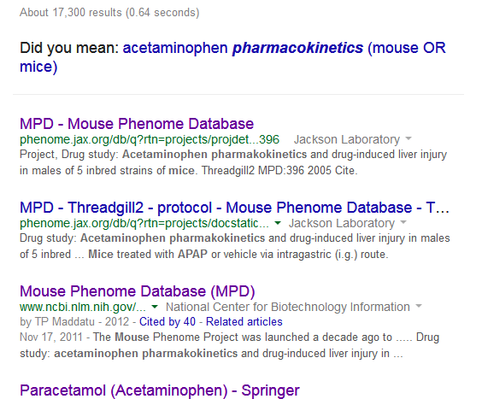
Search Challenge I:
Why we need ontological annotation of models
Is it “pharmacokinetics” (9.1M Google hits)
or “pharmakokinetics” (14K Google hits)?
Challenge: Find Acetaminophen ADME and/or pharmacokinetic data in mice using Google with “acetaminophen pharmakokinetics (mouse OR mice)”
Mouse Phenome Database: Acetaminophen in mice with
ADME data
(not found with pharmacokinetics)
To find something you need to know what it is called.
To effective “publish” something you must use the correct name.
Notes:
Same problem with searching MEDLINE “c” gives 77K, “k” gives 57. Note that the MPD database is indexed by Google (so is BioModels).

Slide 13
Search Challenge II:
Models are often not searchable. Why?
Many “standards based” and “ontological” file types are poorly indexed by Google.
Many generic file types (HTML, word, pdf, python, excel, txt, etc..) are well indexed by Google.
What is in a file (OWL xml example): | What Google “sees”
<owl:Class rdf:about="&pizza;FattyPizza"> <owl:equivalentClass> <owl:Restriction> <owl:onProperty rdf:resource="&pizza;hasCalories"/> <owl:someValuesFrom> <rdfs:Datatype> <owl:onDatatype rdf:resource="&xsd;integer"/> <owl:withRestrictions rdf:parseType="Collection"> <rdf:Description> <xsd:minExclusive rdf:datatype="&xsd;integer">900</xsd:minExclusive> </rdf:Description> </owl:withRestrictions> </rdfs:Datatype> </owl:someValuesFrom> </owl:Restriction> </owl:equivalentClass> <rdfs:subClassOf rdf:resource="&pizza;Pizza"/> </owl:Class> | 900

Slide 14
Ontologies and Controlled Vocabularies
Properly naming things (species, cells, diseases, genes, molecules, …) greatly increases the chances of a model being found and reused.

Slide 15
What is an ontology?
An ontology is a particular view of reality that encompasses a defined set of objects, processes and relationships within that reality.
“Ontological Commitment”
Controlled Vocabulary | Hierarchy of Terms (isA) | Full Ontology
Cell Hepatocyte Leukocyte Organ Heart Liver | Cell Hepatocyte Leukocyte Organ Heart Liver | Cell Hepatocyte Leukocyte Organ Heart Liver
partOf
Notes:
Usually terms in bio-ontologies are identified by numeric identifiers (actually just restricted text strings since the number has no meaning other than uniqueness). Mitosis in GO GO_0007067 GO:0007067 is pretty “Google Unique”

Slide 16
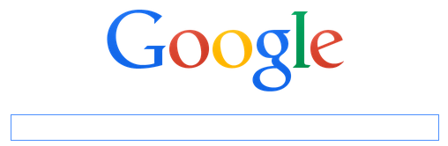
Model and Data Annotation:
Archiving (publishing) and Searching
Swoogle?
Data Creators
Modelers
Assay DBs
Distributed Web
Data Repository
Search and
Annotation tool
Often the
same people
FMA
GO
CL
Data Consumers
Agree to use
Reference
Ontologies
Notes:
Red lines: data annotation (web) publication
Green lines: data search

Slide 17
Outline
Why annotate
What to annotate
  “Who, what, when, where, why and how”
  Applies to data, models, code, results
How to annotate (Tools)
Annotation Standard (MIRIAM)
Examples
Notes:
One hour

Slide 18
“Who, What, When, Where, Why and How”
Applies to the people that built the model
Applies to what the model is about and what is in the model.
  What is the “biological big question” that the model addresses (aka “why would anyone care?)
  What organism (age, sex, …)
  What part of the organism is being modeled?
  What major biological processes is being modeled?
  What are the fine grain objects and processes included in the model?
  What assumptions and simplifications were made?

Slide 19
“Who, What, When, Where, Why and How”
Applies to the people that built the model
Applies to what the model is about and what is in the model.
  What is the “biological big question” that the model addresses (aka “why would anyone care?)
  What organism (age, sex, …)
  What part of the organism is being modeled?
  What major biological processes is being modeled?
  What are the fine grain objects and processes included in the model?
  What assumptions and simplifications were made?
Very similar to what is included in a paper.
Notes:
What is in the first paragraph or two of a paper,
What is in the first paragraph or two of the experimental

Slide 20
“Who, What, When, Where, Why and How”
Applies to the people that built the model
Applies to what the model is about and what is in the model.
  What is the “biological big question” that the model addresses (aka “why would anyone care?)
  What organism (age, sex, …)
  What part of the organism is being modeled?
  What major biological processes is being modeled?
  What are the fine grain objects and processes included in the model?
  What assumptions and simplifications were made?
Often a term from a disease ontology (or Gene Ontology Process)
Notes:
What is in the first paragraph or two of a paper,
What is in the first paragraph or two of the experimental

Slide 21
“Who, What, When, Where, Why and How”
Applies to the people that built the model
Applies to what the model is about and what is in the model.
  What is the “biological big question” that the model addresses (aka “why would anyone care?)
  What organism (age, sex, …)
  What part of the organism is being modeled?
  What major biological processes is being modeled?
  What are the fine grain objects and processes included in the model?
  What assumptions and simplifications were made?
Species Ontology
Notes:
What is in the first paragraph or two of a paper,
What is in the first paragraph or two of the experimental

Slide 22
“Who, What, When, Where, Why and How”
Applies to the people that built the model
Applies to what the model is about and what is in the model.
  What is the “biological big question” that the model addresses (aka “why would anyone care?)
  What organism (age, sex, …)
  What part of the organism is being modeled?
  What major biological processes is being modeled?
  What are the fine grain objects and processes included in the model?
  What assumptions and simplifications were made?
Tissue and organ ontologies (FMA, BRENDA, …)
Notes:
What is in the first paragraph or two of a paper,
What is in the first paragraph or two of the experimental

Slide 23
“Who, What, When, Where, Why and How”
Applies to the people that built the model
Applies to what the model is about and what is in the model.
  What is the “biological big question” that the model addresses (aka “why would anyone care?)
  What organism (age, sex, …)
  What part of the organism is being modeled?
  What major biological processes is being modeled?
  What are the fine grain objects and processes included in the model?
  What assumptions and simplifications were made?
Gene Ontology
Notes:
What is in the first paragraph or two of a paper,
What is in the first paragraph or two of the experimental

Slide 24
“Who, What, When, Where, Why and How”
Applies to the people that built the model
Applies to what the model is about and what is in the model.
  What is the “biological big question” that the model addresses (aka “why would anyone care?)
  What organism (age, sex, …)
  What part of the organism is being modeled?
  What major biological processes is being modeled?
  What are the fine grain objects and processes included in the model?
  What assumptions and simplifications were made?
Gene Ontology, ChEBI, BRENDA, KEGG, …
Notes:
What is in the first paragraph or two of a paper,
What is in the first paragraph or two of the experimental

Slide 25
“Who, What, When, Where, Why and How”
Applies to the people that built the model
Applies to what the model is about and what is in the model.
  What is the “biological big question” that the model addresses (aka “why would anyone care?)
  What organism (age, sex, …)
  What part of the organism is being modeled?
  What major biological processes is being modeled?
  What are the fine grain objects and processes included in the model?
  What assumptions and simplifications were made?
This is difficult, nominally it would include the modelling modality and/or platform. “Assumptions” and “simplifications” may need to be implied by what is described in the other sections.
Notes:
What is in the first paragraph or two of a paper,
What is in the first paragraph or two of the experimental

Slide 26
Typical sources of annotation terms
Databases of Biological Ontologies
  OBO Foundry
  BioPortal
  MIRIAM / Identifiers.org
Databases of Biological Entities
  NCBI Taxonomy (nucleotide sequences)
  UniProt (protein sequences)
Notes:
These typically have pretty good search engines

Slide 27
Outline
Why annotate
What to annotate
How to annotate (Tools)
  The Big Challenge
  COPASI, CellDesigner, SBMLeditor and others
    Strengths and weaknesses
  Reference Ontologies
Annotation Standard (MIRIAM)
Examples
Notes:
One hour

Slide 28
The model annotation Big Challenge
If it is hard to do properly people wont do it.

Slide 29
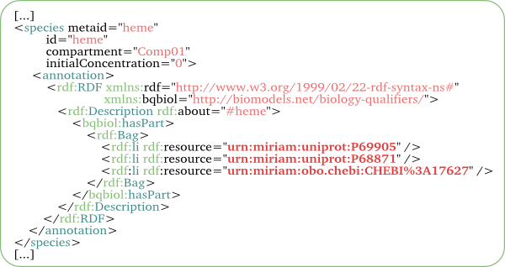
Standard Annotation syntax is ugly and hard to do correctly (SBML example)
From https://www.ebi.ac.uk/biomodels-main/faq

Slide 30
Standard Annotation syntax is ugly and hard to do correctly (SBML example)
Furthermore, many modeling domains don’t have a standard syntax at all.

Slide 31
Standard Annotation syntax is ugly and hard to do correctly (SBML example)
Several tools exist to help annotate
SBML models:
SBMLeditor (http://www.ebi.ac.uk/compneur-srv/SBMLeditor.html)
COPASI (http://copasi.org/)
Cell Designer (http://www.celldesigner.org/)
Semantic SBML (web based, http://semanticsbml.org/semanticSBML/simple/index)

Slide 32
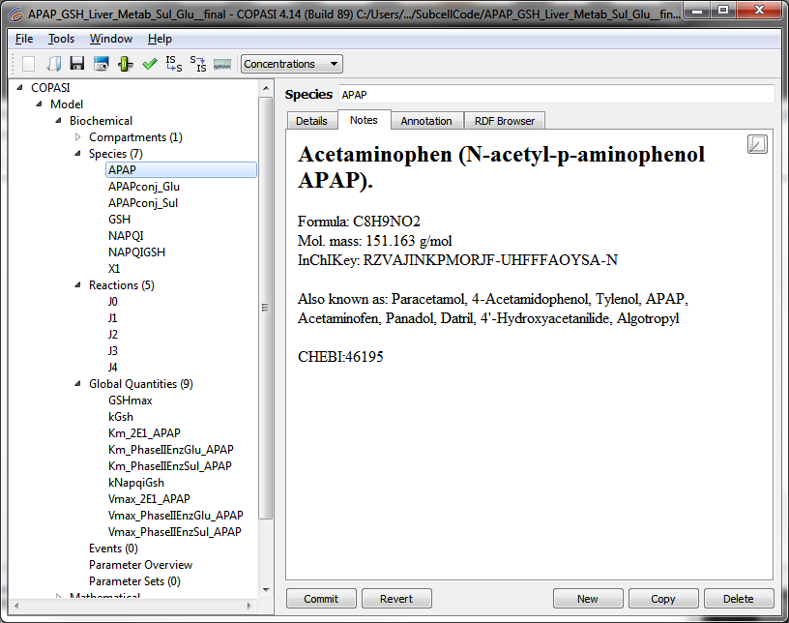
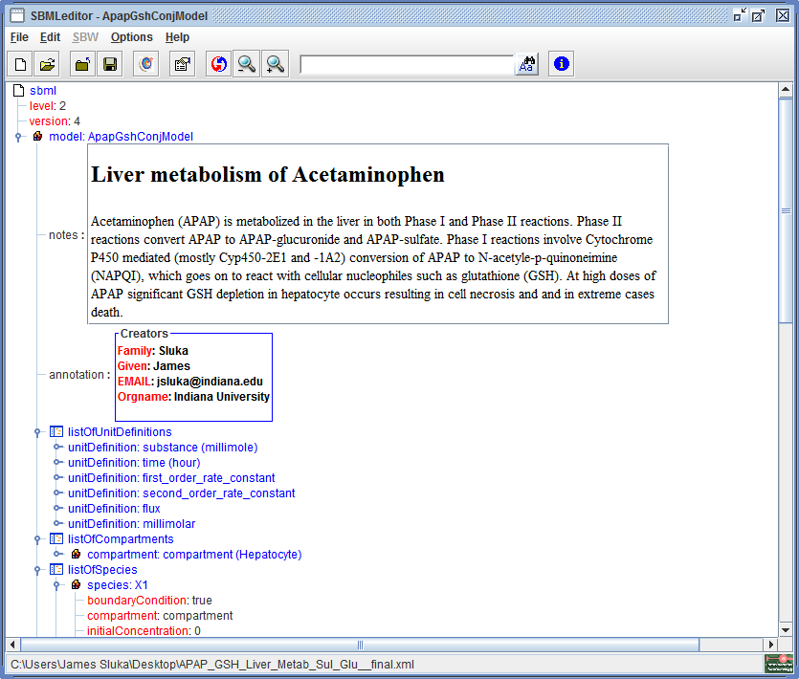
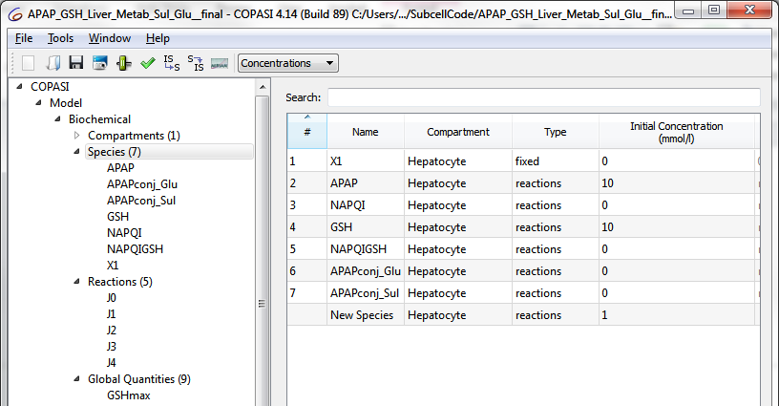
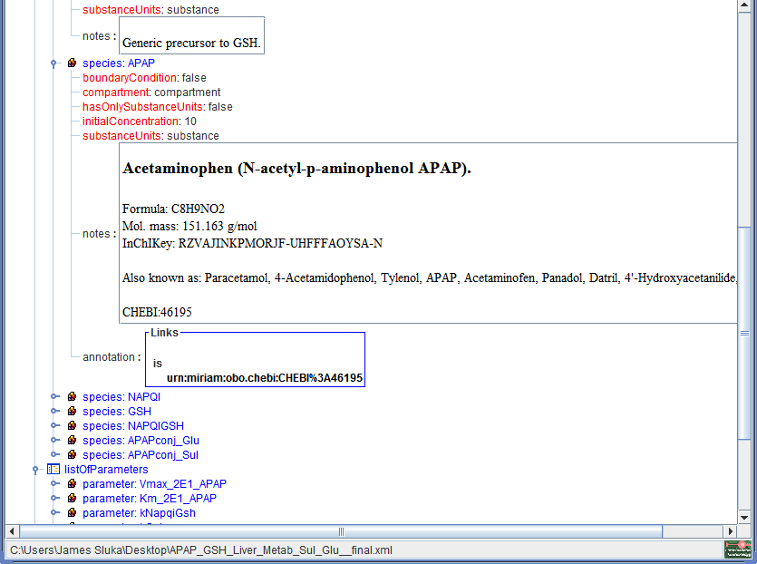
Compare GUIs for COPASI and SBMLeditor for creating and annotating an SBML model file

Slide 33
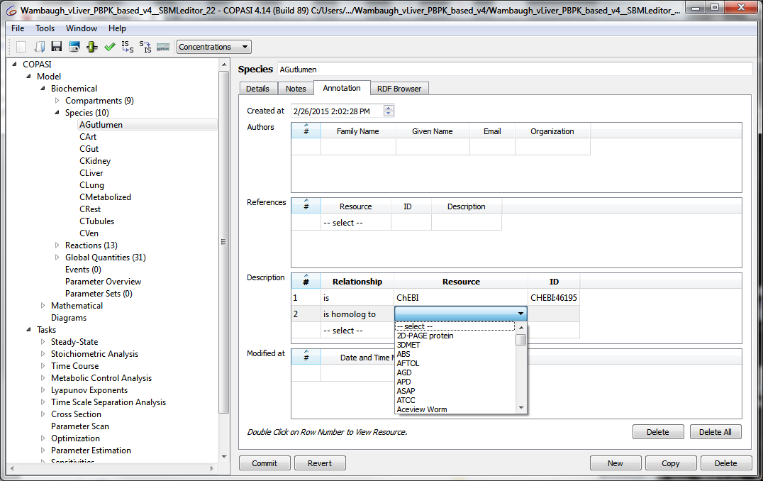
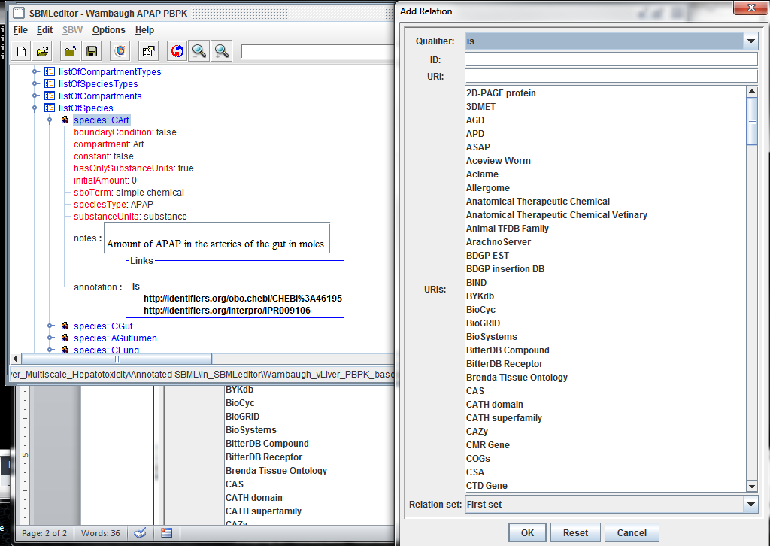
Challenges in annotating a model
GUIs really should embed knowledge and best practices. COPASI and SBMLeditor know the syntax of annotations but do not embed any knowledge of what ontology is suitable to annotate a particular type of object.
Many bio-ontologies listed and it is up to the user to find the correct term using external tools!

Slide 34
A GUI should embed knowledge… of how to properly annotate a model
Types of annotations
  If annotating a cell then use cell ontology, molecules with ChEBI or CASRN, biological process via GO…
  Can define the annotations as RDF triples (include type of relationships, isA, hasProcess, participatesIn, containedIn, …)
Best practices
  Tiered annotations starting with;
    Why was it done → e.g. a disease or GO term
    What objects are included → cell types, non-cellular components, molecules
    What processes → metabolism, mitosis, necrosis, …
  Unit definitions
Hide complexity of underlying syntax
Help people by showing both the ontology term and the term name.

Slide 35
Outline
Why annotate
What to annotate
How to annotate (Tools)
Annotation Standard (MIRIAM)
  Minimum Information Required to Annotate Models
  Broadly applicable, not just for computational models
Examples
Notes:
One hour

Slide 36
Annotation Types in SBML†
BioModels Qualifiers:
Model qualifiers
  is (the model is a description of a biological process)
  isDescribedBy (the model isDescribedBy a publication)
Biology qualifiers
  is (the object is a description of a biological entity)
  hasPart, isPartOf
  isVersionOf , hasVersion (the object isVersionOf a high level biological entity)
  isHomologTo
  isDescribedBy (the object isDescribedBy a publication)
  ^{† Curtesy of Michael Hucka and} http://www.ebi.ac.uk/miriam/main/

Slide 37
BioModels SBML Qualifiers Summary†
For brevity, only relevant XML fragments are shown in the examples , but it should be kept in mind that the annotations always have the following form:
<SBML_ELEMENT ... metaid="SBML_META_ID" ... >
...
<annotation>
...
<rdf:RDF xmlns:rdf="http://www.w3.org/1999/02/22-rdf-syntax-ns#"
xmlns:bqbiol="http://biomodels.net/biology-qualifiers/"
xmlns:bqmodel="http://biomodels.net/model-qualifiers/">
<rdf:Description rdf:about="#SBML_META_ID">
<QUALIFIER>
<rdf:Bag>
<rdf:li rdf:resource="URI" />
...
</rdf:Bag>
</QUALIFIER>
...
</rdf:Description>
...
</rdf:RDF>
...
</annotation>
...
</SBML_ELEMENT>
SBML_ELEMENT The SBML element being annotated. Can be any
SBML element, but usually is model, species, reaction, or compartment.
SBML_META_ID The metaid of the SBML element being annotated.
SBML’s metaid have data type XML ID and must be
unique across the entire model file.
QUALIFIER The BioModels Qualifier; see the rest of this document for a list.
URI The URI of the resource being referenced.
  ^{† Curtesy of Michael Hucka}

Slide 38
---------- biology ----------------------------------
---------- repository ------------------------------
---------- citation ---------------------------------
---------- biology ----------------------------------
---------- biology ----------------------------------
  ^{† Curtesy of Michael Hucka}
Notes:
Note that a Repository link often also links to more biology and citations

Slide 39
---------- repository ------------------------------
---------- biology ----------------------------------
---------- citation ---------------------------------
---------- biology ----------------------------------
---------- biology ----------------------------------
---------- repository ------------------------------
  ^{† Curtesy of Michael Hucka}
Notes:
Note that a Repository link often also links to more biology and citations

Slide 40
Outline
Why annotate
What to annotate
How to annotate (Tools)
Annotation Standard (MIRIAM)
Examples
  Annotating an SBML model
Notes:
One hour

Slide 41
Outline
Why annotate
What to annotate
How to annotate (Tools)
Annotation Standard (MIRIAM)
Examples
  But what if I’m not annotating SBML?
Notes:
One hour

Slide 42
Fall back annotation
To accomplish the main goals of identifying what is in a model and facilitate finding the model:
Web search engines typically index all non-xml plain text files including PDF, DOC, Excel, txt, …
So, simply include the annotation in the file directly.

Slide 43
Direct annotation of code
Embed annotations as language-specific comments
  Include ontology identifies, names and pseudonyms
The resulting file, if visible on the web, will be indexed by Google, Bing, etc.
Numeric ontology identifiers (“GO_0000278”) are typically very unique in the search engine indexes.
Notes:
With help from Herbert Sauro

Slide 44
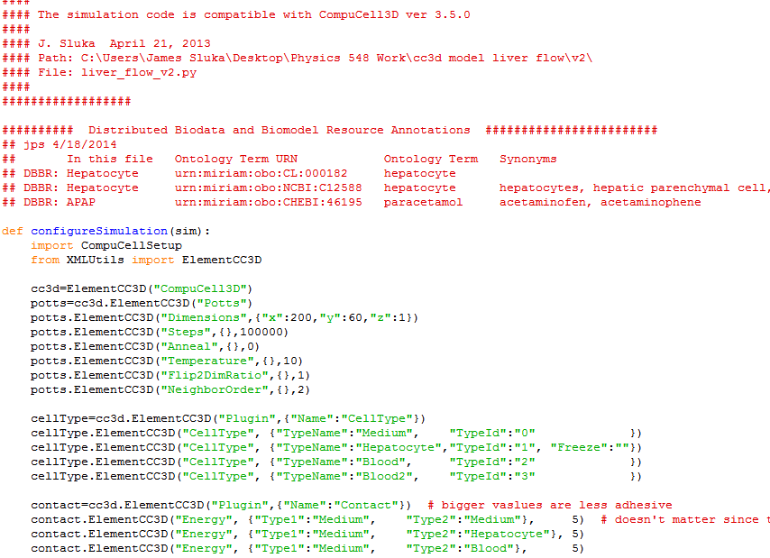
Embedded annotation in Python
Notes:
CompuCell3D Python Code.
With help from Herbert Sauro

Slide 45
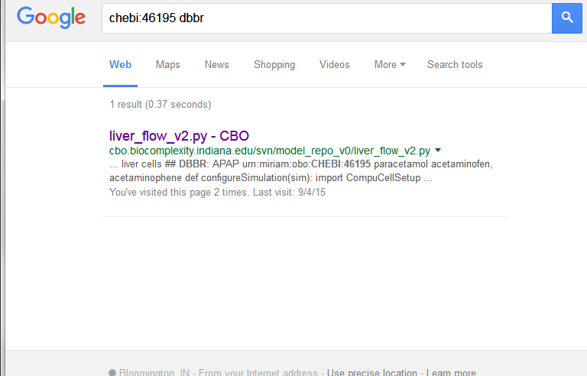
Google can find the file
(and it is the only file found)

Slide 46
Need helper tools for annotation
Some possible approaches:
  Reification of XML (or other syntax) into an “indexable” format
  (similar to SBML2LaTex)
  Doxygen (Python, C++, …) extension that allows direct incorporation of biological annotations within the code. (Similar to, and parallel with, the incorporation of standard programming documentation)
Some desirable qualities:
  Incorporation of ontological IDs (highly unique)
  Tools to help with selection of (embed best practices in the tools):
    Which ontologies to use (chemicals from ChEBI, processes from Gene Ontology, …)
    Tools to help with selection of relationships (isA, part of, definedBy, …)
    Tools that help with the overall structure of the annotations (What’s the big question? What are the biological objects? What are the biological processes?)
    To help people understand the annotation include both the ontology ID (GO:0007067) as well as the name (“mitotic nuclear division”) and pseudonyms (“mitosis”)

Slide 47
Repositories
In order to reuse a model you must first find it
Should it be necessary that a user knows where to look for relevant information?
Types of repositories:
  Persistent databases and ontology resources
    BioModels
    Bio-ontology repositories (OBO Foundry, BioPortal)
    Publishers (papers and supplemental material)
  Free form / web based
Notes:
It is important that large repositories make their info visible to Google

Slide 48
CodeAsKnowledge
  A computational model embeds knowledge:
    biological knowledge
    computational knowledge
  If model “publication” techniques are:
    robust
    consistent across many knowledge domains
    searchable
    machine interpretable
We can use computational models,
and their output, as both data and knowledge.

Slide 49
Acknowledgments
Contributions from:
  Herbert Sauro
  Michael Hucka
  The entire group of James Glazier at Indiana University
Support:
  US EPA
  NIH/NIGMS
  Indiana University
  NSF
  Falk Fund

Slide 50
Additional Resources
BioModels Database annotation description:
https://www.ebi.ac.uk/biomodels-main/faq
Juty, N. et al. BioModels: Content, Features, Functionality, and Use. CPT Pharmacometrics Syst. Pharmacol. 4, 55–68 (2015). http://onlinelibrary.wiley.com/doi/10.1002/psp4.3/full

