Slide 1
Multiscale Models in CompuCell3D
A Liver-centric Multiscale Modeling Framework for Xenobiotics
Leveraging SBML models for subcellular and whole-body scales
This presentation is based on the work of;
James P. Sluka*, Xiao Fu, Maciej Swat, Julio M. Belmonte,
Alin Cosmanescu, Sherry G. Clendenon, John F. Wambaugh†
and James A. Glazier
Biocomplexity Institute, Indiana University
† US Environmental Protection Agency
10 September 2015
Notes:
30 minutes

Slide 2
Modeling Workflow
Biological
Experiments
Biological
Observations
BioModel
Validation
Mathematical
Model
New Knowledge
Verification
Computational
Model
Simulation
Prediction

Slide 3
Cellular Potts Model (CPM)
(aka Glazier-Graner-Hogeweg Model)
Energy formalism
Cell lattice
Thermodynamic trajectory
(not an energy minimization)

Slide 4
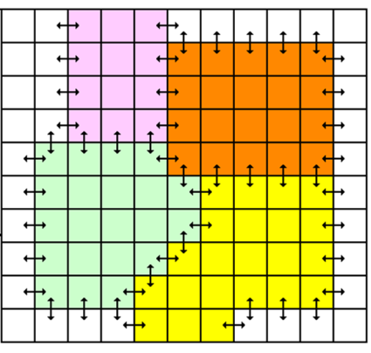
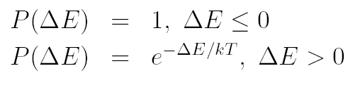
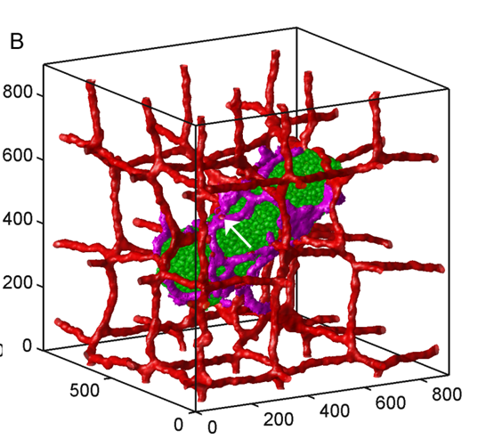
Cellular Potts Model
Developed by James Glazier and Francois Graner
Represents single cell as a collection of pixels on a lattice (regular or irregular) in 2D or 3D.
Physics based.
Uses energy formalism to describe cell properties (usually in the form of constraints), cell-cell interactions and cells’ behaviors.
Stochastic not, deterministic
Very simple and intuitive. Mathematical complexity does not go beyond understanding second order polynomials.
Capable of representing cellular and subcellular structures
Relatively fast up to 10^5 cells on a single CPU.
Used by many labs around the world.
Drawbacks: Time has to be converted from simulation unit to physical unit. Lattice granularity determines level of details of simulated objects. Simulation parameters are not independent –changing one of them triggers changes in others
Software: CompuCell3D, Chaste, Simmune, Morpheus, Tissue Simulation Toolkit

Slide 5

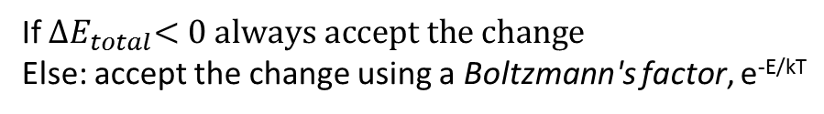
Focusing on observable cellular behaviors
Energy formalism of the CPM allows implementing cellular behaviors as additive terms of the Hamiltonian:
+
$${∆E}_{total}$$
If ${∆E}_{total}<0 always accept the change$
Else: accept the change using a Boltzmann's factor, e^{-E/kT}

Slide 6
Cellular Potts Model implemented in CompuCell3D (CC3D)
A library of Python/C++ modules that implement the CPM.
Core CPM modules coded in C++ for speed.
A helper app’s for:
  building models (Twedit++)
  execution GUI (Player)
Ability to import, control and run SBML models

Slide 7
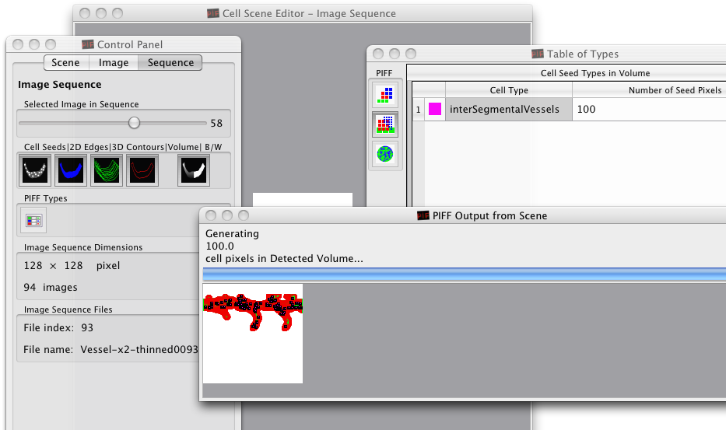
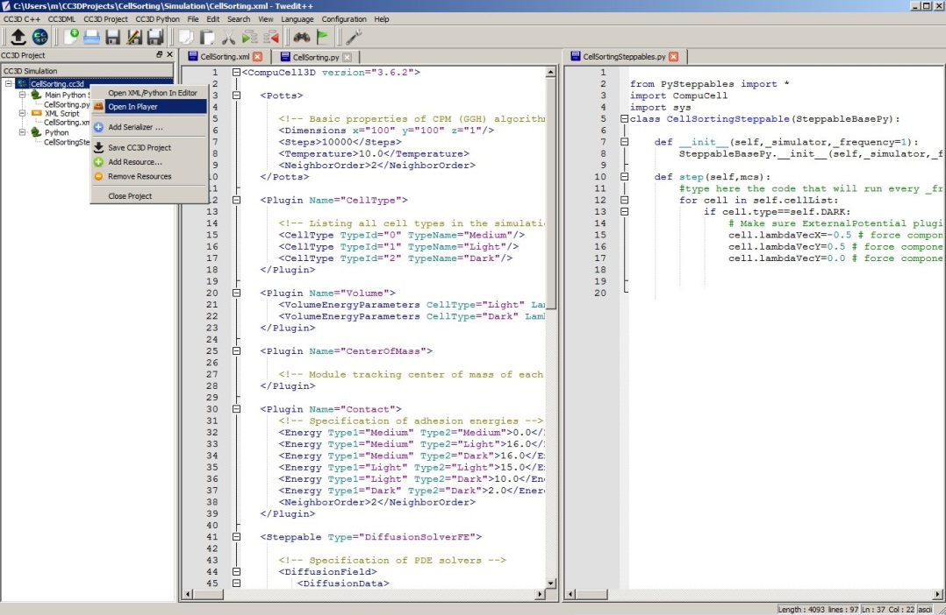
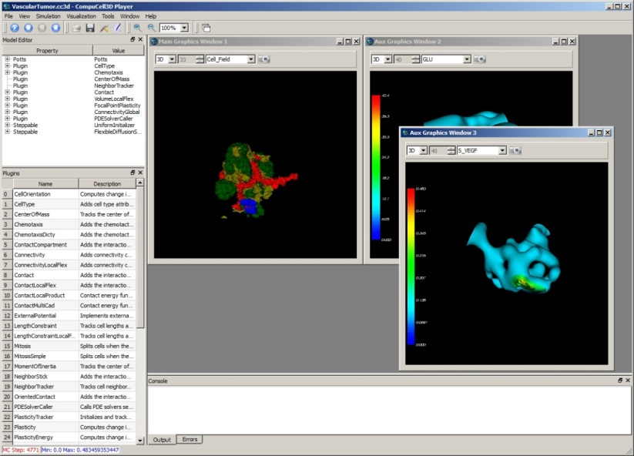
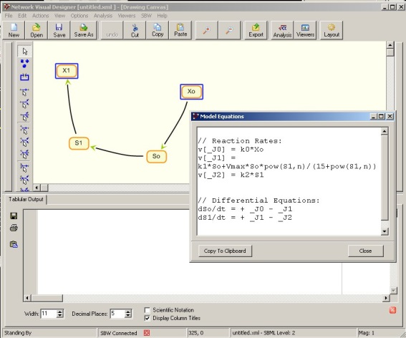
CompuCell3D (batteries included)
Cross-platform, open-source environment for building and running multi-cell multi-scale simulations of tissues and organs
Written in C++ and Python
Describes models using combination of XML and/or Python
Parallel implementation on GPU’s and multi-core machines
Simulation-wizards, simulation editors, graphical interfaces, visualization tools, SBML solvers, and FE solvers (experimental support) included
SBML tools can be used to generate SBML models that CC3D would run inside each cell

Slide 8
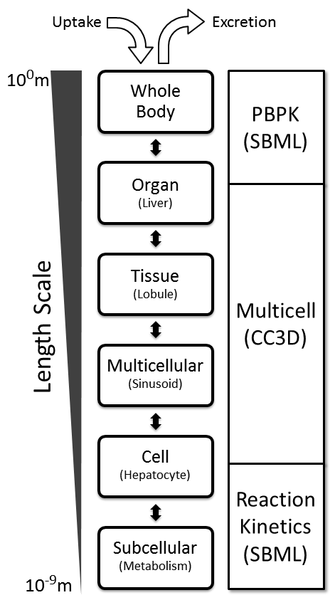
Biological scales and common computational modalities
Notes:
Should have FEM/FEA scale

Slide 9
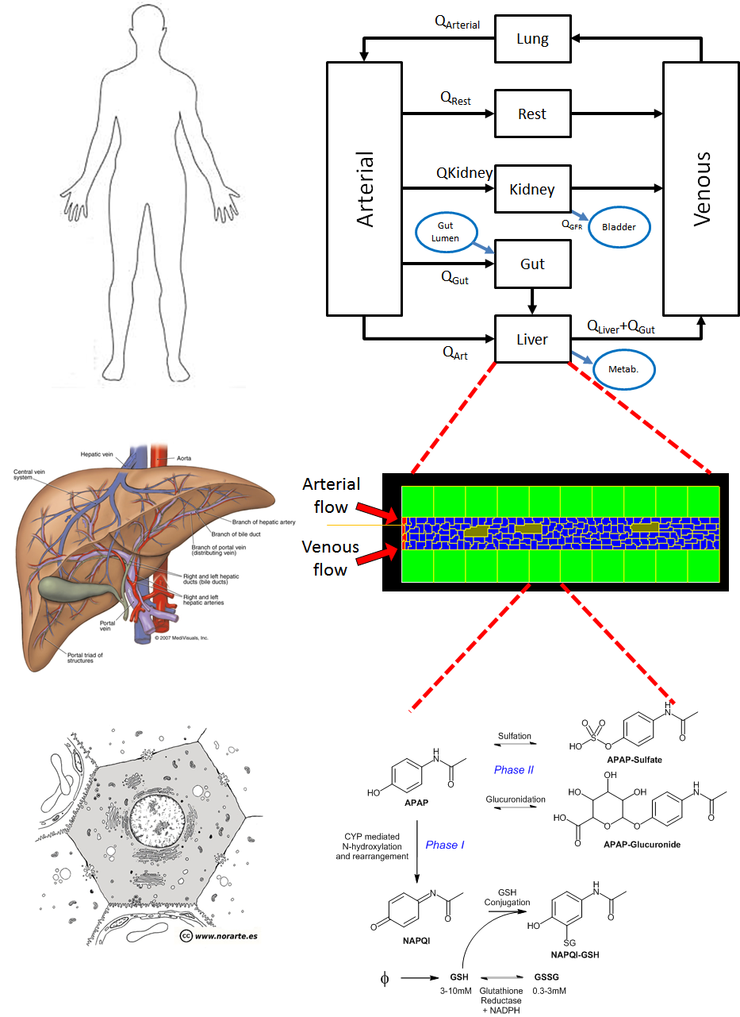
A multiscale, liver-centric model

Slide 10
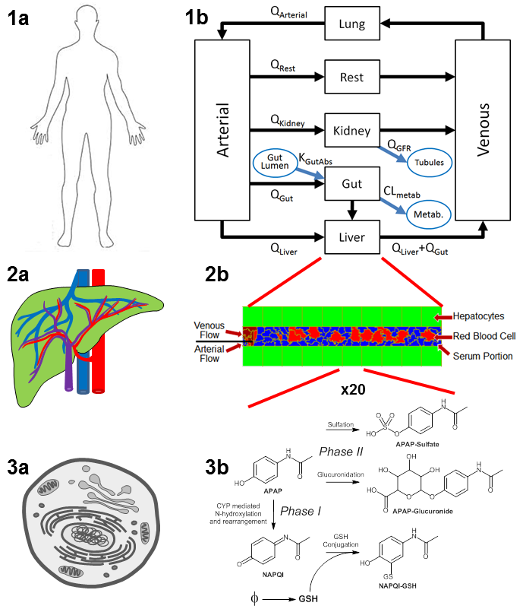
Divide and Conquer Build

Slide 11
Divide and Conquer Build
SBML
CompuCell3D
SBML

Slide 12
Why Acetaminophen (APAP)?*
APAP:
Is a leading cause of acute liver failure in the US.
The therapeutic index (ratio of toxic to therapeutic doses) is unusually small for an over the counter medication.
Is included in many formulations and often a patient isn’t aware that the use of APAP, in conjunction with a prescribed pain killer (like Percocet), leads to high and perhaps lethal APAP doses.
Is often used as the “poster child” compound for Drug Induced Liver Injury (DILI) studies.
* Paracetamol in the EU

Slide 13
Subcellular reaction kinetic model for APAP metabolism: Chemistry

Slide 14
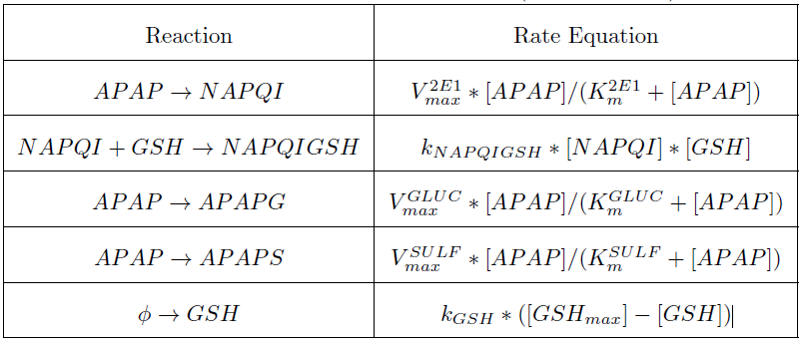
Subcellular reaction kinetic model for APAP metabolism: Equations

Slide 15
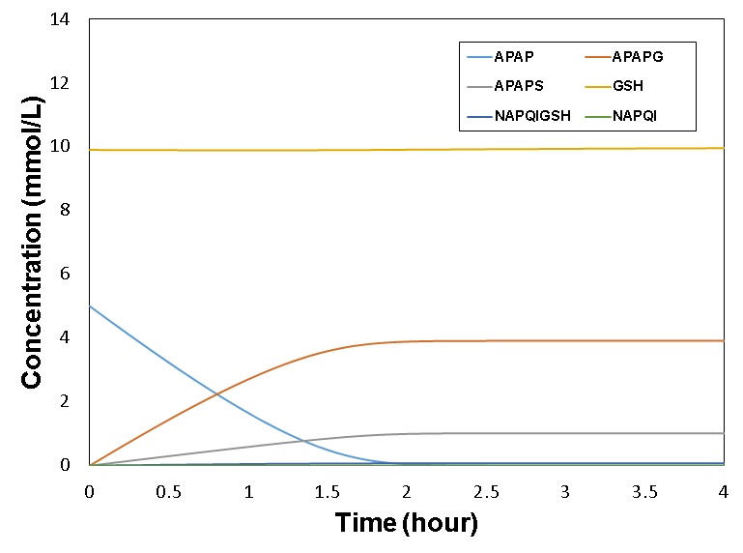
Subcellular reaction kinetic model for
APAP metabolism:
SBML model executed in COPASI
This ratio is known from human ADME studies

Slide 16
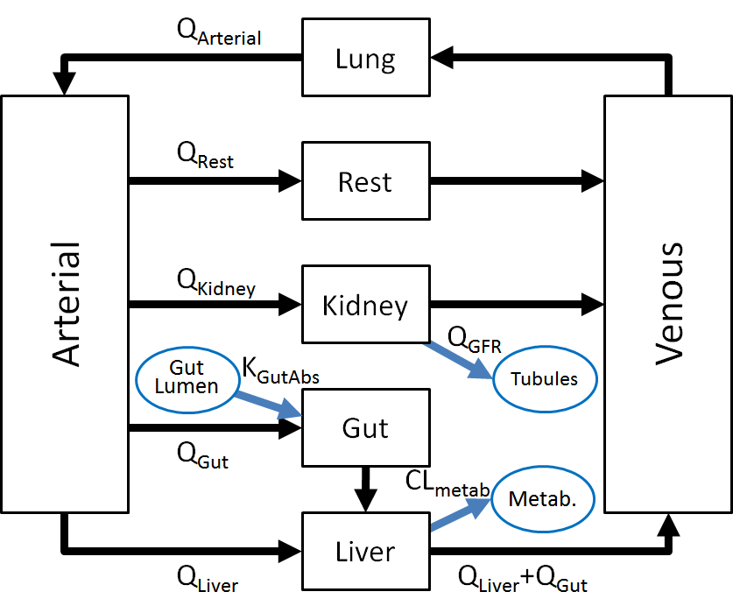
Whole-Body Physiologically Based PharmacoKinetic (PBPK) model

Slide 17
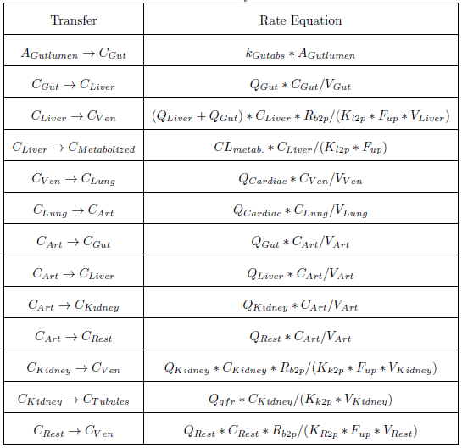
Whole-Body PBPK model: Equations

Slide 18
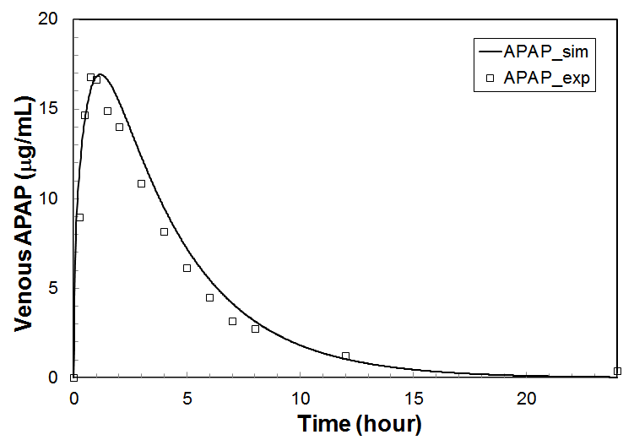
Whole-Body PBPK model:
SBML model executed in COPASI
Plasma concentration of APAP following a simulated 1.4g dose in a 70Kg individual (line). Open symbols are averages for 9 Caucasian subjects, average body weight 68Kg. (Note that this model includes a single first order ODE for APAP metabolism within the liver compartment.)

Slide 19
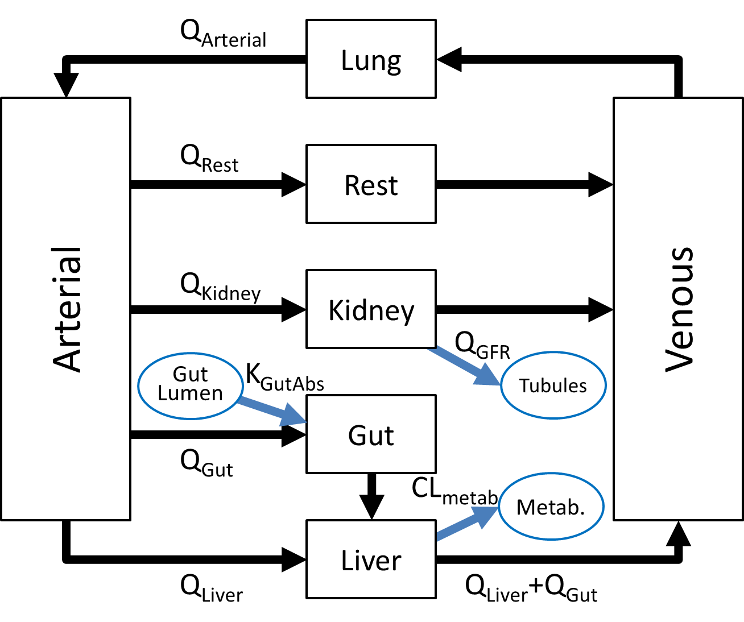
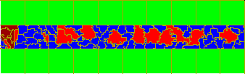
Tissue (multicell) scale model
Hepatocytes
Venous Flow
Red Blood Cell
Arterial
Flow
Serum Portion

Slide 20
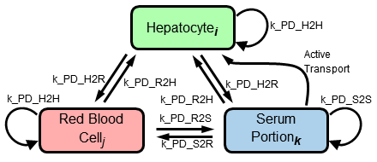
Tissue scale model:
Diffusion and transfer
The diffusion (PDE) model for the multicell scale sinusoid model. Transfer between each of the three cell, or pseudo-cell, types is described by this transfer map. Subscripts indicate that there are multiple cells of each of the types and transfer is calculated between all pairs of cells that are in contact at a particular instant. The paired arrows represent passive transport that equilibrates across pairs of cell types if they are in contact. Looped arrows represent passive transport between adjacent cells of the same type. The single arrow labeled "Active Transport" represents the Michaelis-Menten modeled import of APAP from serum into hepatocytes.

Slide 21
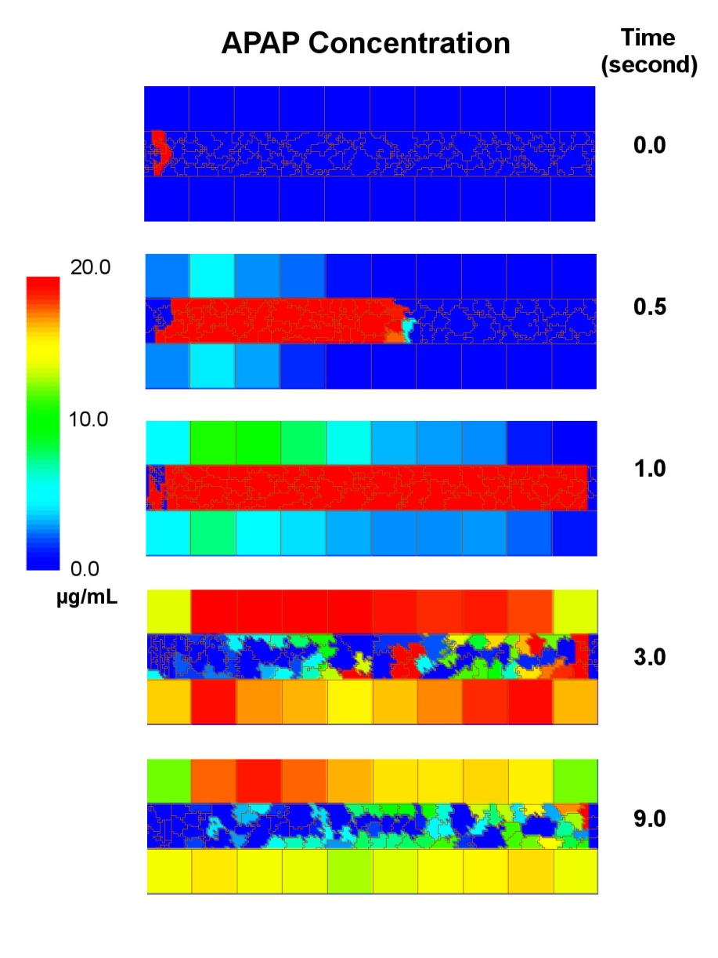
Tissue scale model:
Model in CompuCell3D
Simulation of a two second pulse of APAP being carried through the multicell sinusoid model.

Slide 22
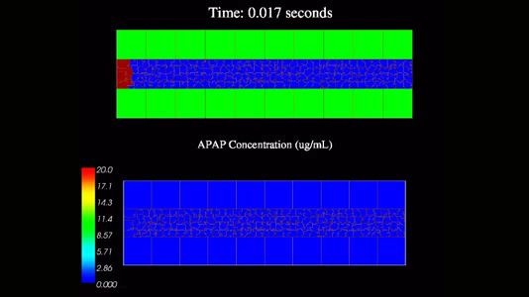
Notes:
APAP_pulse_10sec.mp4

Slide 23
Complete Multiscale
Model
Replicates for;
APAP
APA-Glucuronide
APAP-Sulfate
Three diffusing species;
APAP
APA-Glucuronide
APAP-Sulfate
Replicate in each of the 20 hepatocytes
“Well stirred” containers
Converts APAP to the three metabolites
Notes:
PBPK to CC3D coupling is via concentration, an intensive property (scale insensitive)

Slide 24
Complete Multiscale model
In a simulation step, the CC3D script sequences both the calculations it carries out directly as well as time stepping the linked SBML models.
A computational time step cycle consists of:
Time step the PBPK models updating the quantities of APAP, APAPG and APAPS in each compartment of the PBPK module.
Fetch the quantities of APAP within "CArt" and "CGut" compartments of the PBPK model and calculate the concentration of APAP entering the inlet side of the tissue-level (CC3D) sinusoid module.
The CC3D model creates blood portions and RBCs representing venous and arterial flow that contain the amount of APAP (or APAPG or APAPS) based on the blood concentrations in the two blood flows in the whole-body PBPK models.
The CC3D model then simulates blood flow for a short period of time .
Numerically integrate the transfer of drug molecules at the interface of blood (serum portions and RBCs) and hepatocytes.
Time steps the subcellular SBML models within each hepatocyte, which generates new values for the per-cell concentrations of APAP and metabolites.
At the central vein terminus of the sinusoid the APAP (and metabolites) are returned to the "CVen" compartment exit of the PBPK module.

Slide 25
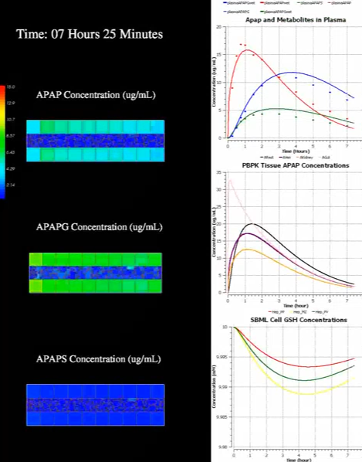
Complete Multiscale model
Notes:
Static image

Slide 26
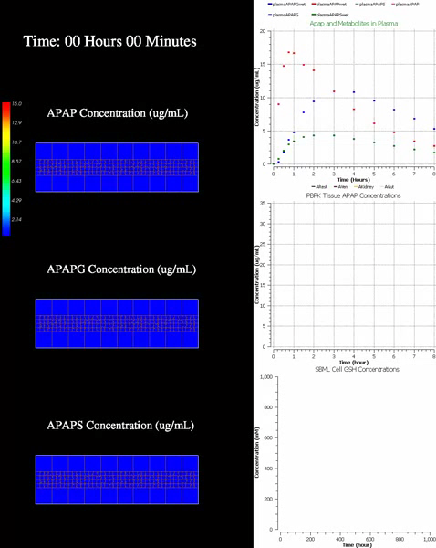
Notes:
Complete_8hr.wmv
Dots in top graph are human ADME data

Slide 27
Advantages of using existing tools and standards
Can use existing tools for model--
  creation
  execution
  parameter fitting
  etc.
Can re-use existing models
Can use the well developed annotation standards for the SBML models

Slide 28
Modify, and partially tune the whole-body model
ADME averages from 4 health fasted adults given 12mg/kg orally as a solution.
Gastric emptying
(9 minutes)
Data from: Prescott, L. F. “Kinetics and metabolism of paracetamol and phenacetin.”
Br. J. Clin. Pharmacol. 10 Suppl 2, 291S–298S (1980).

Slide 29
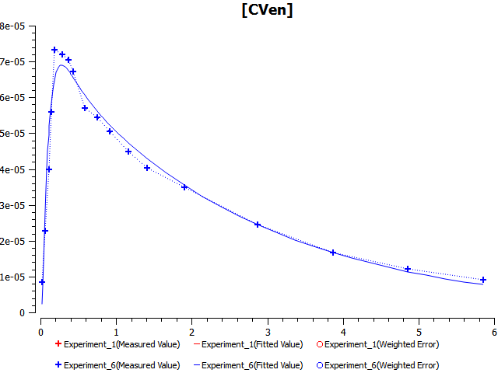
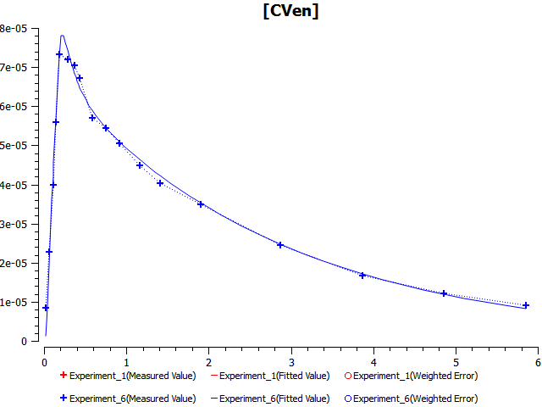
Modify, and partially tune the whole-body model
Modify the whole-body PBPK model replacing the first order gut
absorption ODE (left) with a Michaelis-Menten (saturable) ODE (right).
Notes:
Could argue that I am overfitting the data (the data isn’t THAT good)

Slide 30
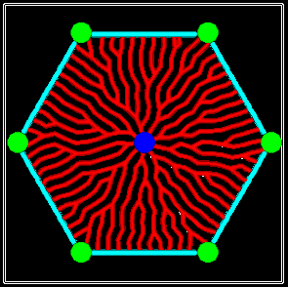
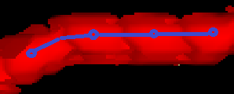




More realistic (and more computationally complex) liver lobule model
PT
Definition of nodes and edges:
CAP
SIN
$$j$$
$$k$$
$$l$$
$$i$$
CV
Notes:
Shown here is the vasculature in a single-layer lobule from a top view. Each vessel segment is defined as a unique node. Neighboring segments together form edges linking two nodes.
Xiao Fu
30

Slide 31
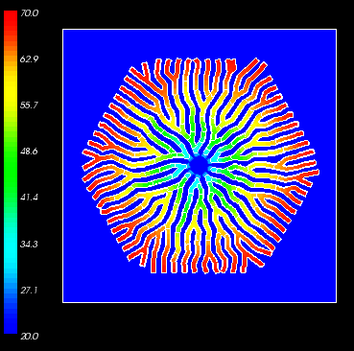
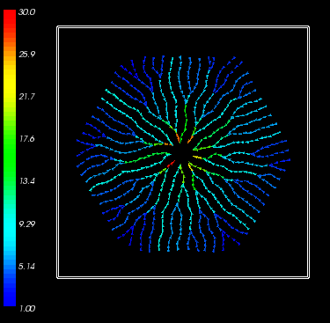
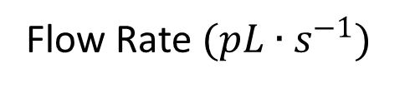
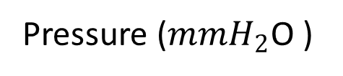
Results for constant pressure condition:
Pressure and Flow Profiles
Pressure ($mmH_{2}$O )
Flow Rate $(pL∙s^{−1})$
Notes:
Kirchhoff's Law and fluid dynamics laws
Xiao Fu
31

Slide 32
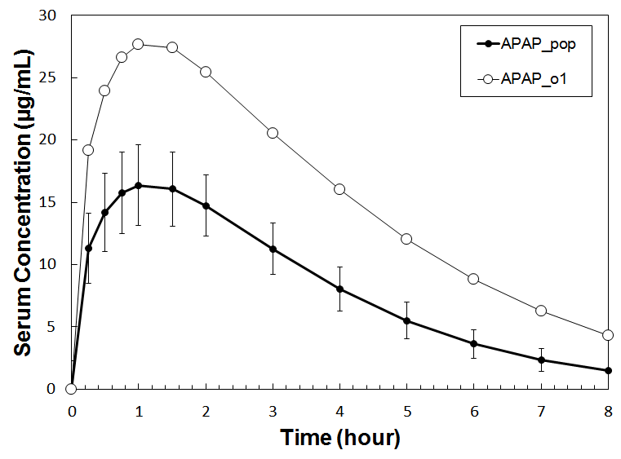
Population modeling
Assumed that each parameter in the multi-scale model is selected from a +/- 25% normal distribution about the parameter’s best fit value.
Results for 839 simulated individuals
Comparison of the average response (closed symbols) of the simulated population with the simulated individual from the population that deviates the most from the population average (open symbols).
Notes:
IIRC, did not allow BW or dose to change. The outlier “individual” has slow APAP uptake into the Hepatocytes, somewhat slower clearance rate and somewhat slower metabolic rate.

Slide 33
Acknowledgments
Support:
  US EPA
  NIH/NIGMS (including a U01)
  Indiana University
  NSF
  Falk Fund

Slide 34
Description of the
Biology versus the Math/Code
e.g., Gene Ontology,
KEGG Pathway
e.g., SBML
Biological Description
e.g., FEBio,
CompuCell3D
MATLAB, C++, …
Mathematical / Computational Description
Notes:
Gene Ontology (GO) might not be a good representative for a descriptive language that is biologically rich but without math/computational info.

