Slide 1
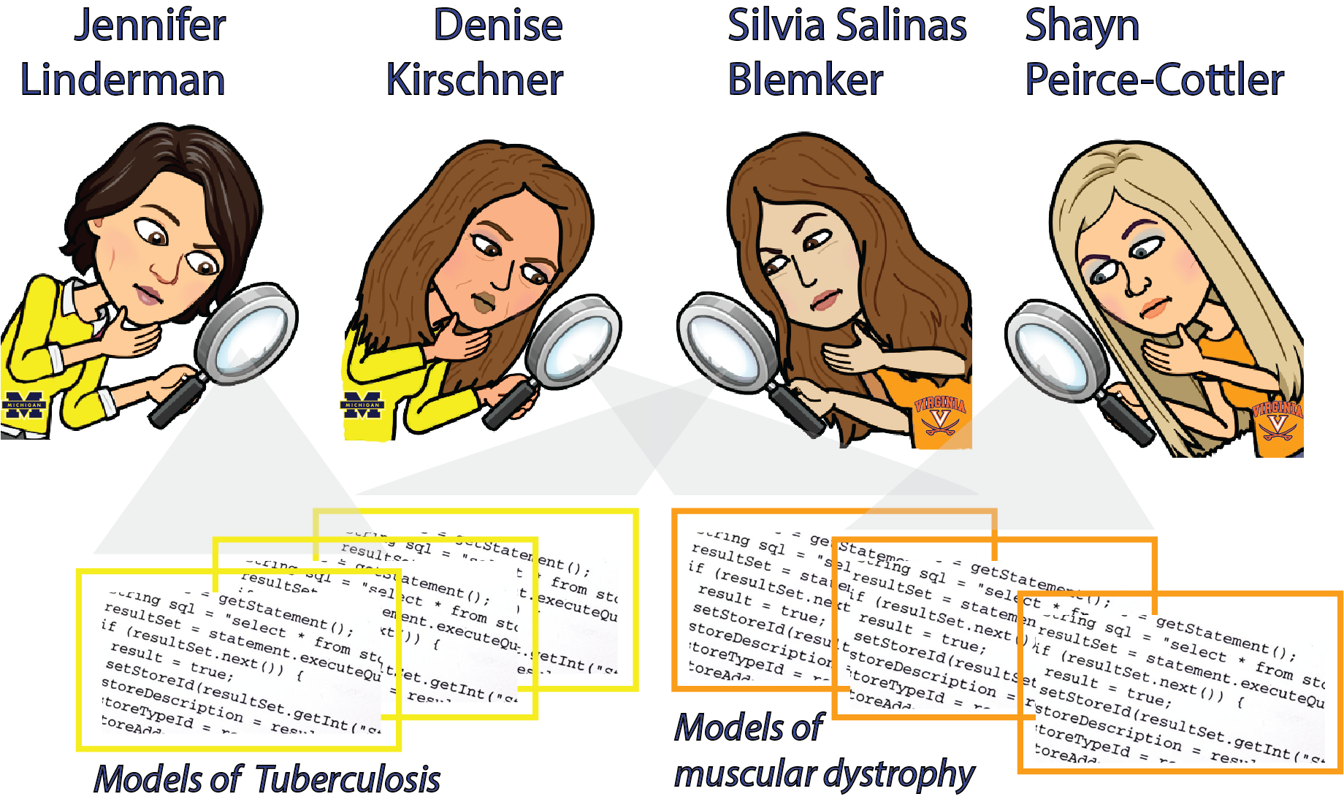
Collaborative third-party evaluation of MSM projects can lead to technical and scientific benefits for funded U01 projects
Blemker, Linderman, Kirschner, Peirce-Cottler

Slide 2
The Two Projects for 3rd Party Review
A Multi-scale Systems Pharmacology Approach to Tuberculosis Treatment: U01-HL131072 Multi-PIs: V. Dartois, J. Flynn, D. Kirschner, J. Linderman
Multi-scale Modeling for Treatment Discovery in Duchenne Muscular Dystrophy U01-AR069393, S. Blemker, S. Salinas and S. Peirce-Cottler

Slide 3
Committee on Credible Practice in
Modeling and Simulation in Healthcare
Goals
(1) Developing and adapting guidelines and procedures for credible MSM practice in healthcare
(2) cultivating consistent terminology
(3) demonstrate workflows for credible practice
(4) promoting credible practice
established to provide a collaborative platform to outline good practice of simulation-based medicine.
focus is to enhance the credibility of computational modeling & simulation for clinical research and decision making

Slide 4
The Perspective of Committee on Credible Practice of Modeling and Simulation in Healthcare
Our two groups have joined together to create a workflow that can
serve as a template to other MSM groups as well. We are following
these 10 rules:
*Rule 1 – Define context clearly
*Rule 2 – Use appropriate data
*Rule 3 – Evaluate within context
*Rule 4 – List limitations explicitly
*Rule 5 – Use version control
*Rule 6 – Document adequately
*Rule 7 – Disseminate broadly
*Rule 8 – Get independent reviews
*Rule 9 – Test competing implementations
*Rule 10 – Conform to standards

Slide 5
The Perspective of Committee on Credible Practice of Modeling and Simulation in Healthcare
Our two groups have joined together to create a workflow that can
serve as a template to other MSM groups as well. We are following
these 10 rules:
*Rule 1 – Define context clearly
*Rule 2 – Use appropriate data
*Rule 3 – Evaluate within context
*Rule 4 – List limitations explicitly
*Rule 5 – Use version control
*Rule 6 – Document adequately
*Rule 7 – Disseminate broadly
*Rule 8 – Get independent reviews-We have two Independent evaluators
*Rule 9 – Test competing implementations
*Rule 10 – Conform to standards

Slide 6
Evaluation 1
Dr. Chang Gong , Johns Hopkins from Popel Group has provided an independent evaluation of our code:
--ABM, hybrid formulation, ODEs, PDEs, C++, object-oriented programming, graphical interfaces
  Meetings: August 11, 2017 and January 30th, 2018
  Conclusion: test implicit Crank-Nicholson PDE solver to improve speed over current FFT and ADE algorithms

Slide 7
Evaluation 2 - more in depth-focus
Drs. Blemker and Peirce-Cottler are providing a co-review process with us on their project
  Meetings: Feb 9, 2018 and February 28, 2018
  planned: March 21, 2018 and April 2018
  Evaluation on:
    Model formulations, modeling choices, model credibility planning, code versioning, etc.

Slide 8
TB Grant Overview
Improve TB treatment with antibiotics by pairing computational modeling with experimental methods for imaging drug distribution within lung granulomas from humans, non-human primates (NHP) and rabbits.
Specific aims:
Determine spatial and temporal distributions of TB antibiotics within granulomas, and predict the development of resistance
Identify optimal antibiotic treatment regimens for TB
Perform virtual clinical trials to test treatment regimens we identify, and test one identified regimen against the standard regimen in NHPs.
Notes:
Jennifer starts here

Slide 9
TB Grant Overview
Granuloma model (at right):
ABM + ODEs + PDEs
Immune cells and bacteria are agents
Paired with
Antibiotic PKPD
Immune cell dynamics in lymph nodes and blood (ODEs)
Experimental data:
Multiple antibiotics
Rabbit: PKPD; MALDI-MS imaging of granulomas to get drug distribution
NHP: PET imaging; granuloma composition; treatment outcomes, etc.
And also
Uncertainty and sensitivity analyses
Optimization algorithms
Scaling to whole-host level
Virtual clinical trials

Slide 10
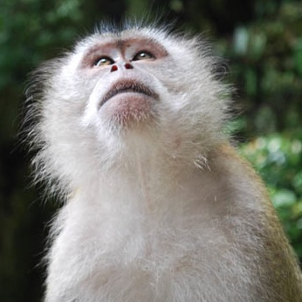
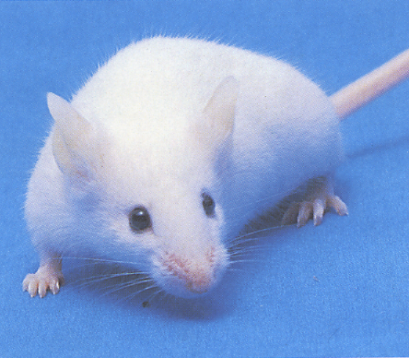
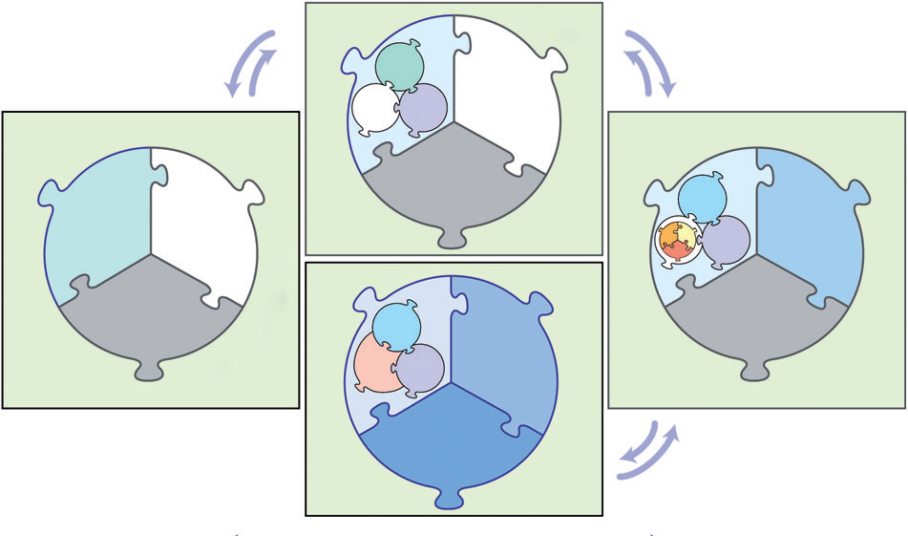

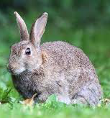
Particular areas of interest for our discussion
Model structure & assumptions
  Moving between animal models and disparate types of data
  Moving between scales
  Fine vs. coarse graining, e.g. moving from ABM to ODE in portions of model; stochastic vs. deterministic elements

Slide 11
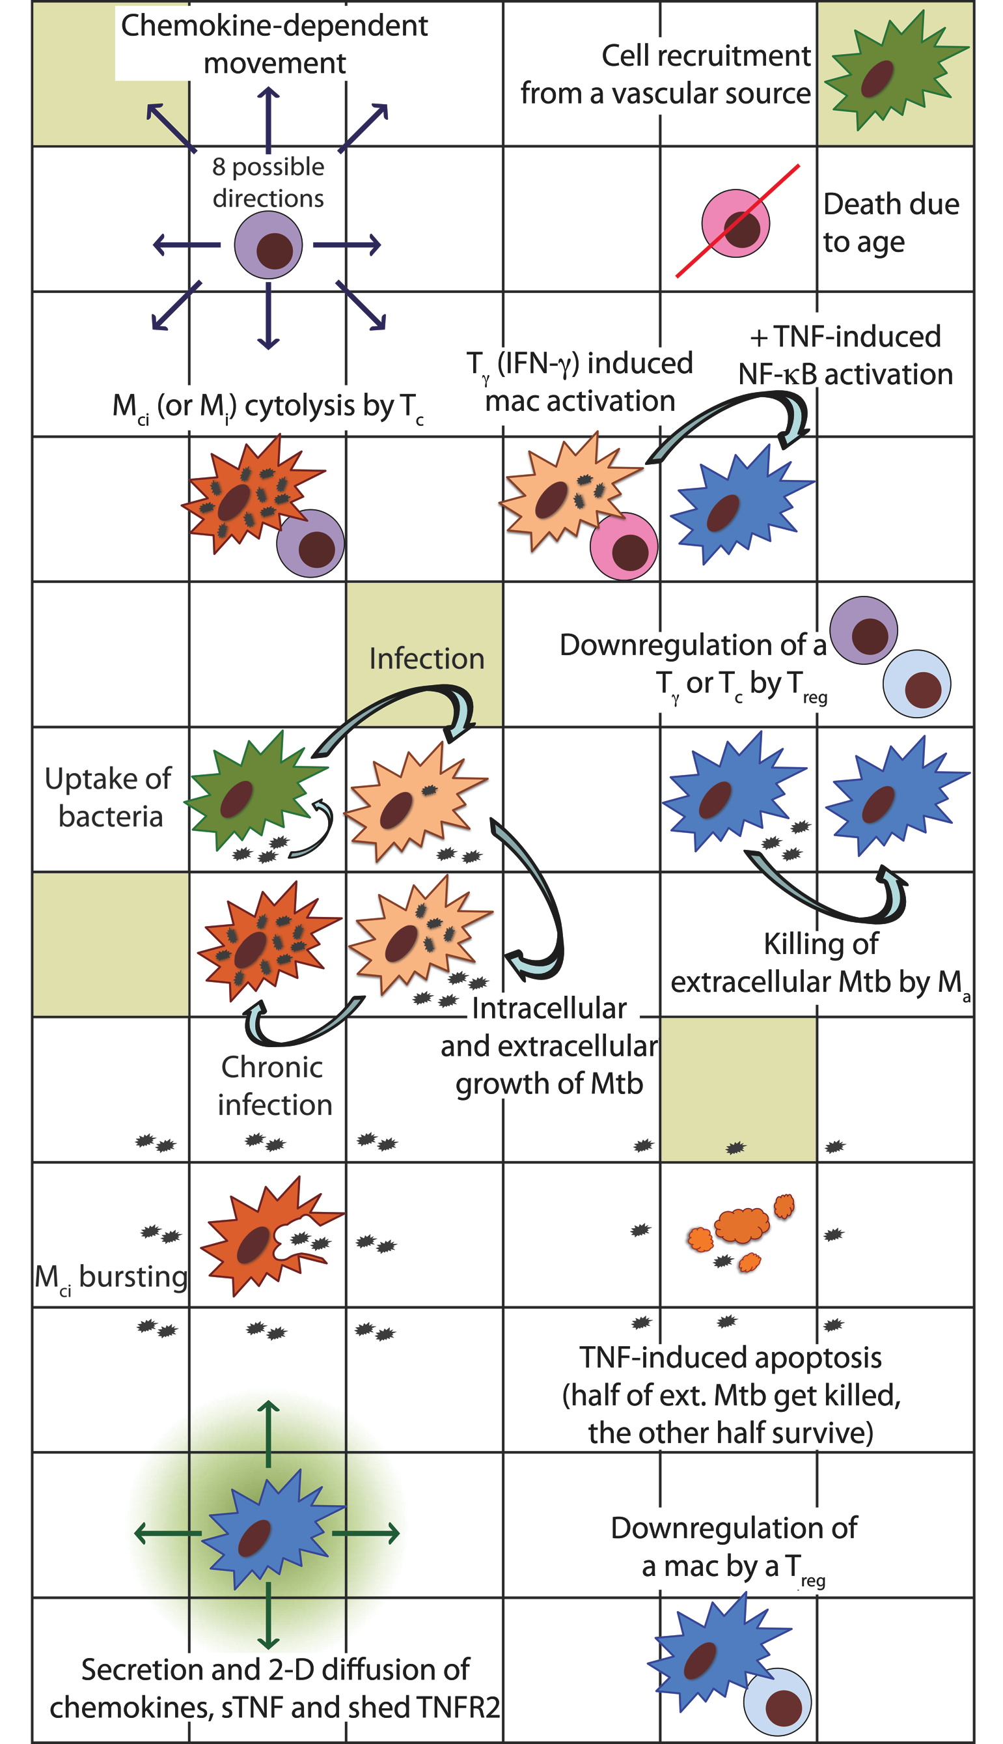
Particular areas of interest for our discussion
Model structure & assumptions
  Moving between animal models and disparate types of data
  Moving between scales
  Fine vs. coarse graining, e.g. moving from ABM to ODE in portions of model; stochastic vs. deterministic elements
Immunology
  ABM rules and cell behavior

Slide 12
Particular areas of interest for our discussion
Model structure & assumptions
  Moving between animal models and disparate types of data
  Moving between scales
  Fine vs. coarse graining, e.g. moving from ABM to ODE in portions of model; stochastic vs. deterministic elements
Immunology
  ABM rules and cell behavior
Best practices for MSM
  Version control, documentation, code-testing
  Uncertainty and sensitivity analysis approaches
Identifying the significant PRCCs from an ABM

Slide 13
Particular areas of interest for our discussion
Model structure & assumptions
  Moving between animal models and disparate types of data
  Moving between scales
  Fine vs. coarse graining, e.g. moving from ABM to ODE in portions of model; stochastic vs. deterministic elements
Immunology
  ABM rules and cell behavior
Best practices for MSM
  Version control, documentation, code-testing
  Uncertainty and sensitivity analysis approaches
Broader education for our students/postdocs
  “Looking under the hood” of model-building
  How to appeal to not only specialists but also modelers more generally

Slide 14
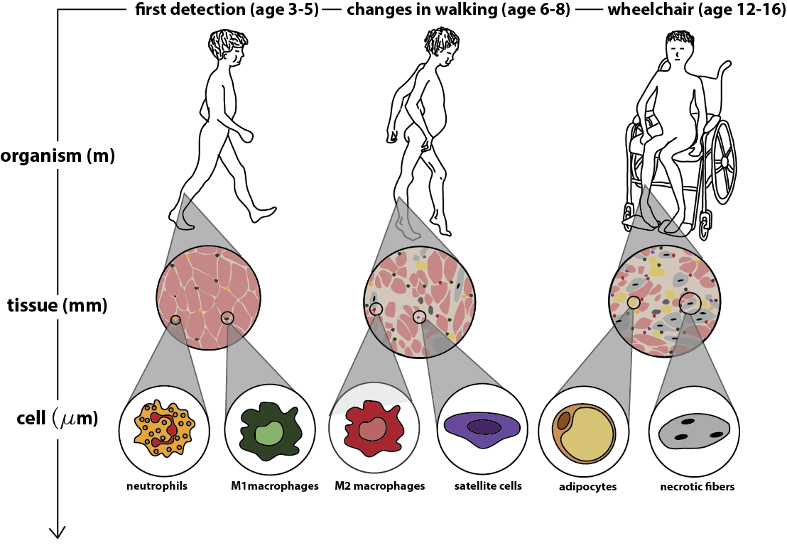
DMD Grant Overview
Develop novel treatments for Duchemme muscular dystrophy by pairing computational modeling with experimental methods for tracking disease progression in mice and humans.
Specific aims:
Develop and validate a multiscale model of muscle degeneration in dystrophic mouse muscles.
Use the multiscale model to simulate pre-clinical treatments in dystrophic mouse muscles.
Extend the multiscale model to simulate muscle degeneration and treatment effects in boys with DMD.
Notes:
Jennifer starts here

Slide 15
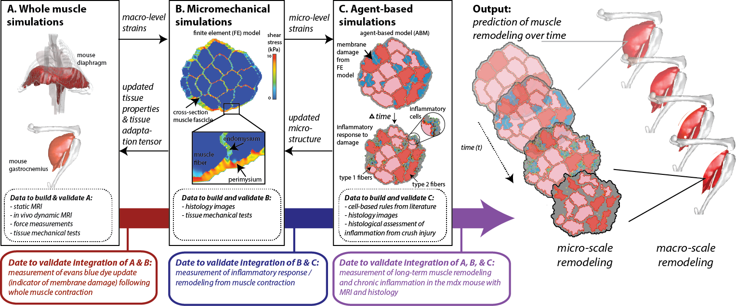
DMD grant approach overview
Uncertainty and sensitivity analyses
Optimization algorithms
Virtual clinical trials
ABM + ODEs + PDEs
Multiple cell agents

Slide 16
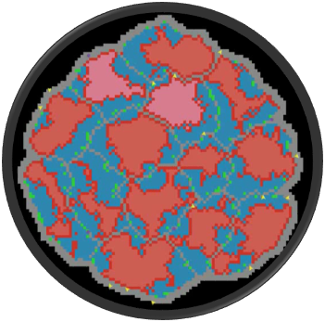
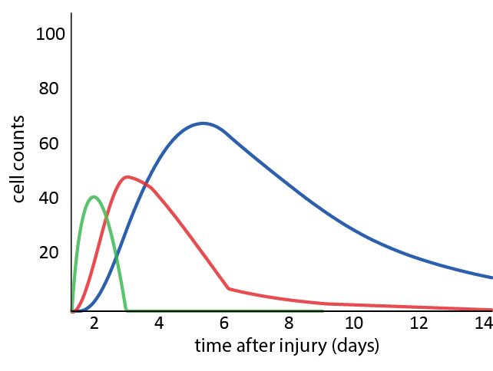
Particular areas of interest for our discussion
Model structure & assumptions
  ABM => ODE’s as models evolve
  Integrate FE & ABM

Slide 17
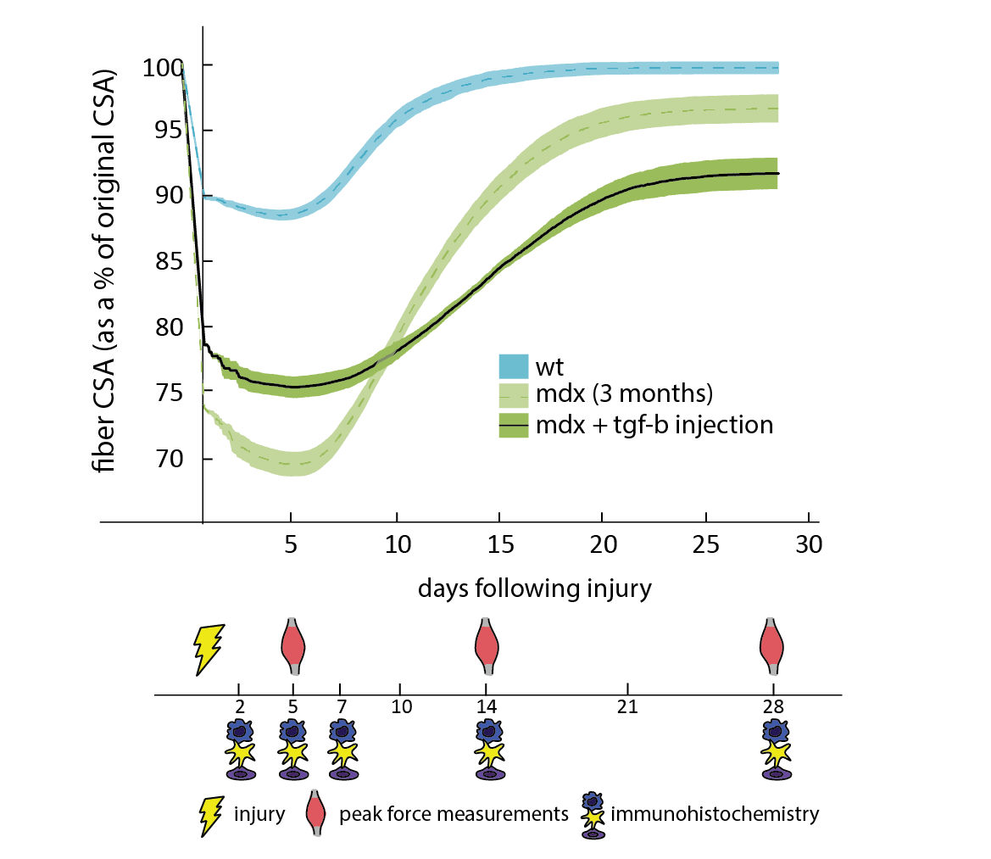
Particular areas of interest for our discussion
Model structure & assumptions
  ABM => ODE’s as models evolve
  Integrate FE & ABM
Experimental design based on model predictions
Notes:
So finally, with these predictions we are able to design our experiments.
-So we have used the regeneration curves to make predictions on when we think the regeneration metrics will be substantially different- and used this data to power our study
-Additionally, we used our cell count curves- which are not shown here- to define our terminal time points for histology and immunohistochemistry

Slide 18
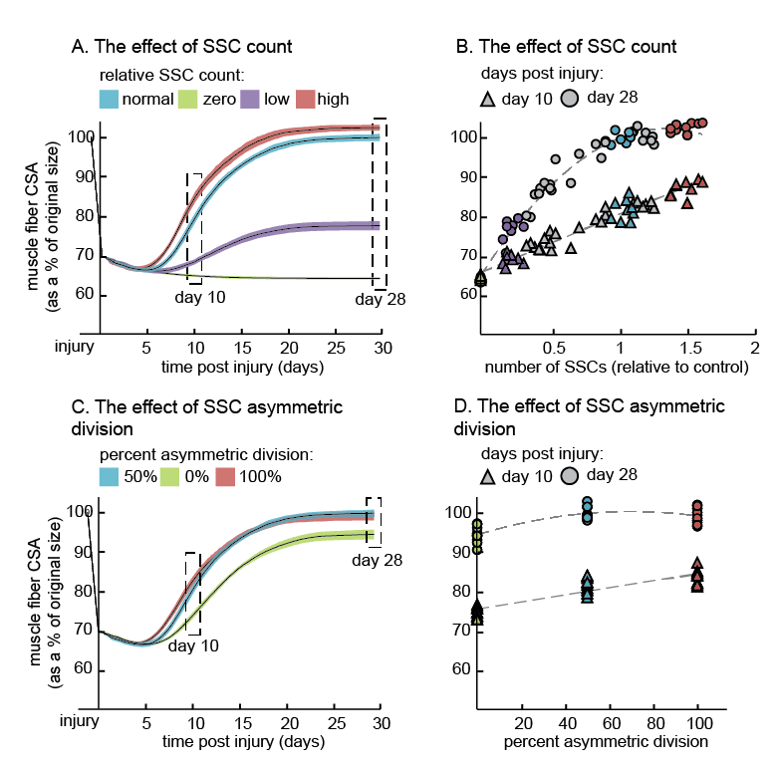
Particular areas of interest for our discussion
Model structure & assumptions
  ABM => ODE’s as models evolve
  Integrate FE & ABM
Experimental design based on model predictions
Best practices for MSM
  Version control, documentation, code-testing
  Uncertainty and sensitivity analysis approaches

Slide 19
Particular areas of interest for our discussion
Model structure & assumptions
  ABM => ODE’s as models evolve
  Integrate FE & ABM
Experimental design based on model predictions
Best practices for MSM
  Version control, documentation, code-testing
  Uncertainty and sensitivity analysis approaches
Broader education for our students/postdocs
  “Looking under the hood” of model-building – multiple students working with same code
  Sharing code between students at U of M and UVA

Slide 20
U.Mich-UVA Model Credibility Cross-Evaluation (5-part plan)
Part 1. Download and run each other’s models [Rule 1 (define context), Rule 6 (document)]
Part 2. Cross-evaluate model design and implementation with a focus on the use of experimental data in model specification and validation [Rule 1 (define context), Rule 2 (use of data), Rule 3 (evaluate within context), Rule 4 (limitations)]
Part 3. Version control best practices sharing [Rule 5 (version control), Rule 6 (document), Rule 9 (competing implementations)]
Part 4. Publication strategy [Rule 7 (disseminate broadly), Rule 8 (independent reviews), Rule 10 (conform to standards)]
Part 5. Journal the experience!

Slide 21
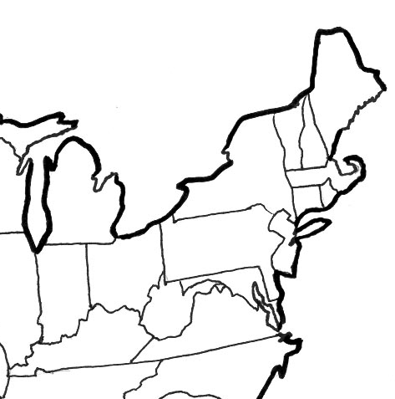


Part 1. Download and run each other’s models [Rule 1 (define context), Rule 6 (document)]
Prior to submitting a model for publication
Share the model (or a portion thereof)
Download, run, explore, read provided documentation, give feedback
Blemker and Peirce-Cottler post published models on SimTK.
Linderman and Kirshner post compiled code on their websites.

Slide 22
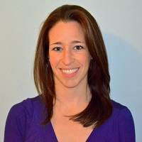

Part 2. Cross-evaluate model design and implementation [Rule 1 (define context), Rule 2 (use of data), Rule 3 (evaluate within context), Rule 4 (limitations)]
Bi-monthly 1.5 hr. group “Bluejeans” video conference meetings with U. Mich. Team and UVA Team
Includes graduate students and post docs
45 min. presentations with 45 min. discussion
Dive under the hood of the model
Focus on how we’re using data to parametrize/specify and validate our models.
February 2018: Kelley Virgilo, UVA presenter
April 2018: Josey Cicchese, U. Mich presenter

Slide 23



Part 3. Version control best practices sharing [Rule 5 (version control), Rule 6 (document), Rule 9 (competing implementations)]
Each team crafted a bulleted list of how we do version control for our models.
Then, we swapped lists and provided feedback to each other.
Currently, we’re revising based on the feedback and combining into a “final” version that can be shared with IMAG community.
IMAG

Slide 24
Part 4. Publication strategy [Rule 7 (disseminate broadly), Rule 8 (independent reviews), Rule 10 (conform to standards)]
Prior to publication, teams share manuscripts and provide feedback
Discuss strategy for publication (journals, reviewers, etc.)
Meet face-to-face once per year

Slide 25
Part 5. Journal the experience!
Document all meetings and interactions (notes, photos, and video) on Google Drive
Goal: Produce a “reflection” paper or documentary to summarize our experiences
Share with and receive feedback from others in the IMAG community
Possible white paper?

