Slide 1
TOPMed
Present & Future
Pankaj Qasba, Ph.D.
TOPMed Team

Slide 2
NHLBI Trans-Omics for Precision Medicine (TOP Med): Present & Future
Stimulate discovery in high impact disease areas
Build a Resource for the Scientific Community
Ensure well phenotyped and genotyped participants are chosen from traditionally underrepresented populations
Stimulate Systems Medicine Approaches to health and disease research
To Enable/Facilitate Precision Medicine

Slide 3
Goals
Build a Resource
Diversity
Large Sample Size
Ability to Integrate Data
Early Discovery
Focus on Specific Diseases
Focus on Specific Patient Groups
Focus on Underrepresented Groups
Leverage other NIH investments in WGS
Build upon NHLBI investment in existing cohorts
Contribute to other NHLBI genomics efforts

Slide 4
TOPMed Basics
Sequencing Centers:
Broad Institute
University of Washington
NYGC
Illumina
Baylor
Informatics Research Center:
University of Michigan
Data Coordinating Center:
University of Washington
Archive / Bioinformatics Support:
National Center for Biotechnology Information-NCBI

Slide 5
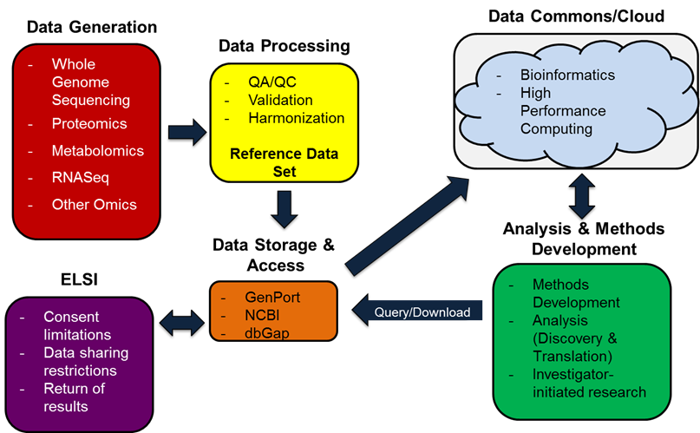
TOPMed Program Components

Slide 6
TOPMED - Where Are We Now? Diverse Genome-Phenome Resource
72K Participants (Goal of 100K to 150K)
Phenotype Diversity
Population Diversity
Developing a rich data source representative of the diverse HLBS phenotypes and populations that can enable multi-omics exploration to define the mediator pathways of HLBS disorders and discovery novel therapies.
Notes:
Back up

Slide 7
TOPMed WGS data Generation
Aug 2014 Phase 1 samples identified
Oct 2016
Phase 1 in
dbGAP
Feb 2015
Phase 1 ships
Feb 2016
Phase 2 ships
Apr 2016
Phase 1 complete
March 2017
Phase 2 complete
Phase 1, N=19,870
Phase 2, N=51,973
Phase 3, N=47,443
Spring 2018 anticipate 119,286
WGS completed
Feb 2017
Phase 3 ships

Slide 8
Continuing to Build Critical Components of TOPMed through Investigator-initiated Activities
NHLBI X01: WGS
(PAR-16-021)
NHGRI CCDG
(RFA-HG-15-001)
Centralized Omics REsource (CORE)
NHLBI U01: Analysis
(RFA-HL-17-011)
NHLBI Genomics Portal (GenPort)
NIH Collaborations
(e.g., BD2K, PMI)
Multipronged strategy to continue to build and enhance the TOPMed resource
Active investigator-initiated funding opportunities will build on existing phenotypes/diversity while adding new, nontraditional cohorts (e.g., EHR-based)
Certain phenotypes (e.g., asthma, COPD, SCD, atrial fibrillation, early MI) on a trajectory for reaching sample size with sufficient power to enable focused scientific inquiry
Notes:
NHLBI is funding and pursuing the following efforts to build critical components of the TOPMed program.
(PAR-16-021) NHLBI TOPMed: Omics Phenotypes of Heart, Lung, and Blood Disorders (X01). Through this funding opportunity announcement (FOA), NHLBI plans to review and accept applications from researchers interested in contributing samples for TOPMed WGS and other -omics studies. Researchers interested in helping grow the TOPMed data commons can find more information about this announcement at the (PAR-16-021) NHLBI TOPMed: Omics Phenotypes of Heart, Lung, and Blood Disorders (X01) FAQ.
Centralized Omics REsource (CORE) for TOPMed. NHLBI has solicited proposals for multiple contract awards that will support the collection of WGS and other -omics data such as genome-wide DNA methylation, sequencing of expressed RNAs, and metabolite profiling.
(RFA-HL-17-011) NHLBP TOPMed Program: Integrative Omics Approaches for Analysis of TOPMed Data (U01). Through this funding opportunity announcement (FOA), NHLBI plans to support the development of new methods for the analysis of -omics data in the TOPMed program. Awardees are expected to build and share their analytic tools with the TOPMed data commons. Visit (RFA-HL-17-011) NHLBP TOPMed Program: Integrative Omics Approaches for Analysis of TOPMed Data (U01) FAQ to see discussions about this closed funding announcement.
NHLBI Genomics Portal (GenPort). NHLBI has released a Small Business Innovation Research (SBIR) award announcement to help develop, operate, and maintain the NHLBI GenPort data commons that will support the TOPMed program. Read NHLBI-HR-17-05-CS for more information.
Trans-NIH collaborations. NHLBI is working with various National Institutes of Health (NIH) partners to share data and technical advice. Not only will these exchanges stimulate research, but they also will help NHLBI tackle short- and long-term technical issues related to sequencing standardization, large dataset storage and access, data commons and pilot cloud computing design, and how the TOPMed program may complement the NIH Precision Medicine Initiative Cohort Program.

Slide 9
TOPMed Investigator Team

