Slide 1


Spatial scales, big data and disease transmission dynamics : influenza as a case study
Cécile Viboud¹,Vivek Charu^{1,2}, Julia Gog^{1,3},
Stephen Kissler³, Lone Simonsen^{1,4}, Ottar Bjørnstad^{1,5},
Bryan Grenfell^{1,6}
¹Fogarty International Center, National Institutes of Health, USA
²Johns Hopkins University, USA
³University of Cambridge, UK
⁴ George Washington University, USA
⁵ Pennsylvania State University, USA
⁶Princeton University, USA
RAPIDD (Research And Policy in Infectious Diseases Dynamics)

Slide 2
Background
  Increasingly detailed influenza diffusion models since 1960s (Rvachev & Baroyan 1967, Rvachev & Longini 1985, Ferguson et al 2005, Halloran et al 2008)
  Limited validation against detailed disease data:
    Gravity models (Viboud et al 2006, Eggo et al 2012; Gog et al 2013)
  Fine-grained, city-level, US influenza surveillance data
  Statistical analyses and mechanistic models of spread
    distance
    population size
    movement (workflows and air traffic)
    environmental factors
    subtype/antigenic changes

Slide 3
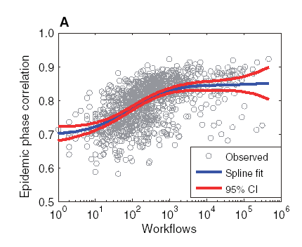
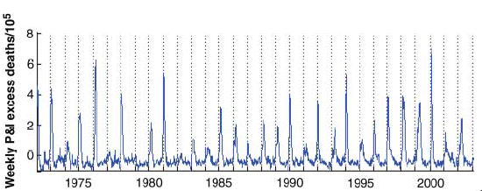
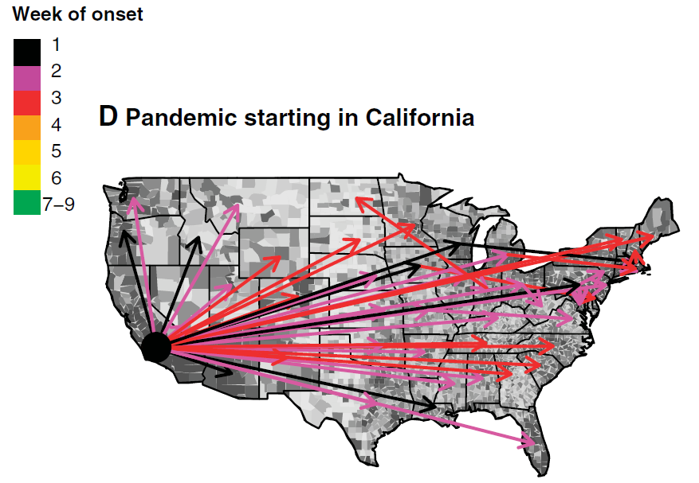
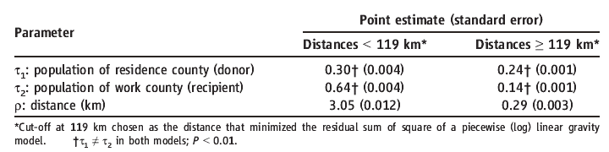
Workflows drive the regional spread of seasonal influenza in the US
Gravity model for commuter workflows between states=
Pop^{t1} * Pop^{t2} / distance^{r}
Viboud et al Science 2006; Ferguson et al Nature 2005

Slide 4
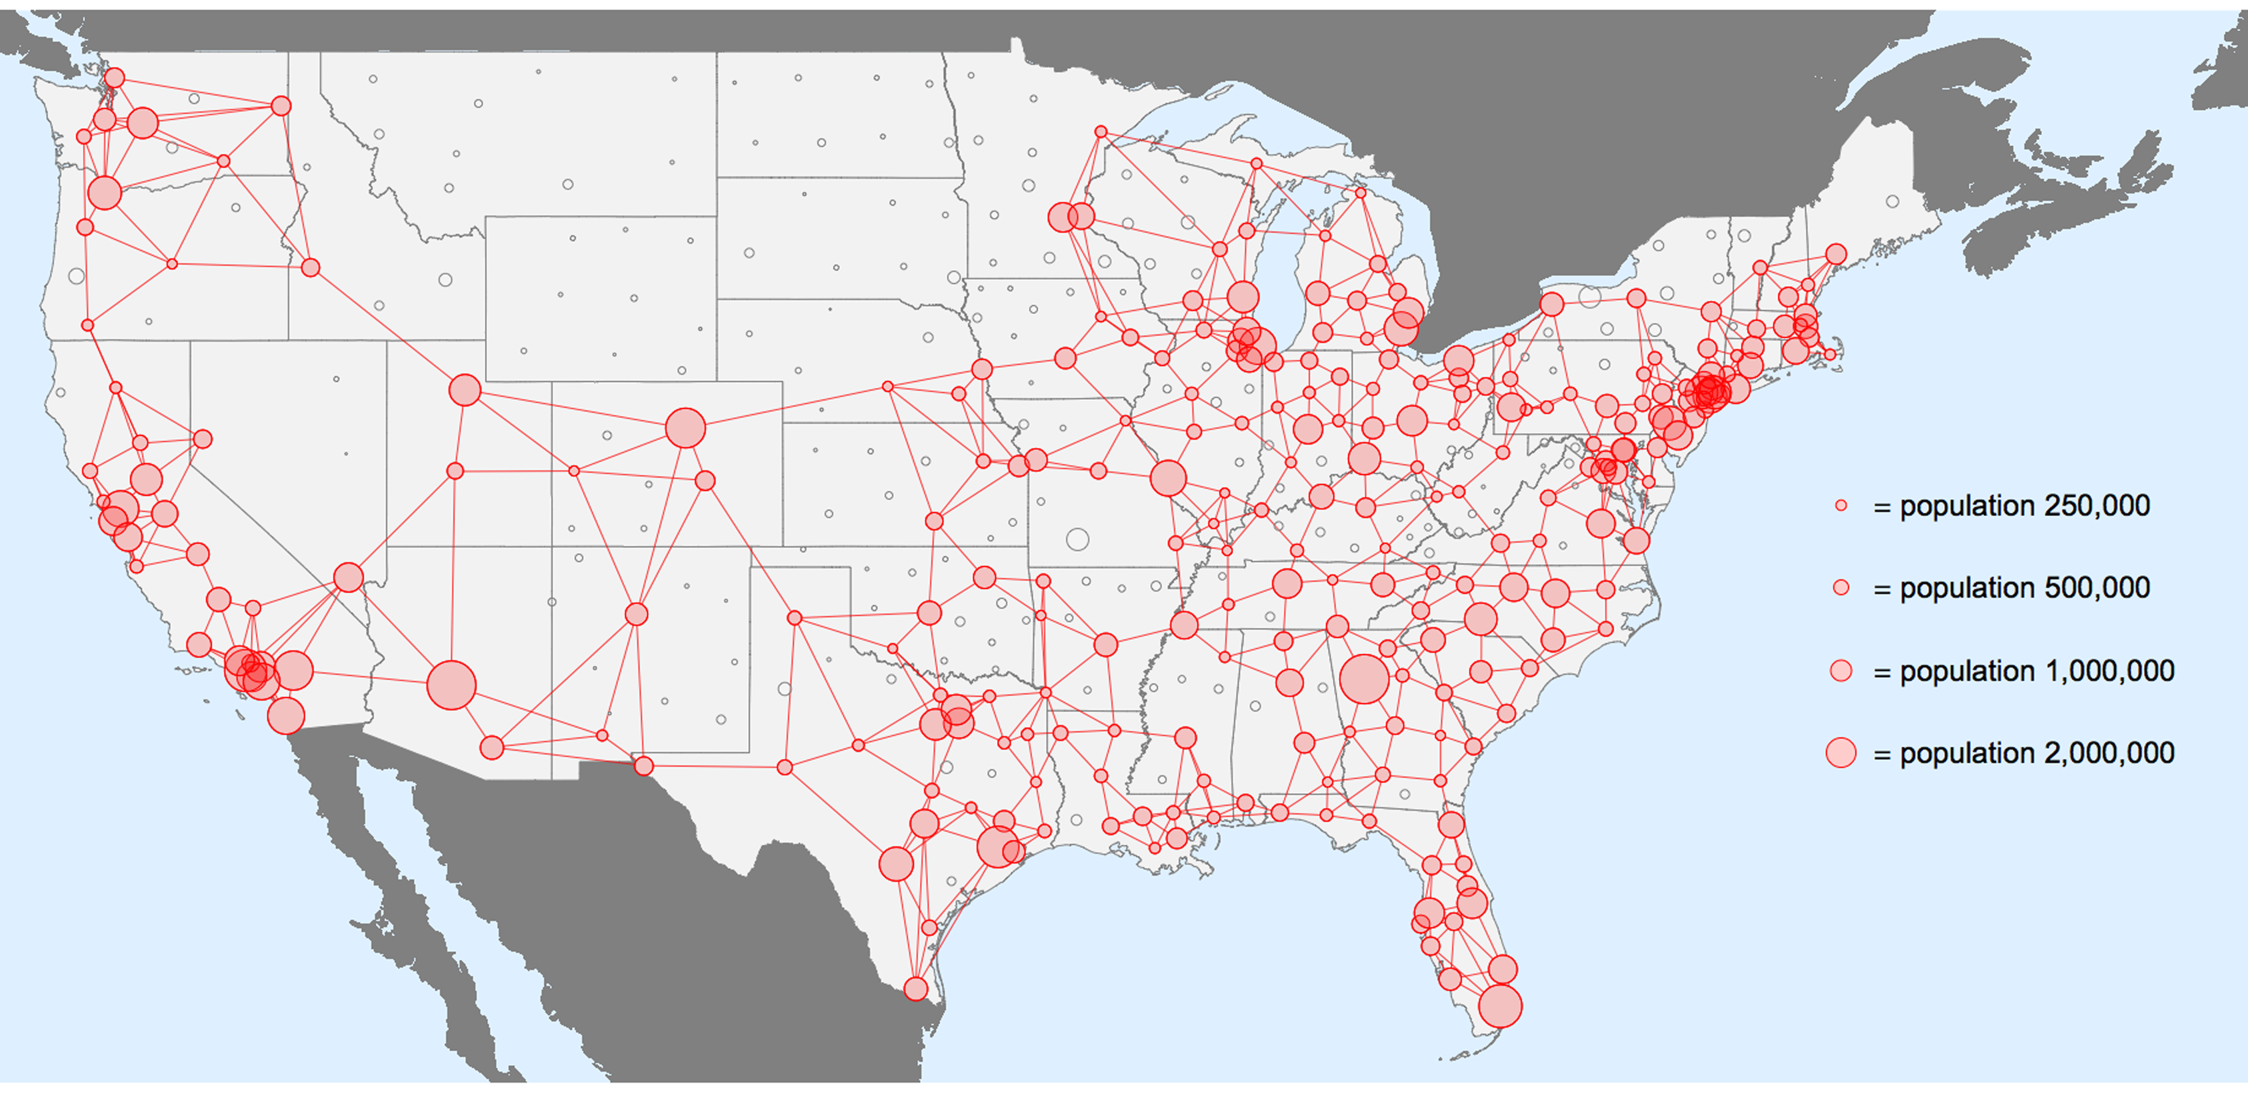
Influenza private surveillance network – IMS Health
CMS-500 forms sent by physicians to medical insurance
Covers 77% of the US population (50% of physicians)
336 cities reporting weekly influenza-like-illness (ILI) visits over 8 seasons (2002-2010)
ILI: influenza, OR fever combined with respiratory symptoms, OR febrile viral illness
Census and environmental data (workflows, air traffic, humidity)
Notes:
Goals: characterize relationships between cities in the network (connectivity) to transmission.

Slide 5
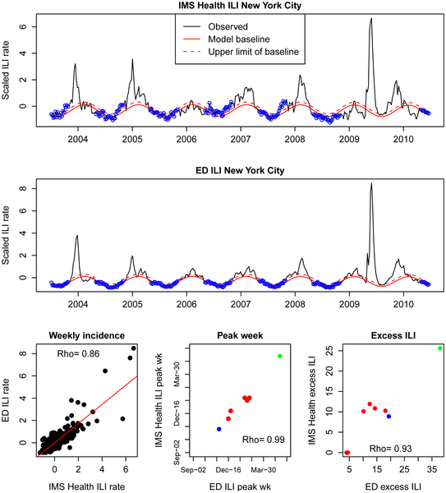
Medical claims track local influenza epidemics
Medical claims data works better than Google Flu Trends in New York
Viboud et al, Plos One, 2014; Olson et al, Plos Comp Bio 2013

Slide 6
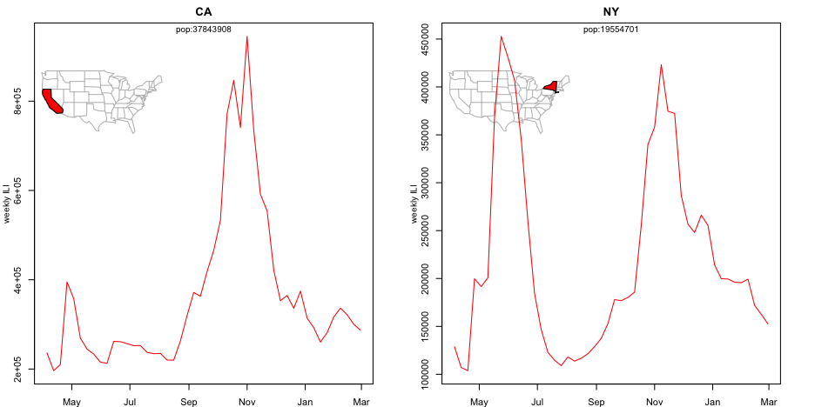

Geographic variation between states, 2009 pandemic
2009
2009
Spring wave
Fall
wave
Fall
wave
Spring wave
Gog et al, Plos Comp Bio 2014

Slide 7
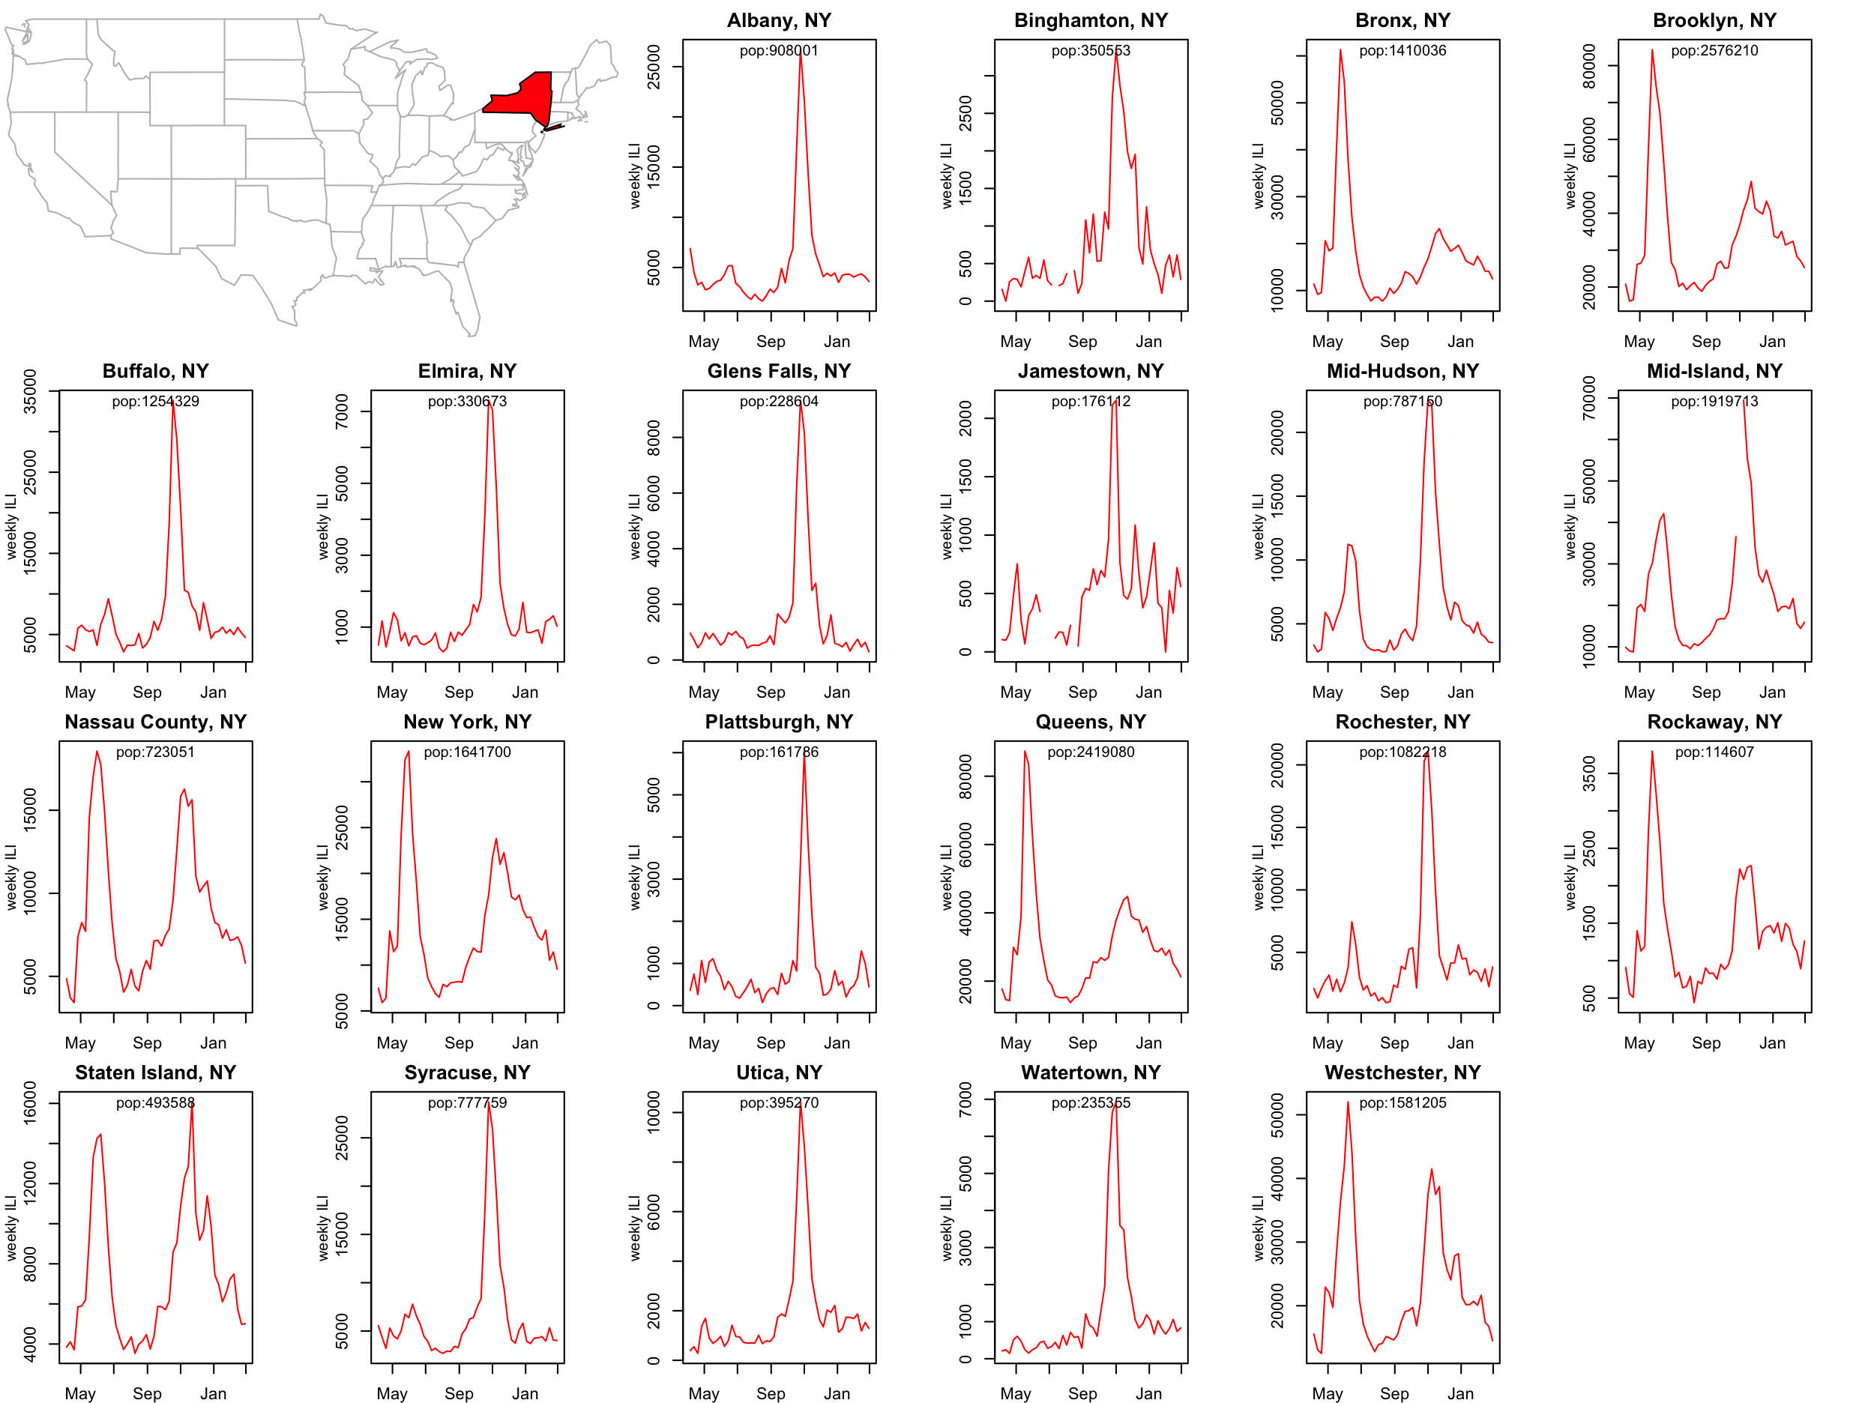
NY State
Viboud et al, Plos One, 2014

Slide 8
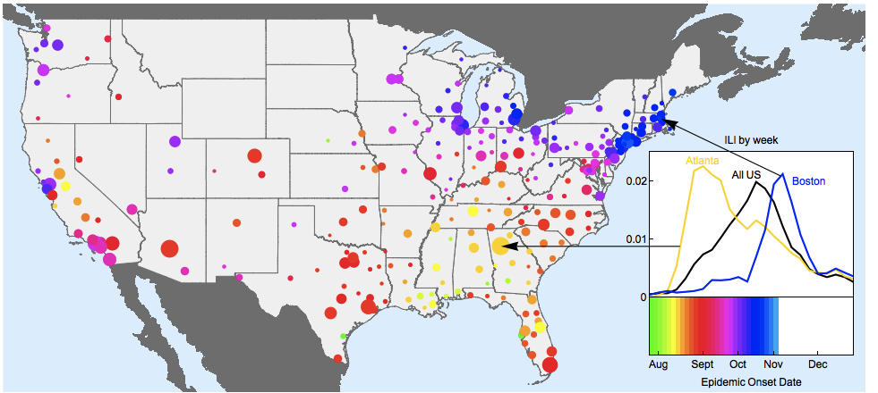
Slow spread of the fall 2009 pandemic wave
Strongest spatial structure in epidemic onsets
Early start in Georgia/Alabama; spreads over 3-months period
Gog et al, Plos Comp Bio 2014

Slide 9
Model: force of infection
Build combinations of models, and determine likelihood of observed data from each model
Gog et al, Plos Comp Bio 2014
susceptible
infectious
Distance?
Population size?
Schools?
Humidity?
Population size?
Population sizes
Distance
Humidity
(Shaman et al)
Schools indicator (from Chao et al. JID 2010)
Spring wave strength
External seeding based on population size
Normalisation strength
(Eggo et al. Interface 2010)

Slide 10
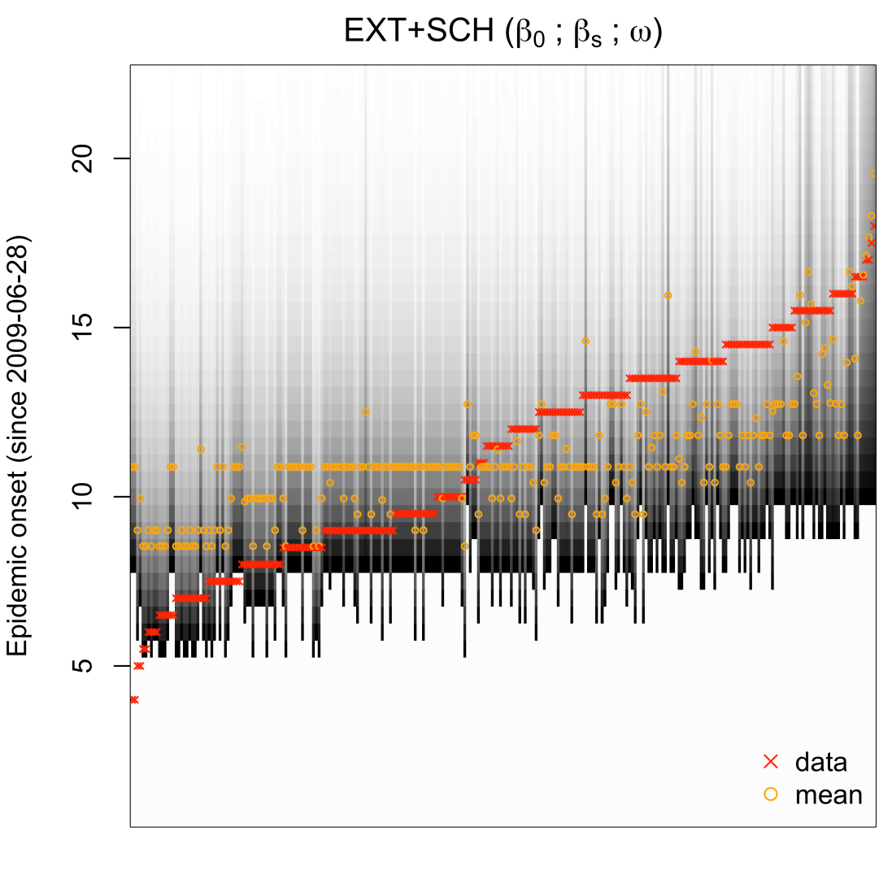
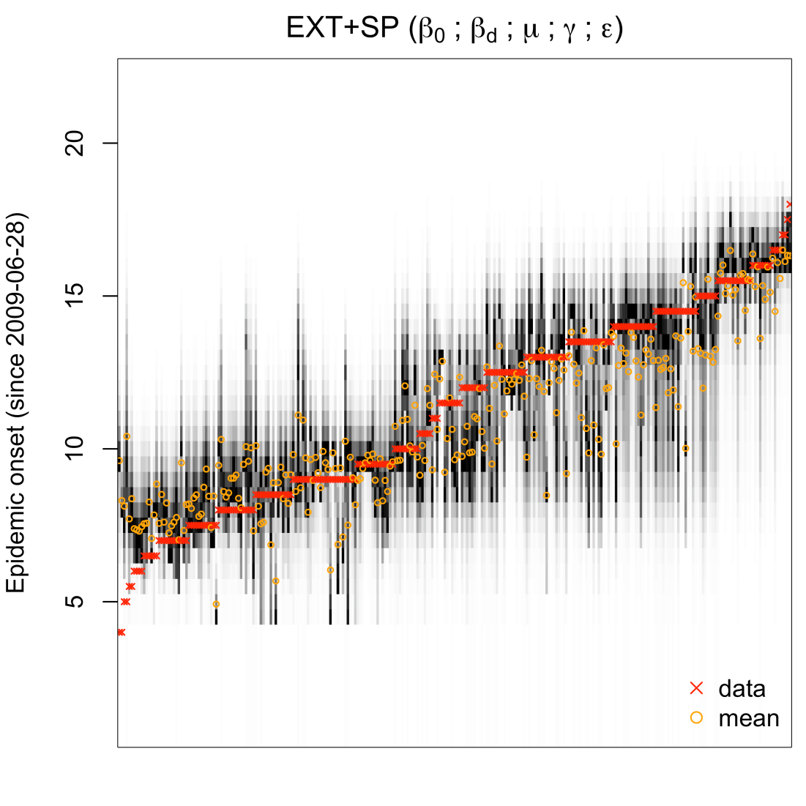
Distance and school timing and capture the spread pattern of the 2009 pandemic
Schools (no distance)
Distance (no schools)
Very local spatial spread
School terms play a minor role in explaining patterns
Unexpected : slower and more spatial than expected (children)
Gog et al, Plos Comp Bio 2014

Slide 11
Weekly ILI time series 2002/03 to 2009/10
Standardized ILI incidence
2003
2005
2007
2009
Notes:
Figure 1. Standardized influenza-like-illness time series from four locations (Spencer, IA; Bryan, TX; Roanoke, VA; Denver, CO) for which onset times for all eight seasons (2002/2003-2009/2010) were extracted. The 2003/2004 epidemic and 2009/2010 pandemic are highlighted to indicate that in these seasons >99% of viruses in circulation were the same subtype (A/H3N2 in 2003/2004 and A/H1N1 in 2009/2010). Onset times for each season are depicted as dashed lines, demarcating conceptually the time in each season at which a city-level influenza epidemic is sparked by external seeding.

Slide 12
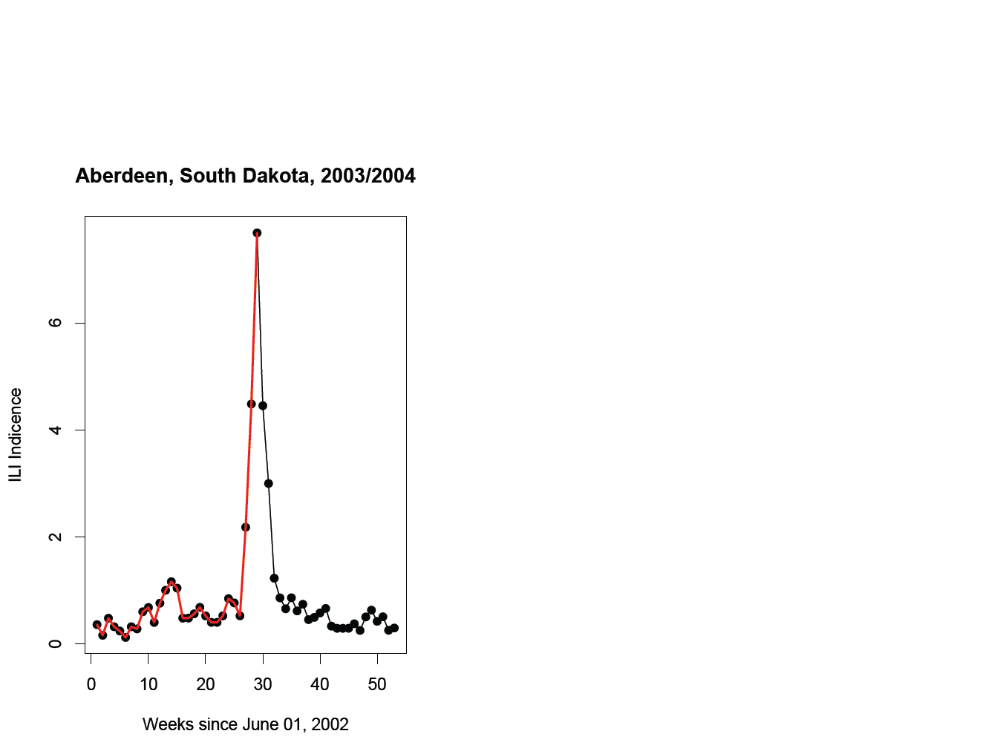
Disease onset in each city: broken stick method

Slide 13
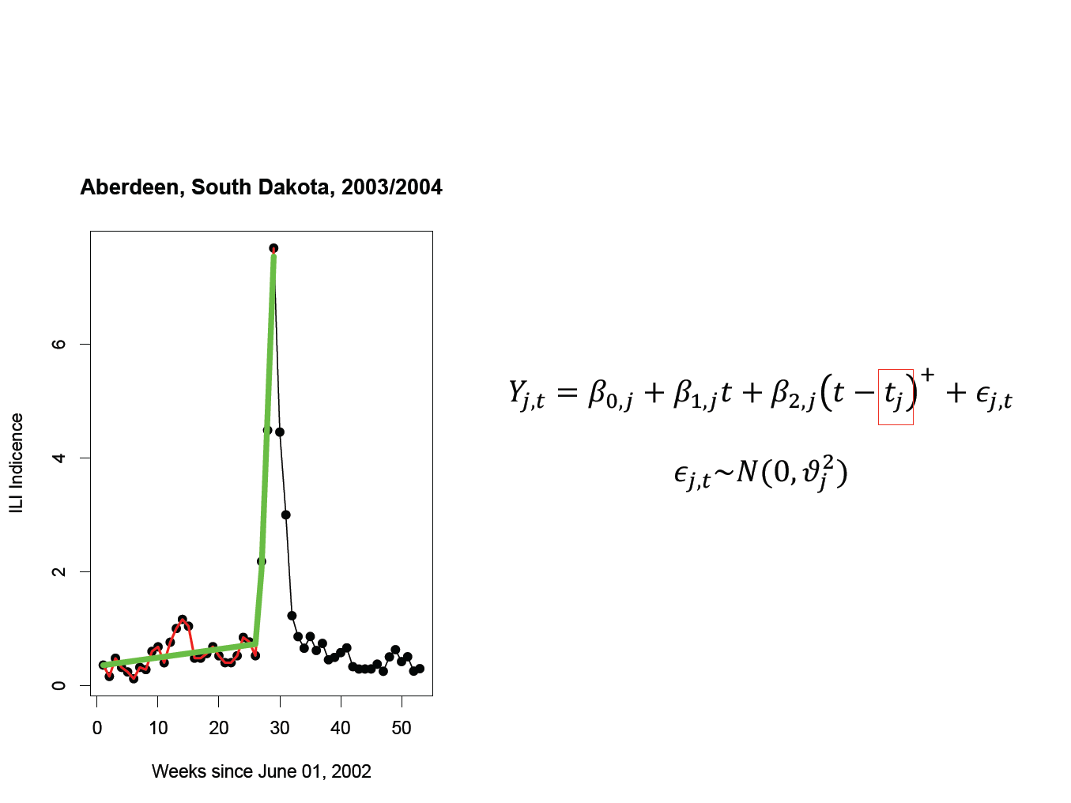
Disease onset in each city: broken stick method

Slide 14
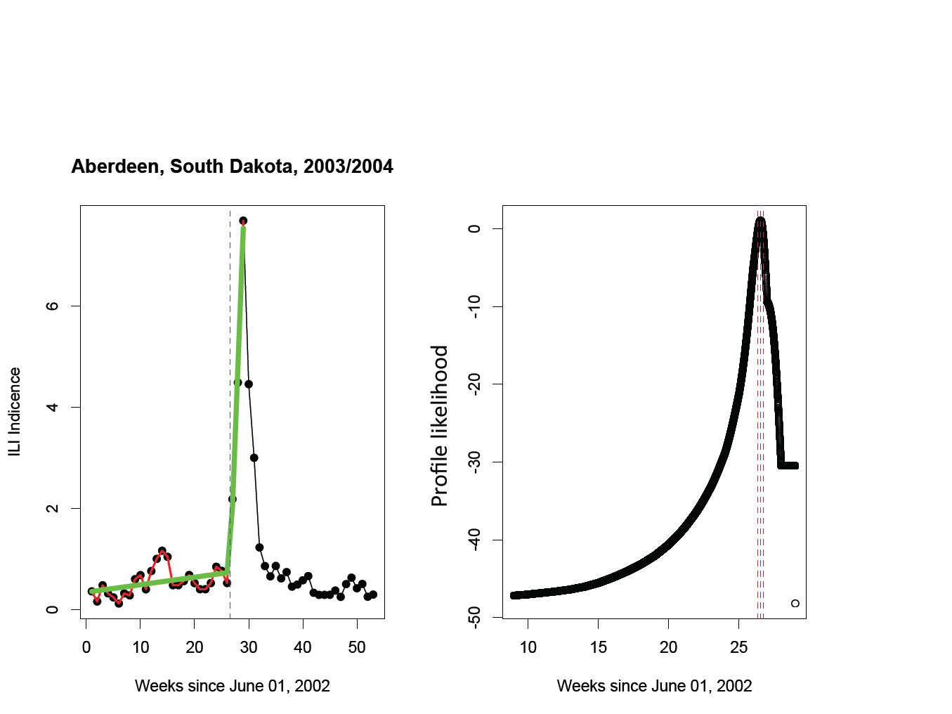
Disease onset in each city: broken stick method

Slide 15
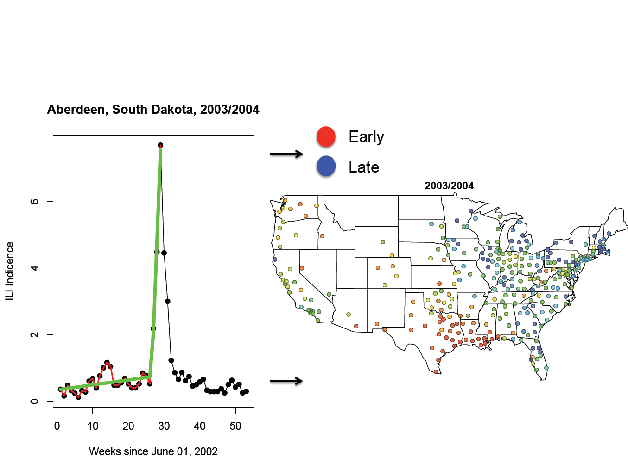
Disease onset in each city: broken stick method

Slide 16
Patterns of spread, 2002-2010
early
late

Slide 17
Distance?
2002-03
2003-04
2004-05
2005-06
Pairwise onset difference
2006-07
2007-08
2008-09
2009 pandemic

Slide 18
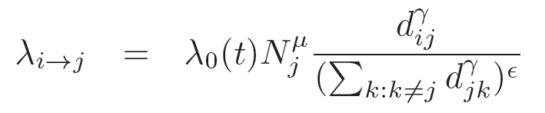

Semi-parametric mechanistic model
infectious
susceptible
city i
city j
Force of infection on susceptible city j:
Distance
Baseline risk
Normalization:
e=0, density-dependant (# neighbors)
e=1, density-independant (% neighbors)
Recipient population size
Seeding term
Diggle Stat Meth Med Res 2006, Eggo et al, JRSI 2012; Gog et al Plos CB, 2014

Slide 19
Model estimates
Season | 2002-03 | 2003-04 | 2004-05 | 2005-06 | 2006-07 | 2007-08 | 2009-10
Dom. subtype | A/H1N1 + B | A/H3N2 | A/H3N2 + B | A/H3N2 + B | A/H1N1 + B | A/H3N2 + B | A/H1N1 pdm
# locations | 221 | 290 | 270 | 218 | 198 | 270 | 281
Distance γ | -2.08 | -2.22 | -2.30 | -2.19 | -2.65 | -2.18 | -2.64
Recipient pop μ | 0.11 | 0.21 | 0.35 | 0.31 | 0.33 | 0.28 | 0.15
Normalization ε | 0.59 | 1.06 | 0.96 | 0.86 | 0.62 | 0.91 | 1.16
Seeding ρ | 0.0014 | 0.031 | 0.99 | 0 | 0.084 | 0.36 | 0.28
Consistent estimate for distance
Normalization>0; % of infected neighbors more important than #
Larger cities have higher risk of infection

Slide 20
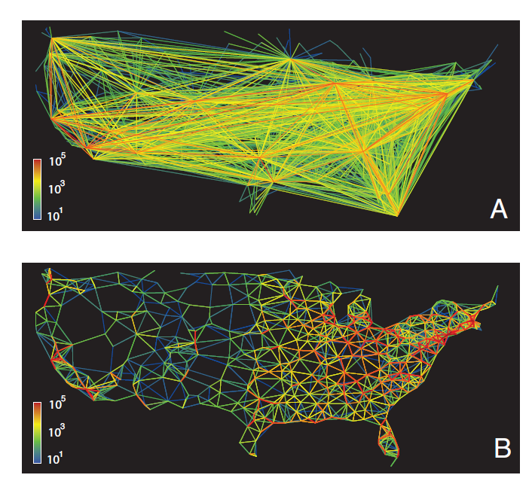
Use of different mobility proxies
Air traffic
Work commutes
Balcan et al PNAS 2005

Slide 21
Model comparison with different mobility proxies
Season | # cities
 |  | AIC Best model | ΔAIC Distance | ΔAIC Work commutes | ΔAIC Air traffic
2002-03 | 221 | 1815.65 | 0 | 25.46 | 78.87
2003-04 | 290 | 2478.19 | 0 | 30.16 | 105.13
2004-05 | 270 | 2303.46 | 0 | 24.53 | 129.61
2005-06 | 218 | 1703.73 | 0 | 45.32 | 161.8
2006-07 | 198 | 1623.43 | 9.27 | 0 | 66.32
2007-08 | 270 | 2365.40 | 0 | 8.31 | 59.81
2009-10 | 281 | 2306.22 | 0 | 57.42 | 247.09
Work commutes always outperform air traffic
Distance-based model performs best in most years

Slide 22
Next level of data resolution:
Hubs of pandemic influenza transmission (basins of attraction)
2009 pandemic
Kissler et al, Plos Biology In Press

Slide 23
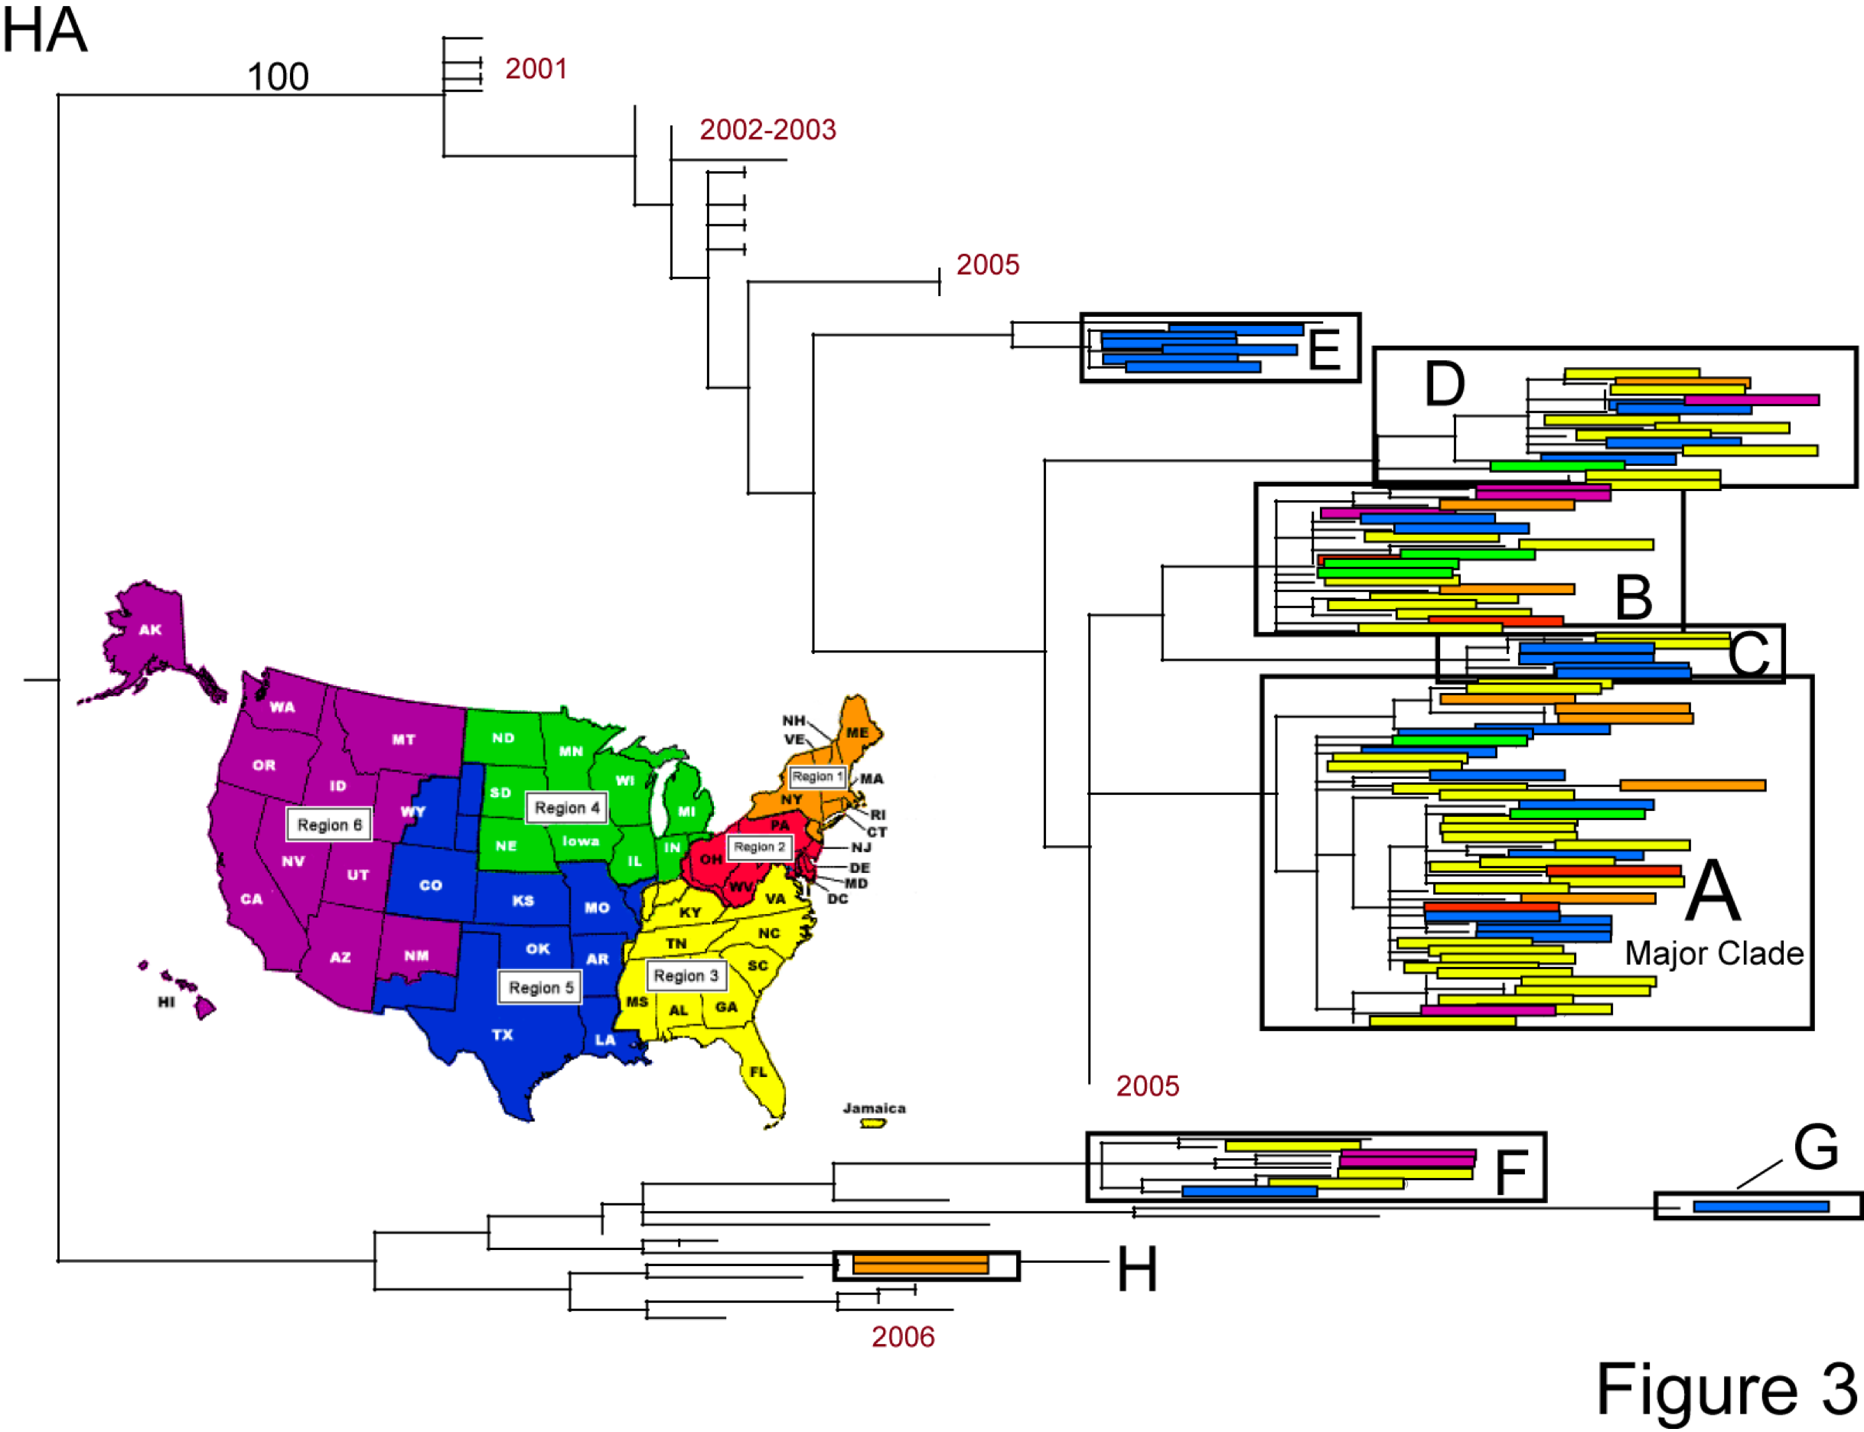
Spatial diffusion of A/H1N1 in the United States
• Multiple introductions, no cross-season persistence, no spatial structure
Nelson et al, Plos Path 2008
Notes:
23

Slide 24
Conclusions/perspectives: influenza spread
Heterogeneity between seasons
Local mode of spread
  distance (commuting)
  modulated by (recipient) pop size
  proportion of neighbors infected
7/8 epidemics started in the South
Local mode of spread strongest in seasons marked by antigenic changes (2003-04, 2009 pandemic)
Granularity of data matters; more progress needed
Need to reconcile patterns in epidemiological data and pathogen sequences

Slide 25







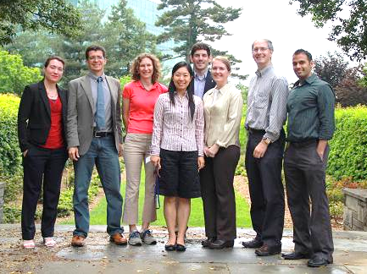
Thank you!
Notes:
25
25
3/21/2017
25
25

