Slide 1
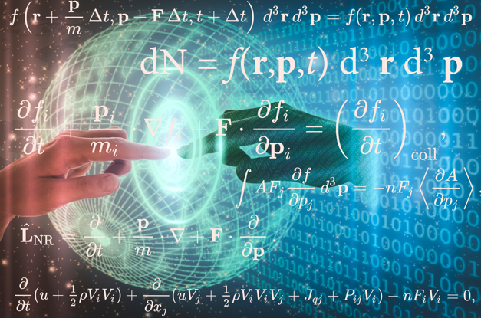
What Does Team Science Have to Do with BMTs? Addressing Gaps and Challenges to Successful BDT Implementation: How to fill what is missing? L. Michelle Bennett L.M.Bennett Consulting, LLC September 30, 2024 IMAG/MSM Teaming4BDT Meeting

Slide 2
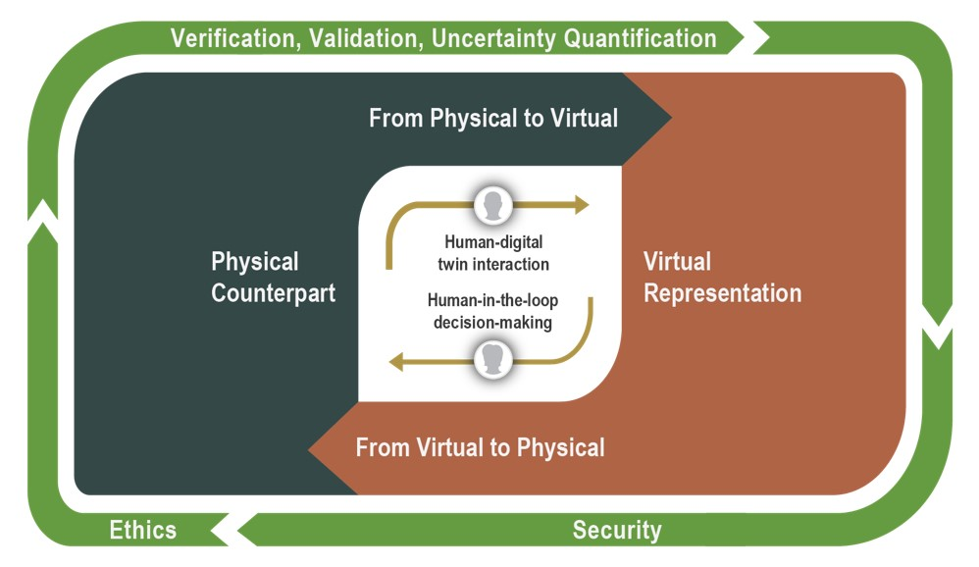
NASEM Definition of a Digital Twin
“A digital twin is a set of virtual information constructs that mimics the structure, context, and behavior of a natural, engineered, or social system (or system-of-systems), is dynamically updated with data from its physical twin, has a predictive capability, and informs decisions that realize value. The bidirectional interaction between the virtual and the physical is central to the digital twin."
A Digital Twin is More Than Just Simulation and Modeling

Slide 3
BDT as a System of Systems
Multiple systems work together to create a comprehensive whole
Independent systems can be swapped out for improvements, upgrades, enhancement, maturing the BDT over time
Without all independent systems integrated, working in an interoperable fashion, and performing maximally, there can be no BDT
The scientific team developing the BDT is no different….
It must work together to develop, mature, and sustain a BDT over time
Must work collaboratively, interact, and perform maximally.
If it does not, the promise of the BDT may elude achievement

Slide 4
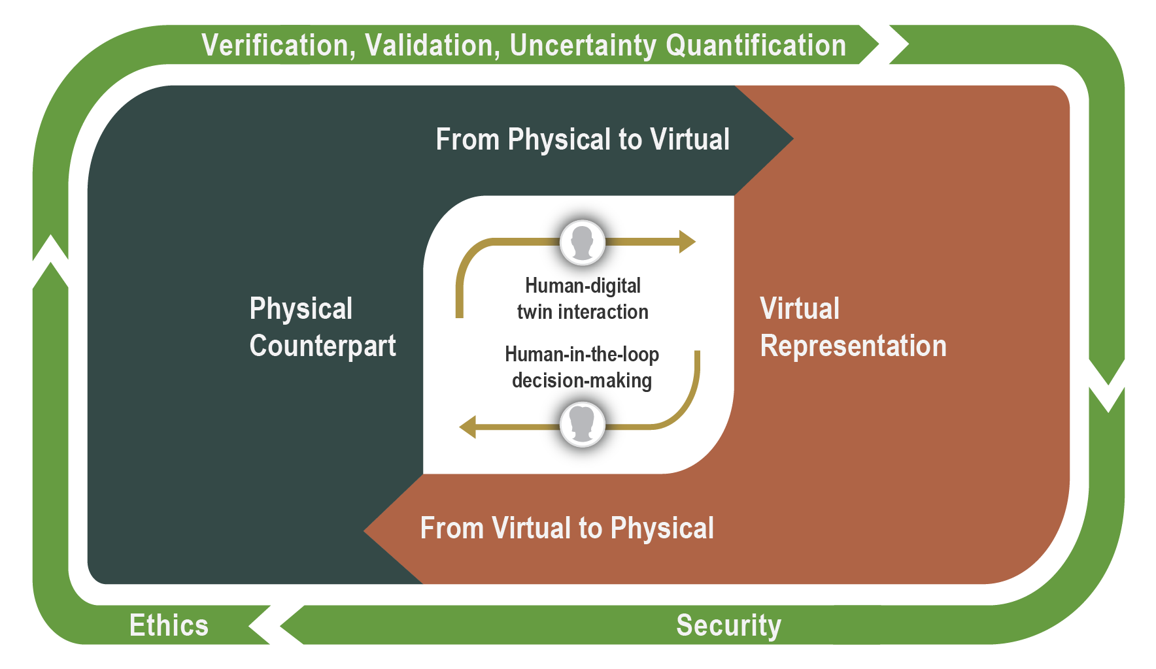
BDT as a System of Systems

Slide 5
The Complex Nature of Developing a BDT
Is likely more than any one person can take on alone
Even if one could, outcomes will be more creative, innovative, and impactful if other highly intelligent individuals from diverse perspectives are involved

Slide 6
BDTs Require Diverse Expertise

Slide 7
BDTs May Require a Team of Teams

Slide 8
Build Your Team on Purpose
Don’t just cross your fingers and hope it all works out.
Photo by Dayne Topkin on Unsplash

Slide 9
A Team of Experts ≠ An Expert Team

Slide 10
The greater the proportion of experts a team had, the more likely it was to disintegrate into nonproductive conflict or stalemate
Gratton and Erickson, HBR, November 2007
https://hbr.org/2007/11/eight-ways-to-build-collaborative-teams
Photo by Jeshoots Com on Unsplash

Slide 11
The Four Pillars
Trust and
Psychological Safety
Agreeing on Expectations
Productive Conflict
Vision

Slide 12
Tools for Setting Expectations
“Welcome Letter”
Institutional Agreements
Collaboration Agreement
A scaffold for building deeper trust including what you can expect of me, what I expect of you, what to do if we disagree
Language about team participation in an offer letter or pre-tenure agreement
Joint appointment agreements
Jointly created agreement among collaborators: can be formal or informal in its creation
https://zenodo.org/records/6394789
…and creating a scaffold for building trust

Slide 13
Why Set Expectations?
Done well ….
Leads to a culture of trust and psychological safety
Provides a set of norms and processes by which the team agrees to operate (science and relationship)
A platform for holding self- and others accountable
Increased scientific productivity, innovation, and impact
Builds and sustains successful team relationships

Slide 14
Governance
Physical Asset
Virtual Asset
Etc…
Etc…
Etc…

Slide 15
Science: Research Plan
Relationships: Collaboration Plan
Inextricably woven to strengthen each other

Slide 16
The creation of something new is not accomplished by the intellect but by the play instinct acting from necessity. The creative mind plays with the subject it loves. - Carl Jung

Slide 17
Questions
Contact me
Email: Michelle.LMBC@gmail.com
Lab:
LinkedIn: linkedin.com/in/l-michelle-bennett-50855a10/
Telephone/text: 202-815-2746
Resources: LMBennettConsulting.com

